Slide 1
Use of the “shape-of-anomaly” data misfit in
3D inversion by planting anomalous densities
Leonardo Uieda
Valéria C. F. Barbosa

Slide 2
Difference in shape

Slide 4
Scale factor:

Slide 5
Scale factor:

Slide 6
Scale factor:

Slide 7
Predicted (model)
Observed

Slide 10
Planting anomalous densities

Slide 11
(observed)

Slide 12
mesh

Slide 13
(predicted)
seed

Slide 14
Choose the best:
&
compactness

Slide 15
Choose the best:
&
Exchange for shape-of-anomaly

Slide 16
SOA
SOA

Slide 17
SOA
SOA

Slide 18
SOA
SOA

Slide 19
SOA
SOA

Slide 20
SOA
SOA

Slide 21
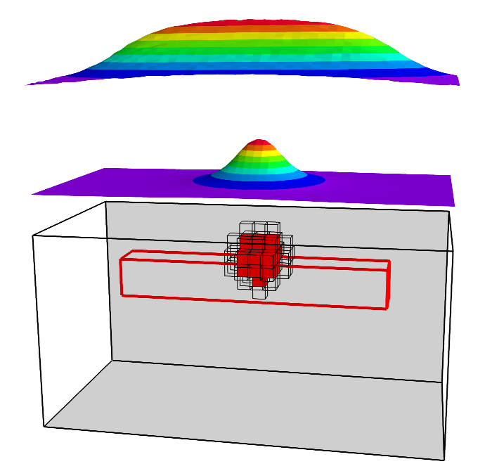
SOA
SOA

Slide 22
SOA
SOA

Slide 23
SOA
SOA

Slide 24
SOA
SOA

Slide 25
SOA
SOA

Slide 26
SOA
SOA

Slide 27
SOA
SOA

Slide 28
Synthetic tests

Slide 32
SOA

Slide 33
SOA

Slide 34
SOA
SOA

Slide 35
SOA
SOA

Slide 37
SOA

Slide 38
SOA

Slide 39
SOA
SOA

Slide 41
SOA

Slide 42
SOA

Slide 43
SOA
SOA

Slide 44
Redenção granite

Slide 45
Bouguer anomaly
Outcrop

Slide 46
Bouguer anomaly
Oliveira et al.(2008)
~ 6 km

Slide 47
Bouguer anomaly
Oliveira et al.(2008)
Seed at 3km
~ 6 km

Slide 48
SOA
Known outcrop

Slide 49
SOA
Known outcrop
Outcrop at wrong place

Slide 50
SOA
Known outcrop
Outcrop at wrong place
~ 9 km

Slide 51
SOA

Slide 52
SOA
Outcrop at right place

Slide 53
SOA
Outcrop at right place
~ 6 km

Slide 54
SOA
SOA

Slide 55

SOA
SOA
6 km

Slide 56
In conclusion

Slide 57
SOA
SOA

Slide 58
SOA
SOA

Slide 59
SOA
SOA

Slide 60
SOA
SOA

