Slide 1

Robust 3D gravity gradient inversion by planting anomalous densities
Leonardo Uieda
Valéria C. F. Barbosa
Observatório Nacional
2011

Slide 2
Outline

Slide 3
Outline
Forward Problem

Slide 4
Outline
Forward Problem
Inverse Problem

Slide 5
Outline
Forward Problem
Inverse Problem
Planting Algorithm
Inspired by René (1986)

Slide 6
Outline
Forward Problem
Inverse Problem
Planting Algorithm
Inspired by René (1986)
Synthetic Data

Slide 7
Outline
Forward Problem
Inverse Problem
Planting Algorithm
Inspired by René (1986)
Synthetic Data
Real Data
Quadrilátero Ferrífero

Slide 8
Forward problem

Slide 9
Observed

Slide 10
Observed

Slide 11
Observed
Anomalous density

Slide 12
Observed
Want to model this
Anomalous density

Slide 13
Interpretative model

Slide 14
Interpretative model
Right rectangular prism

Slide 15
Prisms with
not shown

Slide 16
Prisms with
not shown

Slide 17
Predicted
Prisms with
not shown

Slide 18
Predicted
Prisms with
not shown

Slide 19
Predicted
Contribution of jth prism
Prisms with
not shown

Slide 20
More components:

Slide 21
More components:

Slide 22
More components:

Slide 23
More components:

Slide 24
More components:
Jacobian (sensitivity) matrix

Slide 25
More components:
Column vector of

Slide 26
Forward problem:

Slide 27
Inverse problem:
?

Slide 28
Inverse problem

Slide 29
Minimize difference between
and
Residual vector

Slide 30
Minimize difference between
and
Residual vector
Data-misfit function:

Slide 31
Minimize difference between
and
Residual vector
Data-misfit function:
ℓ₂-norm of r

Slide 32
Minimize difference between
and
Residual vector
Data-misfit function:
ℓ₂-norm of r
Least-squares fit

Slide 33
Minimize difference between
and
Residual vector
Data-misfit function:
ℓ₂-norm of r
ℓ₁-norm of r
Least-squares fit

Slide 34
Minimize difference between
and
Residual vector
Data-misfit function:
ℓ₂-norm of r
ℓ₁-norm of r
Least-squares fit
Robust fit

Slide 35
ill-posed problem
non-existent
non-unique
non-stable

Slide 36
constraints
ill-posed problem
non-existent
non-unique
non-stable

Slide 37
constraints
ill-posed problem
well-posed problem
non-existent
exist
non-unique
unique
non-stable
stable

Slide 38
Constraints:
1. Compact

Slide 39
Constraints:
1. Compact
no holes inside

Slide 40
Constraints:
1. Compact
no holes inside
2. Concentrated around “seeds”

Slide 41
Constraints:
1. Compact
no holes inside
2. Concentrated around “seeds”
User-specified prisms
Given density contrasts
Any # of ≠ density contrasts

Slide 42
Constraints:
1. Compact
no holes inside
2. Concentrated around “seeds”
User-specified prisms
Given density contrasts
Any # of ≠ density contrasts
3. Only
or

Slide 43
Constraints:
1. Compact
no holes inside
2. Concentrated around “seeds”
User-specified prisms
Given density contrasts
Any # of ≠ density contrasts
3. Only
or
4.
of closest seed

Slide 44
Well-posed problem:
Minimize goal function

Slide 45
Well-posed problem:
Minimize goal function
Data-misfit function

Slide 46
Well-posed problem:
Minimize goal function
Regularizing parameter
(Tradeoff between fit and regularization)

Slide 47
Well-posed problem:
Minimize goal function
Regularizing function

Slide 48
Well-posed problem:
Minimize goal function
Regularizing function
Similar to
Silva Dias et al. (2009)

Slide 49
Well-posed problem:
Minimize goal function
Regularizing function
Similar to
Silva Dias et al. (2009)
Distance between
jth prism and seed

Slide 50
Well-posed problem:
Minimize goal function
Regularizing function
Similar to
Silva Dias et al. (2009)
Distance between
jth prism and seed
Imposes:
Compactness
Concentration around seeds

Slide 51
Constraints:
1. Compact
Regularization
2. Concentrated around “seeds”
3. Only
or
4.
of closest seed

Slide 52
Constraints:
1. Compact
Regularization
2. Concentrated around “seeds”
3. Only
or
Algorithm
4.
of closest seed
Based on René (1986)

Slide 53
Planting Algorithm

Slide 54
Setup:
= observed data

Slide 55
Setup:
= observed data
Define interpretative model
Interpretative model

Slide 56
Setup:
= observed data
Define interpretative model
All parameters zero
Interpretative model

Slide 57
Setup:
= observed data
Define interpretative model
All parameters zero
seeds
Interpretative model

Slide 58
Setup:
= observed data
Define interpretative model
All parameters zero
seeds
Include seeds
Prisms with
not shown

Slide 59
Setup:
= observed data
Define interpretative model
All parameters zero
seeds
= predicted data
Include seeds
Compute initial residuals
Prisms with
not shown

Slide 60
Setup:
= observed data
Define interpretative model
All parameters zero
seeds
= predicted data
Include seeds
Compute initial residuals
Predicted by seeds
Prisms with
not shown

Slide 61
Setup:
= observed data
Define interpretative model
All parameters zero
seeds
= predicted data
Include seeds
Compute initial residuals
Prisms with
not shown

Slide 62
Setup:
= observed data
Define interpretative model
All parameters zero
seeds
= predicted data
Include seeds
Compute initial residuals
Neighbors
Find neighbors of seeds
Prisms with
not shown

Slide 63
Growth:
Try accretion to sth seed:
Prisms with
not shown

Slide 64
Growth:
Try accretion to sth seed:
Choose neighbor:
1. Reduce data misfit
2. Smallest goal function
Prisms with
not shown

Slide 65
Growth:
Try accretion to sth seed:
Choose neighbor:
1. Reduce data misfit
2. Smallest goal function
j = chosen
(New elements)
j
Prisms with
not shown

Slide 66
Growth:
Try accretion to sth seed:
Choose neighbor:
1. Reduce data misfit
2. Smallest goal function
j = chosen
(New elements)
Update residuals
j
Prisms with
not shown

Slide 67
Growth:
Try accretion to sth seed:
Choose neighbor:
1. Reduce data misfit
2. Smallest goal function
j = chosen
(New elements)
Update residuals
j
Contribution of j
Prisms with
not shown

Slide 68
Growth:
Try accretion to sth seed:
Choose neighbor:
1. Reduce data misfit
2. Smallest goal function
j = chosen
(New elements)
Update residuals
None found = no accretion
j
Variable sizes
Prisms with
not shown

Slide 69
Growth:
Try accretion to sth seed:
Choose neighbor:
1. Reduce data misfit
2. Smallest goal function
j = chosen
(New elements)
Update residuals
None found = no accretion
Prisms with
not shown

Slide 70
Growth:
Try accretion to sth seed:
Choose neighbor:
1. Reduce data misfit
2. Smallest goal function
j = chosen
(New elements)
Update residuals
None found = no accretion
j
Prisms with
not shown

Slide 71
Growth:
Try accretion to sth seed:
Choose neighbor:
1. Reduce data misfit
2. Smallest goal function
j = chosen
(New elements)
Update residuals
None found = no accretion
j
At least one seed grow?
Prisms with
not shown

Slide 72
Growth:
Try accretion to sth seed:
Choose neighbor:
1. Reduce data misfit
2. Smallest goal function
j = chosen
(New elements)
Update residuals
None found = no accretion
j
At least one seed grow?
Yes
Prisms with
not shown

Slide 73
Growth:
Try accretion to sth seed:
Choose neighbor:
1. Reduce data misfit
2. Smallest goal function
j = chosen
(New elements)
Update residuals
None found = no accretion
j
At least one seed grow?
Yes
No
Prisms with
not shown
Done!

Slide 74
Advantages:
Compact & non-smooth
Any number of sources
Any number of different density contrasts
No large equation system
Search limited to neighbors

Slide 75
Remember equations:
Initial residual
Update residual vector

Slide 76
Remember equations:
Initial residual
Update residual vector
No matrix multiplication (only vector +)

Slide 77
Remember equations:
Initial residual
Update residual vector
No matrix multiplication (only vector +)
Only need some columns of A

Slide 78
Remember equations:
Initial residual
Update residual vector
No matrix multiplication (only vector +)
Only need some columns of A
Calculate only when needed

Slide 79
Remember equations:
Initial residual
Update residual vector
No matrix multiplication (only vector +)
Only need some columns of A
Calculate only when needed
& delete after update

Slide 80
Remember equations:
Initial residual
Update residual vector
No matrix multiplication (only vector +)
Only need some columns of A
Calculate only when needed
& delete after update
Lazy evaluation

Slide 81
Advantages:
Compact & non-smooth
Any number of sources
Any number of different density contrasts
No large equation system
Search limited to neighbors

Slide 82
Advantages:
Compact & non-smooth
Any number of sources
Any number of different density contrasts
No large equation system
Search limited to neighbors
No matrix multiplication (only vector +)
Lazy evaluation of Jacobian

Slide 83
Advantages:
Compact & non-smooth
Any number of sources
Any number of different density contrasts
No large equation system
Search limited to neighbors
No matrix multiplication (only vector +)
Lazy evaluation of Jacobian
Fast inversion + low memory usage

Slide 84
Synthetic Data

Slide 85
Data set:
3 components
51 x 51 points
2601 points/component
7803 measurements
5 Eötvös noise

Slide 86
Model:

Slide 87
Model:
11 prisms

Slide 88
Model:
11 prisms
4 outcropping

Slide 89
Model:
11 prisms
4 outcropping

Slide 90
Model:
11 prisms
4 outcropping

Slide 91
Strongly interfering effects

Slide 92
Strongly interfering effects
What if only interested in these?

Slide 93
Common scenario

Slide 94
Common scenario
May not have prior information
Density contrast
Approximate depth

Slide 95
Common scenario
May not have prior information
Density contrast
Approximate depth
No way to provide seeds

Slide 96
Common scenario
May not have prior information
Density contrast
Approximate depth
No way to provide seeds
Difficult to isolate effect of targets

Slide 97
Robust procedure:

Slide 98
Robust procedure:
Seeds only for targets

Slide 99
Robust procedure:
Seeds only for targets

Slide 100
Robust procedure:
Seeds only for targets
ℓ₁-norm to “ignore” non-targeted

Slide 101
Robust procedure:
Seeds only for targets
ℓ₁-norm to “ignore” non-targeted

Slide 102
Inversion:
13 seeds
7,803 data

Slide 103
Inversion:
13 seeds
7,803 data

Slide 104
Inversion:
13 seeds
7,803 data

Slide 105
Inversion:
13 seeds
7,803 data

Slide 106
Inversion:
13 seeds
7,803 data

Slide 107
Inversion:
13 seeds
7,803 data
37,500 prisms

Slide 108
Inversion:
13 seeds
7,803 data
37,500 prisms
Only prisms with zero
density contrast not shown

Slide 109
Inversion:
13 seeds
7,803 data
37,500 prisms
Only prisms with zero
density contrast not shown

Slide 110
Inversion:
13 seeds
7,803 data
37,500 prisms
Only prisms with zero
density contrast not shown

Slide 111
Inversion:
13 seeds
7,803 data
37,500 prisms
Only prisms with zero
density contrast not shown

Slide 112
Inversion:
13 seeds
7,803 data
37,500 prisms
Only prisms with zero
density contrast not shown

Slide 113
Inversion:
13 seeds
7,803 data
37,500 prisms
Recover shape of targets
Only prisms with zero
density contrast not shown

Slide 114
Inversion:
13 seeds
7,803 data
37,500 prisms
Recover shape of targets
Total time = 2.2 minutes (on laptop)
Only prisms with zero
density contrast not shown

Slide 115
Inversion:
13 seeds
7,803 data
37,500 prisms
Predicted data in contours

Slide 116
Inversion:
13 seeds
7,803 data
37,500 prisms
Predicted data in contours
Effect of true targeted sources

Slide 117
Real Data

Slide 118
Data:
3 components
FTG survey
Quadrilátero Ferrífero, Brazil

Slide 119
Data:
3 components
FTG survey
Quadrilátero Ferrífero, Brazil
Targets:
Iron ore bodies
BIFs of Cauê Formation

Slide 120
Data:
3 components
FTG survey
Quadrilátero Ferrífero, Brazil
Targets:
Iron ore bodies
BIFs of Cauê Formation

Slide 121
Data:
Seeds for iron ore:
Density contrast 1.0 g/cm³
Depth 200 m

Slide 122
Inversion:
46 seeds
13,746 data
Observed
Predicted

Slide 123
Inversion:
46 seeds
13,746 data
164,892 prisms

Slide 124
Inversion:
46 seeds
13,746 data
164,892 prisms

Slide 125
Inversion:
46 seeds
13,746 data
164,892 prisms

Slide 126
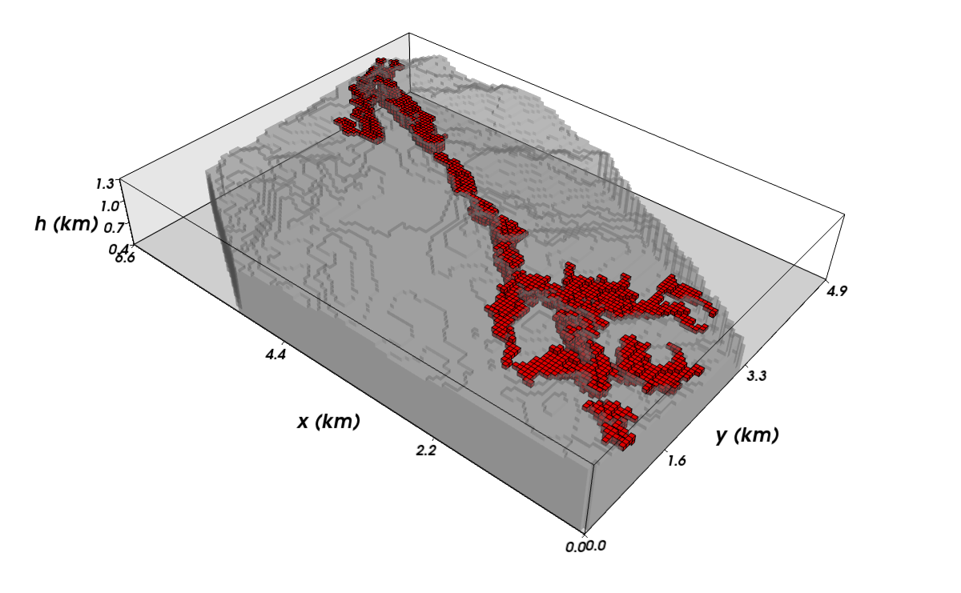
Inversion:
46 seeds
13,746 data
164,892 prisms

Slide 127
Inversion:
46 seeds
13,746 data
164,892 prisms

Slide 128
Inversion:
46 seeds
13,746 data
164,892 prisms

Slide 129
Inversion:
46 seeds
13,746 data
164,892 prisms
Only prisms with zero
density contrast not shown

Slide 130
Inversion:
46 seeds
13,746 data
164,892 prisms
Only prisms with zero
density contrast not shown

Slide 131
Inversion:
46 seeds
13,746 data
164,892 prisms
Only prisms with zero
density contrast not shown

Slide 132
Inversion:
46 seeds
13,746 data
164,892 prisms

Slide 133
Inversion:
46 seeds
13,746 data
164,892 prisms

Slide 134
Inversion:
46 seeds
13,746 data
164,892 prisms
Agree with previous interpretations
(Martinez et al., 2010)

Slide 135
Inversion:
46 seeds
13,746 data
164,892 prisms
Agree with previous interpretations
(Martinez et al., 2010)
Total time = 14 minutes
(on laptop)

Slide 136
Conclusions

Slide 137
Conclusions
New 3D gravity gradient inversion
Multiple sources
Interfering gravitational effects
Non-targeted sources
No matrix multiplications
No linear systems
Lazy evaluation of Jacobian matrix

Slide 138
Conclusions
Estimates geometry
Given density contrasts
Ideal for:
  Sharp contacts
  Well-constrained physical properties
    Ore bodies
    Intrusive rocks
    Salt domes

Slide 139
Cronograma
Mestrado
2010: Cumprir disciplinas
2010-2011: 7 trabalhos em congresso (5 primeiro autor)
10/2011: Submeter artigo para Geophysics
11/2011: Defesa da dissertação de mestrado
Continuação
Adaptar para gravimetria e magnetometria
Disponibilizar software Open Source

