Slide 1
Comment Jason Roberts
If you simulate dosing on CRRT, then your maintenance dose needs to 9 mg/kg, it is higher than the non-CRRT dose for obvious reasons. At the moment you haven’t simulated a CRRT dose for CRRT patients.

Slide 2
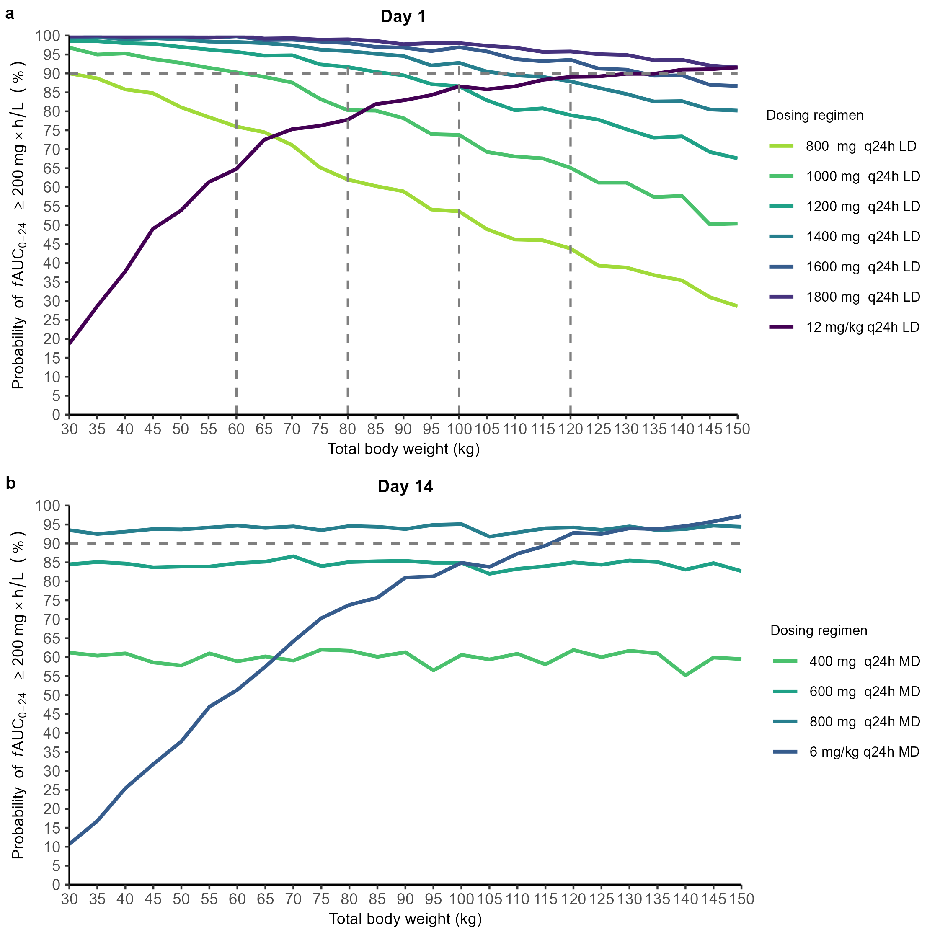
Answer
Fig. 2b shows that a flat 800 mg dose, administered q24h, provides >90%PTA.
A 9 mg/kg q24h regimen equals a 800 mg q24h regimen for a patient with body weight 89 kg.
The flat 800 kg q24h simulation in Fig. 2b shows that there is no need to dose any higher in patients with body weight >89 kg.
Patients with a lower body weight will not reach 90% PTA when they receive 9 mg/kg.
  This can be derived from the flat 600 mg q24 regimen; Under a 9 mg/kg regimen, a patient with body weight 67 kg will receive an absolute dose of 600 mg.
67kg

