Slide 1
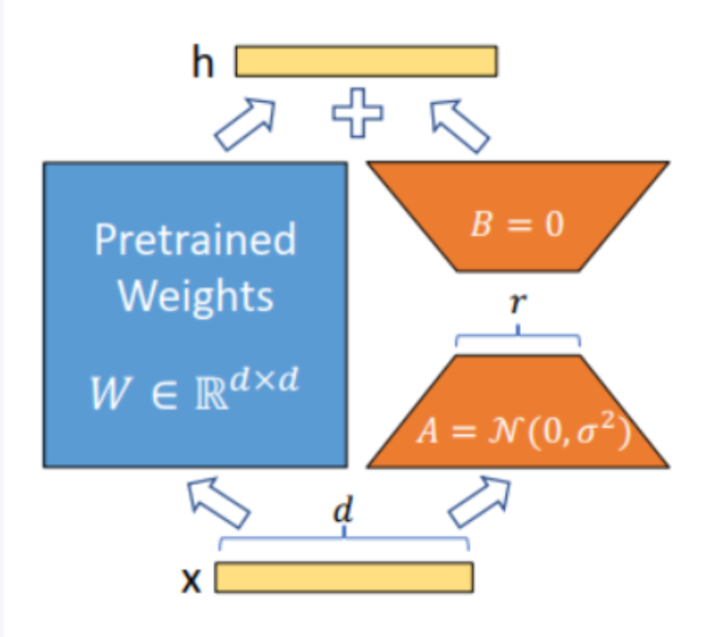
Finetuned DINOv2
fineduned dinov2
dinov2 + lora
train dataset

Slide 2
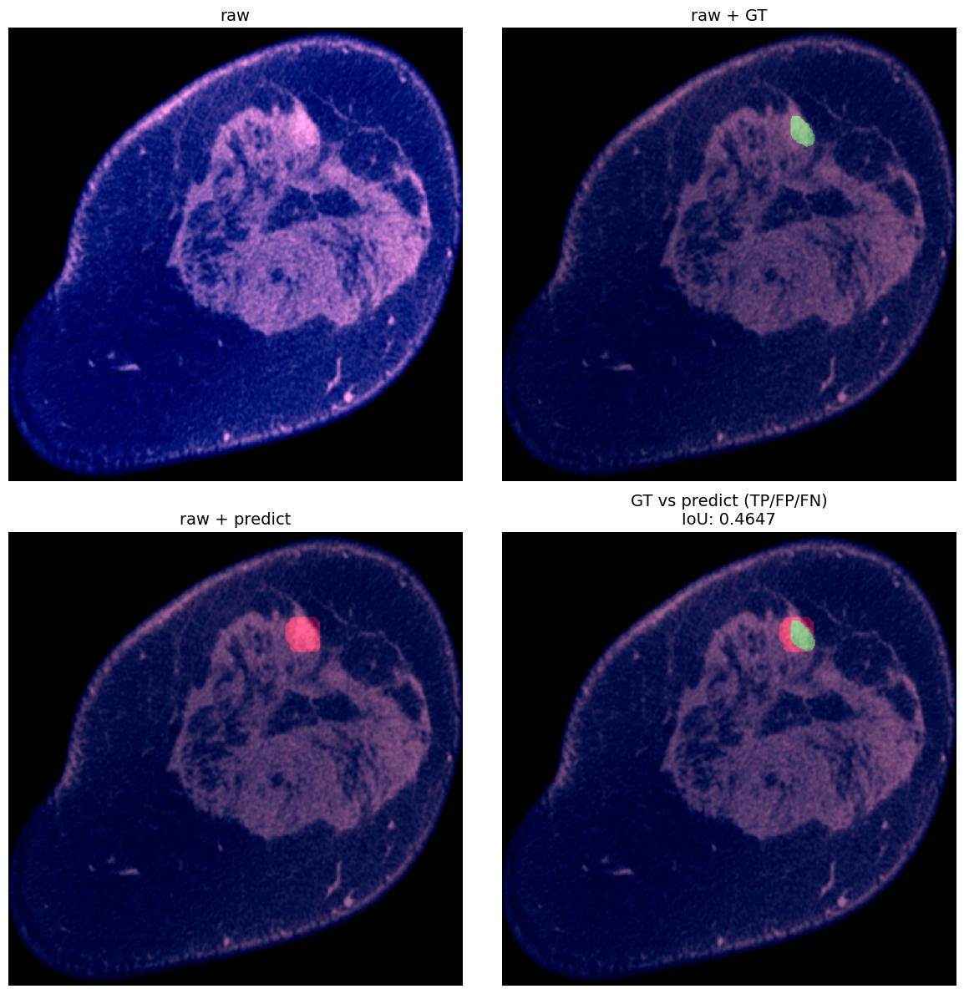





Extract tumor feature
ResNet(:-4) featmap_size $(49,49,512)$
original image
feature map
Finetuned
DINOv2
ROIAlign
Flatten
ResNet(:-4)
$$(3,3,512)$$
$$(1,9,512)$$
$$（392,392)$$
$$(49,49,512)$$
$$(1,1,512)$$
但其实这里还是有个问题 就是可能预测出多个框，也就是 （N,H,W,C）

Slide 3
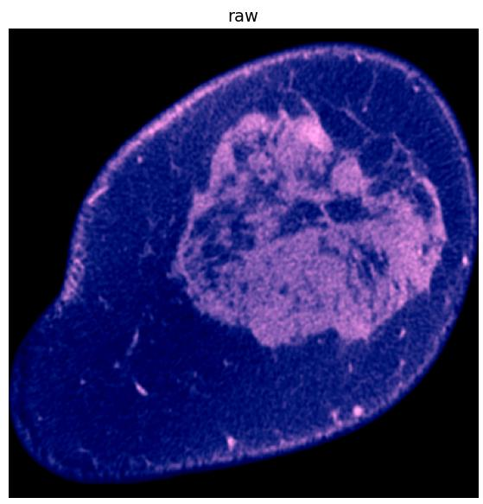




Classify with ViT
Benign
MLP Head
Malignant
Transformer encoder
CLS token
Extract tumor feature

