Slide 1
Projet de Fin d'Études Tutor: Stephane vialle
Silin WANG (SIR)
27/03/2015

Slide 2
contents
PART Ⅰ (working on mic)
regular for
PART Ⅱ (working on phi-host)
Artificial Neural Network
irregular for
offload
Training
Testing
Parallelization
Result

Slide 3
Part Ⅰ
regular for
irregular for
offload

Slide 4
regular for
#pragma omp parallel { #pragma omp for for(size_t i = 0; i < thesize; i++) tab[i] = i; #pragma omp for for(size_t i = 0; i < thesize; i++) tab[i] = pow(pow(0.99, tab[i]), pow(0.99, tab[i])); }

Slide 5
regular for
Machine mic has 57 physical cores
57
57*4
110
165
228

Slide 6
irregular for
#pragma omp parallel { #pragma omp for schedule (static, k) //(dynamic, k) for(size_t i = 0; i < thesize; i++) double res = 0; for(int j = 0; j < i+1; j++) res += pow(tab[j], i); tab[i]=res; }

Slide 7
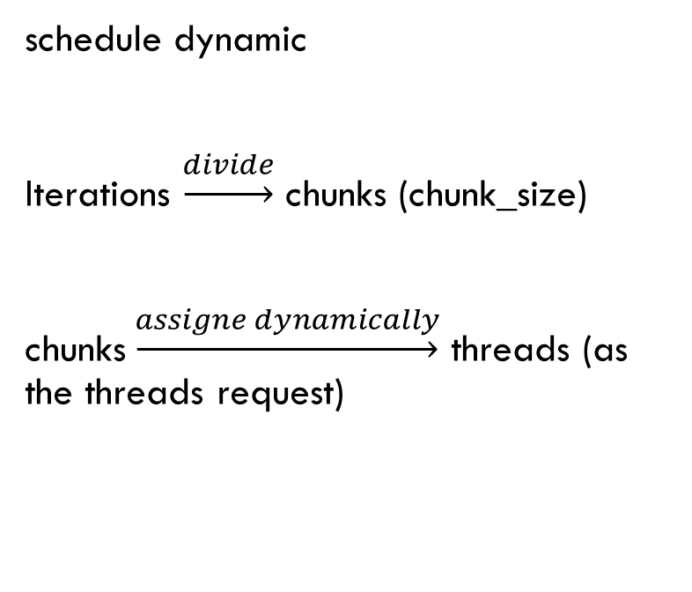
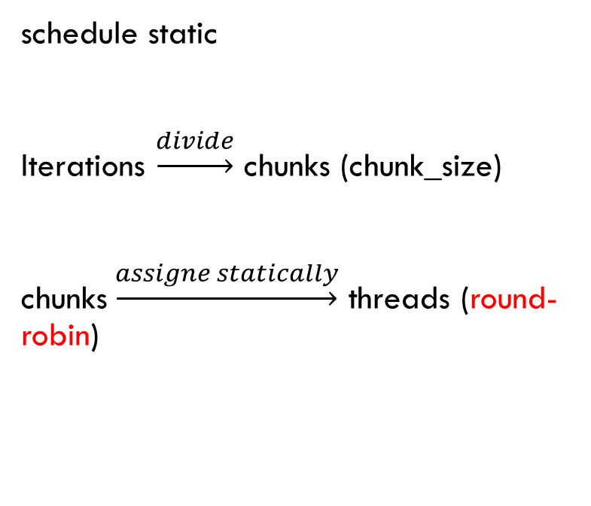
schedule static
Iterations $\underset{→}{divide}$ chunks (chunk_size)
chunks$\underset{→}{assigne statically}$ threads (round-robin)
schedule dynamic
Iterations $\underset{→}{divide}$ chunks (chunk_size)
chunks$\underset{→}{assigne dynamically}$ threads (as the threads request)

Slide 8
Without schedule and static default

Slide 9
With schedule (57 threads)

Slide 10
With schedule (228 threads)

Slide 11
Offload
#pragma offload_transfer target(mic:0) in(mytab:length(SIZE) free_if(0) align(ALIGN)) nocopy(myres :length(SIZE) alloc_if(0) free_if(0)) smct=emtt=omp_get_wtime(); dmtt+=emtt-smtt; #pragma offload target(mic:0) nocopy(mytab : alloc_if(0) free_if(0)) nocopy(myres : alloc_if(0) free_if(0)) { compute(mytab,SIZE,myres,mnt); } smtt=emct=omp_get_wtime(); dmct+=emct-smct; #pragma offload_transfer target(mic:0) nocopy(mytab : alloc_if(0) free_if(1)) out(myres : length(SIZE) alloc_if(0) free_if(1)) emtt = omp_get_wtime(); dmtt = emtt - smtt;

Slide 12
On phi-host

Slide 13
On mic
8

Slide 14
Part Ⅱ
Artificial Neural Network
Training
Testing
Parallelization
Result

Slide 15
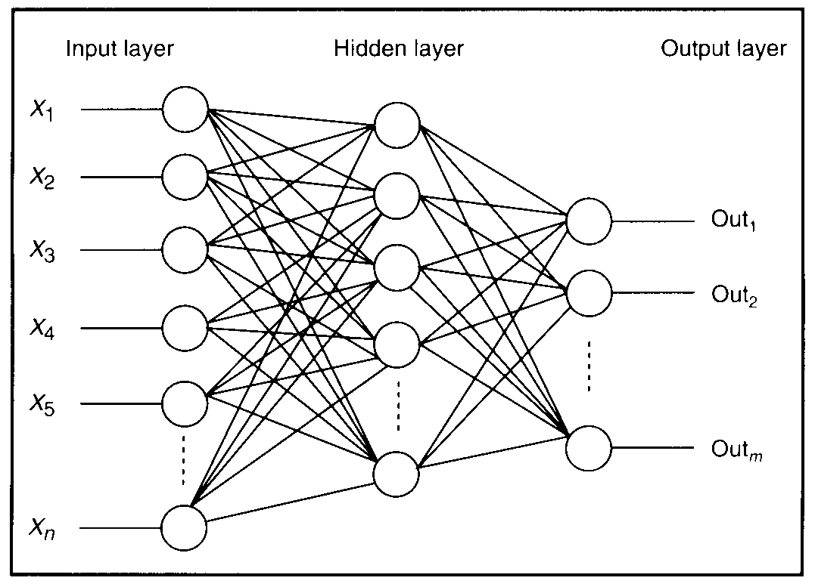
Artificial Neural Network

Slide 16
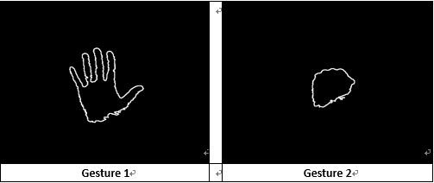
Training and testing
200 vectors for testing
200 vectors for training

Slide 17
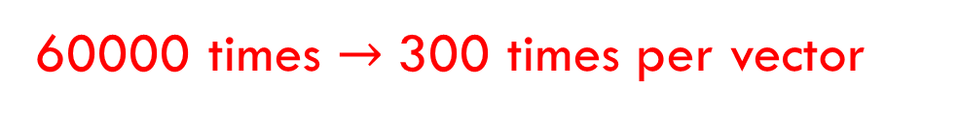
Training and testing
Pick a input vector in random
Propagation
Calculate errors
Backpropagation
Get weights
60000 times $→$300 times per vector

Slide 18
Training and testing
The accuracy of recognition: 88.5%
Execution time: 9.9297 seconds

Slide 19
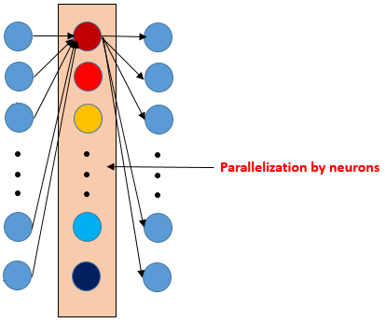
Parallelization

Slide 20
Parallelization
#pragma omp parallel { for (int i=0; i<NumHiddenLayers + 1; ++i){ #pragma omp single { //part A…………. } #pragma omp for for (int j=0; j<vecLayers[i].NumNeurons; ++j){ for (int k=0; k<NumInputs; k++) { //part B…………………….... } } #pragma omp single { //Part C………..... } } }

Slide 21
results
55%

Slide 22
results
#pragma omp parallel { for (int i=0; i<NumHiddenLayers + 1; ++i){ #pragma omp single { //part A…………. } #pragma omp for for (int j=0; j<vecLayers[i].NumNeurons; ++j){ for (int k=0; k<NumInputs; k++) { //part B…………………….... } } #pragma omp single { //Part C………..... } } }
single_time_1
Para_loop_time
single_time_2

Slide 23
Thank you!!

