Slide 1
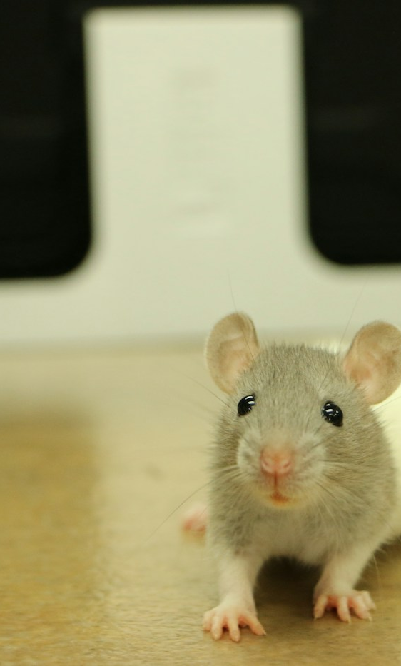

ADVANCED ENGLISH LISTENING AND SPEAKING
UNIT 3
THE PLAGUE
A small flea. A serious disease. Why?
PRESENTERS
Speaker A
Speaker B
Hubei University of Technology · English Presentation
Notes:
Slide 1 | Speaker A
SCRIPT A: adapted from original
Good morning, teachers and classmates. I'm A. Today, my partner and I will talk about plague. Look at this mouse. Isn't it cute? But some wild mice and rats, and the fleas on them, can carry plague bacteria. Of course, not every mouse has the disease. How can a small flea cause such a serious problem?
SCRIPT B: new deck only
Good morning, everyone. I'm A. Our topic today is plague. The mouse in this picture looks harmless. So why are we talking about a dangerous disease? Some wild animals and the fleas on them can carry the bacteria that cause plague. The picture introduces our question; it does not show an infected mouse. Let's learn what plague is and how it spreads.
SOURCES
https://www.cdc.gov/plague/about/index.html

Slide 2
UNIT 3 / THE DISEASE
What is plague? How does it spread?
Caused by bacteria: Yersinia pestis
Not a virus. A disease shared by animals and people.
INFECTED ANIMAL
→
INFECTED FLEA
→
PERSON
A source of bacteria
Carries the bacteria
Infected by a flea bite
OTHER ROUTES
Contact with infected
animal tissues or fluids
Pneumonic plague: cough droplets
during close contact
Sources: WHO — Plague; CDC — About Plague. Full links in notes.
2 / 5
Notes:
Slide 2 | Speaker A
SCRIPT A: adapted from original
Plague is a serious disease caused by bacteria called Yersinia pestis. It is not caused by a virus. Look at the three boxes. A flea bites an infected animal and picks up the bacteria. Then it bites a person and passes them on. People can also get sick through contact with an infected animal's blood or body tissues. Pneumonic plague can spread through cough droplets during close contact.
SCRIPT B: new deck only
On this slide, the key word is bacteria. Plague is caused by Yersinia pestis, not a virus. The three boxes show one common route. First, a flea feeds on an infected animal. Next, that flea carries the bacteria. Then it bites a person. There are two other routes: contact with infected animal tissues, and close contact with a person who has lung plague. That person can spread bacteria through cough droplets.
SOURCES
https://www.who.int/news-room/fact-sheets/detail/plague

Slide 3
UNIT 3 / TYPES & SYMPTOMS
Three main forms of plague
The same bacterium. Different parts of the body.
01
Bubonic
LYMPH NODES
Swollen, painful nodes; the most common form
02
Septicemic
BLOOD
Serious bleeding and shock
03
Pneumonic
LUNGS
Cough and breathing problems; can spread between people
All forms need urgent care. Untreated infection can spread in the body.
Source: CDC — Signs and Symptoms of Plague. Full link in notes.
3 / 5
Notes:
Slide 3 | Speaker A
SCRIPT A: adapted from original
There are three main types of plague. Bubonic plague causes swollen and painful lymph nodes. It is the most common type. Septicemic plague affects the blood and can cause shock and serious bleeding. Pneumonic plague affects the lungs and can make breathing difficult. These are different forms of the same disease. All three types need quick treatment. People may also have a sudden fever, headache, and feel very weak. A doctor must check these signs carefully. Now, my partner will show us where plague has happened and why it matters.
SCRIPT B: new deck only
This slide compares three forms. Bubonic plague mainly affects the lymph nodes, which become swollen and painful. Septicemic plague affects the blood and can cause shock or bleeding. Pneumonic plague affects the lungs and causes breathing problems. The blue message below is important: every form needs quick medical care. An untreated infection can spread to other parts of the body. People with plague may also develop a sudden fever, headache, and weakness. These signs alone do not prove someone has plague. My partner will now explain the history and the harm.
SOURCES
https://www.cdc.gov/plague/signs-symptoms/index.html

Slide 4
UNIT 3 / WORLD & CHINA
Plague: then and now
14th century
1910–1911
2017
THE BLACK DEATH
NORTHEAST CHINA
MADAGASCAR
A major plague pandemic
with great loss of life
in Europe.
About 60,000 deaths.
Wu Lien-teh helped
lead the response.
2,348 reported cases*
and 202 deaths
by 22 November.
Plague is part of history — and it still exists today.
*Confirmed, probable and suspected cases; 1 Aug–22 Nov 2017. Not a full-year total.
Sources: WHO; University of Hong Kong Libraries — Plague Pandemic in Manchuria. Full links in notes.
4 / 5
Notes:
Slide 4 | Speaker B
SCRIPT A: adapted from original
Thank you, A. Hello everyone, I'm B. Plague caused the Black Death hundreds of years ago. Many people died because they had no effective medicine. It also affected China. During the outbreak in northeast China in nineteen ten and nineteen eleven, about sixty thousand people died. Doctor Wu Lien-teh helped lead the fight against it. Plague still exists today. In Madagascar in twenty seventeen, an outbreak affected many people. By November twenty-second, over two thousand cases had been reported, including suspected cases. These examples show that plague is part of both history and modern life.
SCRIPT B: new deck only
Thank you, A. I'm B. This slide takes us from the past to the present. The first example is the Black Death in the fourteenth century. It caused great loss of life in Europe. The second is northeast China in nineteen ten and nineteen eleven. About sixty thousand people died, and Doctor Wu Lien-teh helped lead the response. The third is Madagascar in twenty seventeen. By November twenty-second, over two thousand cases had been reported, including suspected cases. This recent outbreak reminds us that plague has not disappeared. It is still important to find cases and treat people early.
SOURCES
https://www.who.int/emergencies/disease-outbreak-news/item/27-november-2017-plague-madagascar-en
https://digitalrepository.lib.hku.hk/plague
https://www.who.int/news-room/fact-sheets/detail/plague

Slide 5

UNIT 3 / IMPACT & PREVENTION
Real outbreaks. Real harm.
THE HARM
Lung damage and breathing problems
Serious bleeding, shock and death
Pressure on hospitals and families
Early antibiotics can save lives.
A disease can change everyday life.
Avoid flea bites and sick or dead animals.
After possible exposure, seek care if ill.
Historical scene: an illustration, not an outbreak photograph.
Image reused from the original presentation supplied by the user.
Sources: WHO; CDC. Illustration from the original PPT. Full links in notes.
5 / 5
Notes:
Slide 5 | Speaker B
SCRIPT A: adapted from original
Look at this picture from our original presentation. It is an illustration of an old town, not a real outbreak photo. It helps us think about the fear that disease can bring. Plague can damage the lungs, cause serious bleeding, and even lead to death. Outbreaks also put pressure on hospitals and families. But there is hope. Antibiotics can treat plague, and early treatment can save lives. Do not touch sick or dead wild animals. Protect yourself from flea bites. If you feel sick after possible contact, get medical help quickly and tell the doctor what happened. Do not try to treat it yourself. Let's respect wildlife and follow medical advice. Thank you for listening!
SCRIPT B: new deck only
The picture shows an old town. It is an illustration, not a real photo of an outbreak. It helps us imagine how a serious disease can affect daily life. Beside the photo, we can see the main dangers. Plague can harm the lungs and blood, cause serious bleeding, and lead to death. It can also place a heavy burden on hospitals and families. However, the message at the bottom gives us hope: early antibiotics can save lives. We can reduce risk by avoiding flea bites and leaving sick or dead wild animals alone. After possible exposure, anyone who becomes ill should get medical help quickly. Thank you for listening.
SOURCES
Illustration reused from slide 2 of the user-supplied 鼠疫_蓝白模板版.pptx. It is a historical scene illustration, not documentary evidence or an actual outbreak photograph. Original image provenance was not supplied; no external photo attribution is asserted.
https://www.cdc.gov/plague/signs-symptoms/index.html
https://www.cdc.gov/plague/about/index.html

