Slide 1
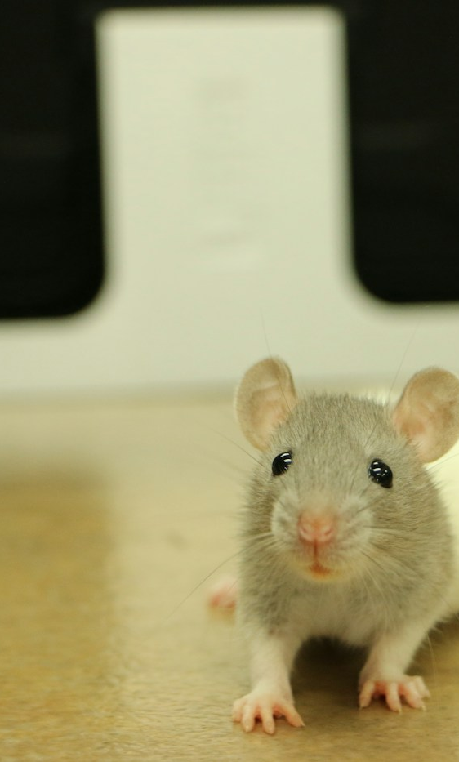

ADVANCED ENGLISH LISTENING AND SPEAKING
UNIT 3
THE PLAGUE
History, transmission, and modern prevention
PRESENTERS
Speaker A
Speaker B
Hubei University of Technology · Group Presentation · 2026
Notes:
Speaker A
Good morning, dear teachers and classmates. I'm A. Today, my partner and I are going to talk about plague. Look at this picture. Isn't the mouse cute? Many of us see mice as small, harmless animals. However, some wild rodents and their fleas can carry a dangerous bacterium. That brings us to today's topic: plague. This does not mean that every mouse is infected. The picture is simply a way to introduce the disease.
Sources, checked 26 October 2026:
https://www.cdc.gov/plague/index.html
Photo: Matthew Mejia / Unsplash, https://unsplash.com/photos/JJWBBuiWwZY . Illustrative mouse photograph, no infection is implied.

Slide 2

ADVANCED ENGLISH LISTENING AND SPEAKING
What is plague?
The Black Death and modern medicine
An infectious disease caused by Yersinia pestis
THEN / NOW
The Black Death in history; effective antibiotics today
Unit 3 Disease
Notes:
Speaker A
Plague is an infectious disease caused by a bacterium called Yersinia pestis. It caused the Black Death, a devastating pandemic in the fourteenth century. At that time, people did not understand bacteria and had no antibiotics. Today, plague still exists in some parts of the world, but modern medicine can treat it. The most important thing is to recognize possible infection and act quickly.
Sources, checked 26 October 2026:
https://www.who.int/news-room/fact-sheets/detail/plague
Historical scene reused from the supplied plague deck. Illustrative artwork, not documentary evidence.

Slide 3
UNIT 3 DISEASE
How plague spreads
A COMMON ROUTE
RODENT
1
A flea feeds on an infected rodent
An infected animal
2
The flea picks up Yersinia pestis bacteria
FLEA
3
An infected flea bites a person
The insect that carries bacteria
OTHER ROUTES
Contact with infected
animal tissues or fluids
Close contact with a person
who has pneumonic plague
PERSON
Risk depends on exposure to infected animals or fleas.
Pneumonic plague can spread through respiratory droplets.
3
Notes:
Speaker A
So, how does plague spread? One common route involves an infected animal, a flea, and a person. A flea feeds on an infected rodent and picks up the bacteria. If that flea then bites a person, it can pass the bacteria into the body. People can also become infected through unprotected contact with infected animal tissues or body fluids. There is another important route: a person with pneumonic plague can spread the bacteria through respiratory droplets during close contact. We will explain this form shortly. The risk depends on exposure, so we should follow local health advice rather than fear every animal we see.
Sources, checked 26 October 2026:
https://www.who.int/news-room/questions-and-answers/item/plague

Slide 4
UNIT 3 DISEASE
Three main forms of plague
The form depends on where the infection mainly develops.
PNEUMONIC PLAGUE
Bubonic plague
Septicemic plague
Close contact
Swollen, painful lymph nodes
Bloodstream infection; possible shock
Respiratory droplets can carry bacteria between people
Pneumonic plague
Disease progression
Lung infection, cough, breathing problems
Untreated infection can spread in the body
All forms are serious
Urgent medical care is essential.
Next: symptoms, treatment, and practical prevention
4
Notes:
Speaker A
There are three main forms of plague. The first is bubonic plague, the most common form. It usually affects the lymph nodes, which become swollen and painful. The second is septicemic plague. It affects the bloodstream and can cause shock and serious bleeding. It may occur on its own or develop from another form. The third is pneumonic plague. It affects the lungs and can cause coughing, chest pain, and difficulty breathing. It can spread between people through respiratory droplets during close contact. These forms describe where the infection mainly affects the body. All of them need urgent medical treatment.
Sources, checked 26 October 2026:
https://www.cdc.gov/plague/signs-symptoms/
Handoff: Now, my partner will explain the symptoms, treatment, and ways to stay safe.

Slide 5
UNIT 3 RESPONSE
Symptoms and treatment
Early antibiotics can save lives
01
Early symptoms
Sudden fever, chills, headache, and severe weakness
02
Exposure history
Tell a doctor about flea bites or contact with potentially infected animals.
03
Antibiotics
Prompt treatment is effective. Delays can lead to serious complications.
04
Urgent care
Seek medical attention immediately if plague is suspected. Avoid self-treatment.
Similar symptoms have many causes. A clinician must assess them.
5
Notes:
Thank you, A. Hello everyone, I'm B.
Speaker B
What symptoms should we notice? Plague can begin with a sudden fever, chills, headache, and severe weakness. Other symptoms depend on the form of the disease. These signs do not prove that someone has plague, because many illnesses cause similar symptoms. However, if they follow a possible flea bite or contact with an infected animal, the person should seek medical attention immediately and tell the doctor about that exposure. Fortunately, antibiotics can treat plague. Starting treatment early can save lives, while a delay can still be deadly. People should not wait for the illness to become severe or try to treat themselves.
Sources, checked 26 October 2026:
https://www.who.int/news-room/fact-sheets/detail/plague

Slide 6
UNIT 3 PREVENTION
Practical prevention
01
Wild animals
Avoid handling sick or dead rodents
Fewer flea bites.
Less risky contact.
02
Flea bites
Use repellent and suitable clothing
03
Pet care
Ask a vet about flea control
Specific precautions help
protect people and pets.
04
Around home
Store food safely and reduce rodent hiding places
Follow local public health advice
After possible exposure, contact health professionals promptly.
6
Notes:
Speaker B
So prevention is very important. First, avoid handling sick or dead wild animals, especially rodents. Report them to the appropriate local service instead. Second, protect yourself from flea bites. When exposure is possible, wear suitable clothing and use an insect repellent according to its label. Third, keep fleas off pets with veterinary advice, and do not let pets roam freely in affected areas. Around the home, store food securely and remove rubbish or clutter that attracts rodents. General cleanliness is useful, but it cannot replace flea control and avoiding risky contact. After close contact with someone who has pneumonic plague, contact health professionals promptly for advice.
Sources, checked 26 October 2026:
https://www.cdc.gov/plague/prevention/index.html

Slide 7
UNIT 3 SUMMARY
What to remember
DISEASE
Yersinia pestis causes plague. The disease still exists today.
SPREAD
Infected fleas, animal contact, and pneumonic plague droplets.
RESPONSE
Early medical care and antibiotics can save lives.
PREVENTION
Avoid risky animal contact and protect against flea bites.
Thank you for listening!
7
Notes:
Speaker B
The story of plague shows how much medical knowledge has changed. A disease that once caused enormous suffering can now be treated, especially when doctors act early. Our response should be based on facts, practical prevention, and respect for wildlife. We can protect ourselves by understanding how infection happens and knowing when to seek help. For example, if we find a dead wild rodent during a trip, we should leave it alone and report it. If we feel unwell after a possible exposure, we should describe the situation clearly to a doctor. Small decisions like these can make a real difference. Thank you for listening!
Sources, checked 26 October 2026:
https://www.who.int/news-room/fact-sheets/detail/plague

