Slide 1

Hashicorp .. :P

Slide 2









High Level Architecture (Azure)
Foundation Nodes
Director Nodes
Worker Nodes
10.0.1.0/24
10.0.2.0/24
10.0.3.0/24

Slide 3
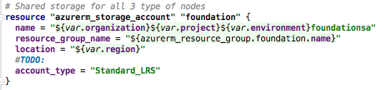
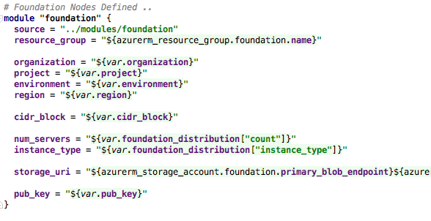
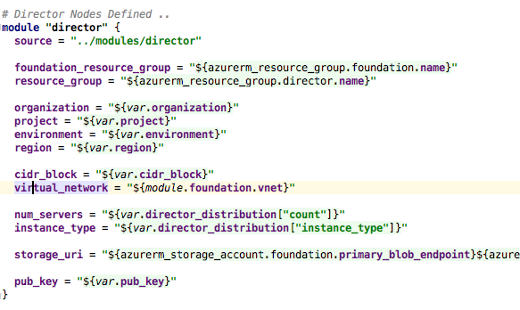
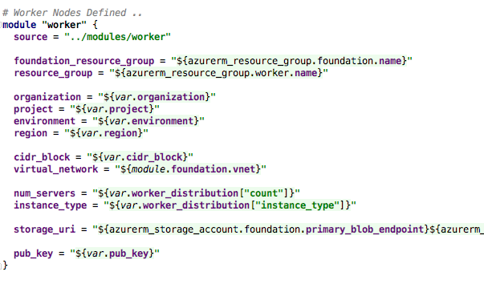
High Level Architecture (Azure)
Foundation Nodes
Director Nodes
Worker Nodes
10.0.1.0/24
10.0.2.0/24
10.0.3.0/24

Slide 4
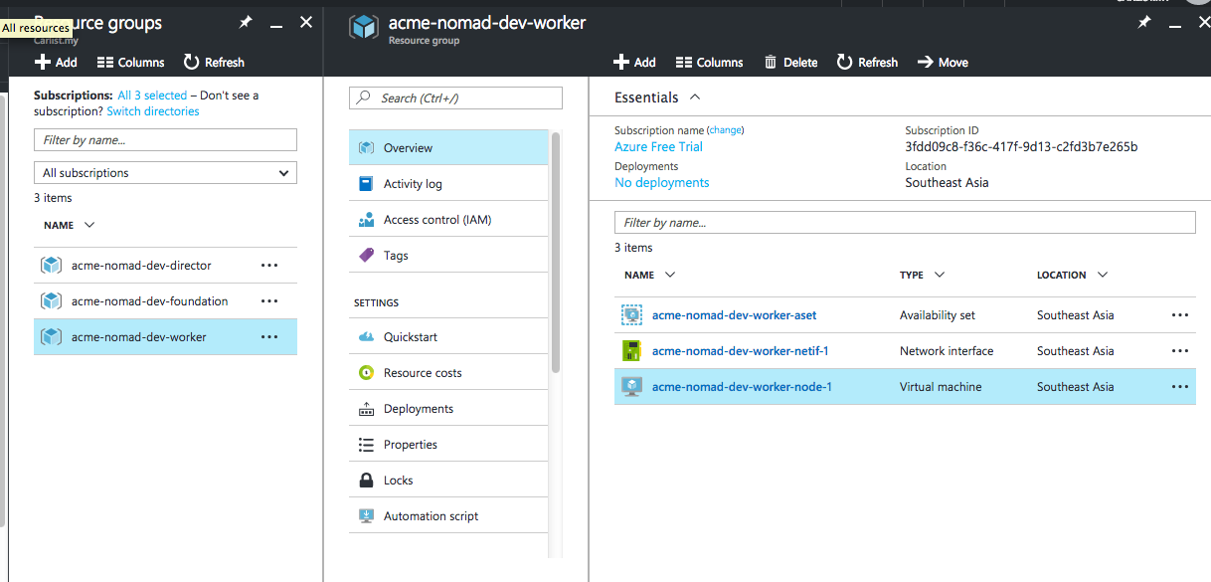
Zero to Nomad Box .. 5 mins
terraform plan
terraform apply -→ Coffee Break ..
URL: here ..

Slide 5


Foundation Nodes
http://thesecretlivesofdata.com/raft/

Slide 6
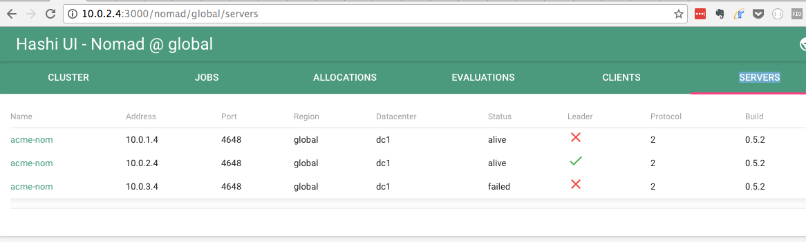
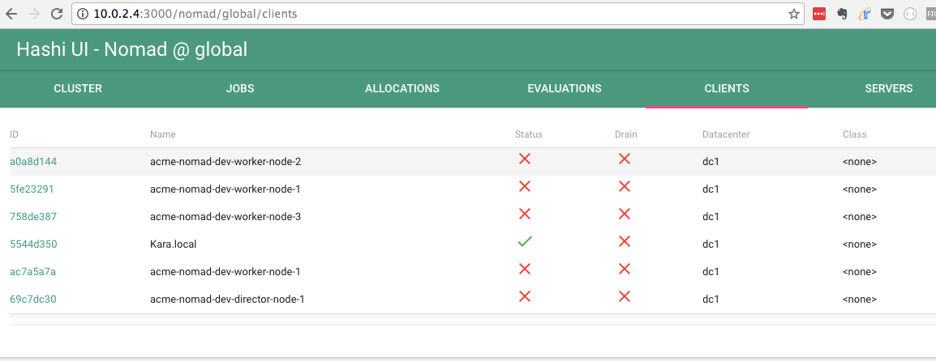
Nomad – Clients & Servers

Slide 7
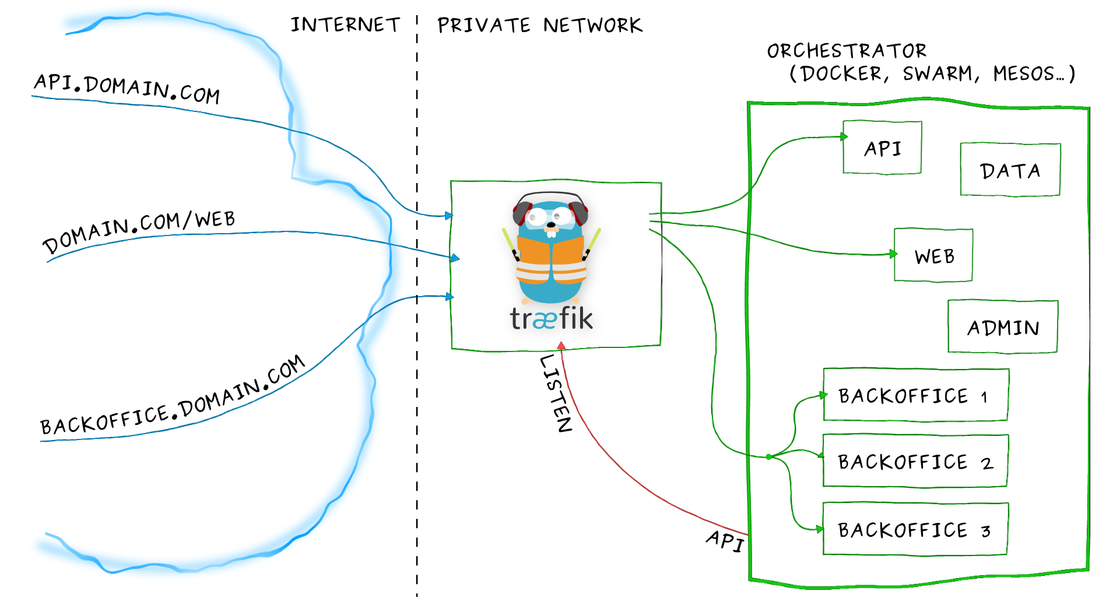
Director Nodes

Slide 8
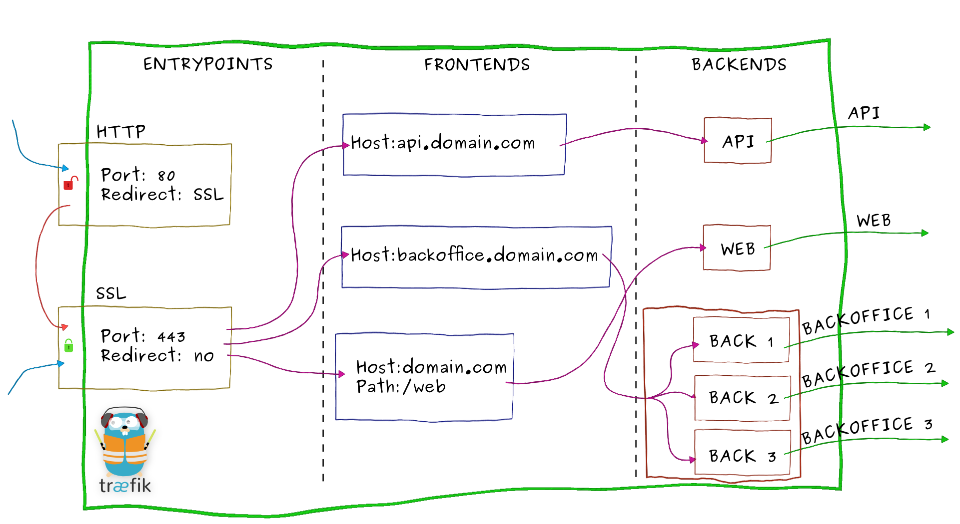
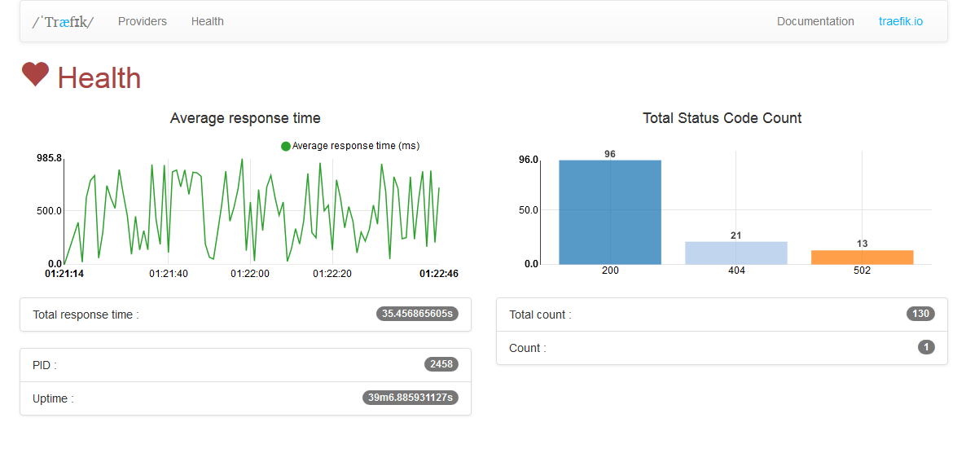
Traefik INternals

Slide 9
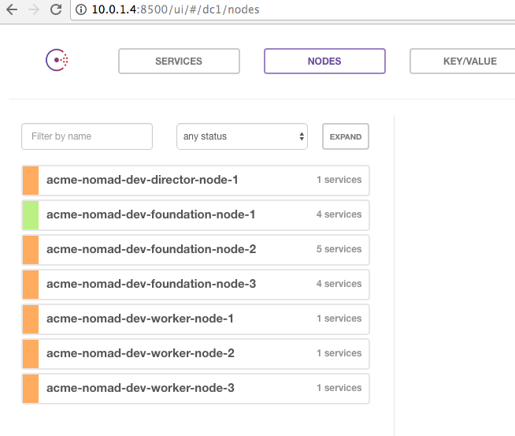
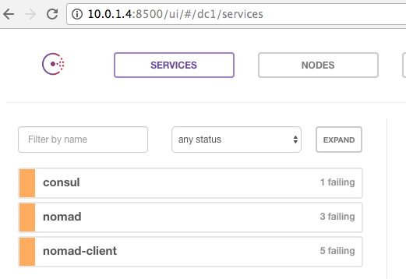
Consul – Services & Nodes
Trouble!

Slide 10
How do internal ervices communcate
DNS
Use Consul SDK for language client
Curl the HTTP path for Consul .. (or use consul key?)
gRPC via linkerd; circuit breaker; blue-green; canary

Slide 11

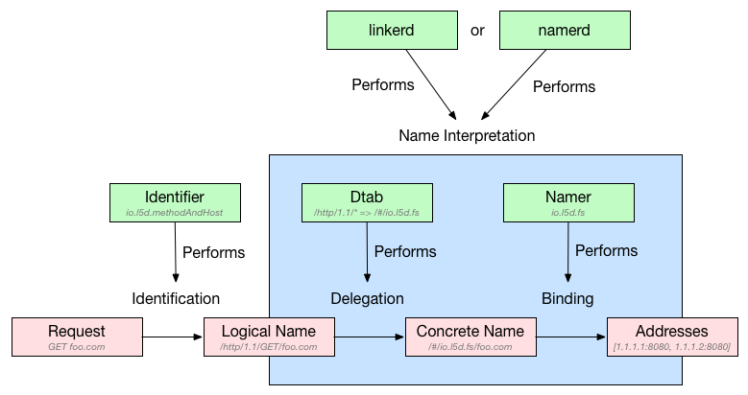
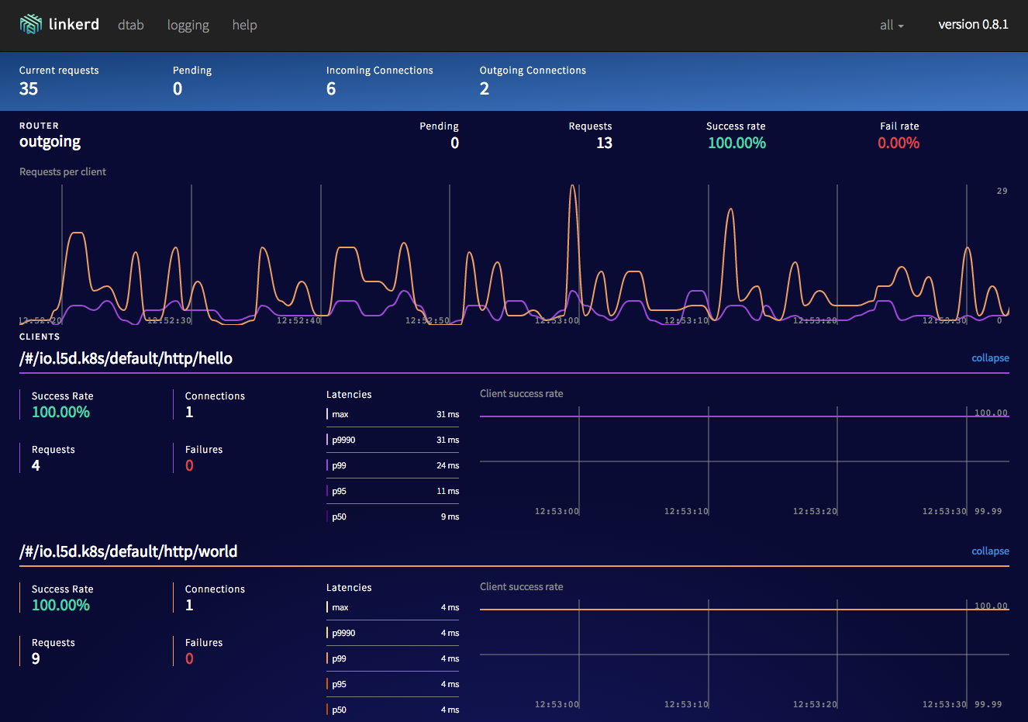
Linkerd (Extra materials)

Slide 12
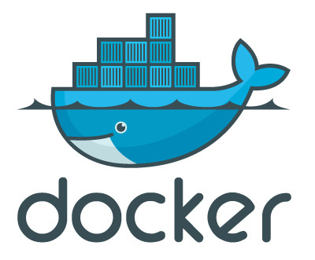






Worker Nodes
Job constraint
CPU, memory
Label
Architecture type
C# + Hyper-V coing soon!
# nomad plan ./job/<job_name>
# nomad run ./job/<job_name>
# nomad status
# nomad stop <job_name>

Slide 13
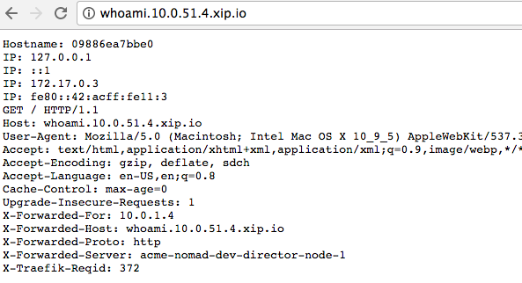
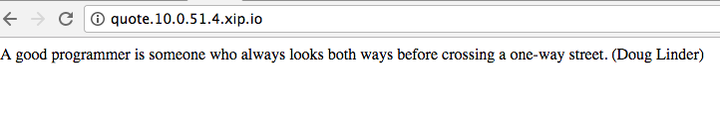
Applications
Simple stateless; how many to scale to??

Slide 14

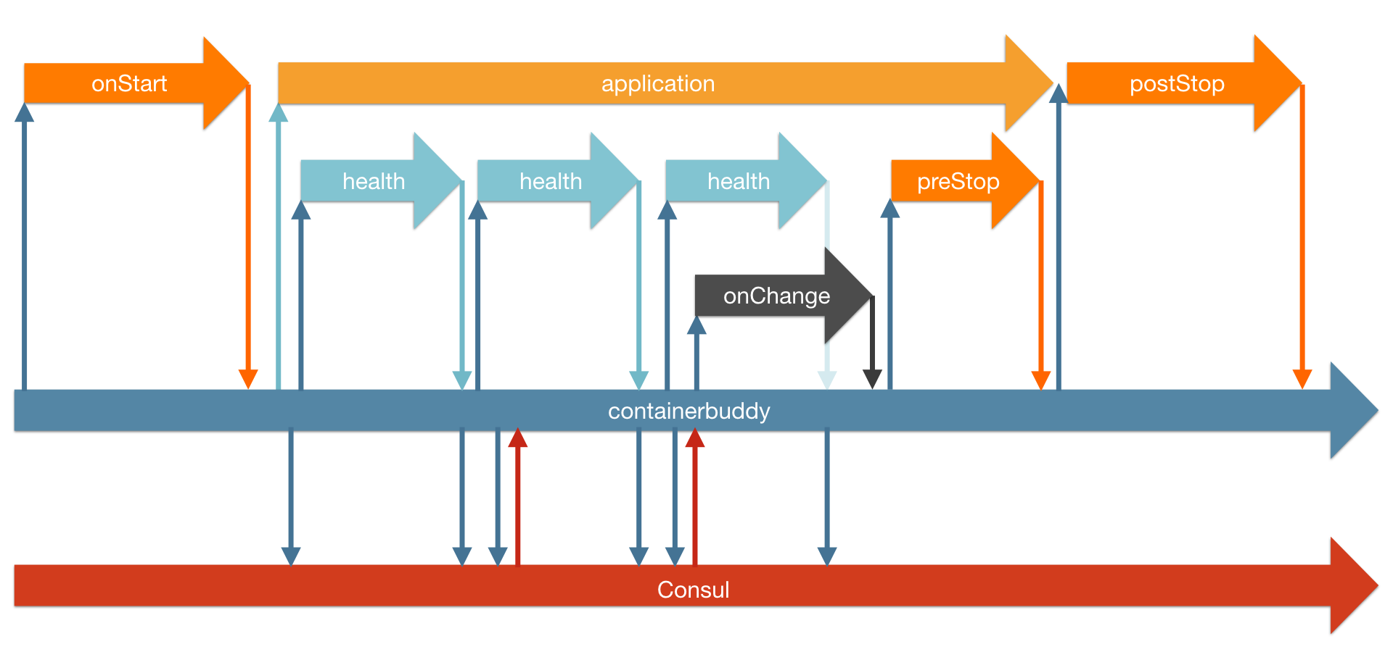
Autopilot Pattern
http://autopilotpattern.io/

Slide 15
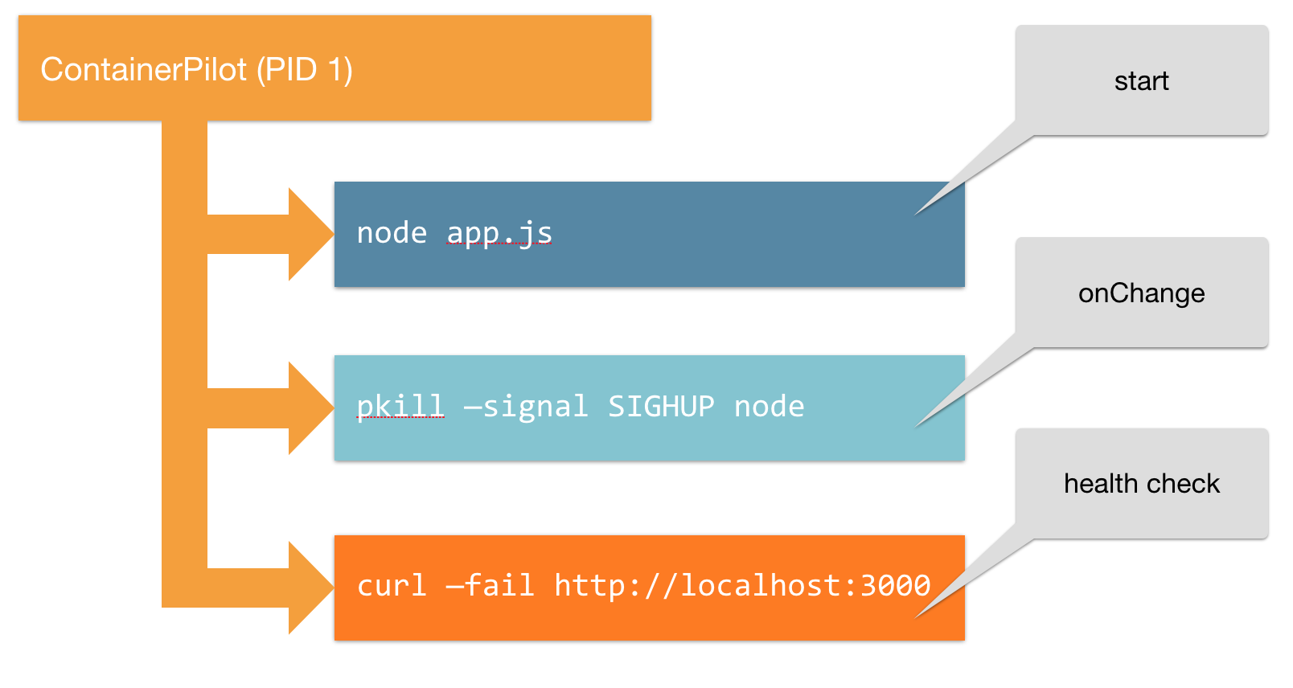
Co-process runs cross cutting
Logging
Telemetry
Linkerd

Slide 16





Hnadling Stateful Services Ideas
Use Azure Database ☺ (only 5USD /m!)
Use with Autopilot Pattern (example, Patroni for PostgreSQL frm Zalando)
Use a NoSQL – ArangoDB
  Azure DocumentDB
Use Expensify’s BedrockDB; built on
Assuming data can fit in host – ZFS
Otherwise, see Manta -

Slide 17
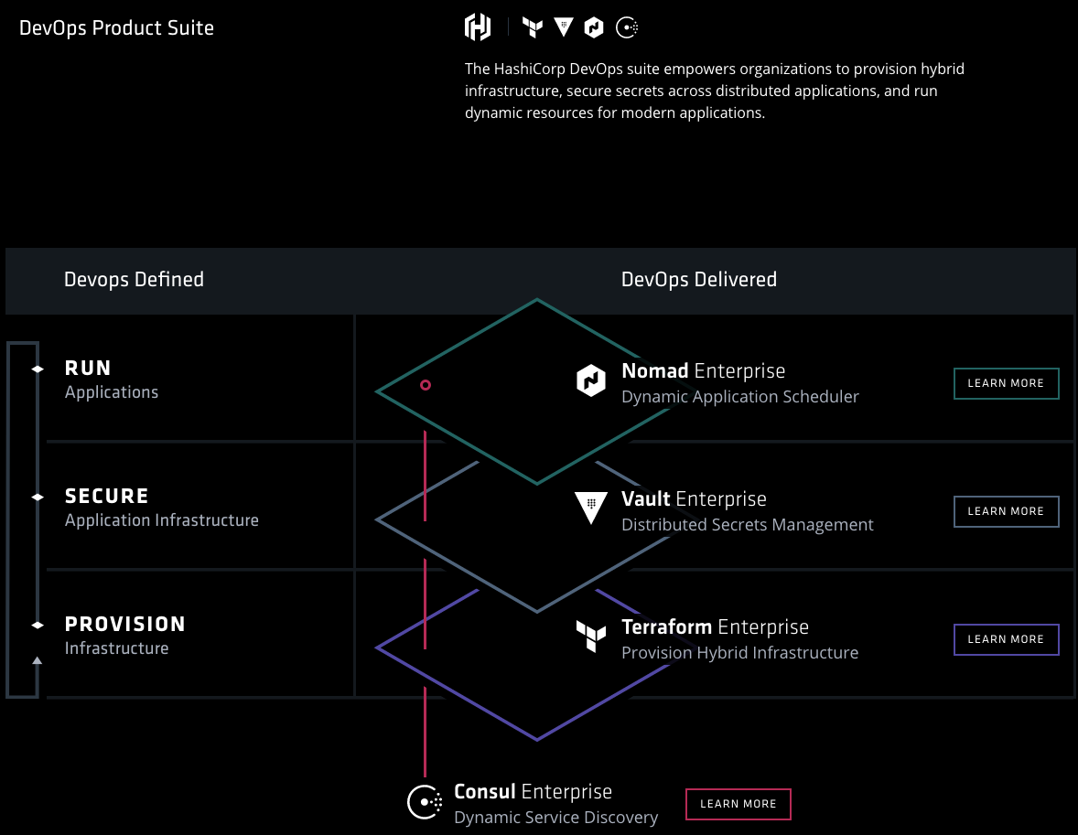
Support Hashicorp!
http://github.com/hashicorp

Slide 18

Thank You Microsoft*!
* For USD150 Bizspark Monthly Credits!
Any Questions?

