Slide 1
Workshop 4
JSP Action and Java bean

Slide 2
Tasks -
Task1
Handle Calculator task using Java Bean and JSP Action
Task2
Handle Customer task using Java Bean and JSP Action
Task 3
Define template using jsp:include

Slide 3
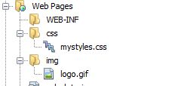
Create a Web Application Project
Project Name WS4_YourStduent NO
Download the Workshop4_supp.zip. Unzip it and put the folder under the Web Pages. You will find the result as follows

Slide 4
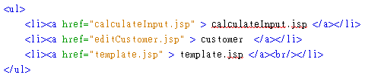
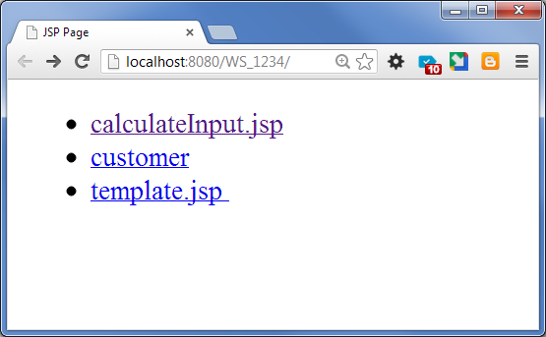
Modify index.jsp and add the following hyperlinks

Slide 5
Calculator Task
Create calculateInput.jsp
It is an input form
Create calculate.jsp
It uses JSP action to create a java bean, ict.bean.CalculateBean, and handle the calculation
Create a java class ict.bean.CalculateBean.java
Create a java class ict.util.CalculateHelper.java

Slide 6
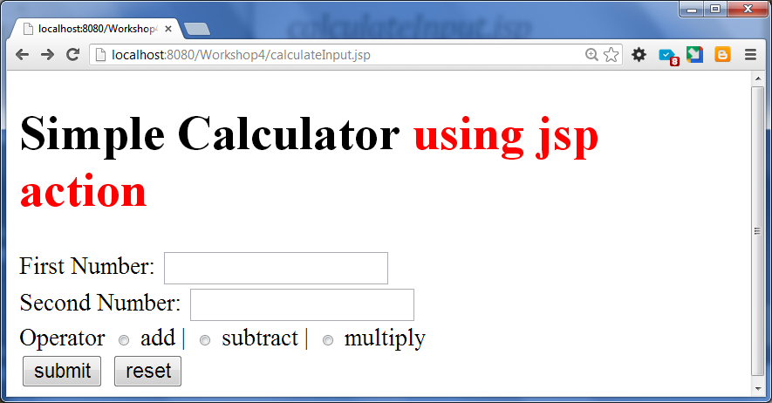
calculateInput.jsp
When the submit button is clicked, request is sent to calculate.jsp.
Define two input boxes value1 and value2
Define a radio input boxes for different operator : add , subtract and multiply.
Define one submit button
Define one reset button

Slide 7
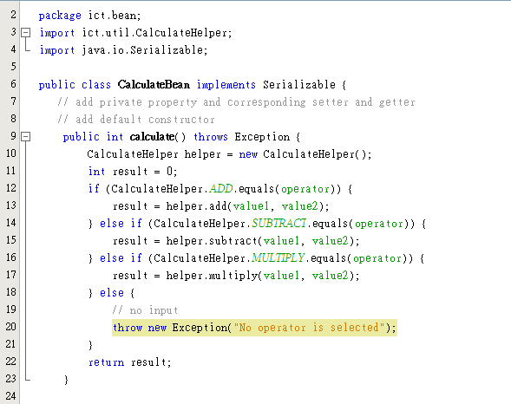
ict.bean.CalculateBean.java
`

Slide 8
CalculateBean
Define a bean CalculateBean.java user package ict.bean
ict.bean.CalculateBean.java
The bean class implements Serializable
The bean private properties are follows:
value1 which type is an integer
value2 which type is an integer
operator which type is a String
Define public getter and setter for the properties
Define the default constructor
The calculate () method uses the ict.util.CalculateHelper to perform calculation
Notes:
To serialize an object means to convert its state to a byte stream so way that the byte stream can be reverted back into a copy of the object. A Java object isserializable if its class or any of its superclasses implements either thejava.io.Serializable interface or its subinterface, java.io.Externalizable.

Slide 9
Serializable
To serialize an object means to convert its state to a byte stream so way that the byte stream can be reverted back into a copy of the object. A Java object is serializable if its class or any of its superclasses implements either the java.io.Serializable interface or its subinterface, java.io.Externalizable.
Reference
https://docs.oracle.com/javase/jndi/tutorial/objects/storing/serial.html

Slide 10
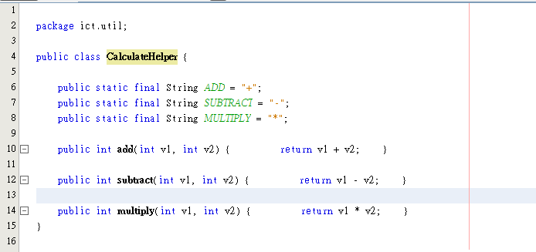
ict.util.CalculateHelper.java

Slide 11
calculate.jsp using jsp Action
<%-- use jsp action to create java bean of ict.bean.CalculateBean with id of cBean
The scope is request
--%>
<%-- use jsp action to set property of the CalculateBean --%>
<%-- use jsp action to display property of the CalculateBean --%>
<br/>
<%-- display the result using jsp expression --%>
The result is
Notes:
Refer to the studentByValue.jsp and StudentInfo.jsp

Slide 12
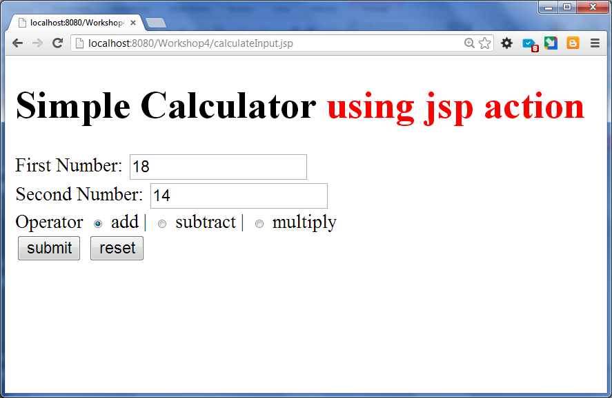
Define Calculate.jsp

Slide 13
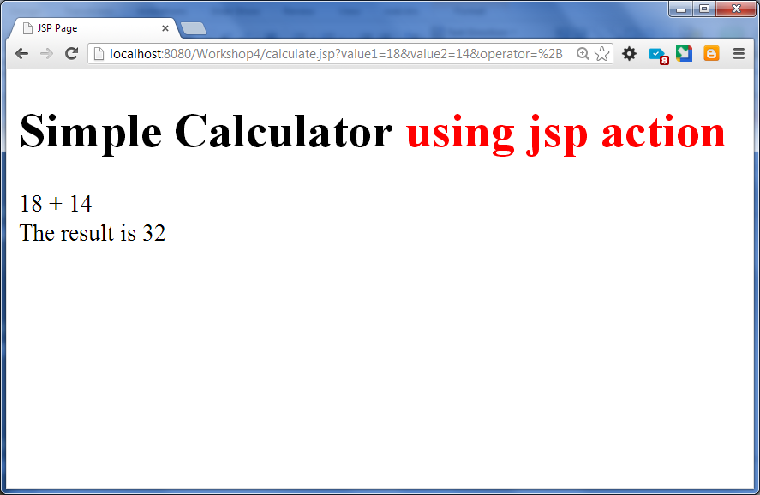
Result displayed by Calculate.jsp using jsp action

Slide 14
CustomerBean with jsp Action

Slide 15
Task 2 - Customer Bean and Jsp Action
Define a java class ict.bean.CustomerBean.java
Define editCustomer.jsp
is an input form for collecting customer information
Define handleCustomer.jsp
use jsp action to create customer bean in request scope
display the current inputted information
and all the customer information in a table format.

Slide 16
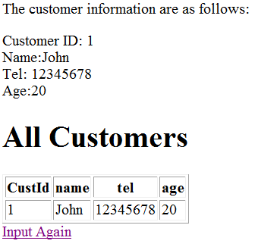
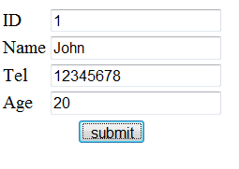
Sample Run – Input the first customer Information
Input
Expected Result

Slide 17
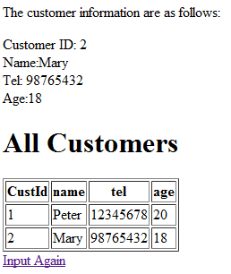
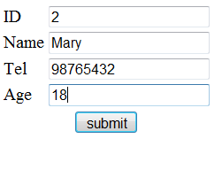
Add 2nd Customer information
Input
Expected Result

Slide 18
CustomerBean
Assume you have in a database. The customer table has the following 4 columns
CustId 5 characters
Name 25 characters
Tel 10 characters
Age integer

Slide 19
Create a java class ict.beanCustomerBean.java
The class CustomerBean is user package ict.bean
ict.bean.CustomerBean
The bean private properties are follows
String custId
String name
String tel
int age
Define public getter and setter for all the properties
Define a default constructor

Slide 20
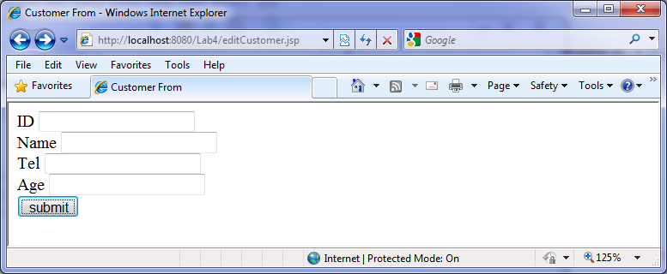
Define a editCustomer.jsp as follows
Action=handleCustomer.jsp

Slide 21
handleCustomer.jsp
<!– write jsp page directive to import java.util.* -->
<!– write jsp page directive to import ict.bean.CustomerBean-->
<!-- Use jsp declaration to declare an ArrayList, customers,
It temporarily stores all the inputted customer-->
<html> <head> <title>Handle Customer</title> </head>
<body>
<!-- use jsp useBean action to create a ict.bean.CustomerBean with id ‘c’-->
<!-- use jsp setProperty action to obtain value from input form -->
<!-- use jsp getProperty action to display current inputted value-->
<%
// add the customer, c, to the customers ArrayList
// display all the customers in a table format
// show a hyperlink to ask user to input again
%>
</body>
</html>

Slide 22
Demo Your work

Slide 23
To define the scope the ArrayList of customer with jsp:useBean action (Enhanced Version)
Make a copy of handleCustomer.jsp and named it with handleCustomer2.jsp
Remove ArrayList customer from the JSP declaration block
and replace it with jsp action <jsp:useBean >
You will have two jsp:useBean actions
CustomersBean (Store an arrayList of customerBean)
CustomerBean (Store information a customerBean)
Specify the scope attribute as either application or session or request in CustomersBean
Find out the difference of the scope.

Slide 24
ict.bean.CustomersBean
The CustomersBean has
a property of an ArrayList of CustomerBean
A setter and getter of the ArrayList
A addCustomer (CustomerBean customer) method
Default constructor, which will initialize the ArrayList, customers

Slide 25
ict.bean.CustomersBean
package ict.bean;
import java.util.ArrayList;
public class CustomersBean implements Serializable {
private ArrayList<CustomerBean> customers;
// getter and setter of customers.
// default constructor
public void addCustomer(CustomerBean customer) {
this.customers.add( customer);
}
}

Slide 26
Find out differences of application, session and request scope
After you complete the handleCustomer2.jsp
Experiment 1
Set the CustomersBean to application scope
Open two different browsers (IE and chrome)
Input a customer information using IE
Input a customer information using chrome
Check whether the customer information which inputted via IE display in chrome? Visa versa
Experiment 2
Set the CustomersBean to session scope
Open two different browsers (IE and chrome)
Input a customer information using IE
Input a customer information using chrome
Check whether the customer information which inputted via IE display in chrome? Visa versa

Slide 27
Experiment 3
Set the CustomersBean to request scope
Open one different browsers
Input a customer information (first customer)
Input another customer information (second customer)
Check whether the first customer information still exist after the second customer submitted to the server.

Slide 28
Task 3
Create a template with jsp: include

Slide 29
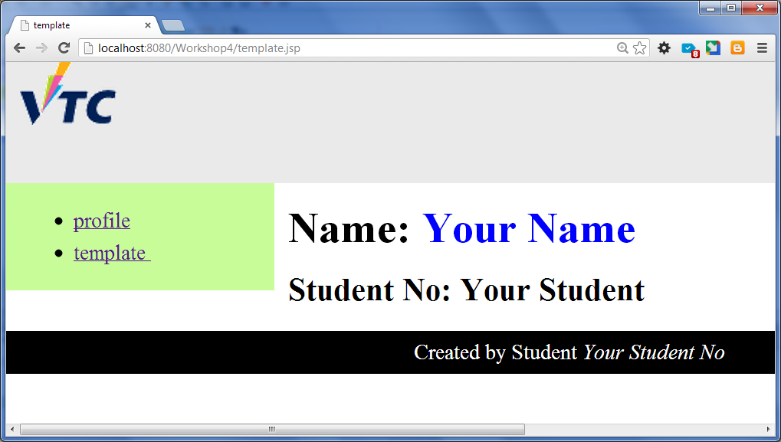
Use css template with jsp:include
Create the following jsp files
heading.jsp
menu.jsp
footer.jsp
main.jsp
template.jsp
profile.jsp

Slide 30
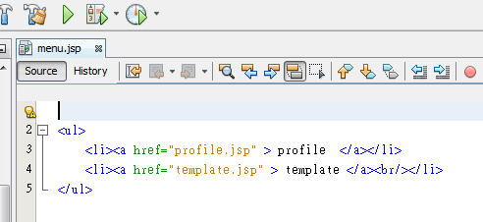
menu.jsp
Since this file will be include in another file, no need to add the tag <html>.
Just need the unordered list is enough

Slide 31
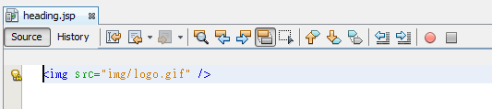
heading.jsp

Slide 32
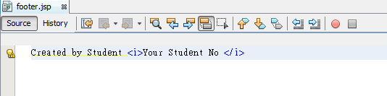
footer.jsp

Slide 33
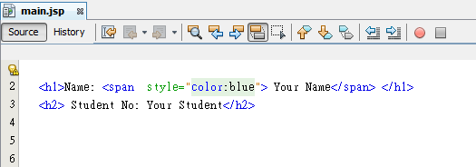
main.jsp

Slide 34
template.jsp 1/2
<%@page contentType="text/html" pageEncoding="UTF-8"%>
<!DOCTYPE html>
<html> <head>
<title>template</title>
</head>
<body>
<div id="maincontainer">
<div id="topsection"><div class="innertube">
<jsp:include page="heading.jsp" />
</div>
</div>
<div id="contentwrapper">
<div id="contentcolumn">
<div class="innertube">
<jsp:include page="main.jsp" />
</div>
</div>
</div>

Slide 35
template.jsp 2/2
<div id="leftcolumn">
<div class="innertube">
<jsp:include page="menu.jsp" />
</div>
</div>
<div id="footer">
<jsp:include page="footer.jsp" />
</div>
</div>
</body>
</html>

Slide 36
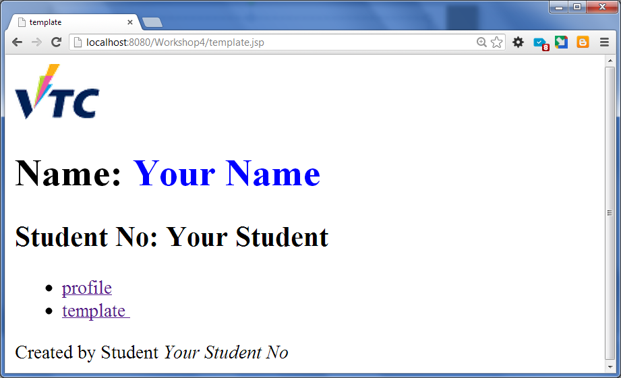
Try out the template.jsp

Slide 37
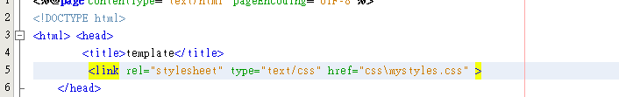
Add the following line to the template.jsp

Slide 38
Try out the template.jsp again

Slide 39
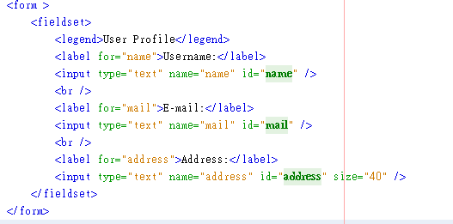
Create a copy the template.jsp and rename it to profile.jsp
In the profile.jsp
Replace the <jsp:include page="main.jsp" /> with the following code

Slide 40

Modify the title to Profile

Slide 41
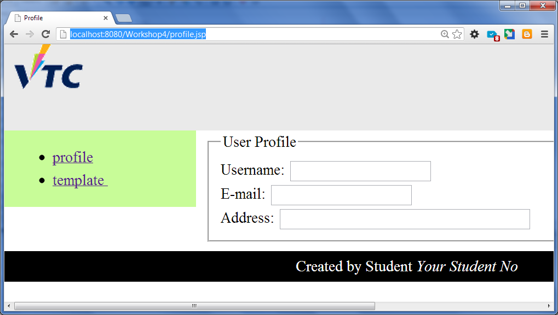
Try to run the profile.jsp

Slide 42
Apply css to align the label
Add the following code after inside head tag
<style type="text/css">
fieldset {
padding: 1em;
font:80%/1 sans-serif;
}
label {
float:left;
width:20%;
margin-right:0.5em;
padding-top:0.2em;
text-align:right;
font-weight:bold;
}
</style>

Slide 43
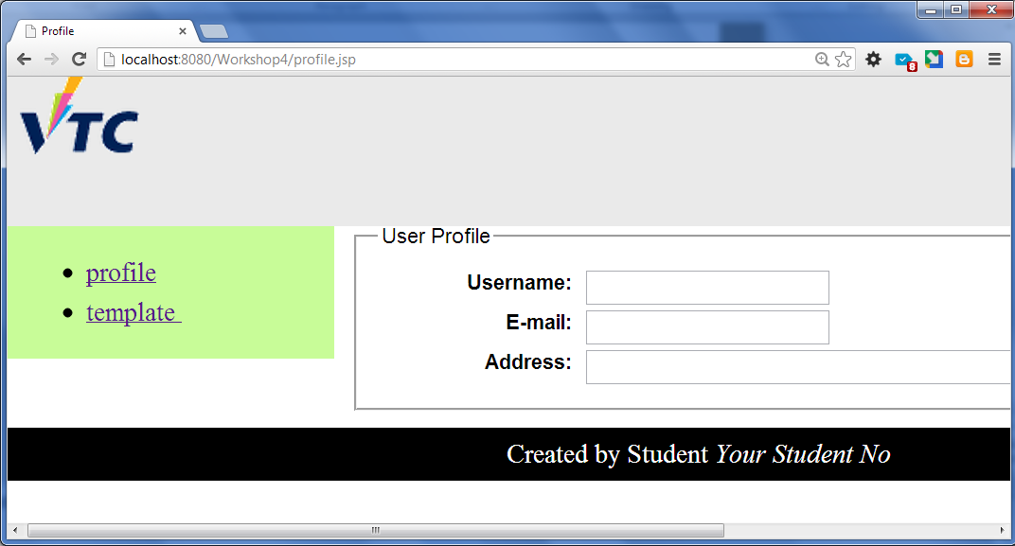
Try to run the profile.jsp again

