Slide 1
Building a RESTful Employee Management API with Spring Boot
Hands-on Workshop – From Zero to a Working CRUD API

Slide 2
Learning Objectives
By the end of this workshop,
Develop a complete Spring Boot REST API implementing a layered architecture.
Apply essential Spring MVC and Spring Data JPA annotations.
Understand the DispatcherServlet as the Front Controller in Spring Boot.
Test the API effectively using Postman or cURL.

Slide 3
Prerequisites
Java 17 or higher installed
NetBeans IDE with Spring Boot support
Postman (optional) or cURL (built-in on most systems)
Internet access for Spring Initializr
cURL is now presented as a lightweight, scriptable alternative to Postman.)

Slide 4
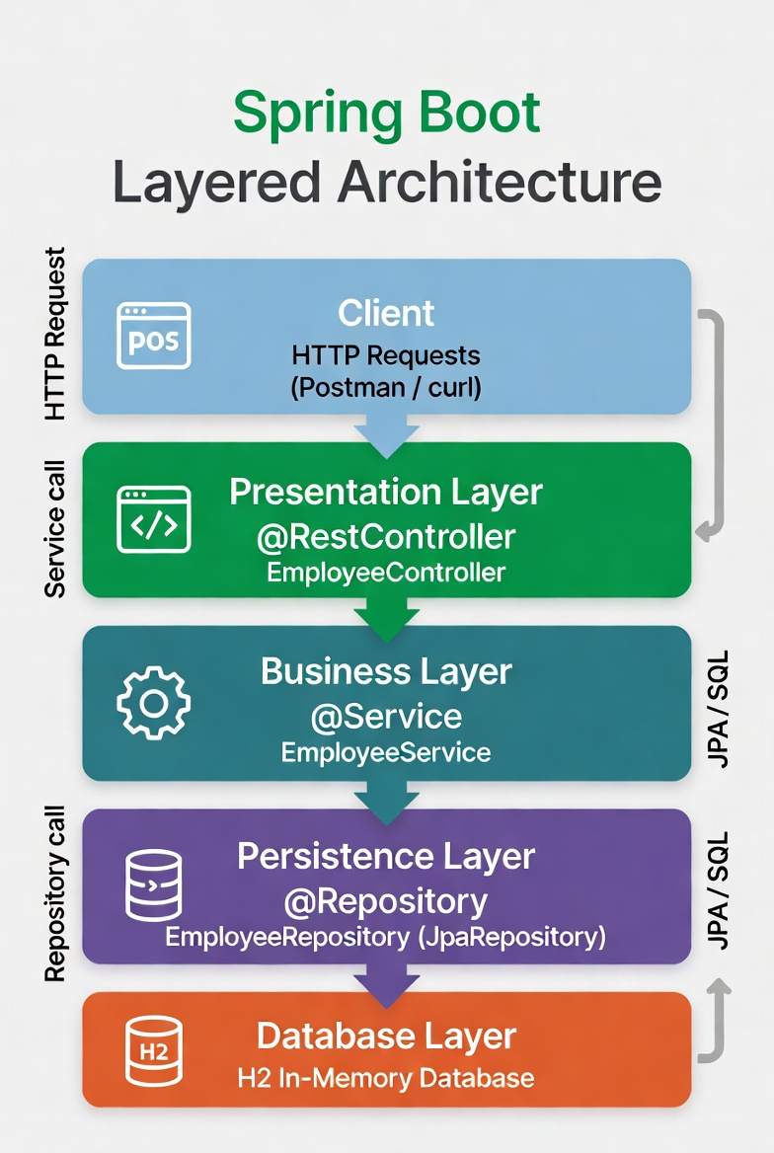
Project Overview
Simple Employee REST API at /api/employees
Full CRUD (Create, Read, Update, Delete) support
Model = Employee entity (JPA-mapped)
Controller = REST endpoints returning JSON, JSON responses (no HTML needed)
Database: In-memory H2 (for rapid development)

Slide 5
Spring boot?
Automatic configuration eliminates manual XML and boilerplate code.
@SpringBootApplication enables component scanning and auto-configures the DispatcherServlet.
Rapid development with production-ready defaults.

Slide 6

To lists
Step 1 Create Spring boot Project
Step 2 Model Layer (Employee Entity)
Step 3: Persistence Layer – Repository
Step 4: Create the Business Layer
Step 5: Create the Presentation Layer – REST Controller
Step 6 Employee Data Initializer Class to create sample data
Test with Postman
Or command line curl

Slide 7
Step 1 Create Spring boot Project
Generate the Project with Spring Initializr
Import the resulting ZIP file into NetBeans.
Proceed to the detailed generation instructions on the next slide.

Slide 8
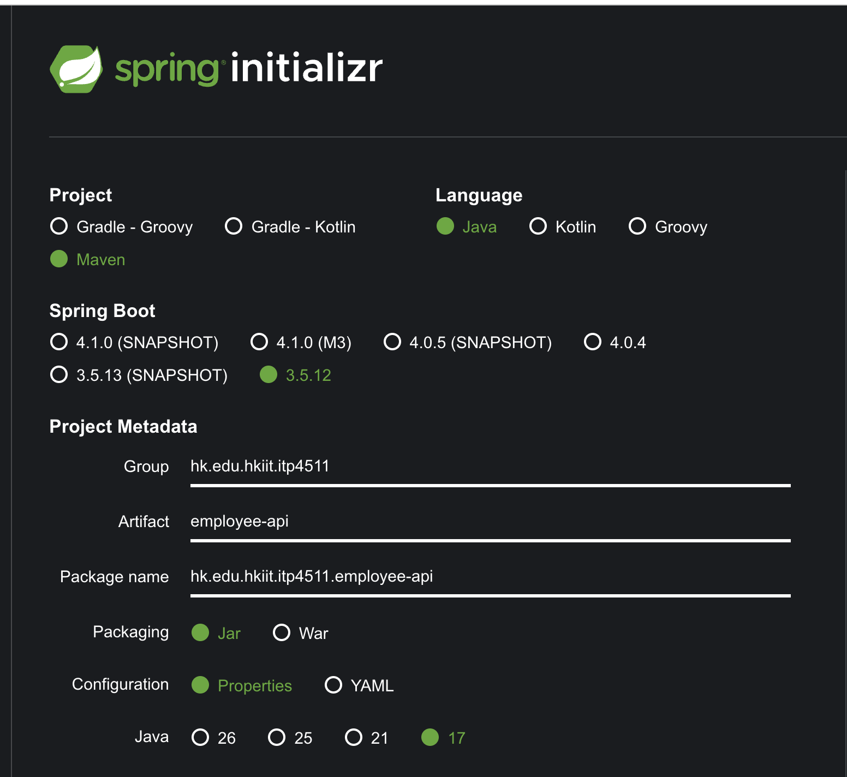
Generate the Project with Spring Initializr
go to https://start.spring.io.
Fill in the form exactly as follows: Project: Maven
Language: Java
Spring Boot: 3.5.x (latest stable)
Group: hk.edu.hkiit.itp4511
Artifact: employee-api
Name: employee-api
Description: Employee REST API with Spring MVC
Package name: hk.edu.hkiit.itp4511.employee-api
Packaging: JAR
Java: 17
https://start.spring.io/#!type=maven-project&language=java&platformVersion=3.5.12&packaging=jar&configurationFileFormat=properties&jvmVersion=17&groupId=hk.edu.hkiit.itp4511&artifactId=employee-api&packageName=hk.edu.hkiit.itp4511.employee-api&dependencies=web,data-jpa,h2

Slide 9
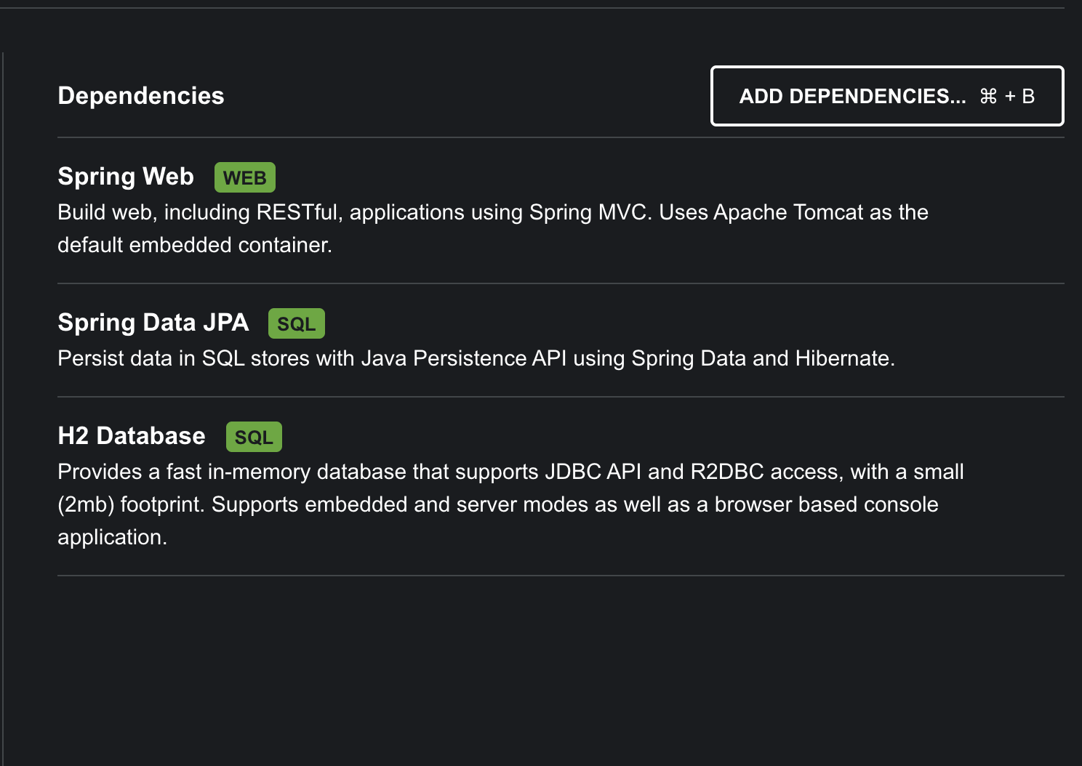
Add dependencies (search and select)
Add the following dependencies (search and select):
Spring Web
Spring Data JPA
H2 Database (in-memory database for quick testing)

Slide 10
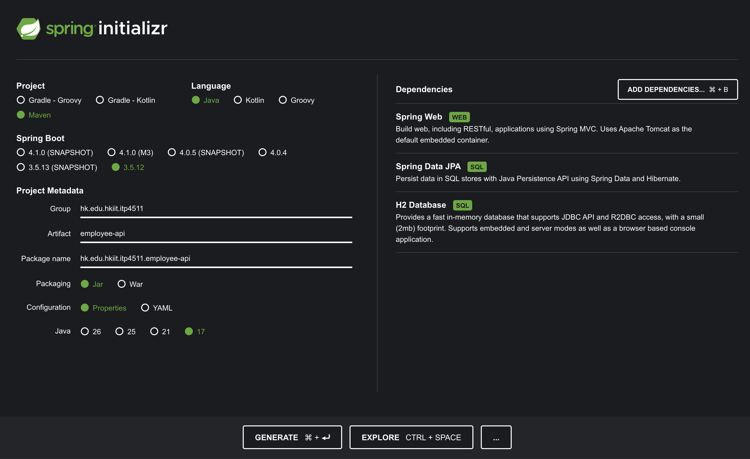
Click Generate → download and unzip the project. Open the project in your IDE.
employee-api.Zip is created

Slide 11
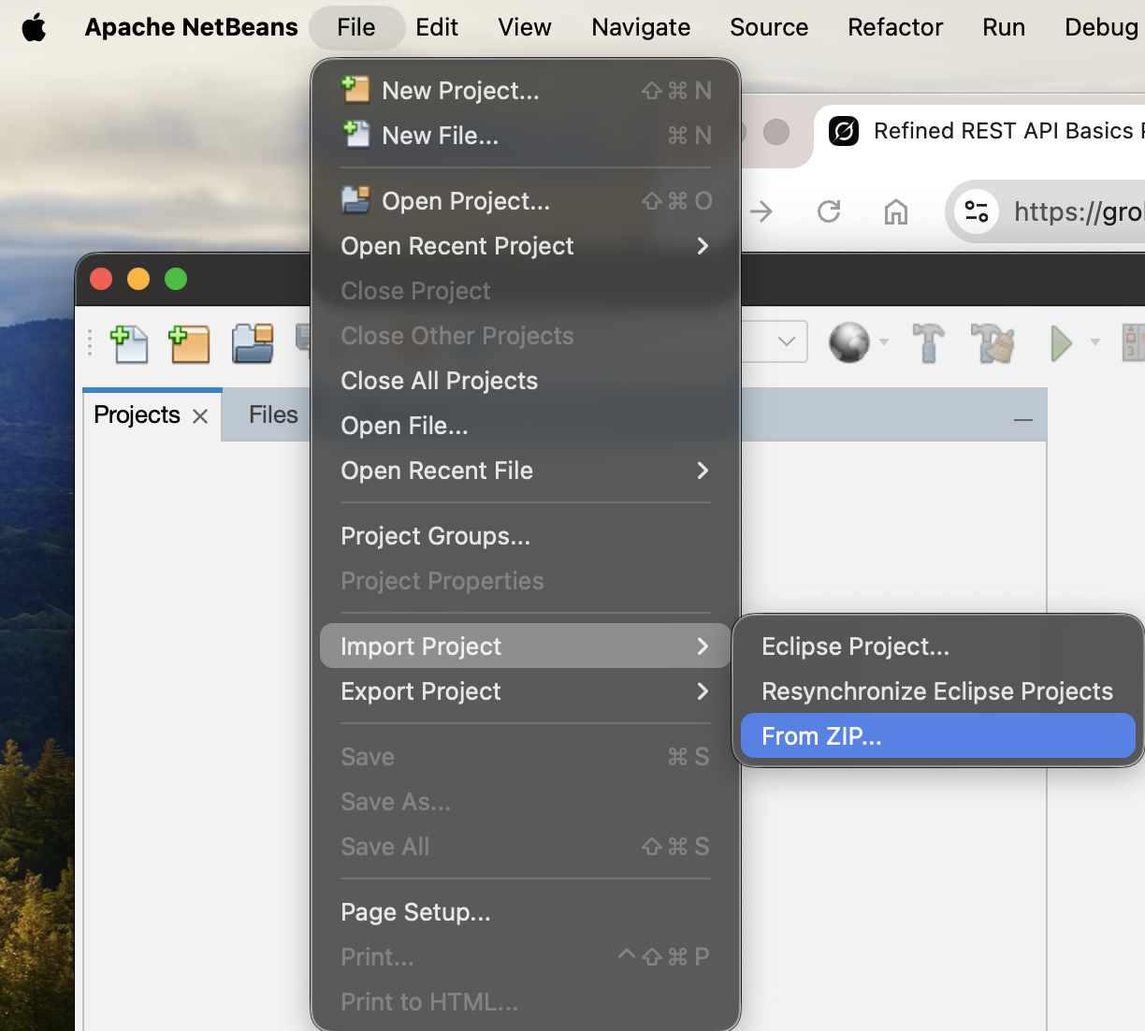
Create a new project by importing
employee-api.Zip
1 File
2. Import Project
3. Select the “employee-api.Zip”

Slide 12
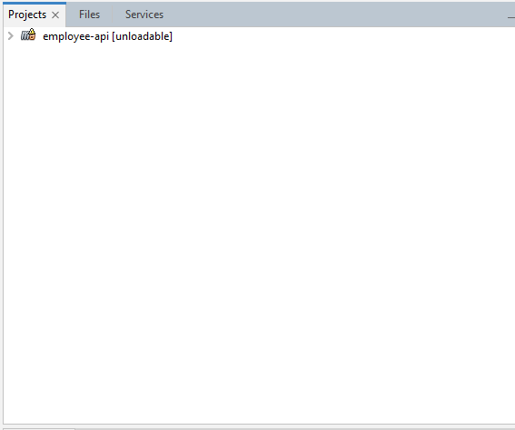
Build the project after import
When you see, unloadable
Right click the project
and select clean and build

Slide 13
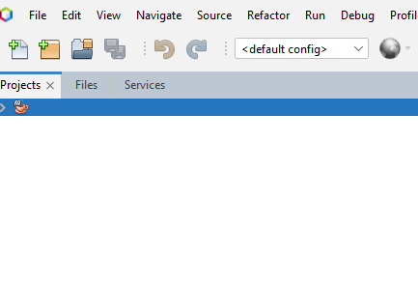
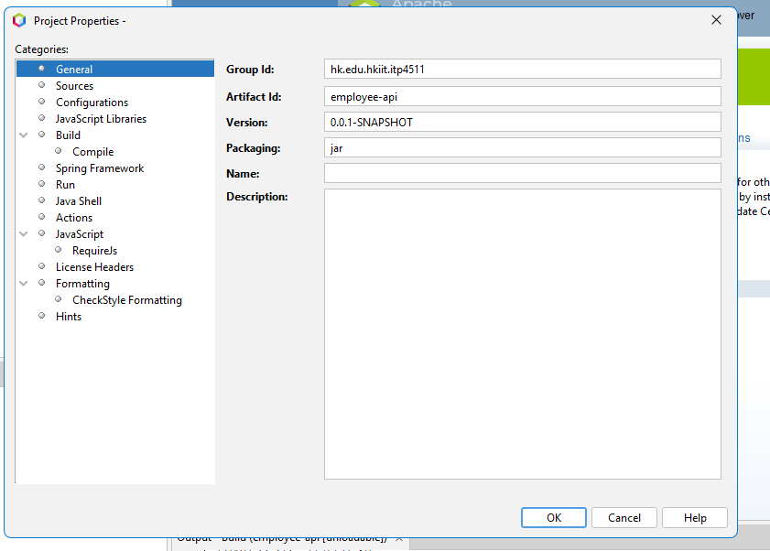
You can update the name of the project
Update the Name to “employee-api”
Right click the project
and select properties
In Gearnal, update the name of project “employee-api”

Slide 14
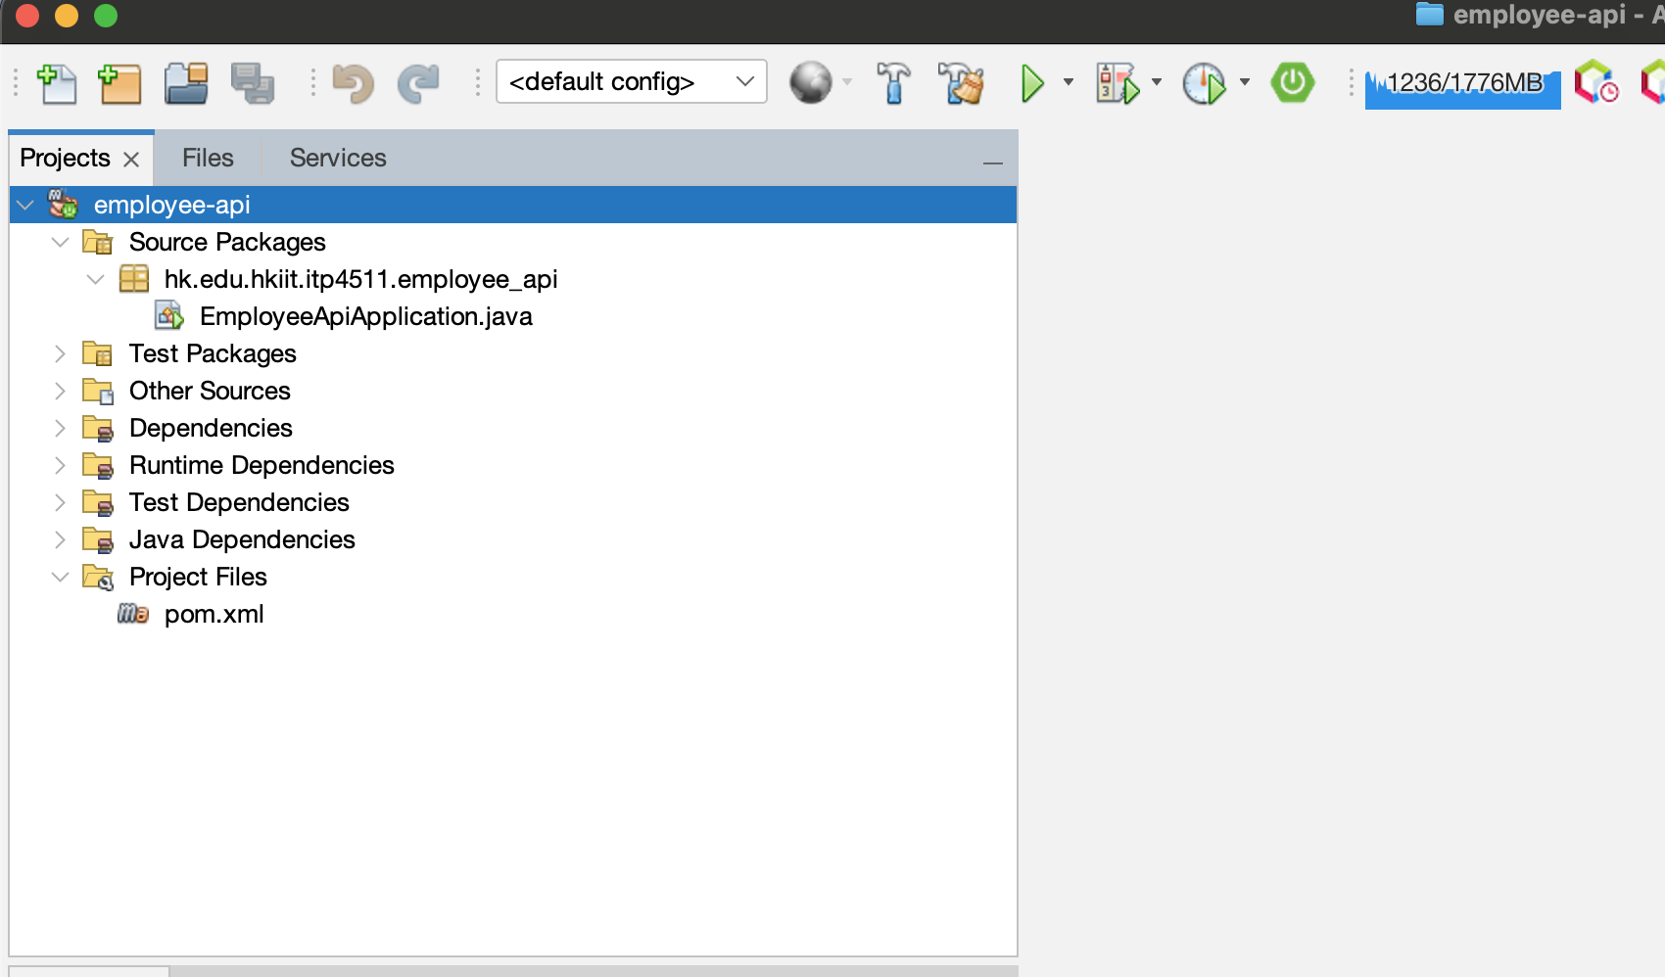
Employee-api project is imported

Slide 15
Step 2 Model Layer (Employee Entity)
Package: hk.edu.hkiit.itp4511.employee_api.model;
File: Employee.java:
package hk.edu.hkiit.itp4511.employee_api.model; import jakarta.persistence.*;
@Entity
@Table(name = "employees")
public class Employee {
@Id
@GeneratedValue(strategy = GenerationType.IDENTITY)
private Long id;
@Column(name = "first_name", nullable = false)
private String firstName;
@Column(name = "last_name", nullable = false)
private String lastName;
@Column(name = "email", nullable = false, unique = true)
private String email;
// Getters and Setters (generate in NetBeans)
}
The Model holds the application data.
@Entity and @Table map the class to a database table.
JPA annotations define the primary key and constraints.
@Id and @GeneratedValue define the primary key.
The Model holds the data.
JPA annotations map this class to a database table.

Slide 16
Step 3: Persistence Layer – Repository
Package hk.edu.hkiit.itp4511.employee_api.repository;
File: EmployeeRepository.java:
The Repository (Persistence Layer) provides CRUD operations without writing SQL.
JpaRepository supplies save(), findAll(), findById(), deleteById(), etc. @Repository enables exception translation.
package hk.edu.hkiit.itp4511.employee_api.repository;
import hk.edu.hkiit.itp4511.employee_api.model.Employee;
import org.springframework.data.jpa.repository.JpaRepository;
import org.springframework.stereotype.Repository;
@Repository
public interface EmployeeRepository extends JpaRepository<Employee, Long> {
}
JpaRepository gives us all CRUD methods for free — no SQL required.

Slide 17
Step 4: Create the Business Layer – Service
Part 1
Package: hk.edu.hkiit.itp4511.employee_api.service;
File: EmployeeService.java:
package hk.edu.hkiit.itp4511.employee_api.service;
import hk.edu.hkiit.itp4511.employee_api.model.Employee;
import hk.edu.hkiit.itp4511.employee_api.repository.EmployeeRepository;
import java.util.List;
import java.util.Optional;
import org.springframework.beans.factory.annotation.Autowired;
import org.springframework.stereotype.Service;
@Service
public class EmployeeService {
private final EmployeeRepository employeeRepository;
@Autowired
public EmployeeService(EmployeeRepository employeeRepository) {
this.employeeRepository = employeeRepository;
}
// methods continue on next slide
The Service layer contains business logic. @Service registers it as a Spring-managed bean.
@Autowired injects the repository via Dependency Injection (Inversion of Control).

Slide 18
Step 4: Create the Business Layer – Service
Part 2
public List<Employee> getAllEmployees() {
return employeeRepository.findAll();
}
public Optional<Employee> getEmployeeById(Long id) {
return employeeRepository.findById(id);
}
public Employee createEmployee(Employee employee) {
return employeeRepository.save(employee);
}
public Employee updateEmployee(Long id, Employee updatedEmployee) {
return employeeRepository.findById(id)
.map(employee -> {
employee.setFirstName(updatedEmployee.getFirstName());
employee.setLastName(updatedEmployee.getLastName());
employee.setEmail(updatedEmployee.getEmail());
return employeeRepository.save(employee);
})
.orElseThrow(() -> new RuntimeException("Employee not found"));
}
public void deleteEmployee(Long id) {
employeeRepository.deleteById(id);
}
}
The Service layer contains business logic and uses constructor injection.

Slide 19
Step 5: Presentation Layer – REST Controller
Part 1
Package: hk.edu.hkiit.itp4511.employee_api.controller;
File: EmployeeController.java:
@RestController = Controller + automatic JSON conversion (no ViewResolver needed).
@RequestMapping sets the base URI for the resource.
@GetMapping, @PostMapping, etc., are shortcuts for HTTP methods (REST uniform interface).
The DispatcherServlet (Front Controller) automatically routes every request to the correct method.
package hk.edu.hkiit.itp4511.employee_api.controller;
// import lib
@RestController
@RequestMapping("/api/employees")
public class EmployeeController {
private final EmployeeService employeeService;
@Autowired
public EmployeeController(EmployeeService employeeService) {
this.employeeService = employeeService;
}
@GetMapping
public List<Employee> getAllEmployees() {
return employeeService.getAllEmployees();
}
// methods continue on next slide
@RestController + HTTP method annotations turn this into a full REST API.
The DispatcherServlet routes every request automatically.

Slide 20
Step 5: Create the Presentation Layer – REST Controller
Part 2
@GetMapping("/{id}")
public ResponseEntity<Employee> getEmployeeById(@PathVariable Long id) {
return employeeService.getEmployeeById(id)
.map(ResponseEntity::ok)
.orElse(ResponseEntity.notFound().build());
}
@PostMapping
public Employee createEmployee(@RequestBody Employee employee) {
return employeeService.createEmployee(employee);
}
@PutMapping("/{id}")
public ResponseEntity<Employee> updateEmployee(@PathVariable Long id, @RequestBody Employee updatedEmployee) {
try {
return ResponseEntity.ok(employeeService.updateEmployee(id, updatedEmployee));
} catch (RuntimeException e) {
return ResponseEntity.notFound().build();
}
}
@DeleteMapping("/{id}")
public ResponseEntity<Void> deleteEmployee(@PathVariable Long id) {
employeeService.deleteEmployee(id);
return ResponseEntity.noContent().build();
}
}

Slide 21
Step 6 Employee Data Initializer Class
Part 1
Create package hk.edu.hkiit.itp4511.employee_api.bootstrap;
create EmployeeDataInitializer.java:
@RestController = Controller + automatic JSON conversion (no ViewResolver needed).
@RequestMapping sets the base URI for the resource.
@GetMapping, @PostMapping, etc., are shortcuts for HTTP methods (REST uniform interface).
The DispatcherServlet (Front Controller) automatically routes every request to the correct method.
package hk.edu.hkiit.itp4511.employee_api.bootstrap;
@Component
public class EmployeeDataInitializer implements CommandLineRunner {
private final EmployeeRepository employeeRepository;
@Autowired
public EmployeeDataInitializer(EmployeeRepository employeeRepository) {
this.employeeRepository = employeeRepository;
}
// methods continue on next slide
This class automatically seeds the database on startup for easy testing.

Slide 22
Step 6 Employee Data Initializer Class
Part 2
@Override
public void run(String... args) throws Exception {
System.out.println("\n=== 🚀 Loading Sample Employee Data ===");
// Clear any previous data (ensures a fresh, consistent dataset on every restart)
employeeRepository.deleteAll();
// Create a clean list of employees
Employee emp1 = new Employee();
emp1.setFirstName("Alice");
emp1.setLastName("Johnson");
emp1.setEmail("alice.johnson@example.com");
Employee emp2 = new Employee();
emp2.setFirstName("Bob");
emp2.setLastName("Smith");
emp2.setEmail("bob.smith@example.com");
Employee emp3 = new Employee();
emp3.setFirstName("Charlie");
emp3.setLastName("Brown");
emp3.setEmail("charlie.brown@example.com");
Employee emp4 = new Employee();
emp4.setFirstName("Diana");
emp4.setLastName("Prince");
emp4.setEmail("diana.prince@example.com");
// Save all employees at once
employeeRepository.saveAll(List.of(emp1, emp2, emp3, emp4));
long count = employeeRepository.count();
System.out.println("✅ Successfully loaded " + count + " sample employees into the database.\n");
}
}
@Component → Spring automatically detects and instantiates this class.
CommandLineRunner → The run() method executes automatically after the Spring Boot application context is fully loaded (but before the server starts accepting requests).
employeeRepository.saveAll(...) → Uses the JpaRepository method you already learned, demonstrating the Persistence Layer in action. deleteAll() → Guarantees a fresh dataset on every restart (ideal for development and workshop testing).

Slide 23
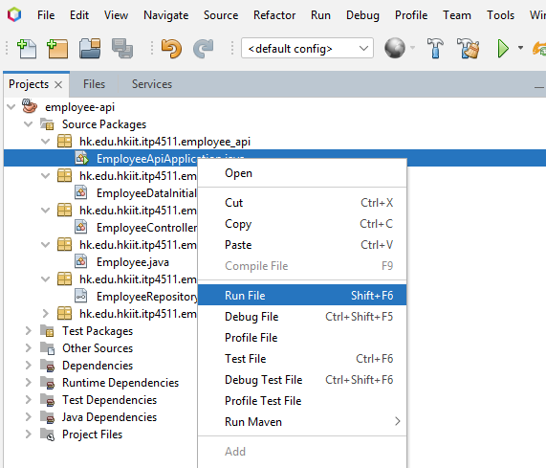
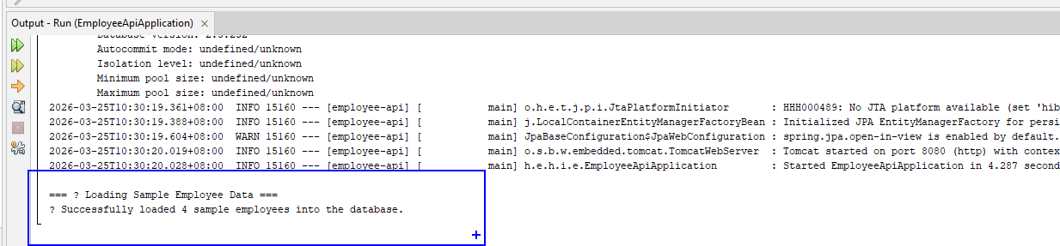
Right Click “EmployeeApiApplication” and Click “Run”
4 sample employees are created into the database

Slide 24
Step 7: Run and Test the API with Postman App
HTTP Method | URL | Body (JSON) | Expected Result
POST | http://localhost:8080/api/employees | { "firstName": "Alice", "lastName": "Smith", "email": "alice@example.com" } | created employee
GET | http://localhost:8080/api/employees | — | List of 4 employees
GET | http://localhost:8080/api/employees/1 | — | Single employee
PUT | http://localhost:8080/api/employees/1 | Updated JSON | Updated employee
DELETE | http://localhost:8080/api/employees/1 | — | 204 No Content
The entire flow (Client → DispatcherServlet → Controller → Service → Repository → H2 Database) happens automatically thanks to Spring Boot’s opinionated design.

Slide 25
Postman
Postman is a popular API platform and desktop application used by developers to build, test, document, and monitor APIs.
It simplifies the API lifecycle
by enabling users to send various HTTP requests (GET, POST, etc.) and view responses without writing extensive code.

Slide 26
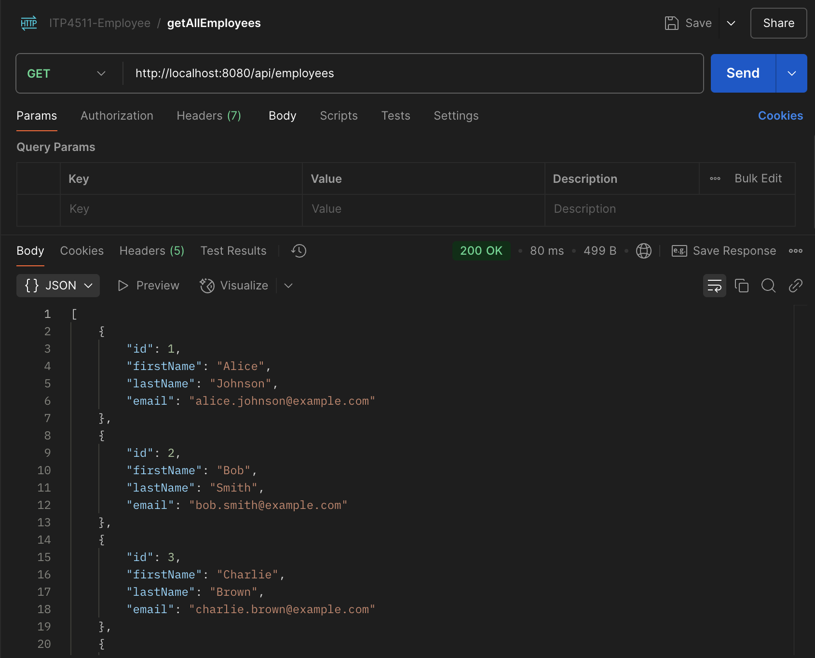
Test GET employees
Create a request and set to GET
http://localhost:8080/api/employees

Slide 27
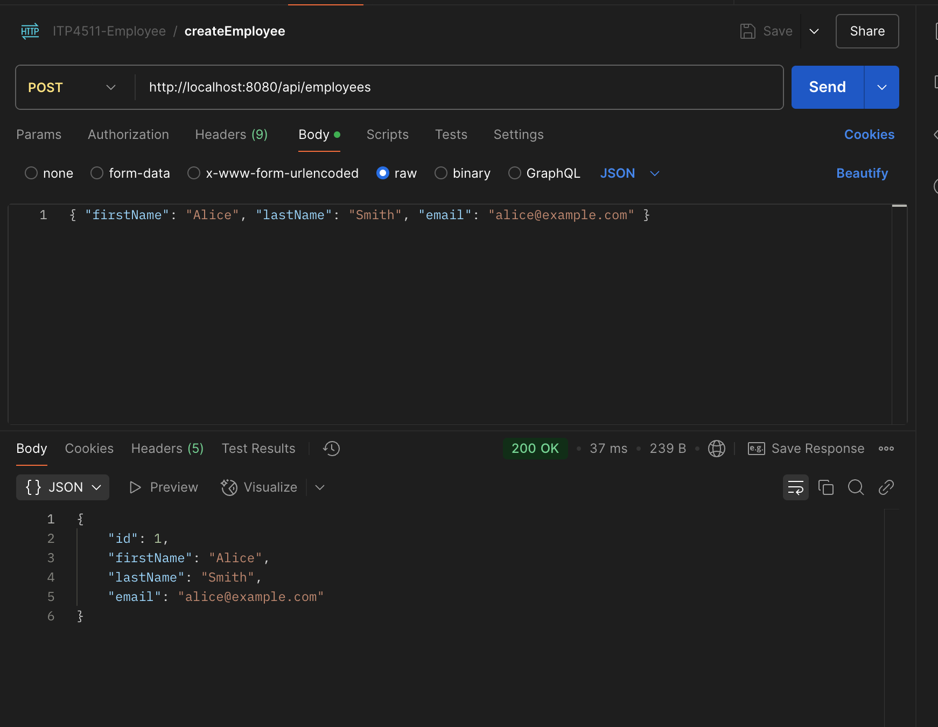
Test POST employees
Create a request and set to POST
Update Body (JSON), Add the following
{ "firstName": "Alice", "lastName": "Smith", "email": "alice@example.com" }

Slide 28
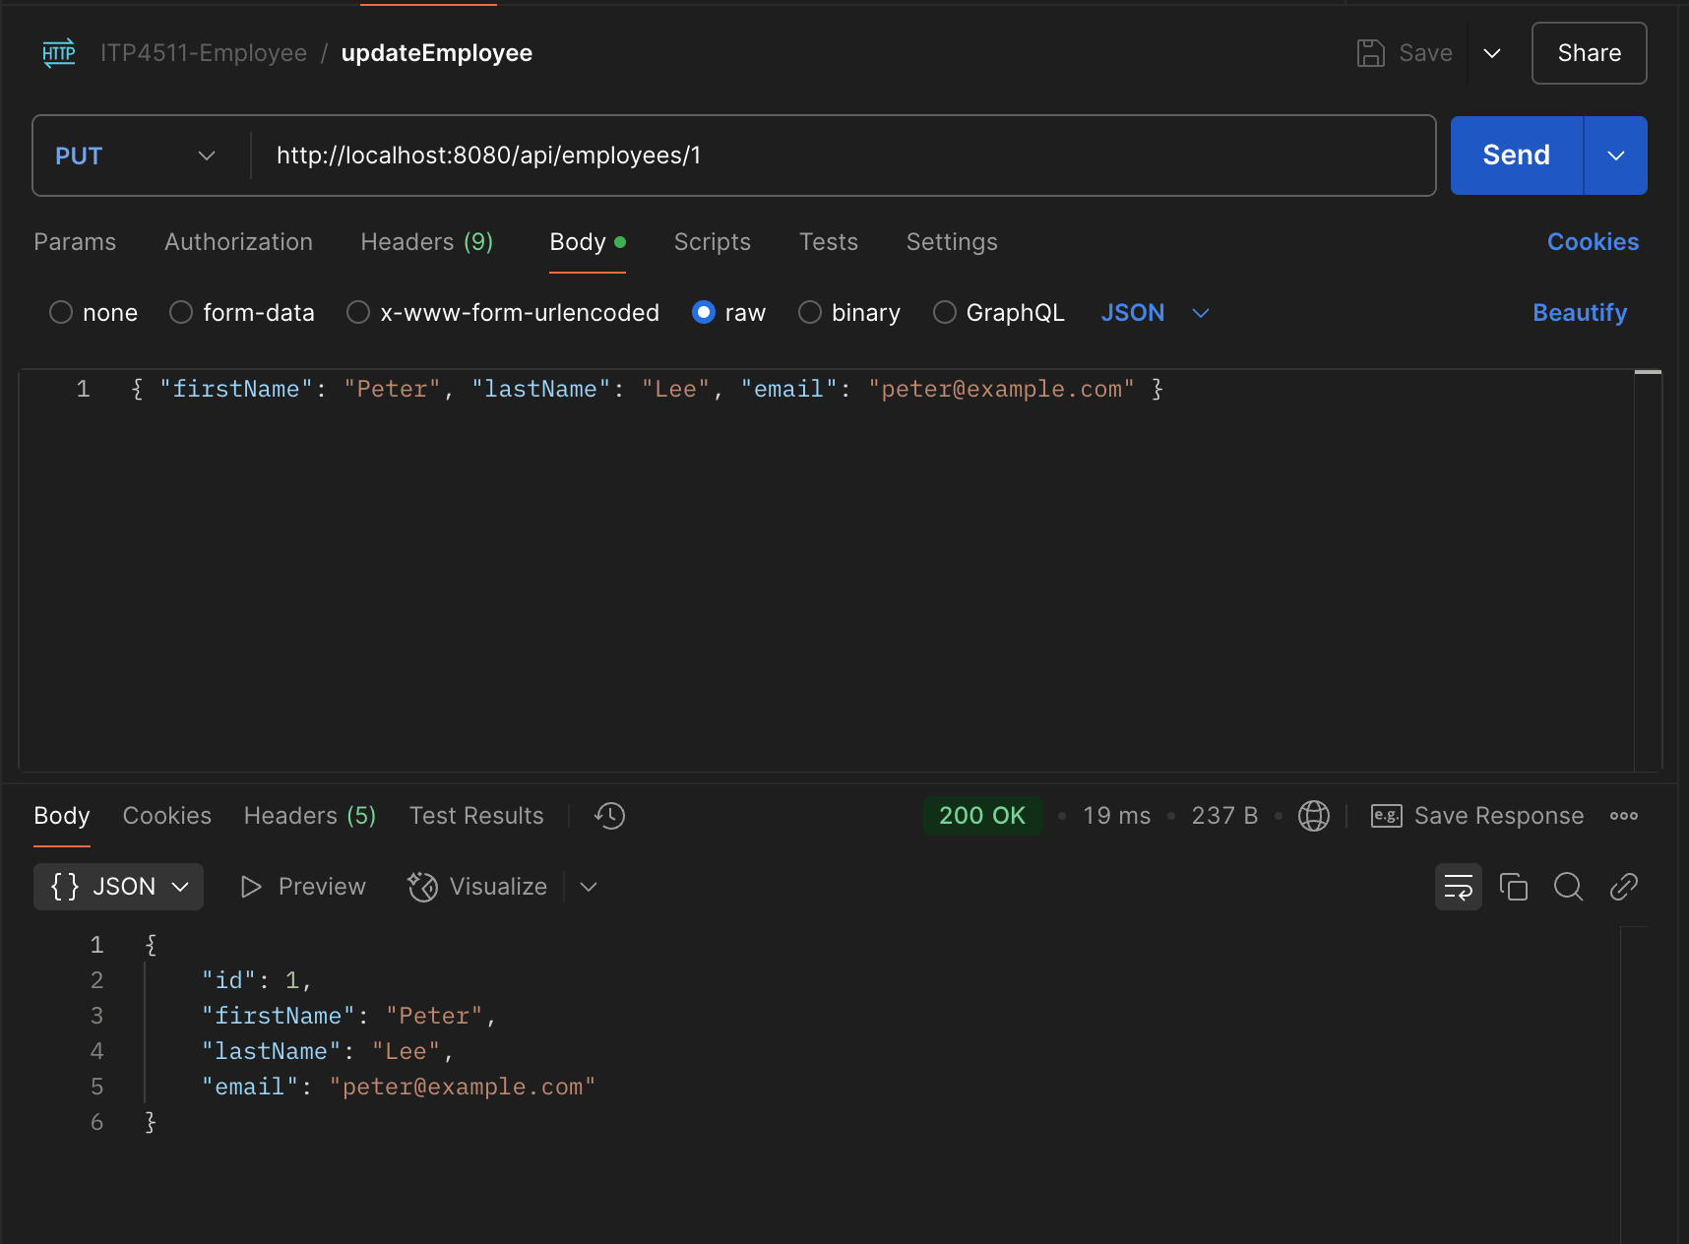
Test PUT employees
Create a request and set to PUT
Update Body (JSON), Add the following
{ "firstName": “Peter", "lastName": “Lee", "email": “peter@example.com" }

Slide 29
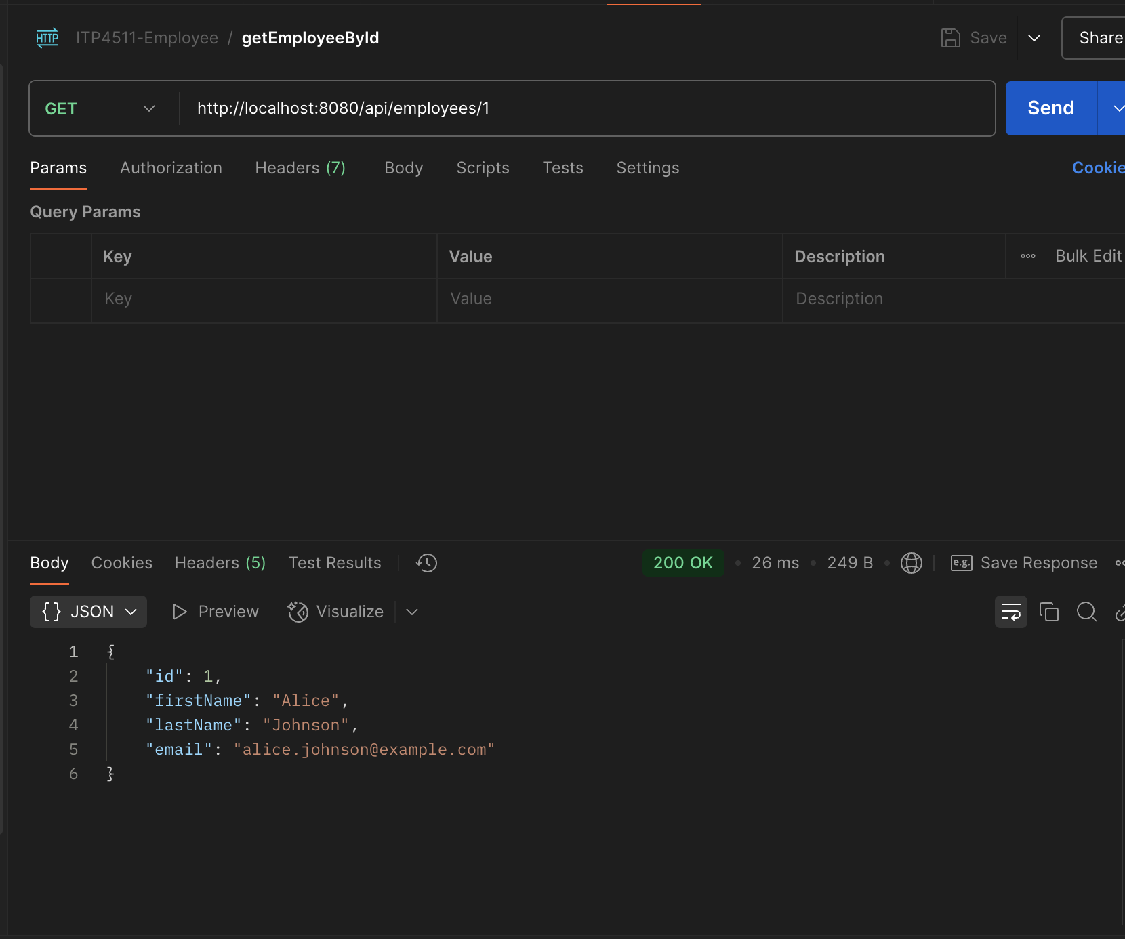
Test GET employeeById
Create a request and set to GET
http://localhost:8080/api/employees/1

Slide 30
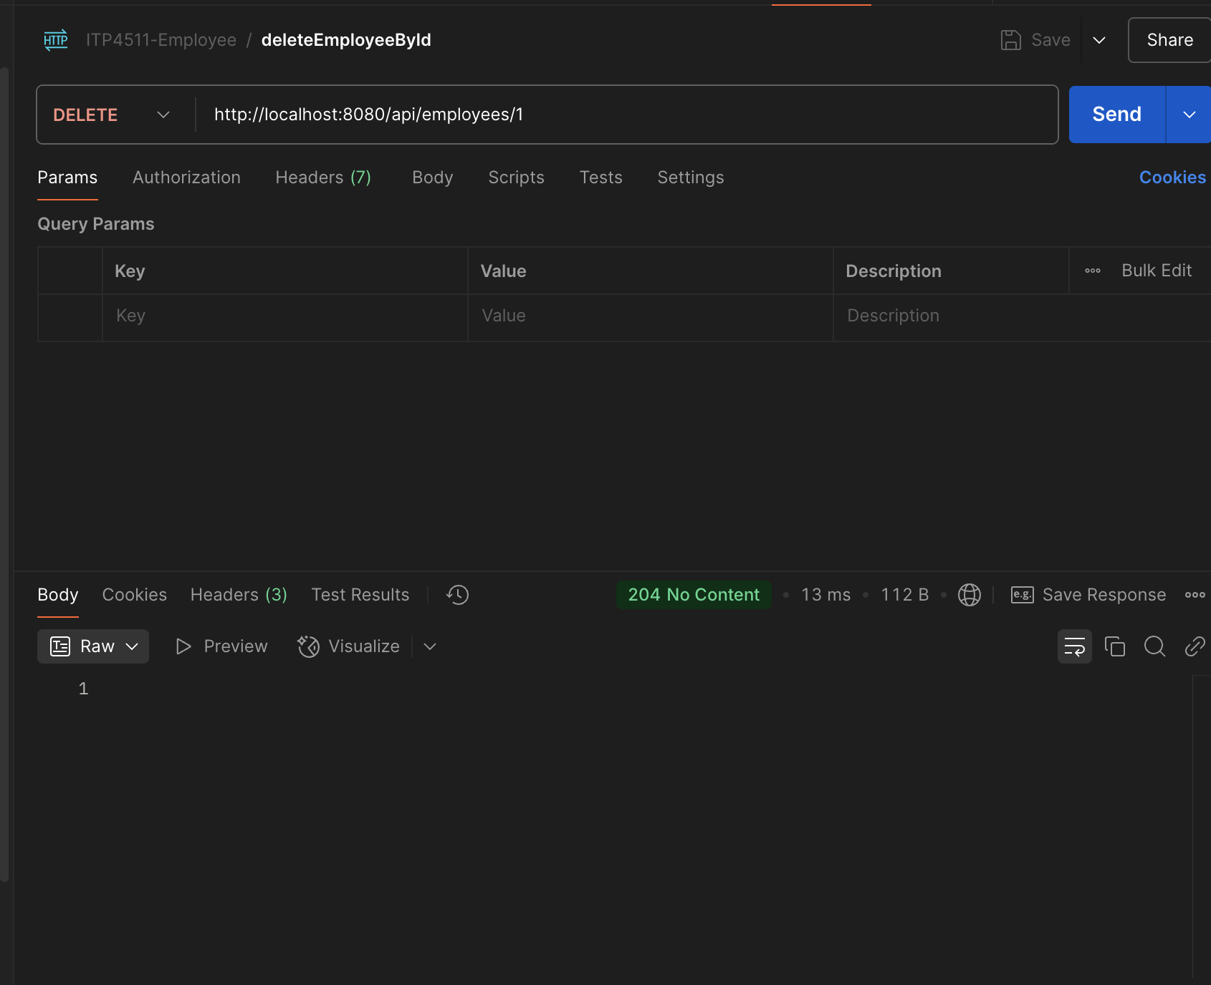
Test delete
Create a request and set to DELETE
http://localhost:8080/api/employees/1

Slide 31
HTTP Method | URL | Body (JSON) | cURL Command | Expected Result
POST | http://localhost:8080/api/employees | {"firstName": "Alice", "lastName": "Smith", "email": "alice@example.com"} | curl -X POST http://localhost:8080/api/employees -H "Content-Type: application/json" -d '{"firstName":"Alice","lastName":"Smith","email":"alice@example.com"}' | Employee created
GET | http://localhost:8080/api/employees | — | curl -X GET http://localhost:8080/api/employees | List of 4+ employees
GET | http://localhost:8080/api/employees/1 | — | curl -X GET http://localhost:8080/api/employees/1 | Single employee
PUT | http://localhost:8080/api/employees/1 | {"firstName": "Peter", "lastName": "Lee", "email": "peter@example.com"} | curl -X PUT http://localhost:8080/api/employees/1 -H "Content-Type: application/json" -d '{"firstName":"Peter","lastName":"Lee","email":"peter@example.com"}' | Employee updated
DELETE | http://localhost:8080/api/employees/1 | — | curl -X DELETE http://localhost:8080/api/employees/1 | 204 No Content

Slide 32
Workshop Summary & Q&A
You have successfully built a production-ready RESTful CRUD API using Spring Boot, JPA, and a clean layered architecture.
The DispatcherServlet automatically handles all request routing.
Testing with Postman or cURL confirms full functionality.

