Slide 1

Extending a Newton-CG Second-order Optimizer to Natural Language Processing
Bachelor’s Thesis
Author: Tao Xiang
Advisor: M. Sc. Severin Reiz and Dr. Felix Dietrich
Technical University Munich
Faculty of Informatics
11. August 2021

Slide 3
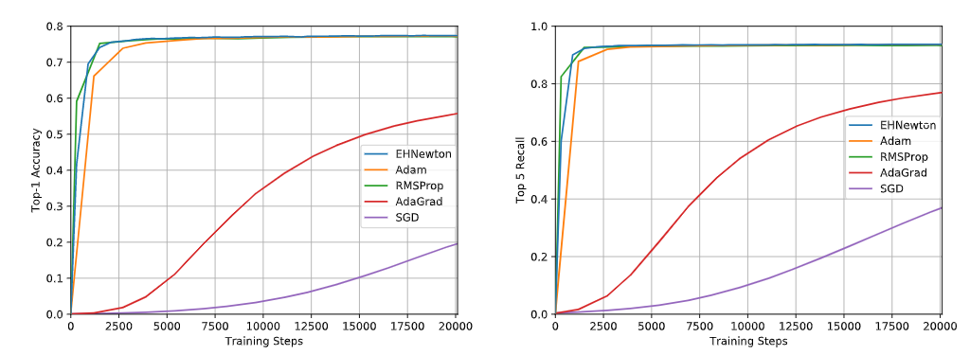
Motivation
We have a second-order optimizer proposed by Julian Suk in his master thesis [1]
In this thesis we call it Newton-CG.
It has already shown good performance compared with first-order optimizers on Image Classification problems in Mihai Zorca’s bachelor thesis [2].
We are interested in its performance on Natural Language Processing problems
In this thesis,
we continue the comparison between Newton-CG and other first-order optimizers
but focus on Movie Reviews Classification problem

Slide 4
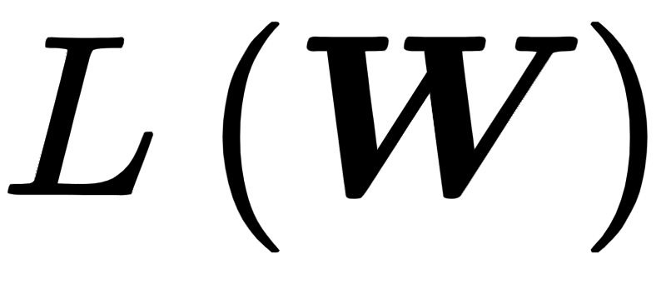
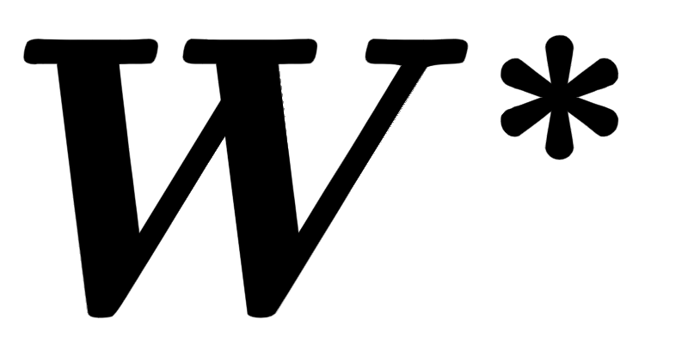
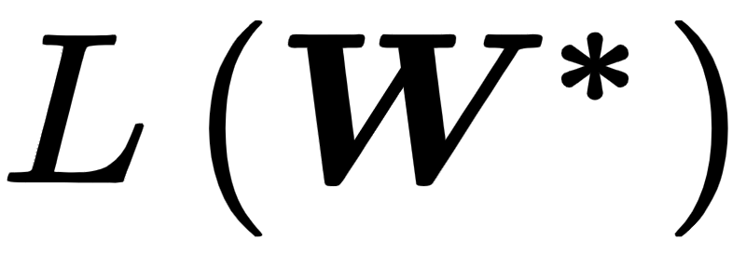
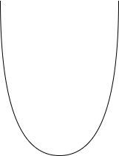
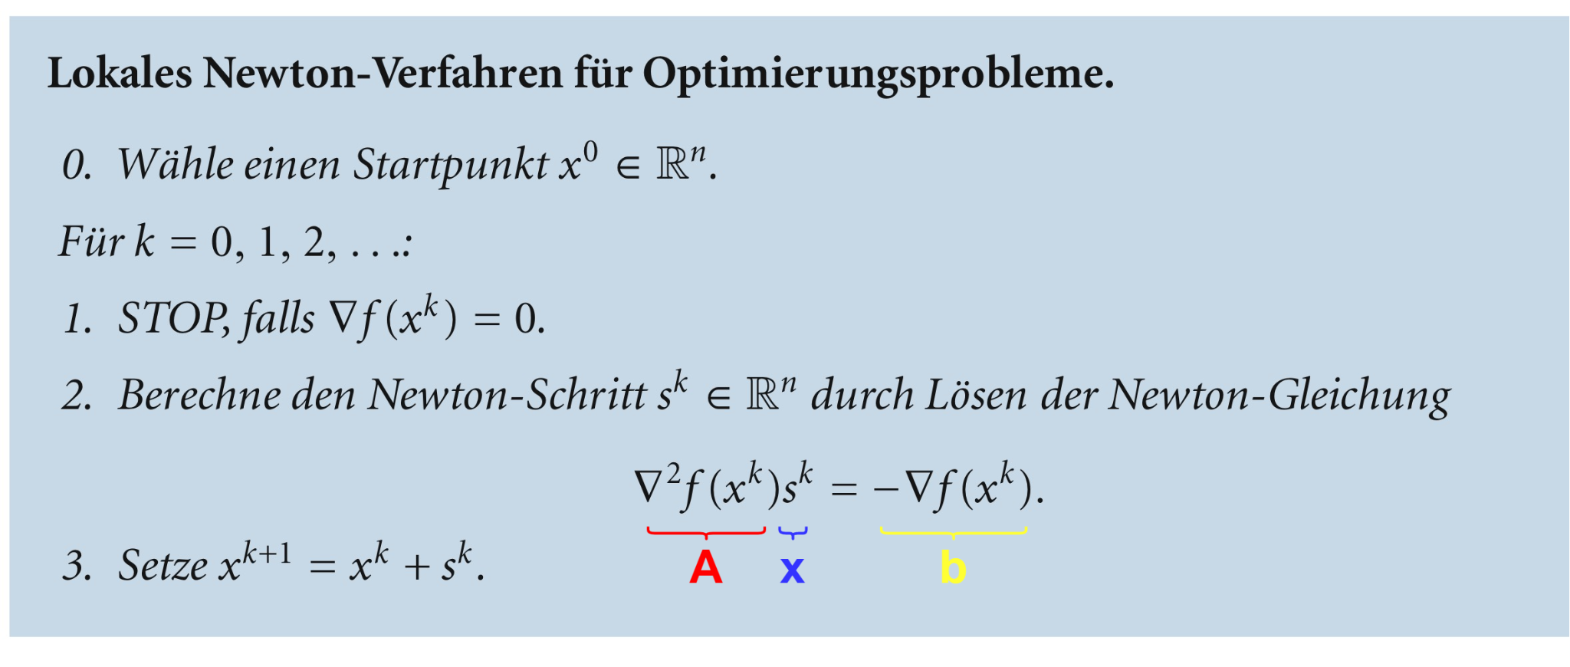
Intro to Newton’s method in optimization
The goal in deep learning: minimize the loss
find the parameters set
so that is mimimal
Local Newton’s method in optimization:
x0
x1
x2
s1
s0
Source: [3]
Normal Newton’s method has many practical problems in deep learning
⇒ Newton-CG

Slide 5
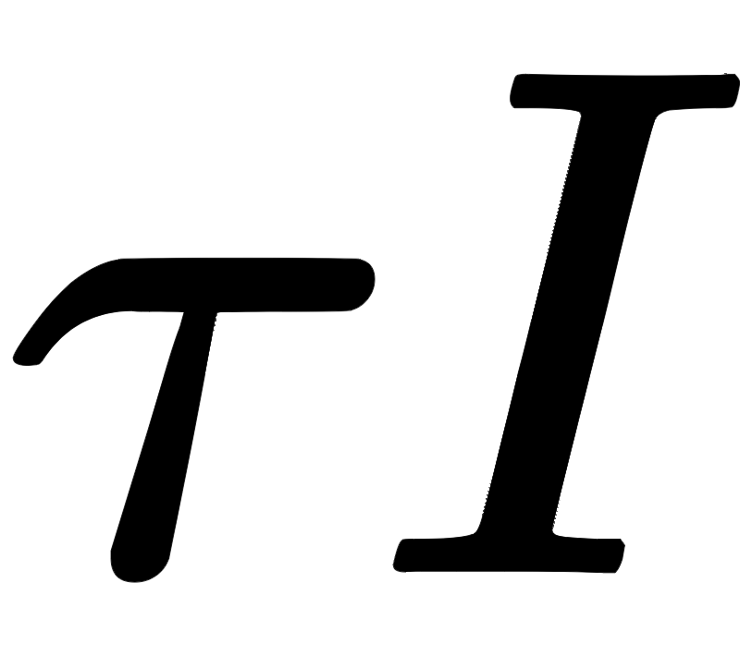

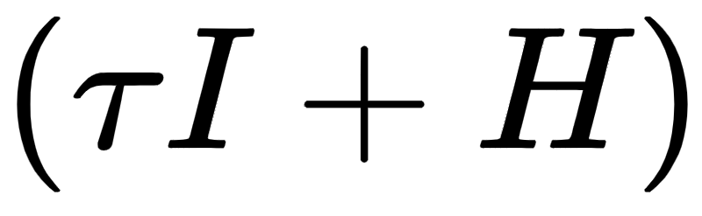

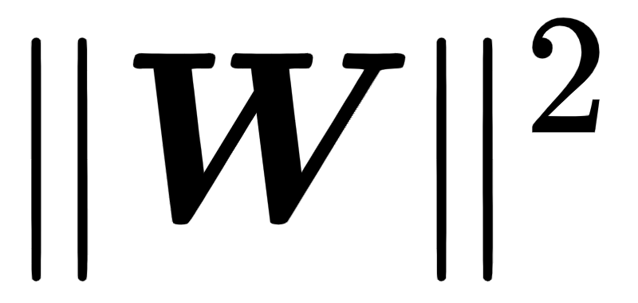
Newton-CG’s solution
Due to highly non-convex loss function,
the Hessian can be indefinite
normal Newton’s method can move in the wrong direction [4]
Newton-CG: apply damping techniques
Tikhonov regularization [5]
adding a multiple of identity matrix to Hessian
= instead of
Too expensive to solve Newton’s equation directly
simply computing the Hessian with is impratical
still need to invert the Hessian? Life is too hard! :(
Newton-CG: approximate the solution instead of solving exactly
use (linear) Conjugate Gradients method
more details in paper!

Slide 6

IMDB Movie Reviews Classification
IMDb
an acronym for “Internet Movie Database”
an online database of information related to films, television programs, etc.
have 50K movie reviews
good for natural language processing or text analytics.
Movie Reviews Classification
The movie reviews can be classified as either positive or negative.
positive review example: “This movie is awesome!”
negative review example: “This movie is so boring.”
typic binary/two-class classification problem

Slide 7
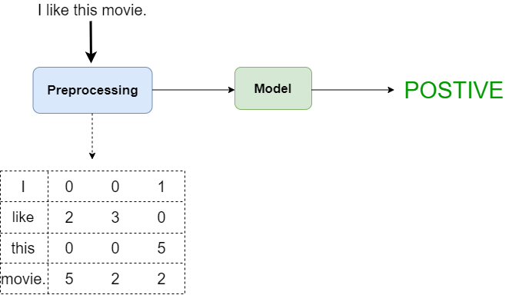
Implementation Overview
Preprocessing includes
tokenization
word embedding
Model includes
Recurrent Neural Network (RNN)
Self-Attention Network

Slide 8
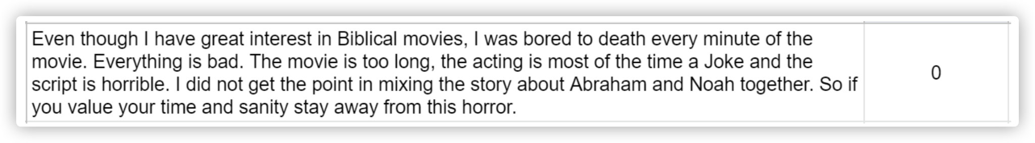
Dataset
Downloaded from Kaggle
totally 45K movie reviews, split into training and validation set
40K movie reviews in training set
5K movie reviews in validation set
A sample movie review and its label from the dataset.

Slide 9
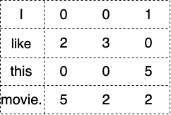
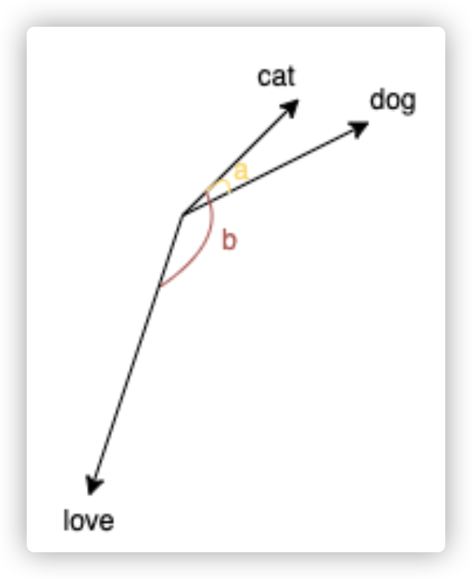
Text Preprocessing
Raw sentences can not be fed to the model directly
need to first transform them into vectors/matrix
An example:
Tokenization
split the sentence into a list of words
e.g. “I like this movie.” ⇒ [“I”, “like”, “this”, “movie”]
Word Embedding
transform each word in the sentence into a vector
All the vectors have equal length
words with similar meanings have “closer” vectors
...
cosa < cosb, meaning cat and dog are more similar in meaning

Slide 10
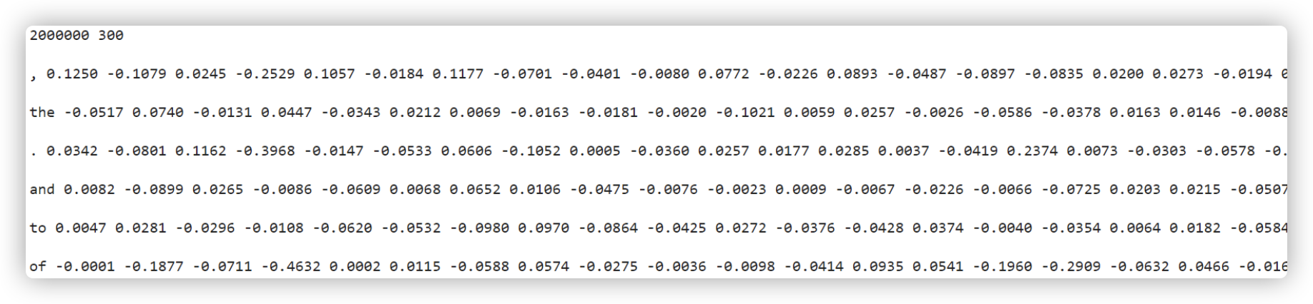
Word Embedding cont.
Word embeddings are important in the performance of NLP tasks [6].
People can train a word embedding layer
not main task in this thesis
we use a pretrained english-word-embedding system
source: fastText
trained on Common Crawl and Wikipedia
contains totally 2000000 words and their corresponding vectors
each of length 300
A snippet of the word embeddings. The first line contains the total number of words/vectors and the length of each vector. Starting from the second row, the first column of each row represents the word, and the following columns are the corresponding vector.

Slide 11
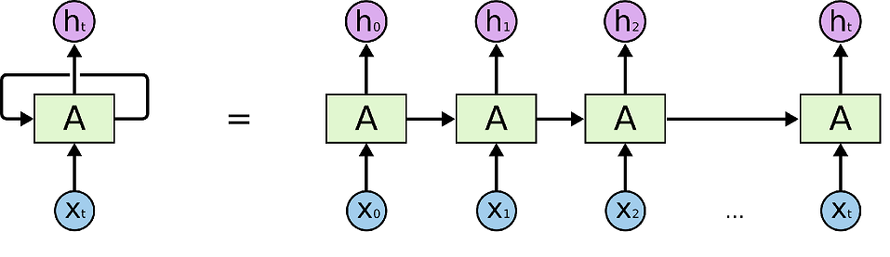
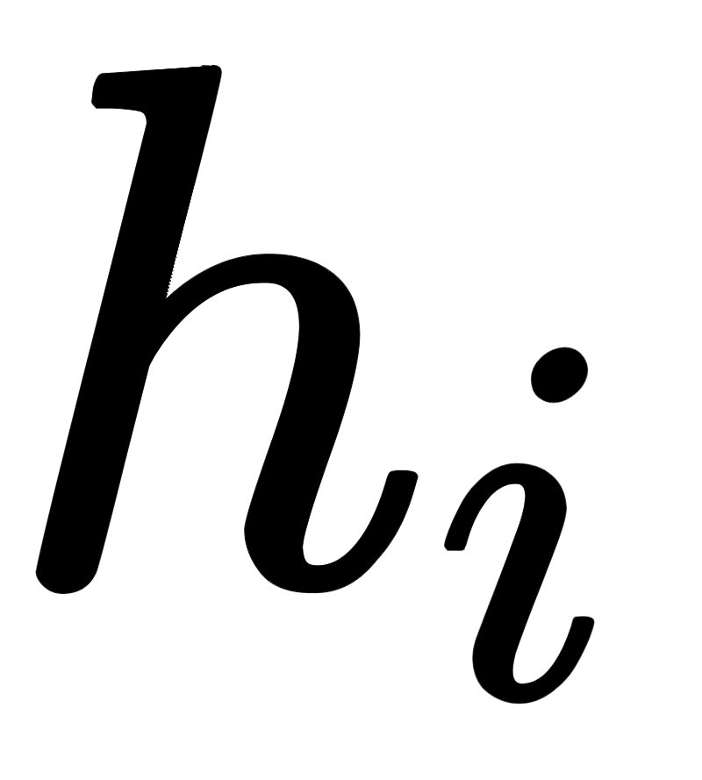
Model: Recurrent Neural Network
Artificial Neural Networks with recurrent connections
Rolled RNN (Left) and unrolled RNN (right). Source: link
can deal with sequential data, such as text
at each time step RNN outputs a hidden state
functions as the memory of RNN and stores the information of previous tokens
at each time step RNN takes the next token and the last hidden state as input
use previous information to predict the next hidden state

Slide 12
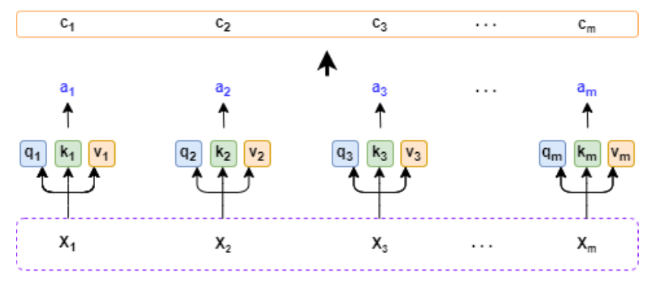
Model: Self-Attention Network
A part of Transformer [7] (“Attention is All You Need”)
not Seq2Seq
not recurrent
Structure of Self-Attention layer.
computes a Context Vector for each token
indicates the corelation between the token and the prediction
e.g. “interesting” is more important than “movie” regarding the prediction

Slide 13
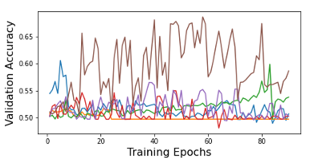
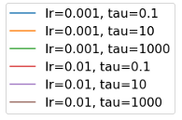
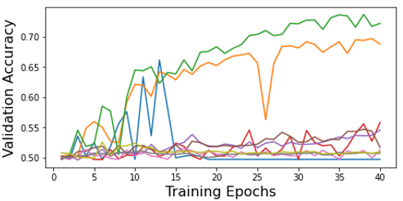
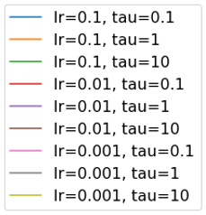
Result 1 - Parameter Search
Find suitable hyperparameters for the optimizers
learning rate
tau (Tikhonov regularization factor)
Comparison of Newton-CG’s hyperparameter configurations on RNN model (left) and Self-Attention model (right).
trained models using Newton-CG with several different hyperparameter conifgurations
pick the one with the best performance
“brown” configuration for RNN model
“green” configuration for Self-Attention model
same for other first-order optimizers

Slide 14
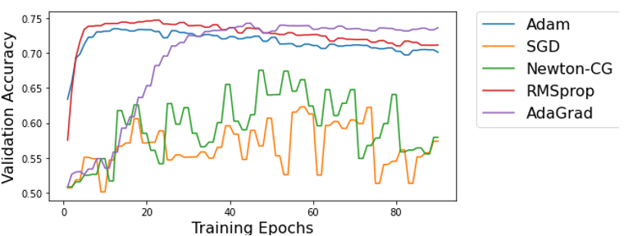
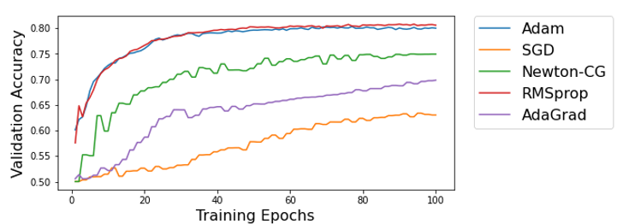
Result 2 - Optimizer Comparison
Comparing Newton-CG with other optimizers
Comparison of Newton-CG and other optimizers on RNN model (left) and Self-Attention model (right).
Newton-CG showed much better performance on Self-Attention model
outclassed AdaGrad and SGD
much more stable
acceptable validation accuracy (75%)
was only better than SGD on RNN model
unstable

Slide 15
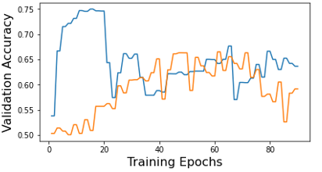

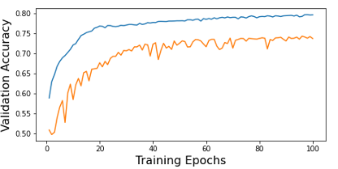
Result 3 - Adam Pretraining
Newton-CG with Adam pretrained
Comparison of pure Newton-CG and Newton-CG with Adam pretrained on RNN model (left) and Self-Attention model (right).
pretraining: use Adam for the first 20 epochs then use Newton-CG
advised by Julian Suk in his master thesis [1]
with Adam pretrained Newton-CG showed better performance on Self-Attention model
higher accuracy (nearly 80%)
more stability
no big improvement on RNN model

Slide 16
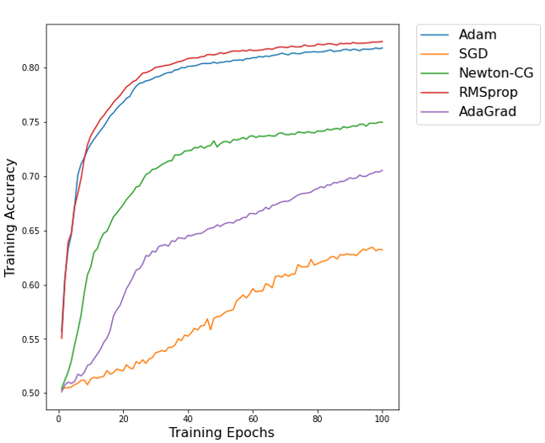
Conclusion
In this thesis:
continued the comparison between Newton-CG and other first-order optimizers
but on NLP problems
implemented two neural network models
RNN model
Self-Attention model
Newton-CG:
Acceptable performance on Self-Attention model
not so good for recurrent neural networks

Slide 17
Reference
[1] J. Suk. Application of second-order optimisation for large-scale deep learning. Master's thesis, Technical University of Munich, Munich, 2020.
[2] Mihai Zorca. Training Deep Convolutional Neural Networks on the GPU Using a Second-Order Optimizer. Bachelor's thesis, Technical University of Munich, Munich, 2020.
[3] Michael Ulbrich and Stefan Ulbrich. Nichtlineare Optimierung, 2012
[4] J. Martens. Second-order optimization for neural networks. Ph.D. dissertation, Univer-sity of Toronto, 2016.
[5] A. N. Tikhonov and V. Y. Arsenin. Solutions of ill-posed problems. Wiley, page pp. 1{30, 1977.
[6] Edouard Grave, Piotr Bojanowski, Prakhar Gupta, Armand Joulin, and Tomas Mikolov. Learning word vectors for 157 languages. In Proceedings of the International Conference on Language Resources and Evaluation (LREC 2018), 2018.
[7] Ashish Vaswani, Noam Shazeer, Niki Parmar, Jakob Uszkoreit, Llion Jones, Aidan N. Gomez, LukaszKaiser, and Illia Polosukhin. Attention Is All You Need. arXiv:1706.03762 [cs.CL], 2017.

Slide 18
Thanks for watching!

