Slide 1
My proposal
Meeting 2

Slide 2
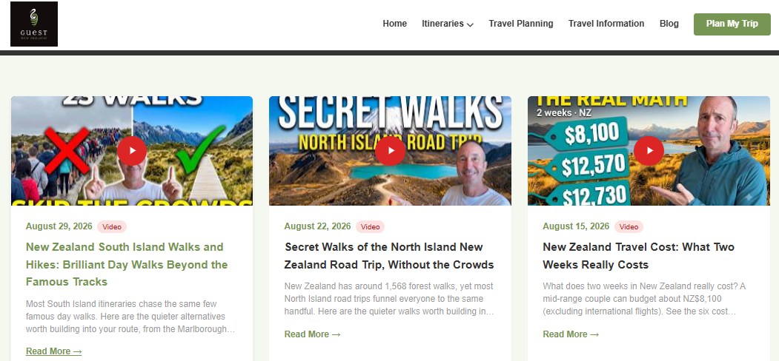
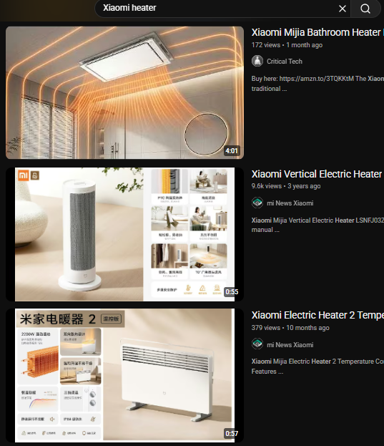
网页设计风格
方案1: block
方案2: list
方案1：图片大
方案2：文字内容具体，图片显示数量多。

Slide 3
Next Step
Improve design
Architecture Design
Presentation of Architecture Design

