Slide 1
My proposal
Meeting 1

Slide 2
The following web pages are available for reference.
First Light Travel: https://www.firstlighttravel.com/
New Zealand Travel Planning: https://guestnewzealand.com/
Akira Sato: https://www.framer.com/marketplace/templates/akira-sato/?utm_source=mstore&via=usemuzli

Slide 3
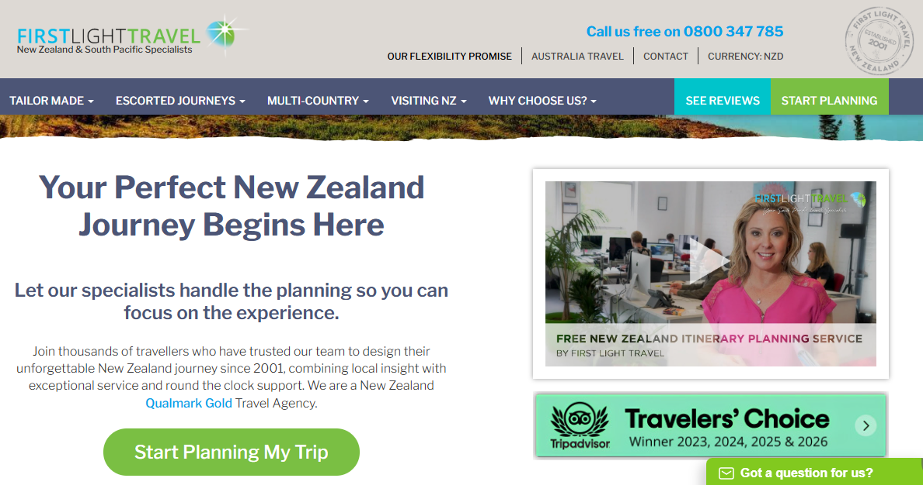

https://www.firstlighttravel.com/
First Light Travel
Option 1
Self introduction page (top nav bar)
Log in button (两种权限）
账号登陆

Slide 4
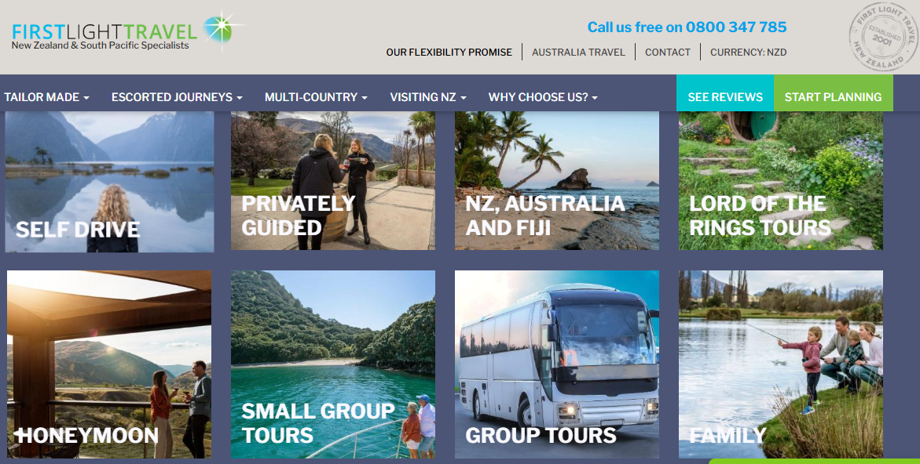
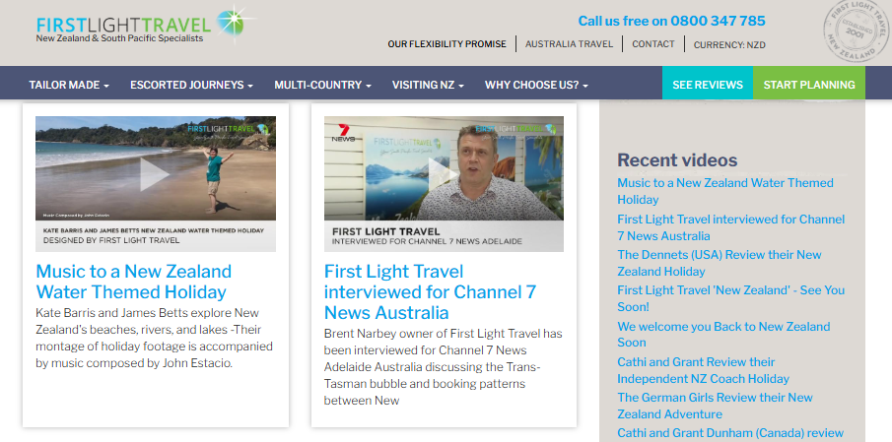
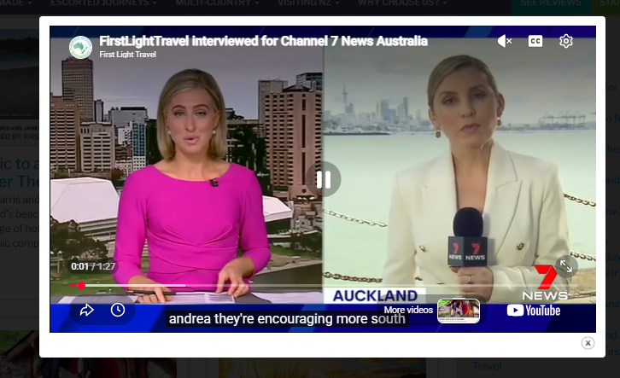





新西兰自驾游、中国自驾游、中国火车出行 各做一个页面
You can choose time ascending or descending
点击Video Gallery进入
https://www.firstlighttravel.com/new-zealand-video-gallery
Click to play video

Slide 5
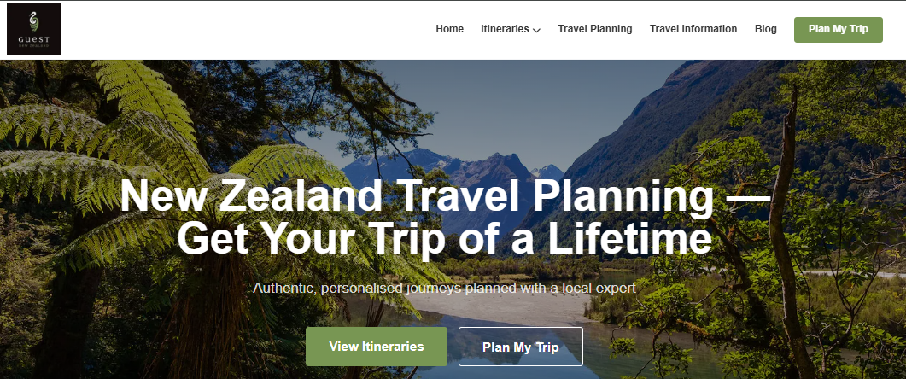
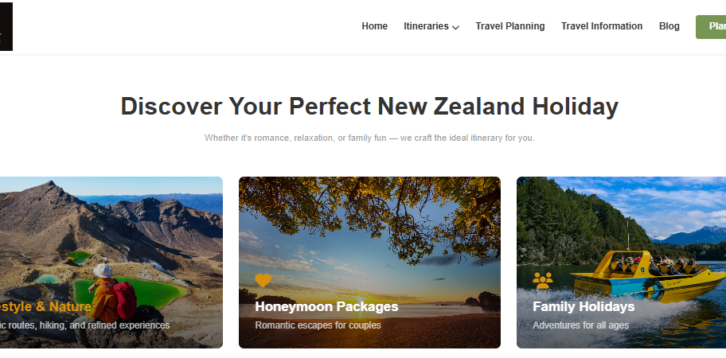
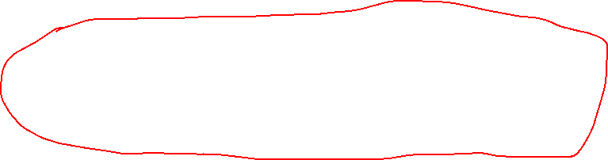

https://guestnewzealand.com/
New Zealand Travel Planning
Home Page
Option 2
Home page
NZ drive tours
China drive tours
China train travelling
Summary
五个页面的hyperlink放在top-nav bar

Slide 6
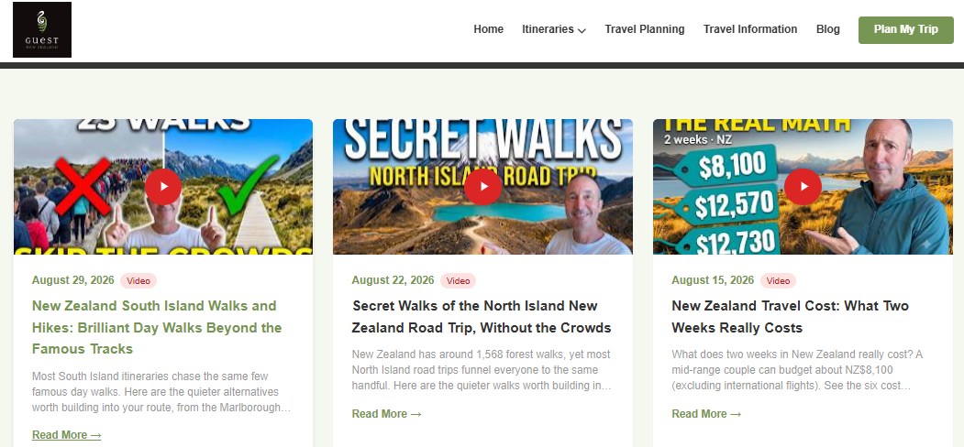


Top-nav bar button clicked into
You can choose time ascending or descending
视频介绍
点击Blog进入https://guestnewzealand.com/new-zealand-travel-blog

Slide 7
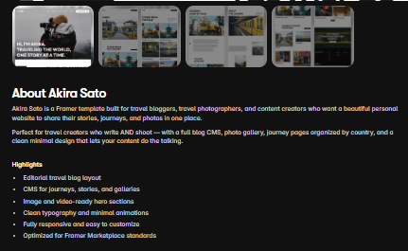
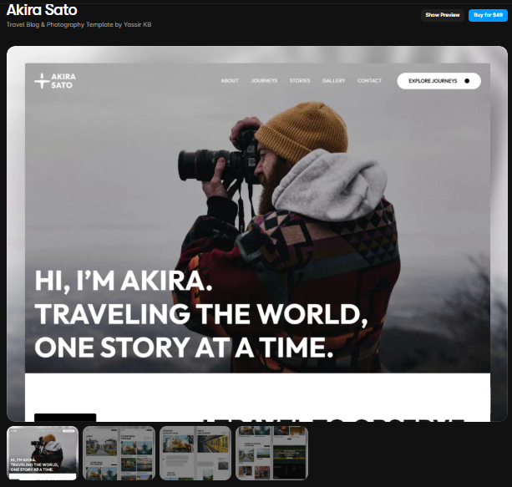




https://www.framer.com/marketplace/templates/akira-sato/?utm_source=mstore&via=usemuzli
Akira Sato
Option 3
Log in button (两种权限）
账号登陆
Heading nav
You can choose time ascending or descending
不要黑背景，改成绿的
Introduction
Home page
NZ drive tours
China drive tours
China train travelling
Summary
五个页面的hyperlink作为图片放在nav-bar

Slide 8
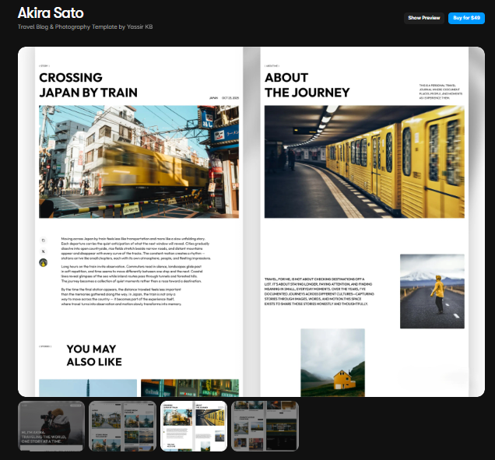
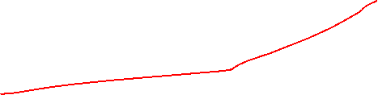



比方说该页面是新西兰自驾游
该视频播放
该视频介绍

Slide 9
最终结果
Option 2

