Slide 1
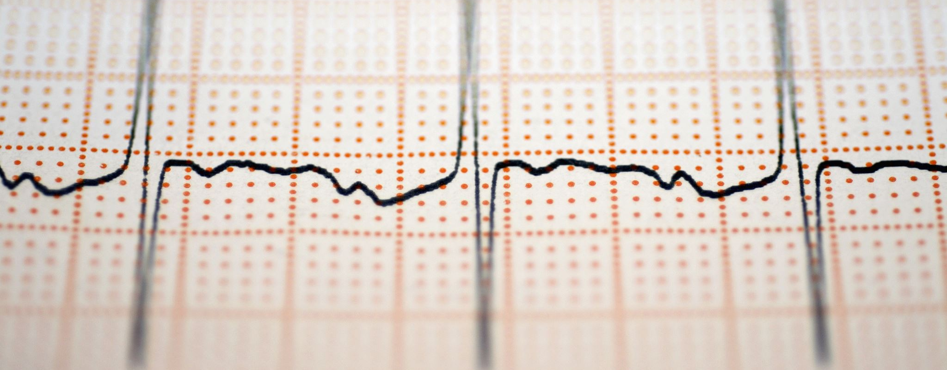
ECG DATA Investigation

Slide 2
To reduce processing time and able to detect real time the signals timely and accurately as possible
ECG SIGNALS specifically for RTOS applications (.dat, .mat,.ecg)
ECG DTATS

Slide 3
Data Source | Number of classes | Class type | Data file types | Header file type | Extra Feature
Normal Sinus Rhythm RR Interval Database | 1 | Normal sinus rhythm | .ecg | .hea | -
MIT-BIH Arrhythmia Database | 1 | Arrhythmia | .dat | .hea | -
PTB Diagnostic ECG Database | 9 | Myocardial infarction, Cardiomyopathy/Heart failure, Bundle branch block, Dysrhythmia, Myocardial hypertrophy, Valvular heart disease, Myocarditis, Miscellaneous, Healthy controls | .dat | .hea | Classify buy patient number
PTB-XL | 6 | Anterior Lateral, Myocardial, Ishemia, Left Ventricular Hyprotrophy, Normal ECG, BBB | .dat | .hea | Classify buy patient number
Shaoxing and Ningbo Hospital ECG Database | 2 | Normal sinus rhythm, Abnormal | .mat | .hea | -
The Apnea-ECG database | 2 | Apnea , Non-apnea | .dat | - | -
MIT-BIH Supraventricular Arrhythmia Database | 1 | Arrhythmia | .dat | .hea | -
Normal-Sinus-Dataset | 1 | Normal sinus rhythm | .mat | .hea | -
Georgia 12-Lead ECG Challenge Database | 2 | Normal, Abnormal | .mat | .hea | -

Slide 4
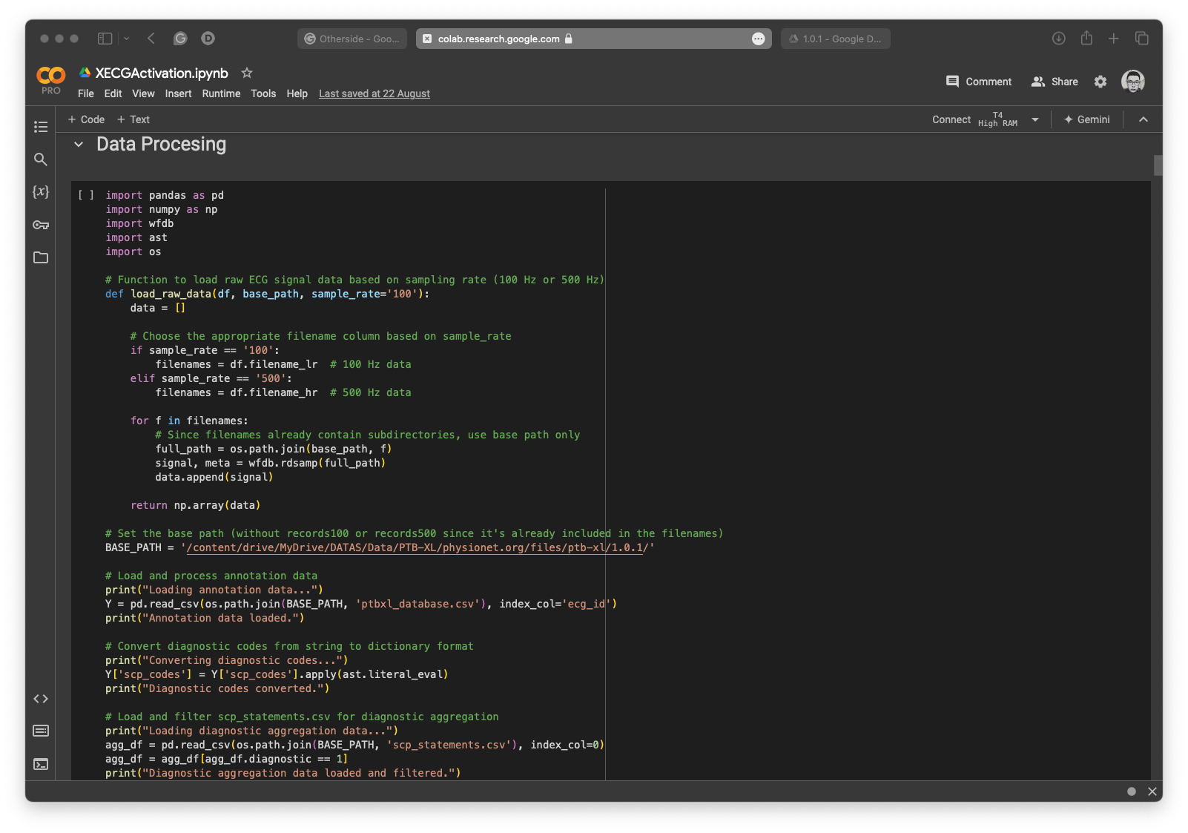
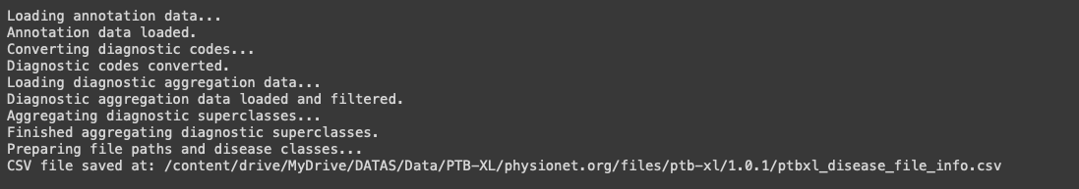
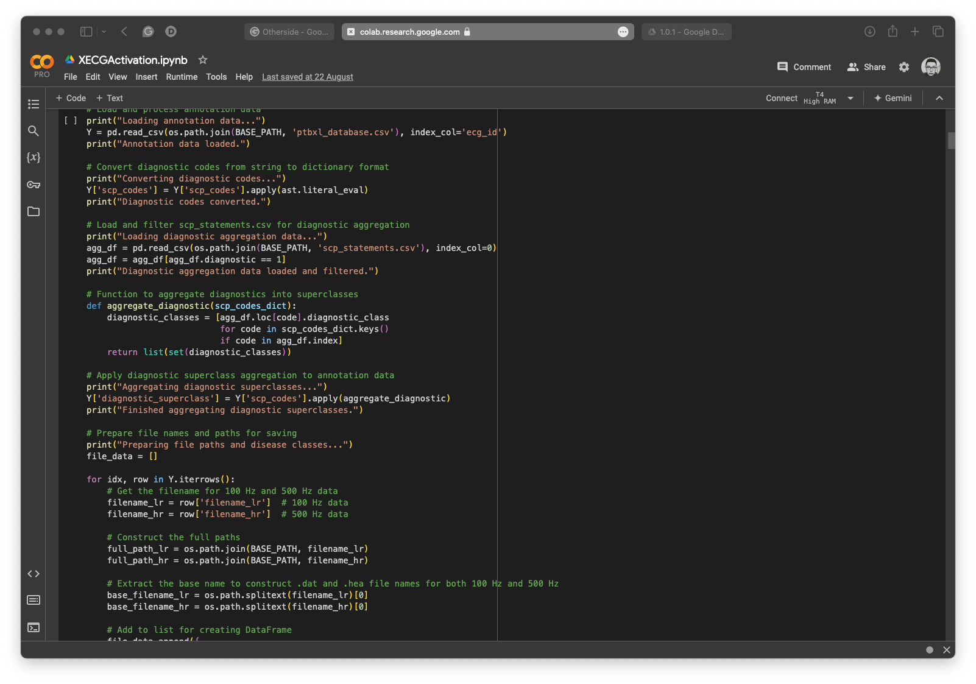
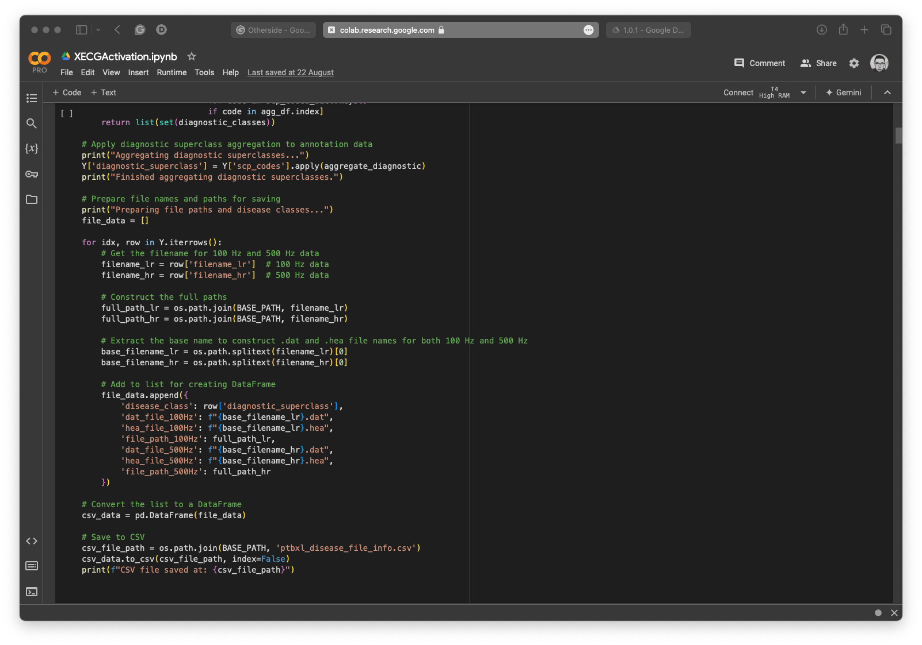
Extracting diseases and classes from original .csv files

Slide 5
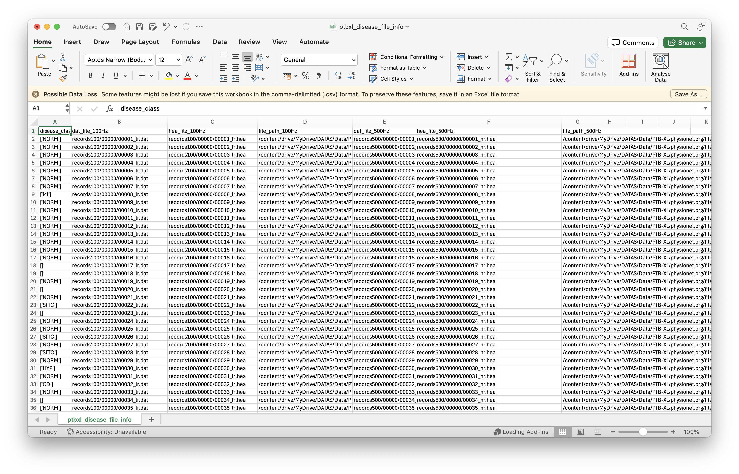

Slide 6
DATA sources
https://www.physionet.org/content/nsr2db/1.0.0/
https://www.physionet.org/content/mitdb/1.0.0/
https://www.physionet.org/content/ptbdb/1.0.0/
https://www.ncbi.nlm.nih.gov/pmc/articles/PMC7967244/
https://physionet.org/content/ptb-xl/1.0.1/
https://physionet.org/content/svdb/1.0.0/
https://www.nature.com/articles/s41597-020-0386-x
https://www.kaggle.com/datasets/ecerulm/apneaecg

Slide 7
Paper sources
https://www.ncbi.nlm.nih.gov/pmc/articles/PMC7967244/
https://www.youtube.com/watch?v=jnxqHcObNK4&list=PLi1abCnCq224TYxWPXNi-nK8Wr3gIdwO8&index=7
https://www.youtube.com/watch?v=FG7__Baq9Ok&list=PLi1abCnCq224TYxWPXNi-nK8Wr3gIdwO8&index=8
https://www.youtube.com/watch?v=09rfD2Du_xg&list=PLi1abCnCq224TYxWPXNi-nK8Wr3gIdwO8&index=15

