Slide 1
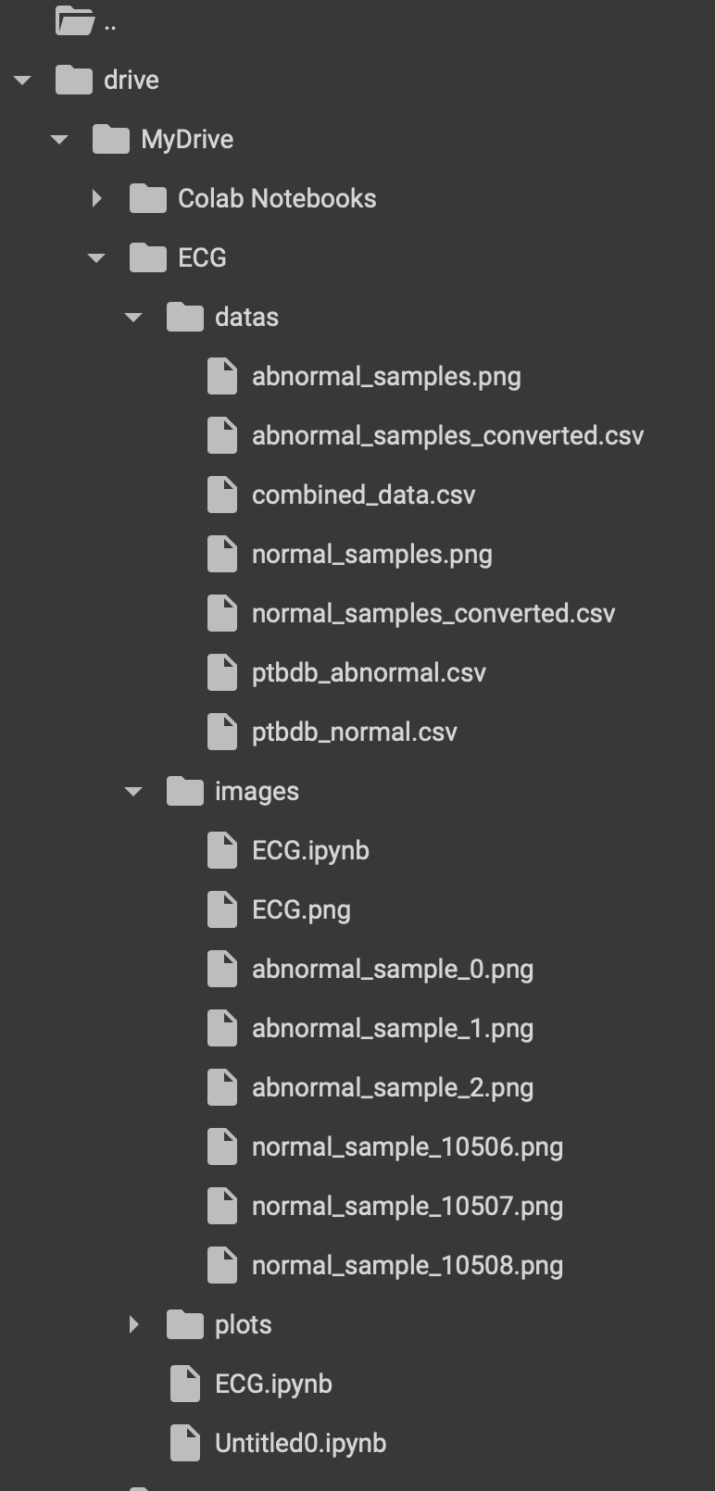

Slide 2
As for the original vs convert wave from comparism
Both of them behave the same but there is a slight changes in converted wave form as well as time shift happens (is those changes indicating there is a slight error as anearlierhint?)
The differences between the original and converted signals are not significantly biased in time.(because the time base shape is constanst only the slight voltage changes)

Slide 3
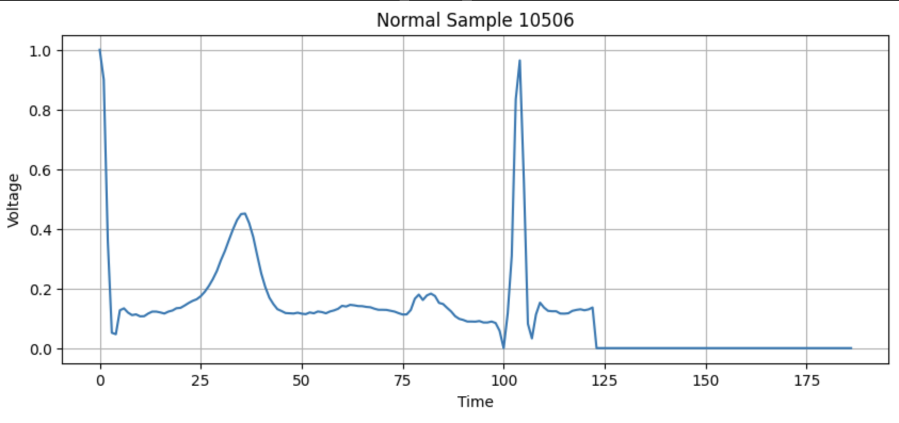
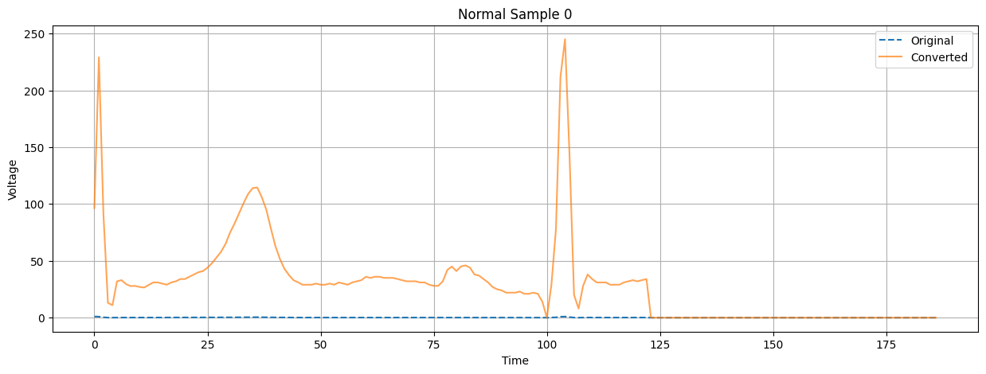
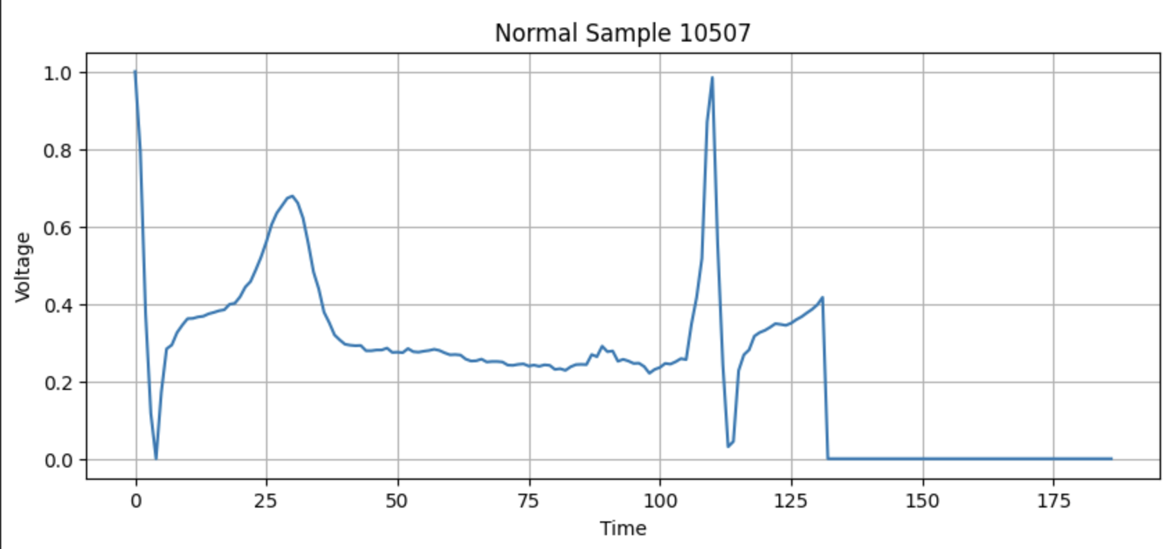
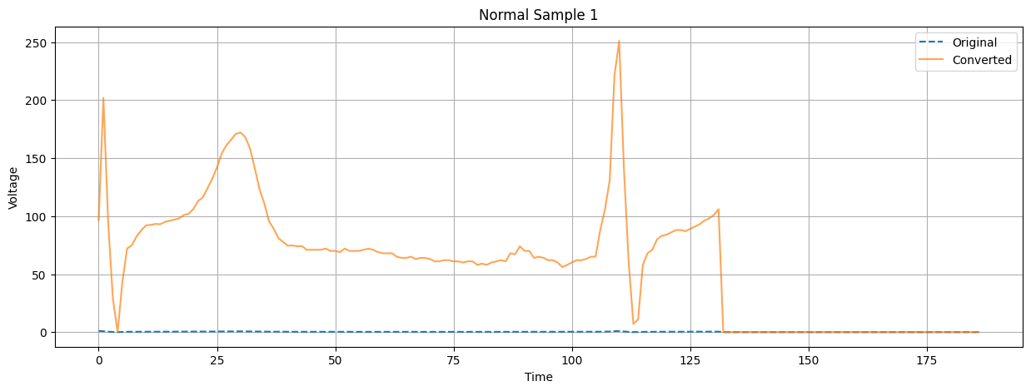
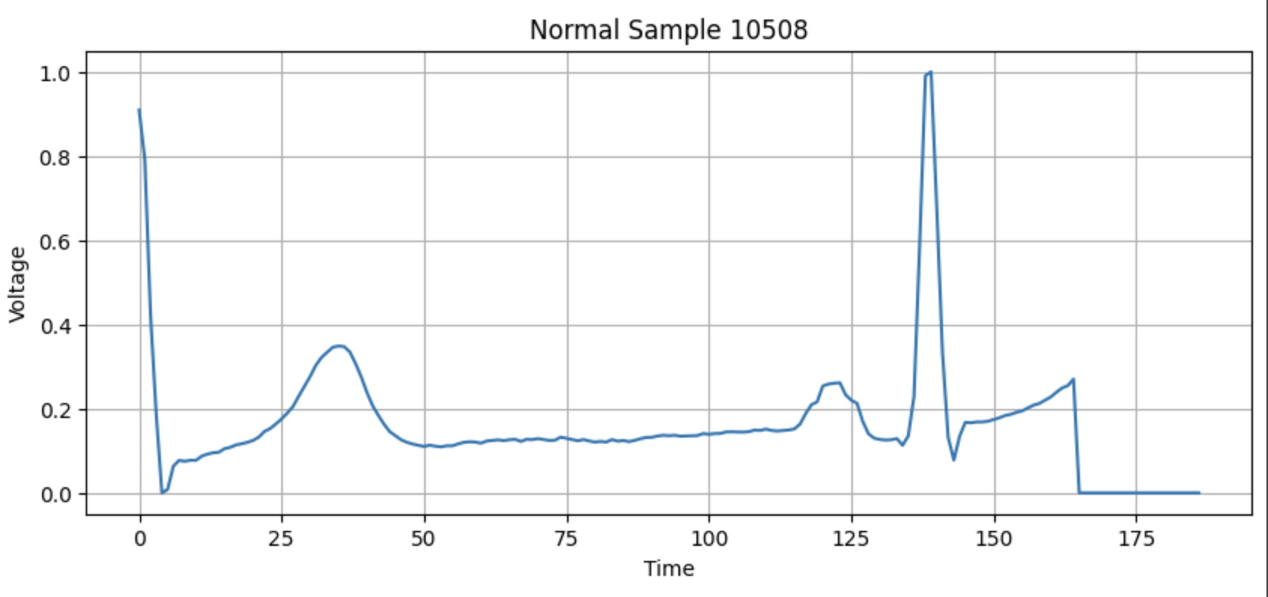
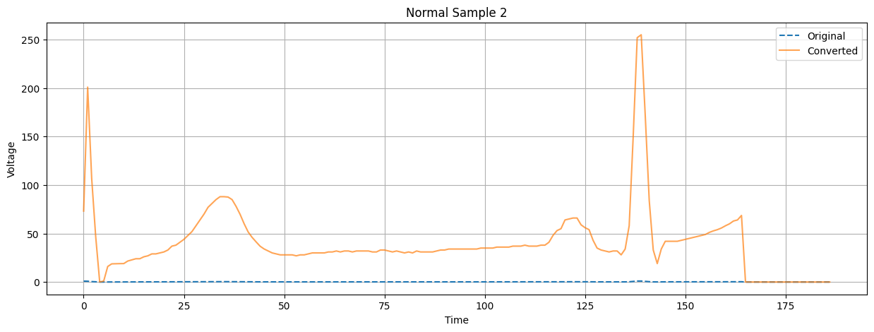

Slide 4
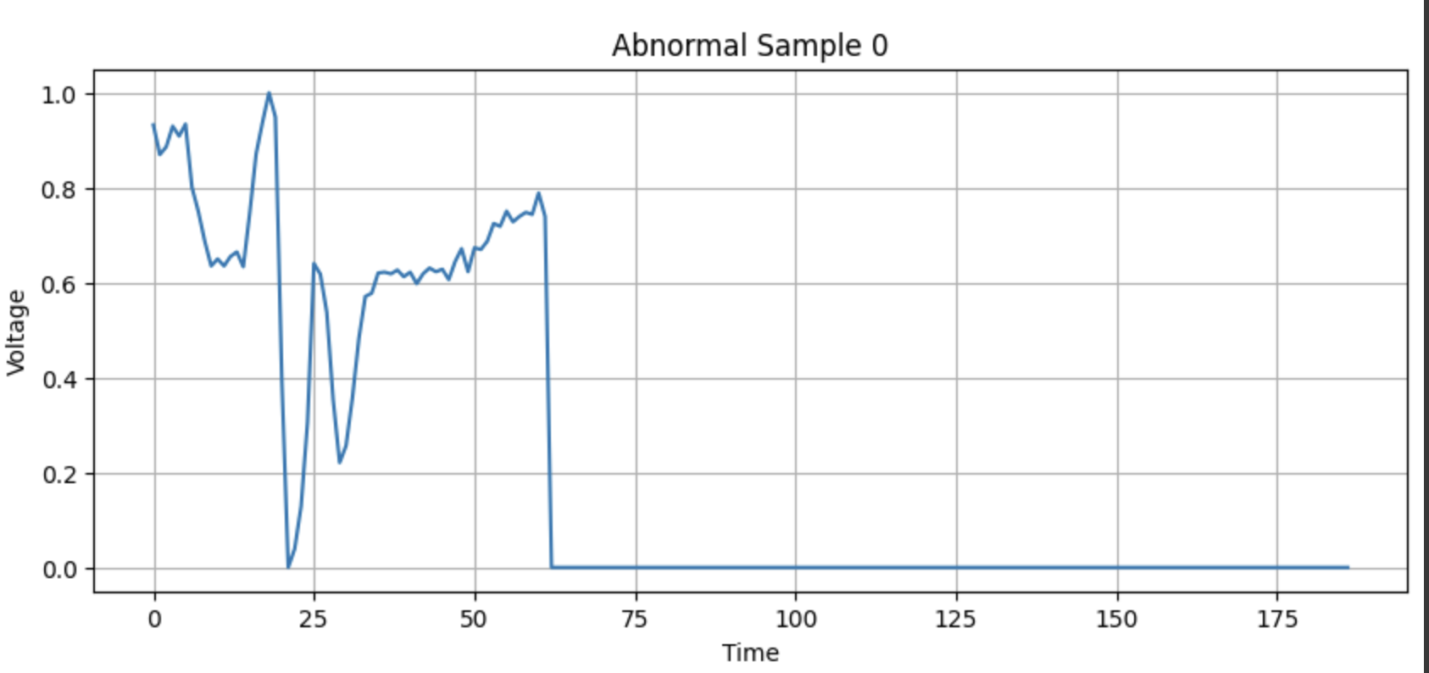
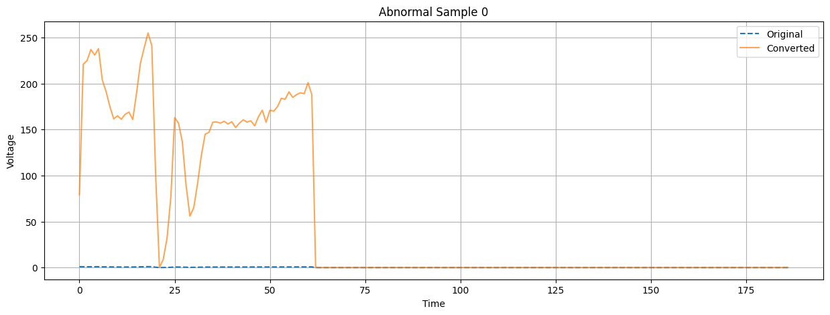
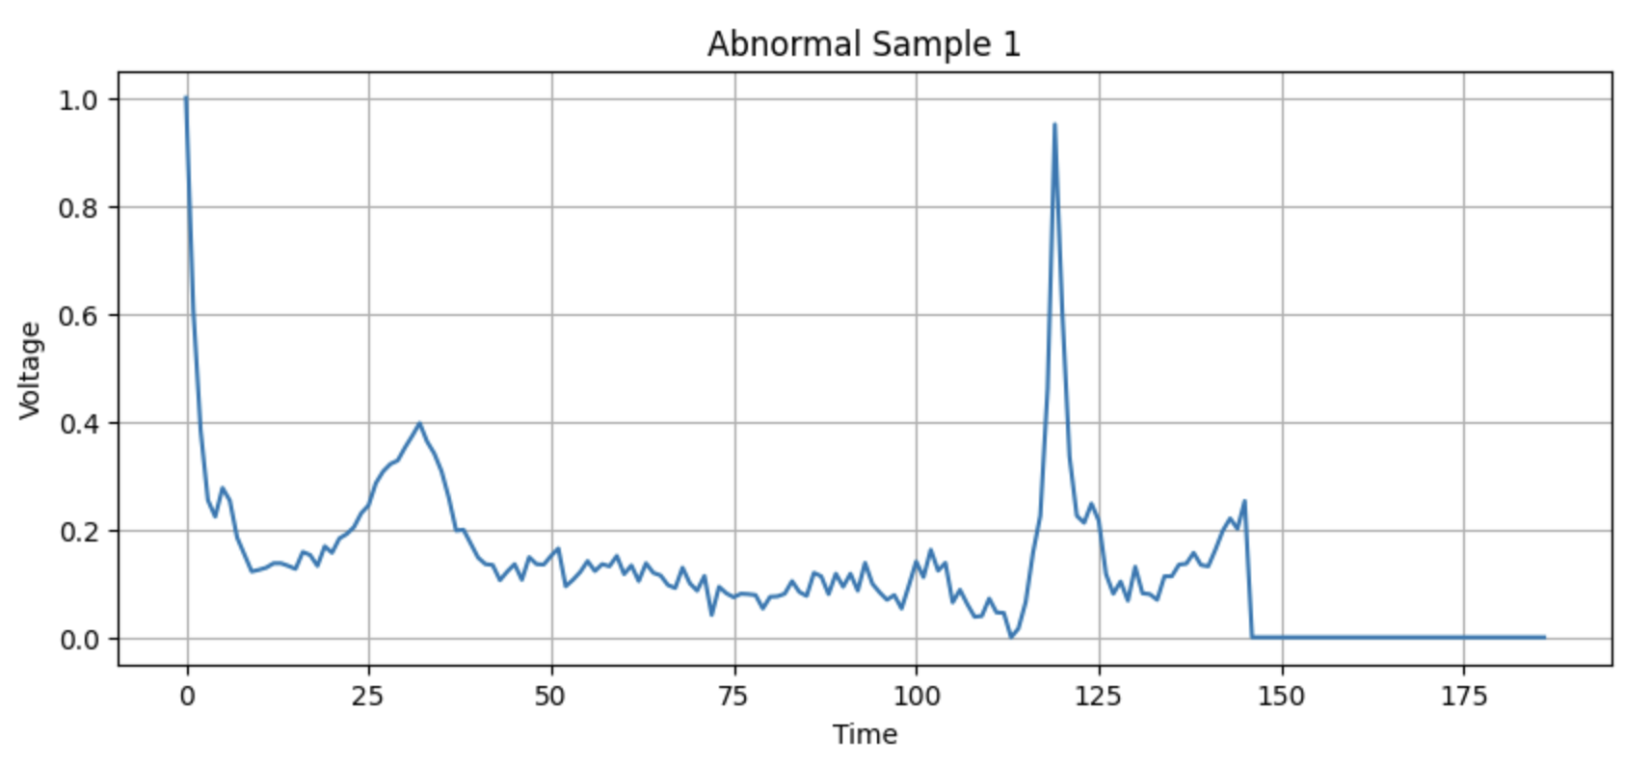
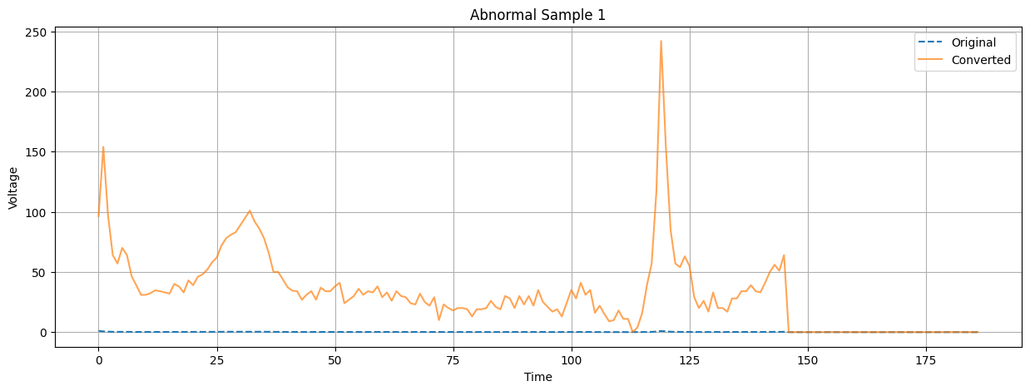
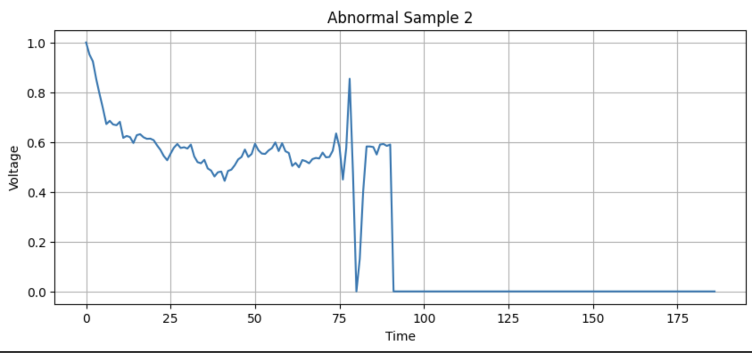
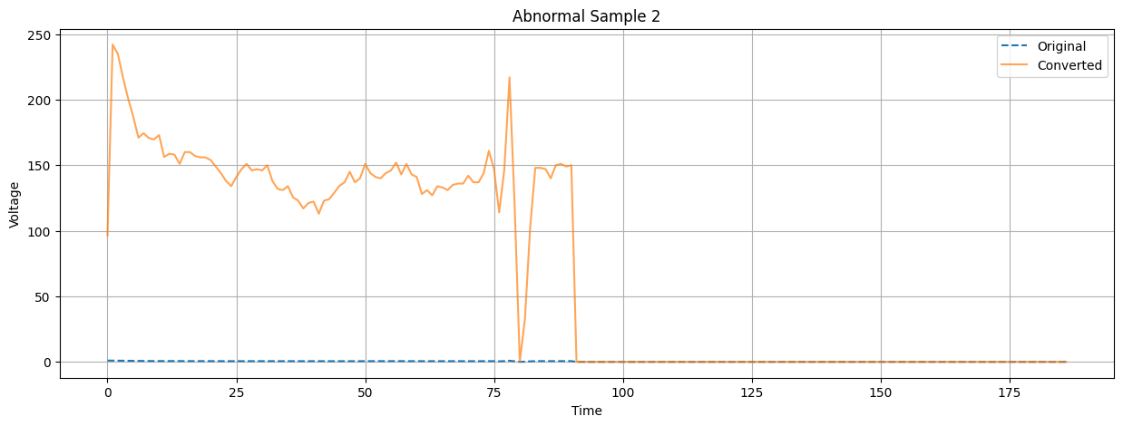

Slide 5
Cross analysis
Lag 0 Peaks: Strong peaks at lag 0 in all samples indicate good alignment between original and converted signals.
Normal Data: Generally shows narrower peaks, indicating better consistency in conversion.
Abnormal Data: Shows broader peaks and more secondary peaks, indicating more variability and potential periodic errors.

Slide 6
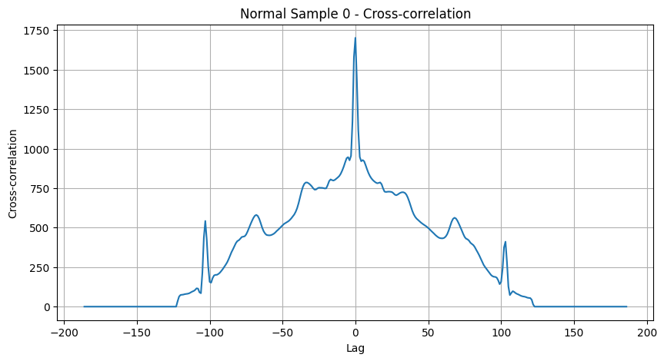
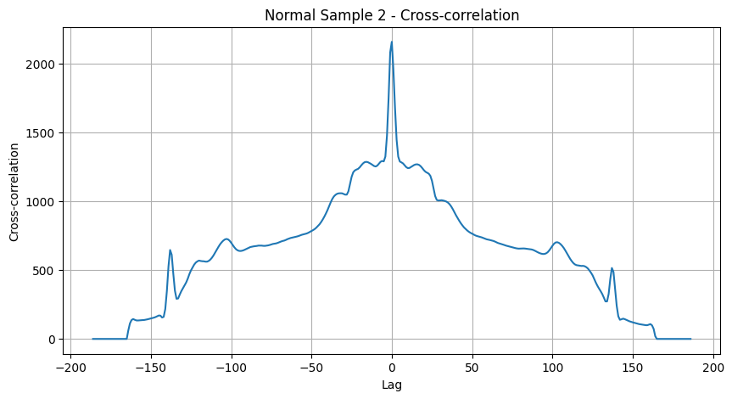
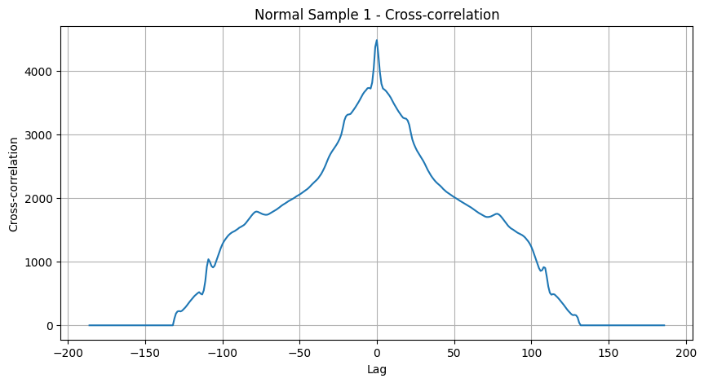

Slide 7
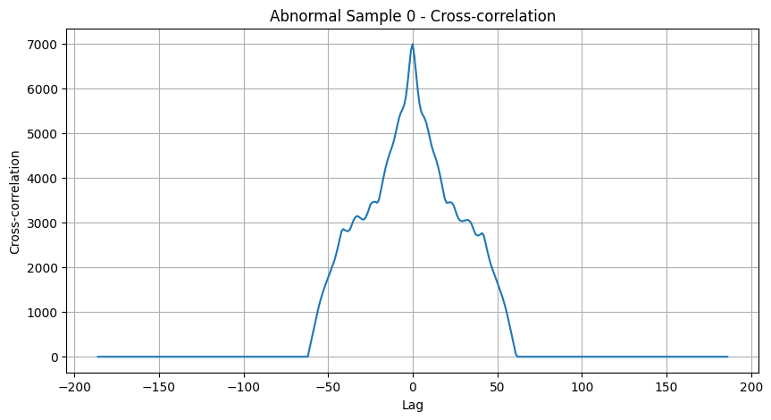
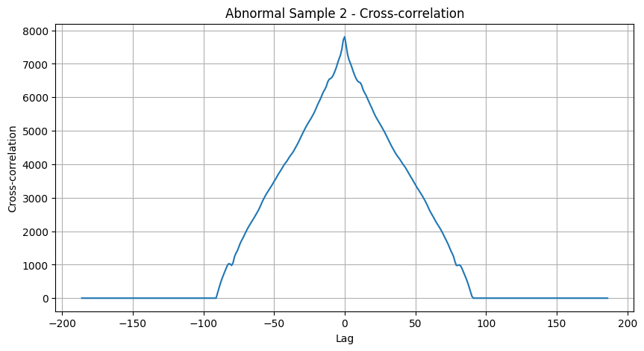
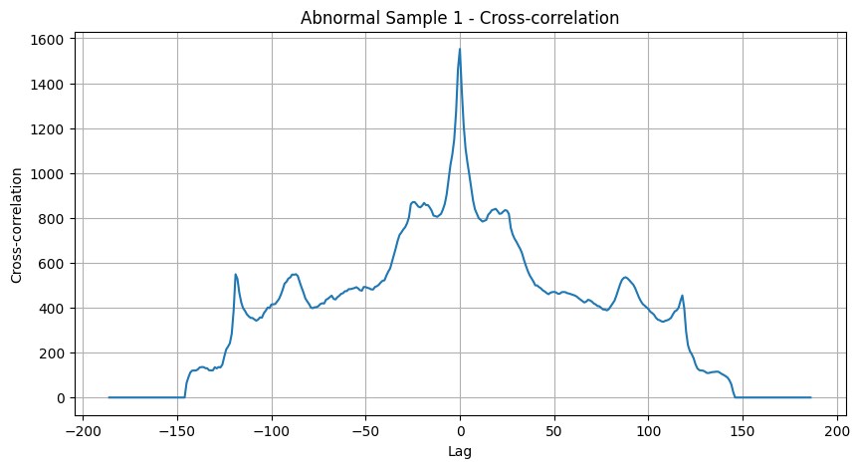

Slide 8
Scatterplots
The scatter plots for both normal and abnormal samples generally show a linear relationship between the original and converted data points.
In some scatter plots, especially in the abnormal data, there's more spread around the line of perfect agreement. This spread suggests higher variability in the conversion process for abnormal data compared to normal data.

Slide 9
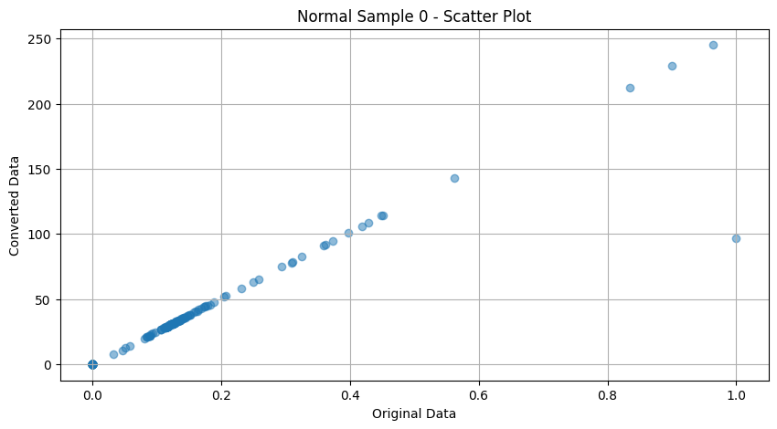
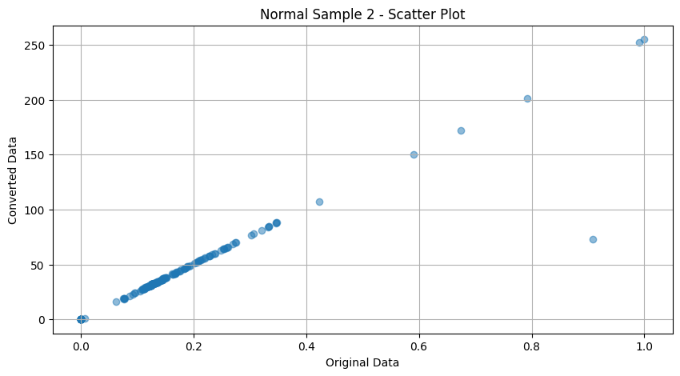
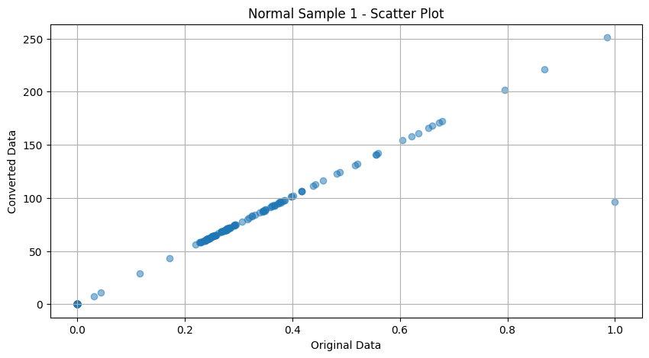

Slide 10
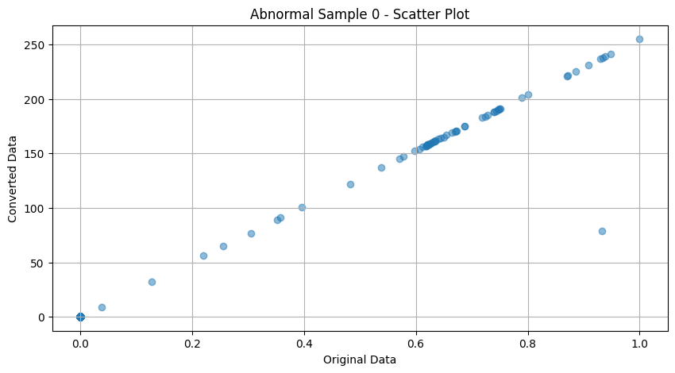
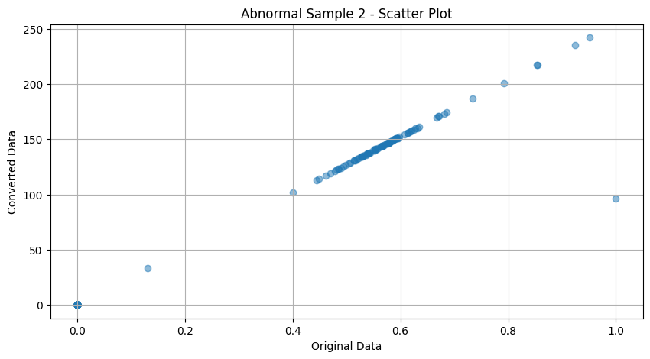
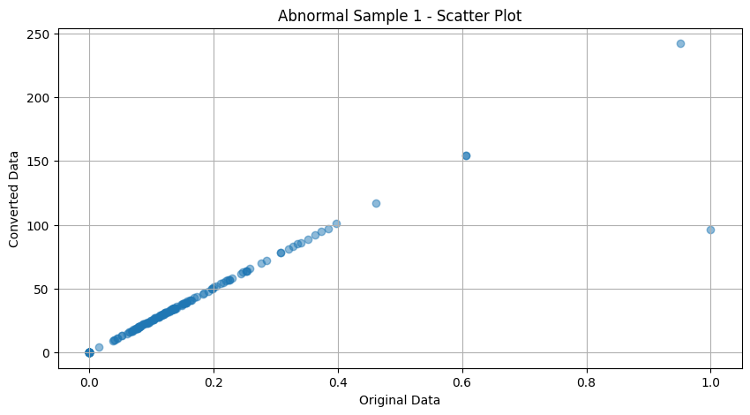

Slide 11
Detailed Interpretations:
Normal Data:
Normal Sample 0:
Data points are mostly clustered along the line with some outliers, indicating good preservation of temporal structure with minor conversion errors.
Normal Sample 1:
Similar to Sample 0, the plot shows a strong linear relationship with a few more outliers.
Normal Sample 2:
Data points follow the line with a noticeable cluster and some outliers, indicating consistent conversion with occasional errors.
Abnormal Data:
Abnormal Sample 0:
Data points are clustered near the line with some significant outliers, indicating preservation of temporal structure with some errors.
Abnormal Sample 1:
The plot shows more spread and outliers, suggesting higher variability and potential conversion errors.
Abnormal Sample 2:
Data points show clustering with noticeable spread, indicating variability and potential errors in the conversion process.
Conclusion
The lag plots reveal that:
The conversion process generally preserves the temporal structure of the original data.
Most data points are clustered near the line of perfect agreement, indicating a high degree of accuracy in the conversion process.
There are some outliers and spread, especially in the abnormal data, suggesting areas where the conversion process could be improved to reduce errors and variability.
Abnormal is likely with more error rates

Slide 12
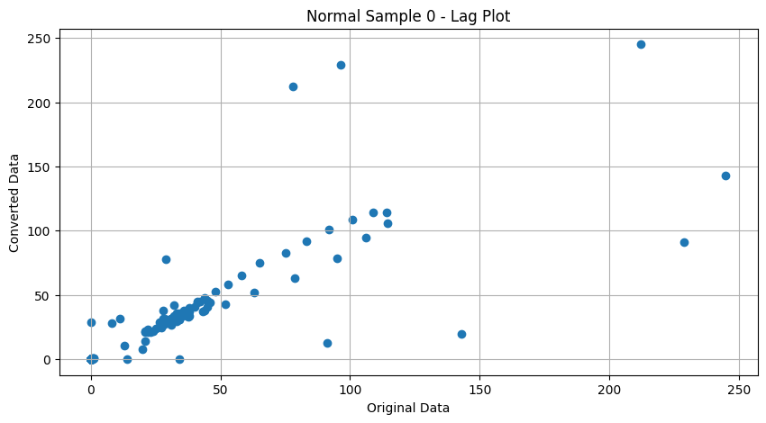
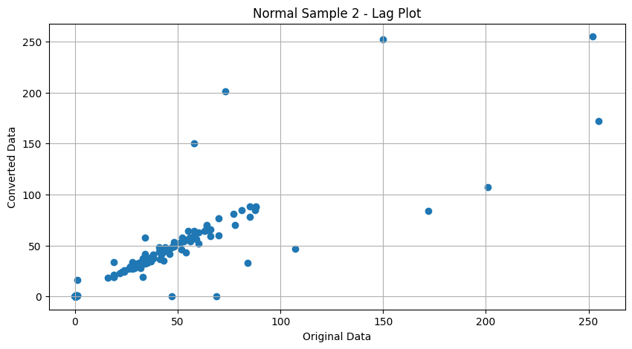
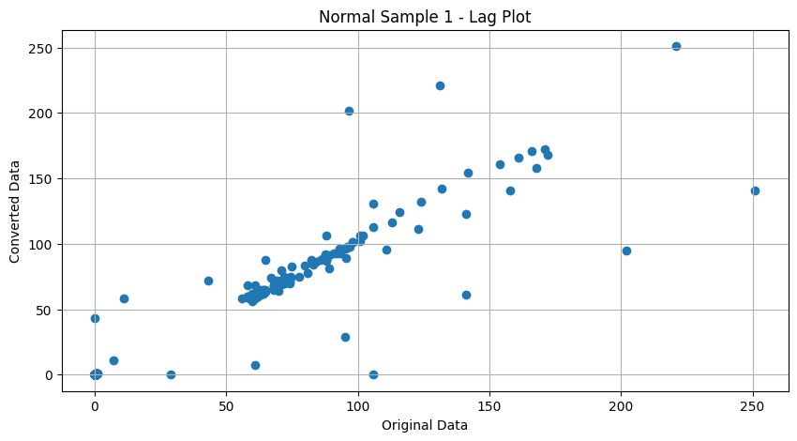

Slide 13
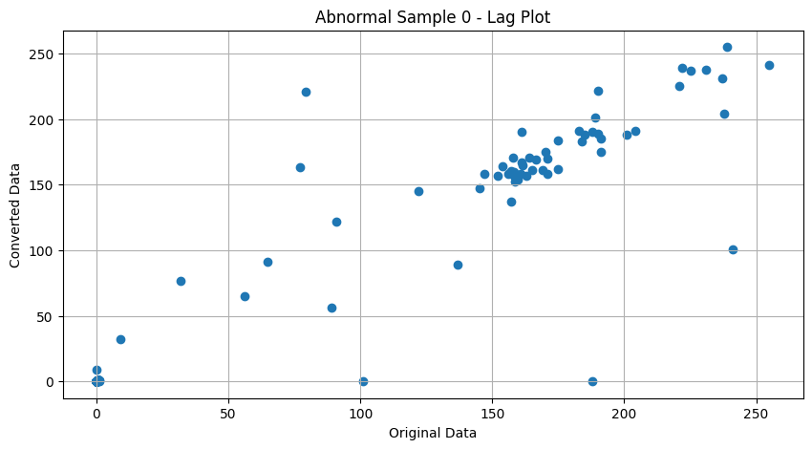
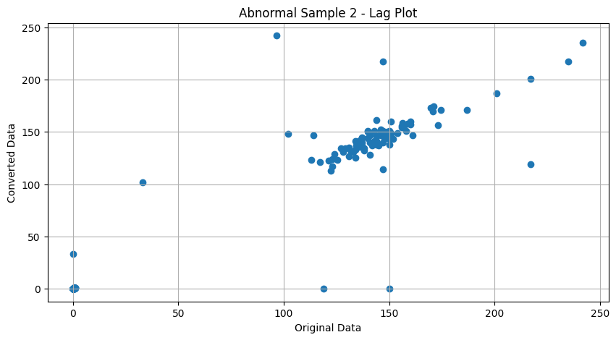
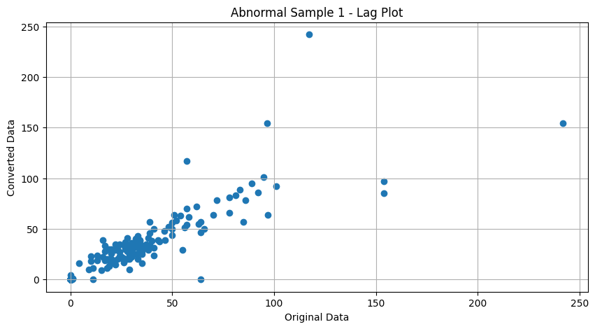

Slide 14
Error detection

Slide 15
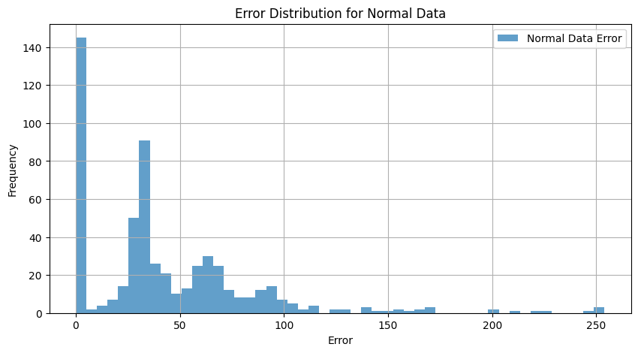
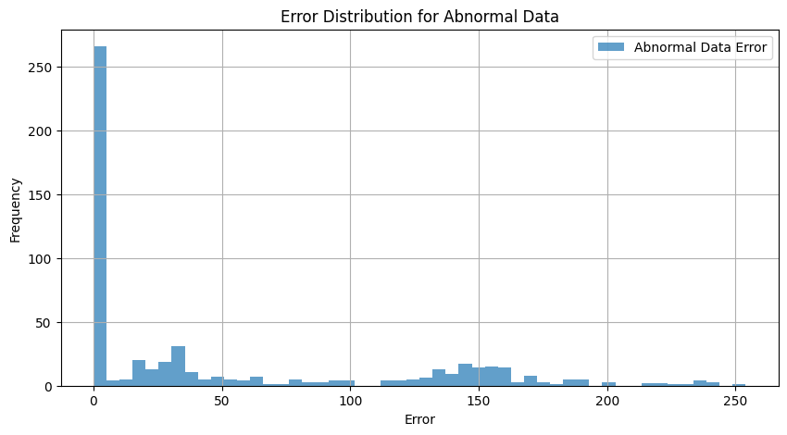
Whereas the error that Normal data introduces spread shorter
Abnormal data conversion likely to occur errors as it is more spread out

Slide 16
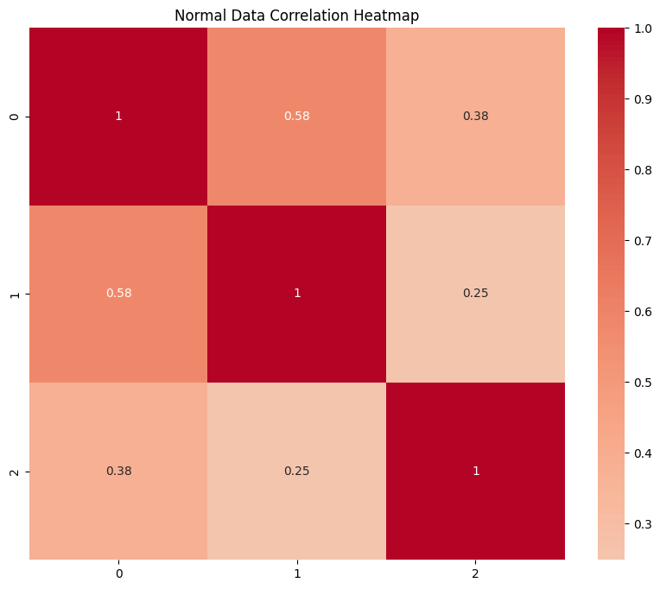
Normal Data Correlation Heatmap
Interpretation:
Diagonal Elements:
The diagonal elements (all 1s) represent the correlation of each sample with itself, which is always 1.
Off-Diagonal Elements:
The off-diagonal elements show the correlation between different samples.
Specific Observations:
Correlation between Sample 0 and Sample 1: 0.58
This indicates a moderate positive correlation between these two samples. They share some similarities.
Correlation between Sample 0 and Sample 2: 0.38
This indicates a weaker positive correlation, suggesting that Sample 0 and Sample 2 are less similar compared to Sample 0 and Sample 1.
Correlation between Sample 1 and Sample 2: 0.25
This is the weakest positive correlation among the pairs, indicating that Sample 1 and Sample 2 are the least similar to each other.

Slide 17
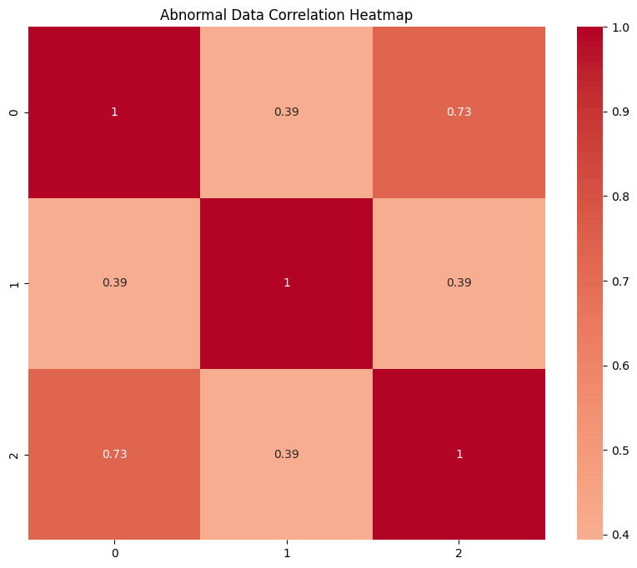
Abnormal Data Correlation Heatmap
Interpretation:
Diagonal Elements:
The diagonal elements (all 1s) represent the correlation of each sample with itself, which is always 1.
Off-Diagonal Elements:
The off-diagonal elements show the correlation between different samples.
Specific Observations:
Correlation between Sample 0 and Sample 1: 0.39
This indicates a moderate positive correlation between these two samples.
Correlation between Sample 0 and Sample 2: 0.73
This indicates a strong positive correlation, suggesting that Sample 0 and Sample 2 are quite similar.
Correlation between Sample 1 and Sample 2: 0.39
This is a moderate positive correlation, indicating a similar level of similarity as between Sample 0 and Sample 1.

