Slide 1
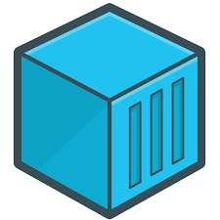

Containers
Conceitos básicos sobre Docker e Kubernetes

Slide 2
O que são containers?
Aplicações virtualizadas
A container is a standard unit of software that packages up code and all its dependencies so the application runs quickly and reliably from one computing environment to another.

Slide 3
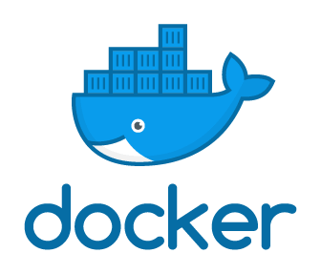
Docker
Docker engine
A Docker container image is a lightweight, standalone, executable package of software that includes everything needed to run an application: code, runtime, system tools, system libraries and settings.

Slide 4
Docker-compose e docker swarm
Services
Cluster

Slide 5
Ambiente de Produção
Requisitos básicos
Alta disponibilidade
Desempenho
Escalabilidade
Segurança

Slide 6
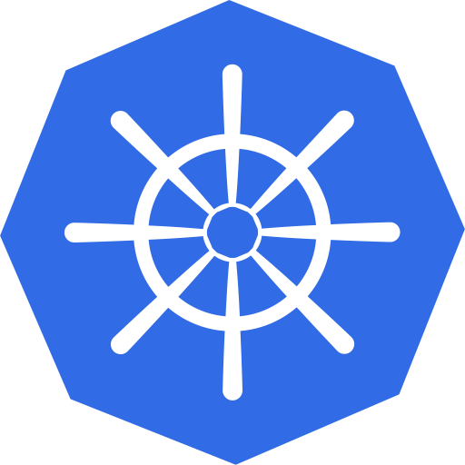
O que é o Kubernetes?
Gerenciador de containers
Kubernetes is an open-source system for automating deployment, scaling, and management of containerized applications.
Nativo Google

Slide 7
Kubernetes na Cloud
Administração
Cloud services
GKE (Google)
AKS (Azure)
EKS (Amazon)

Slide 8
Processo de Deployment
Dev
Coding
Infra
Cloud
CI / CD
Production
Deliver
Validation

Slide 9
Processo Standalone
Git
Repositório
Docker
Docker compose
Dockerfile
Build image
Serviços
Docker Swarm
Cluster
Código da aplicação
Dependências
Node 8
Packege.json
Application
npm
Nodejs
App
Data
Cluster

Slide 10
Processo Cloud
Docker image
Kubernetes
K8s
Registry
Deployments
App Java
Services
Pods
App Node
Endpoint
EKS
AKS
GKS
Imagem docker
Repositório privado
Pod
Pod
Pod
App Java
Pod
Container registry
App Node
Pod
Data
Java
Node
Cluster

Slide 11
Obrigado
Dúvidas
Comentários
Sugestões

