Slide 1
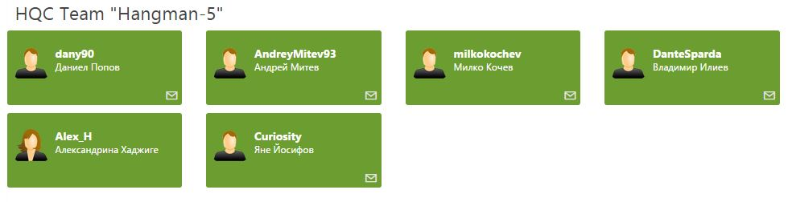
Hangman – 5 Team
High-Quality Code

Slide 2
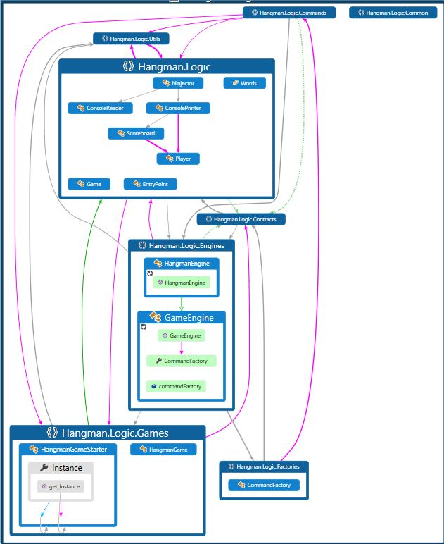
Code Map

Slide 3
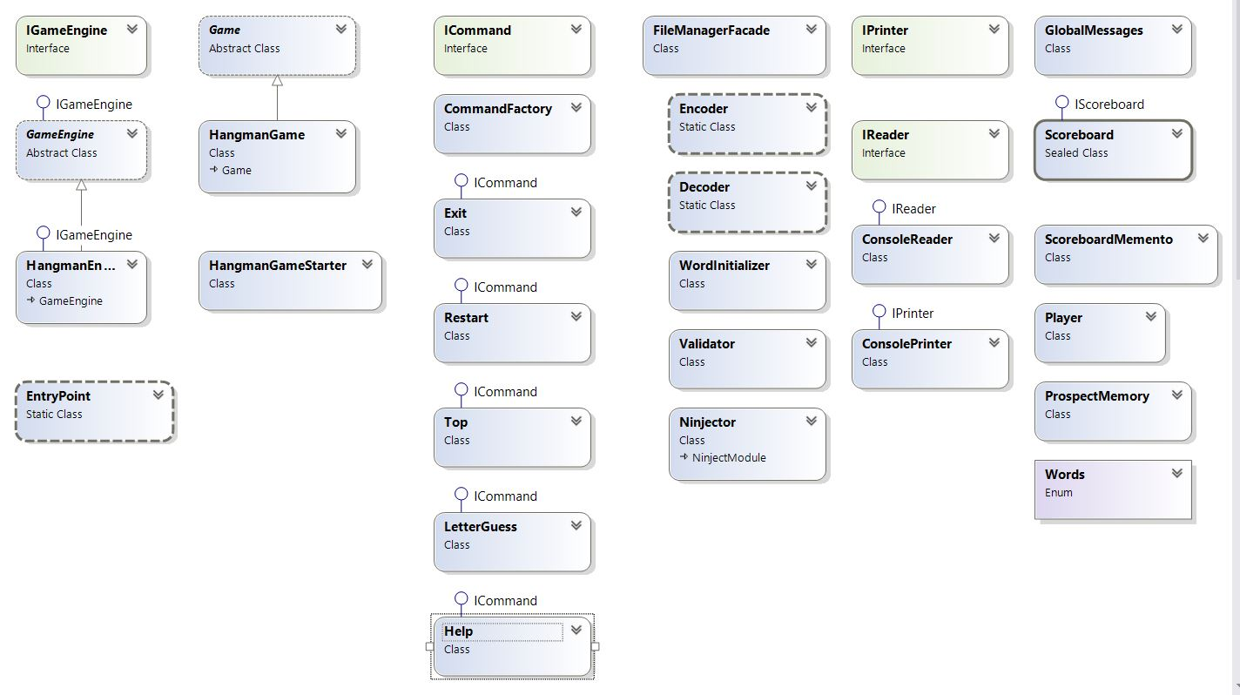
Class Diagram

Slide 4
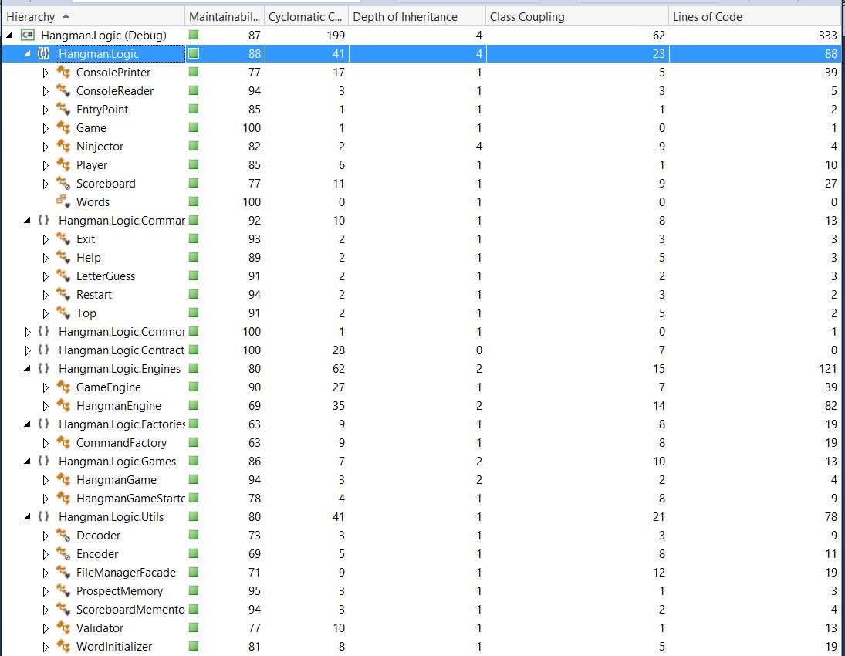
Code Metrix

Slide 5
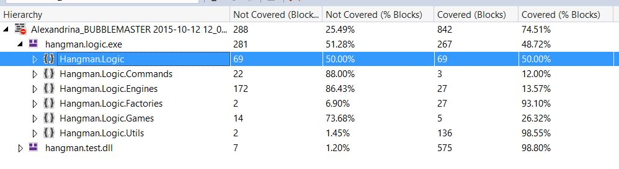
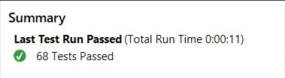
Test Coverage – Add Updated Tests

Slide 6
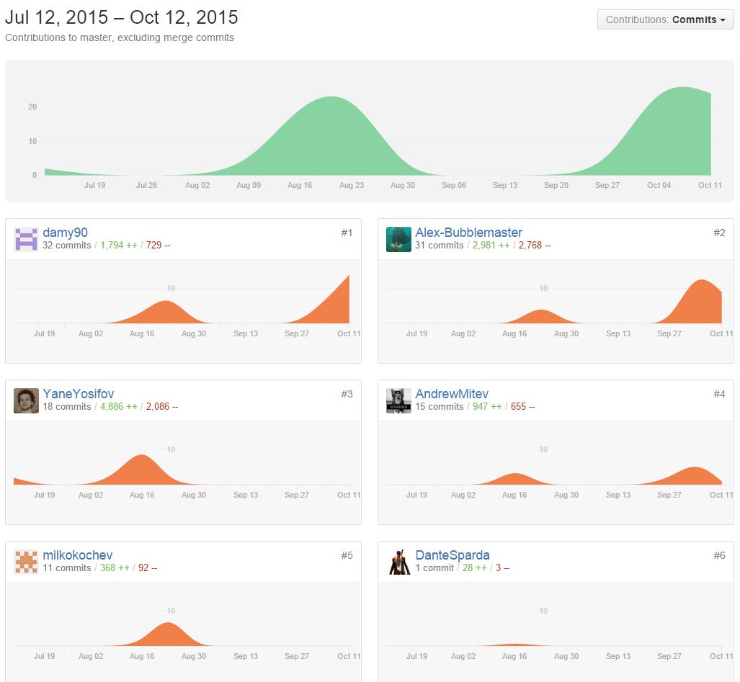
Teamwork Statistics

Slide 7
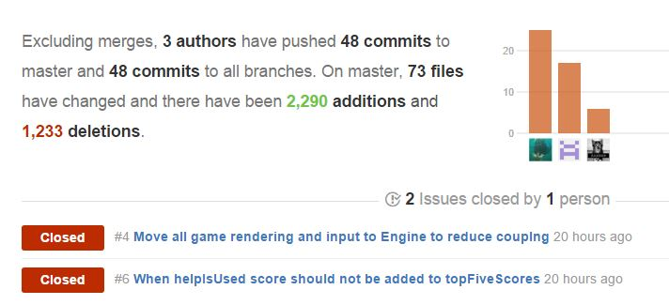
Pulse

Slide 8
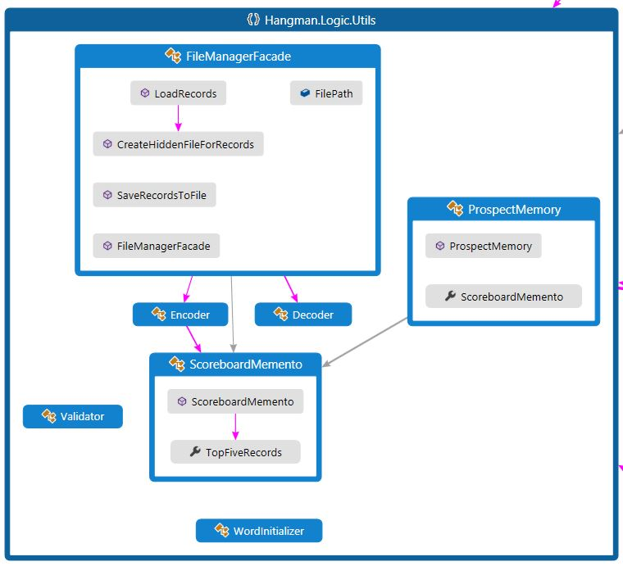
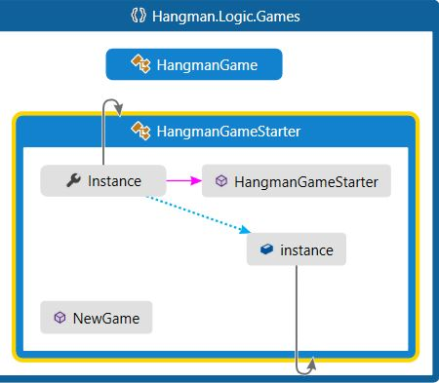
FaÇade and Memento

Slide 9
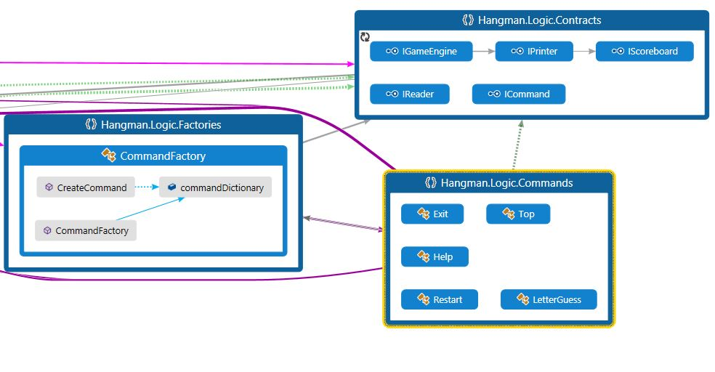
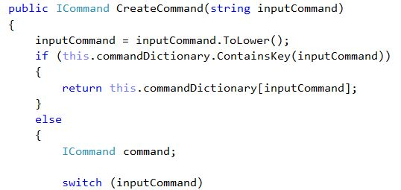
Command, Command Factory + Flyweight

Slide 10
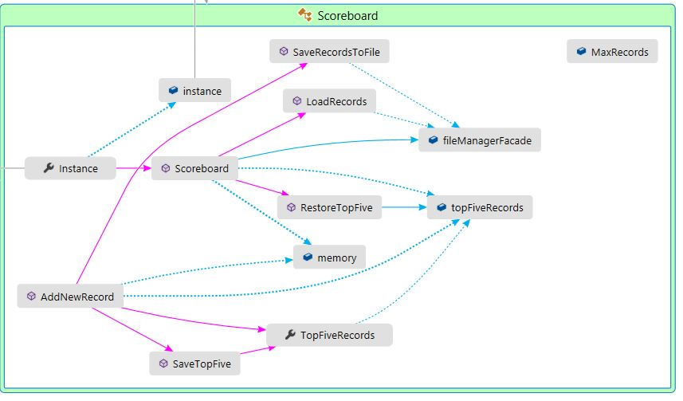
Singleton (Scoreboard & HangmanGameStarter )

Slide 11
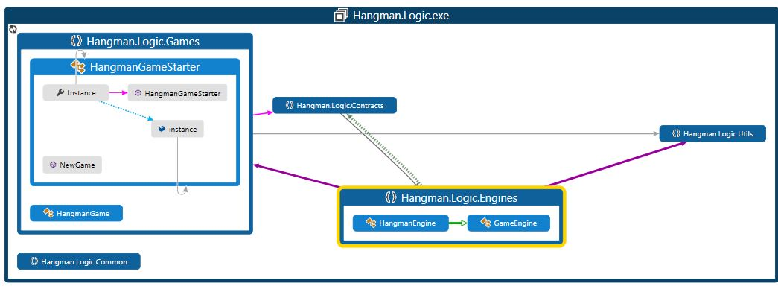
Like a BRIDGE over troubled water

Slide 12
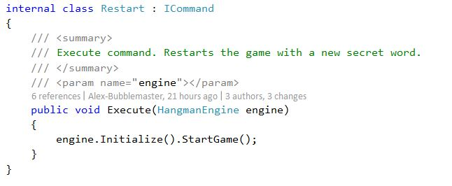
I’m Fluent and I know it(Fluent Interface)

Slide 13
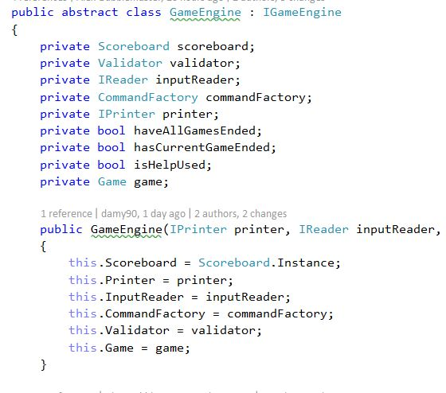
Strategy

Slide 14
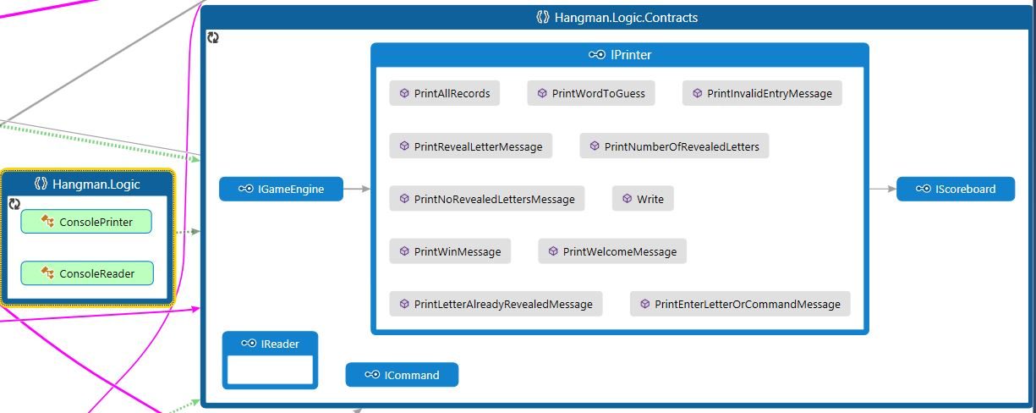
Adapter(if you look with your eyes wide shut :)

Slide 15
http://academy.telerik.com

