Slide 1
A Journey to MMRAG
Notes:
分三次 agenda….

Slide 2
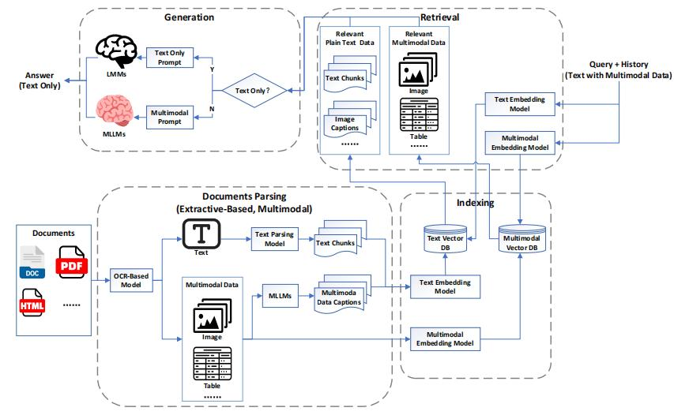
existing solutions for mmrag(1)

Slide 3
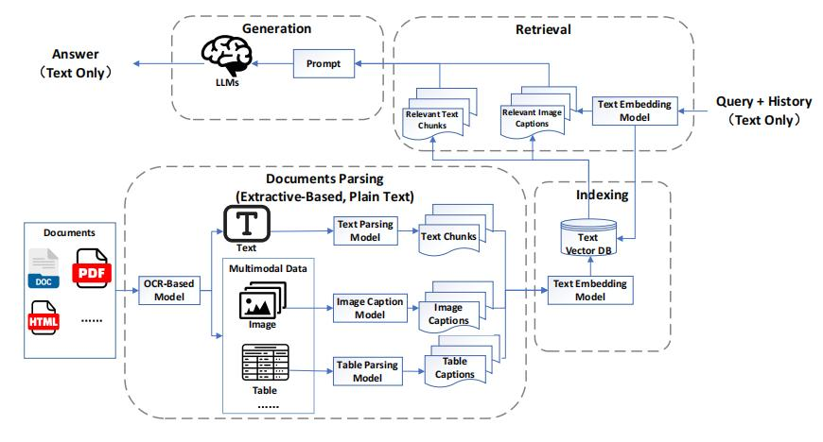
existing solutions for mmrag(2)

Slide 4
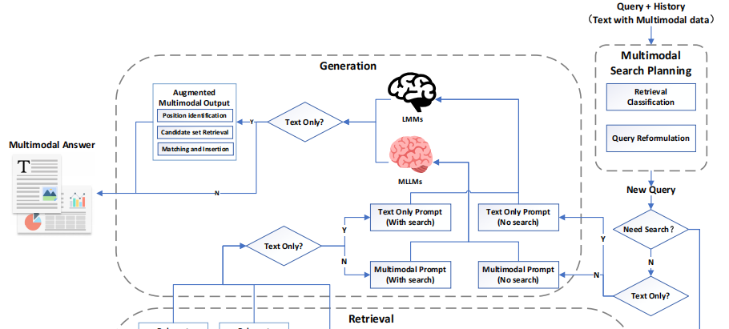
existing solutions for mmrag(3)

Slide 5
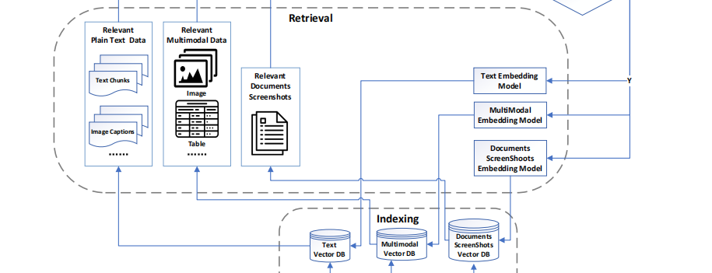
existing solutions for mmrag(3)

Slide 6
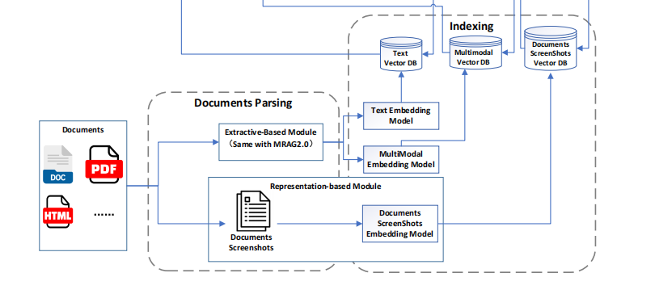
existing solutions for mmrag(3)

Slide 7
our solution
Save charts in a folder with code as name
Original PDF File
Find all charts with descriptions
Insert picture code in the descriptions
Generate vector database
Retrieve input
Text generation
Figure auto insert according to the Desc

