Slide 1
Building Reliable Software Systems
David Leonhartsberger
Frequentis 2016
Notes:
Main focus = design and implemenation techniques for software
Hardware = not my area of expertise
Distributed software required and almost standard nowadays
Some systems are designed to b e fault-toleran t: they either exhibit a w ell-dened failure b eha vior when comp onen ts fail or mask comp onen t failures to users, that is, con tin ue to pro vide their sp ecied standard service despite the o ccurrence of comp onen t failures

Slide 2
Agenda
Motivation
Failure Classification
Why does software stop working
and what can be done about it
Prototype?

Slide 3
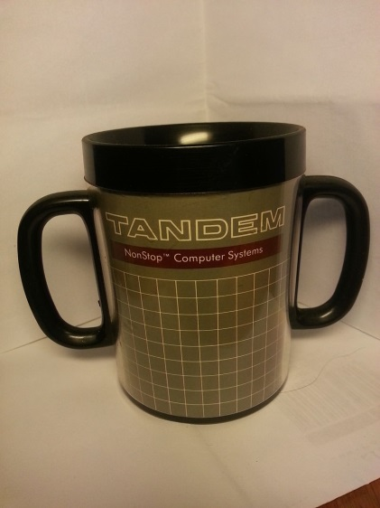
Motivation

Slide 4
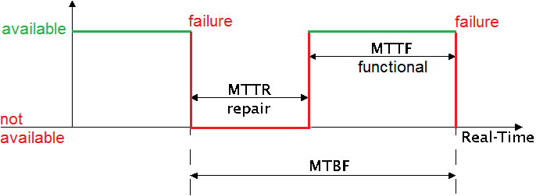
Domain Language
Reliability:
is it not going to fail in the next N hours? = Continuity of correct service
Availability:
can I use it now? = Readiness for correct service
Safety: non-occurence of catastrophic failures
Notes:
LifeX = highly available + reliable for emergency
Safety does single component failure or full system failure have catastrophic consequences-> what are consequences on the user(s) or environment?
safety-critical systems don't always strive to maximize uptime. In fact, they may intentionally take themselves down where threat of injury or loss of life. take themselves to safe state before life-threatening situation reached.
For many safety-critical systems, safe state is to immediately stop

Slide 5
Availability Examples
Gmail, MS Hosted Exchange target 3 nines (unscheduled) in 2010
Google Gmail (99,984) = 1 hour/year
Microsoft Hosted Exchange (>99,9) = 8 hours/year
LifeX ^{[SDD V1.1]}
99,999 hardware availability = 5.26 min/year or 26 sec/month downtime
AT&T 4ESS Switch
designed for 5 nines
Ericsons AXD301ATM switch achieved 9 nines (99,9999999) over 20 years [https://pragprog.com/articles/erlang]
30 milliseconds/year
Notes:
Ericons switch (to it‘s user‘s it was 100% available)

Slide 6
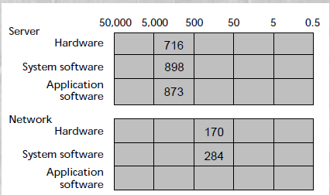
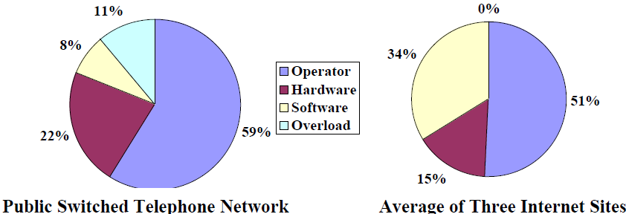
Factors of Unavailability
Change control (configuration change, software fix)
Plan for un-doing a change
Lack of monitoring/alerting
Operations
They are the first to diagnose a failure
Network, software, storage architecture failures
40% of unplanned downtime in business environments is due to application failures;
20% is due to hardware faults, of which 80% are transient
Notes:
Google had problems with massive logs causing lack of storage
AT&T switch battery test caused national wide outage
Operator failures most important to optimize
Software failures second most important
PSTN software very very major
Hardware failure high because internet sites run on hundreds of machines
Represents six weeks to six months of service for 500-5000 computers. (25% of outages had no identifiable cause and are not included in the data.) [ROC]

Slide 7
The need for Operations-friendly services
Todays systems are (extremly) complex and evolve fast
The rise of Utility computing (cloud) = even higher P of failures
Fault tolerance is a key feature
Dont let your operations team compensate poor design decisions and implementation
Hamilton, On Designing and Deploying Internet-Scale Services
System-to-administrator ratio 2:1 - 2,500:1
Low-cost administration correlates highly with how closely the dev, test and operations team work together
If a hardware failure requires any immediate administrative action, the service simply won’t scale cost-effectively and reliably
3 tenets: Expect failures, Keep things simple, Automate everything
Nygard, Release It!
Don’t avoid one-time development expenses at the cost of recurring operational expenses.
A highly stable design usually costs the same to implement as an unstable on.
Notes:
Modern systems Distributed and highly concurrent
Immense amouts of state, code volume
In complex systems there is always something that does not work
Leading companies are aware of the importance of availability

Slide 8
Mindset
Expect failures and incorporate it into the design
Faults cannot be avoided but failures can be prevented
Each failure is an opportunity to learn
Keep things simple
Make Incremental Additions of Reliabilty
Commitment to continuous improvement is essential
Rigorous Testing
Even if you get it right at one time – things will change
Faults will be in none-tested parts, which are the parts that are hard (or expensive) to test
Notes:
In a complex enough system there is always a part that is not working
■ possible failure types?
■ recovery action (for the possible failure types)
Reduction in the number of faults present in the system doesnt imply taht the results of the faults are less servere.
Fix root cause not symptoms
Program testing can be used to show the presence of bugs, but never to show their absence
WeatherFaxService Beispiel: Heartbeat escalate, Retries, Service kill -> Fazit you need to test failure scenarios -> afterwards heavy fault injection testing

Slide 9
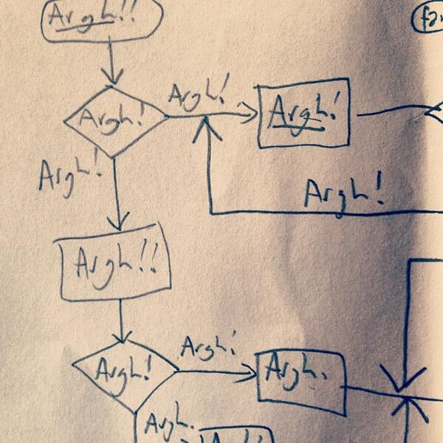
Failure Classification

Slide 10
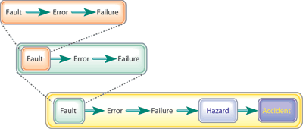
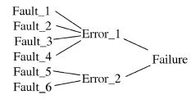

Domain Language
Fault = a bug, dropped packet, memory corruption, incorrect spec
Error = potential cause of failure
Failure = observable incorrect behaviour outside of service boundary
Fault Tolerance = deliver correct service in the presence of faults (service may be at a degraded level)
Notes:
Faults are present in every system
Observers are not aware of the presence of a fault until an error occurs
A single failure must not always lead to a complete system failure
Failure: the inabilitly to perform according to spec, spec describes response to any state and input and real-time interval for the response (a response is any observable output and state transition)
Fault tolerant: exhibit a well-defined failure behaviour when component fail or mask the component failurs to users, that is, continue to provide their specified standard service despite the occurrence of component failures.

Slide 11
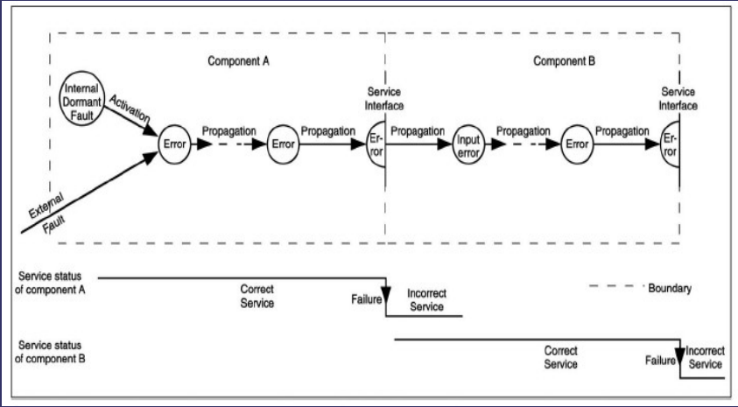
Example: Failure Propagation
OutOfMemory Error
Bug
Thread
Blocking
Forever
Index OutOfRange
NullPointer
Omission Failure
ThreadPool Exhausted
Corrupted File
Notes:
btw all Executors in java use unbounded queues per default

Slide 12
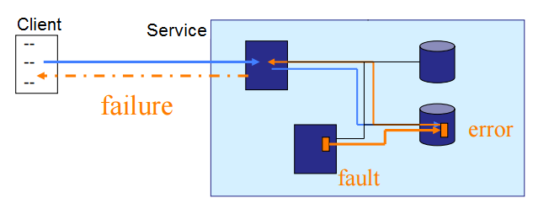
Failure Perception
Omission failure = no response at all
Timing failure = correct response but to too late or too early
Response failure = incorrect response or state transition
Crash failure = no more response after omission failure until restart
Fail-fast = detect and report (Iterator)
Fail-silent = detect and become silent
Failing well, safe vs Failing badly
Failure consistency
Consistent – seen as same failure by all observers = easy to detect! (n+1 … 2n+1)
Inconsitent/Mallicious/Byzantine – appear different to different observers = very hard and expensive to detect! (3n+1)
Notes:
Omission = communication service that occasinally loses but does not delay messages
Timing = delay due to overload/congestion (G7 ghost audio, G7 mirror shutdown, weaterfax service was a timing failure)
Consistent failures are ssen as the same kind of failure by all users or observers of the system
Assumption is failures are independent
Fail fast - passes the responsibility for handling errors, but not detecting them, to the next-higher system design level.
Fail safe – cause minimal or no harm to others (prevents or mitigates unsafe consequences of the system's failure)
Fail secure – ensure integrity on failure
Fail well - A system that fails well is one that compartmentalizes or contains failure.
Fail bad - A system that fails badly is one that fails catastrophically once failure occurs. A single point of failure can thus bring down the whole system

Slide 13
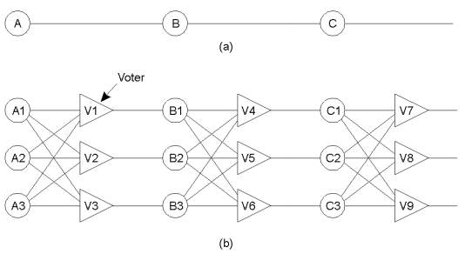
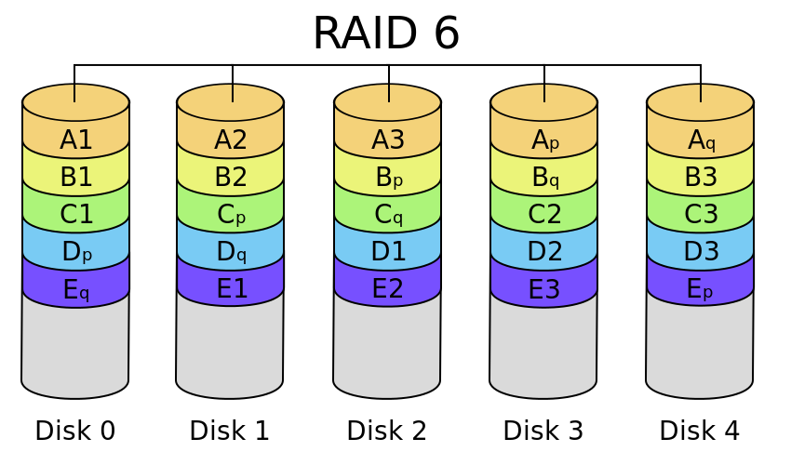
Fault masking
Mask faults within a set of redundant processes
Mask low level failures in higher level services
Prefer strong semantics, easy to detect (crash, omission)
Hides errors -> log them
Client
Storage Service
RealTime Service
Replica
#1
Replica
#2
UDP
Notes:
Mask faults within a set of redundant processes
“Mask the error” or “Fail predictably”
Error masking: Space Failover
Strong semantics in lower level service make it easier for upper level services but are more expensive to implement -> End to End argument
You anyway need to check end to end, lower level failure handling might only be performance optimization

Slide 14
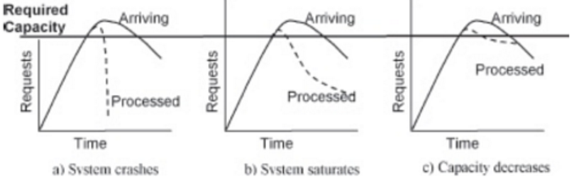
Performance is a Reliability Requirement
At some point „slow“ is considered unavailable
„Slow“ = higher MTTR + higher change of timing failures = less reliable
„Fast“ = react fast + recover fast = more reliable = good user expierence and strong selling point
Notes:
Slow is often worse than dead
rare timing failures (G7) -> execute code that is rarely executed and therefore rarely tested
Clear requirements are necessary

Slide 15
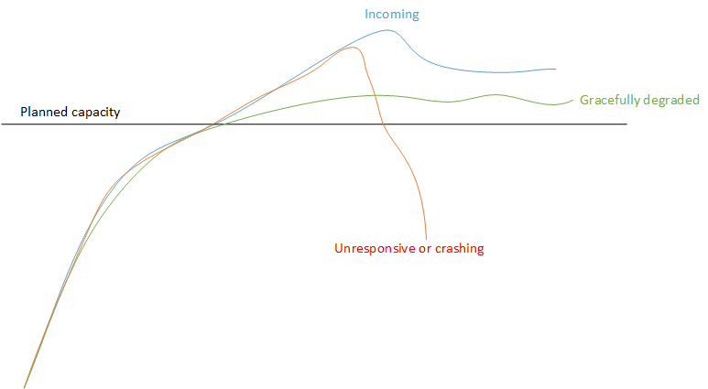
Gracefully degrade
Give good service to some (important) users and tell others to come later (or go somewhere else)
Instead of providing bad service or no service to all users
Notes:
bounded queues
flow control
overflow strategy
back pressure

Slide 16
Fault Model
Assume failures are independent and don’t occur concurrently*
Single fault tolerance is already a big win
Hardware and Software fails fast (blue-screen, stop/crash)
Most faults are “soft” and transient (aka Heisenbugs)
Most of the "hard“ and persistent bugs (aka Bohrbugs) are gone after review, testing phase
1 out of 132 software faults was a Bohrbug the remainder Heisenbugs ^{[Why do computers stop]}
Notes:
Most Hardware faults are transient – error correction, checksum and retransmission – boost MTBF by factor of 5 to 100
Heisenbugs = If program state is reinitialized, operation will usually succeed on retry
Bohrbugs = ones that always fail on retry, are gone after review, testing phase
resetting the program to a quiescent state andreexecuting it will quite likely work, because now the environment is slightly different.
After all, it worked a minute ago

Slide 17
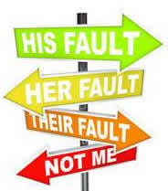
Why does software stop working …

Slide 18
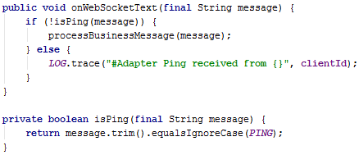
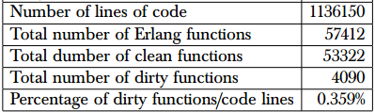
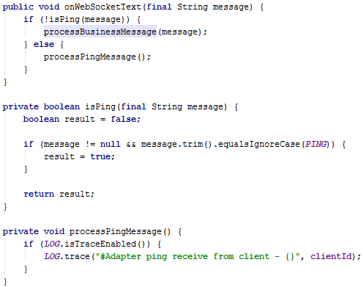
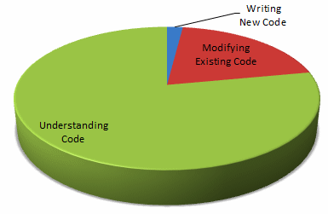
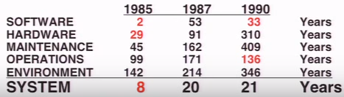
Complexity - State and Code Volume
Most Software keeps and manipulates too much state
Too many side effects = hard to reason about
Carefull state management missing (Error kernel pattern)
Immense amounts of code
Not working towards (programming) patterns
Notes:
Too many side effects
Often very imperative programming style
Carefull state management missing (Error kernel pattern)
Unecessary code, too complex code, self written instead of using existing proven code …
A lot of problems are with state being corrupted.
Most failures are relatet to state: inconsistent, partial data, wrong data, lost data, duplicated data.

Slide 19
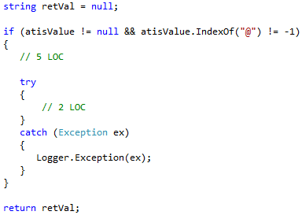
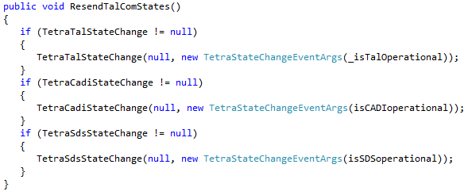
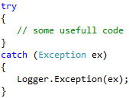
Error Handling …
PCD Client Metrics
> 95% catch clauses contained only logging
!= null
Matching lines: 8674, Matching files: 1362, Total files: 2934 (that’s 46%)

Slide 20
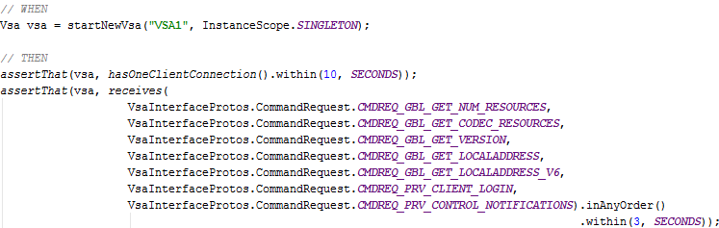
Communication Points
RPCs and Network calls impose a lot of new challenges
Not tolerating slow/dead consumers or fast producers
Not preventing cascading failures
Having a bad (or no) concurrency model or abstraction
Not taking interface and protocol design seriously
Sloppy/imprecise (Timing and failure behaviour not documented)
Complex, chatty protocols (state housekeeping, more unreliable)
P(Request Success Rate) | Messages Sent | P(Success)
0.9999 | 1 | 0.9999
0.9999 | 5 | 0.9995
0.9999 | 8 * 5 (40) | 0.995 (0.5%)
0.999 | 8 * 5 (40) | 0.96 (5%)
Notes:
Failures propagate quickly
out of process communication
Obscure timing bugs
Low level concurrency (Threads, Locks, CAS)
Live contract example is not very specific
Search service did not handle network disconnect

Slide 21
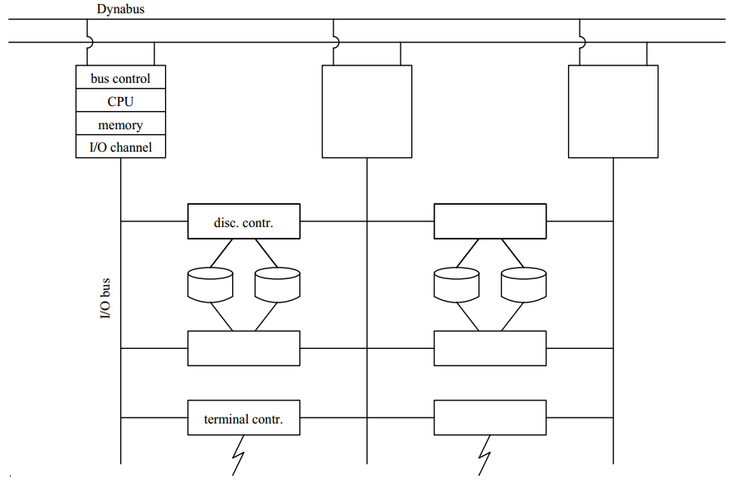
what can be done about it

Slide 22
Architectural Patterns
No single point of failure
Requires redundancy and physical distribution
Isolation
Requires Fault Detection and Identification
Requires fail fast processes: work or stop early
Requires minimal or no sharing
Concurrency
Requires concurrent process abstraction
Stable storage (ACID)
Live Code Upgrade (and Downgrade)
Support „Undo“ operation
Notes:
To achieve fault-tolerance, a distributed system architecture requires redundant processing components!

Slide 23
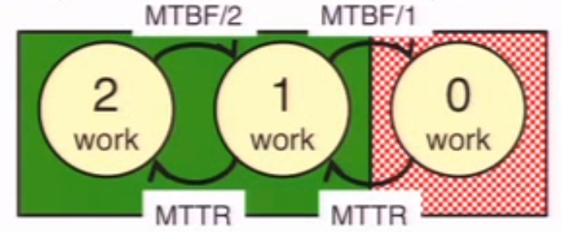
Redundancy and Distribution
Process pairs in different failure zones
Failure zone = thread, OS process, Processor/CPU, VM, PM, rack, site
Replication scheme (Active-Active, Active-Standby, …)
Attention! Strong consistency models imply tight coupling!
Location Transparency
Communication only via async message passing (fault containment)
Logical naming and addressing (URL, DNS, IP+NAT)
Duplex Fail Fast + Repair
MTBF = 6 months
MTTR = 12 hours
MTBF²/(2*MTTR) = ~100 years
Notes:
LWP/Threads
Location Transparency achieves load balancing and failover
Failover requires state managment -> short repair time (GigaSpace proxy, Load balancer etc)
message might never be delivered or takes very long, message passing is inherently unreliable
statefull service failover is difficult
backups also need to be checked

Slide 24
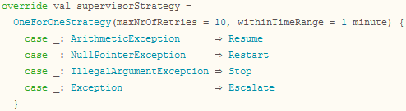
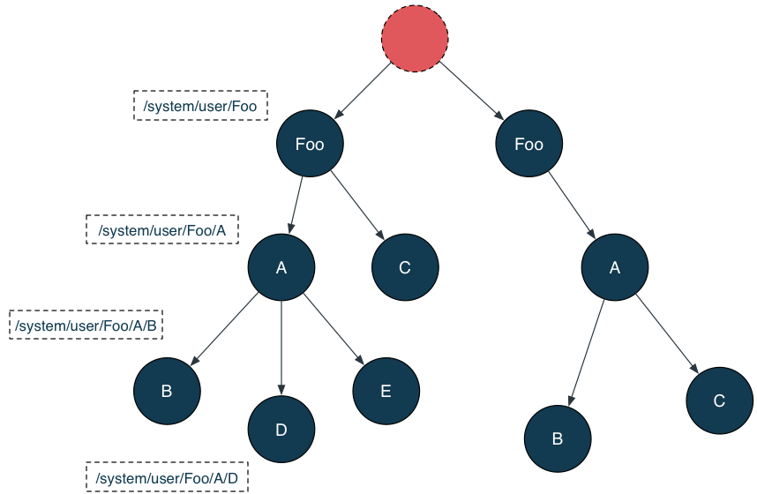
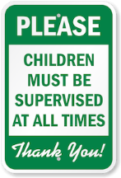
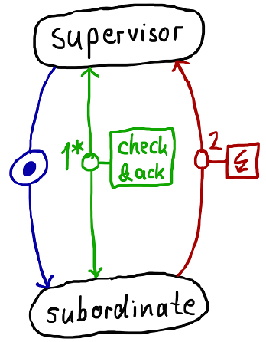
Hierachical decomposition and Supervision
Parent/Child relationship
A parent is responsible for his children
Children escalate failures which they cannot handle
Supervision hierarchies can (and often should) span multiple machines (failure zones)
Notes:
A social and way of dealing with failure, even animals do this
Units of Mitigation
OneForAll and OneforOne Supervision strategies
Never perform dangerous operation yourself, delegate it to outer layer
Managed outside the failed context
Frequently boundaries of responsibilities and failure domains coincide and their hierarchies match well [RDP]

Slide 25
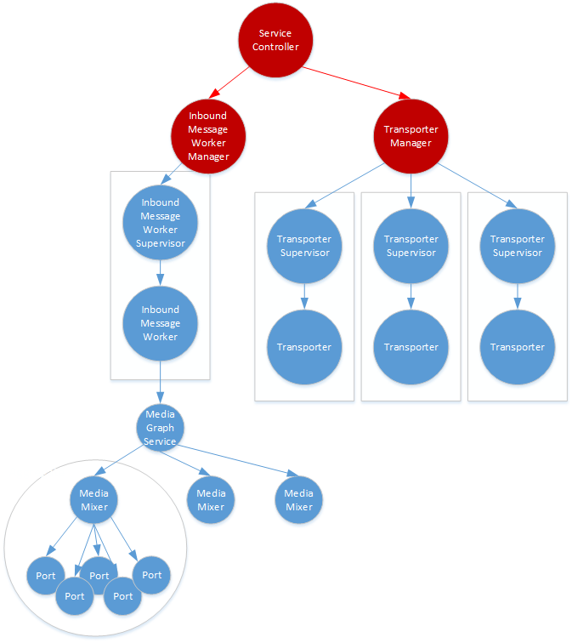
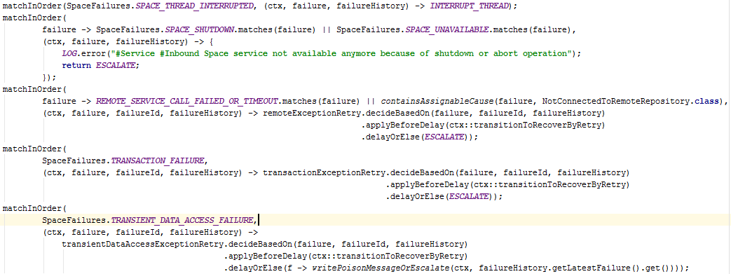
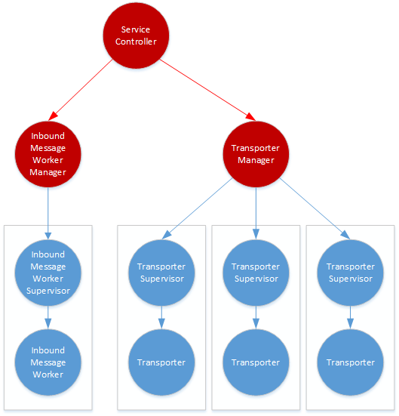
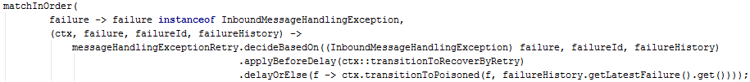

Slide 26
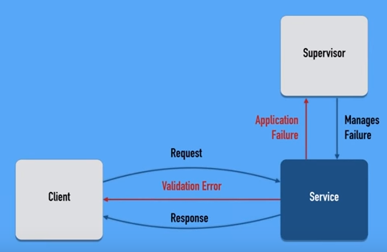
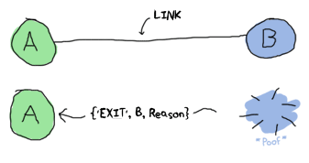
Failure Detection and Identification
Fail Fast - A single process should either do what it is supposed to do or fail as soon as possible
Signal errors as Messages accross process boundaries
Erlang: Process Link, Trap and Monitor
Notes:
Media Graph Service breaking change -> transformd to error response -> immediate signal on UI
Coffee machine example as life essential nutrient for developers
error detection and processing work best with clear boundaries
LifeX: Send error response on exception, link aggregates

Slide 27
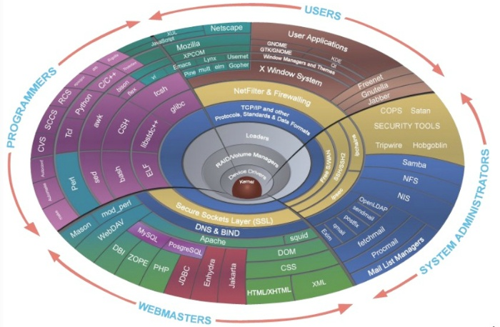
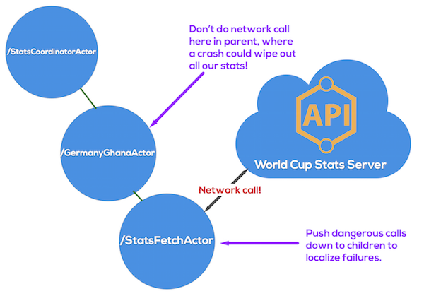
Error kernel
Keep essential state or functionality in the kernel of the system (near the root), delegate „risky“ operations and non-essential state towards the leaves
Identify state
Static state (config, changes rarely)
Scratch state (only used during computation, variables on stack)
Dynamic state
essential and not recomputable (request received from user)
recomputable (not a real problem, just recompute after crash)
Notes:
Enables fine grained Restarts (state re-initialization)

Slide 28
Recovering state - the art of crashing
“Something terrible happened” - everything within a process can be affected by a failure
Corrupted state as result of programming error
Transient but rare timing failure or resource leaks (often costly to diagnose/fix)
Let it crash: Prefer full component restart to internal failure handling
Chance to survive failures that were entirely unforeseen
Crash only software: Only one way to stop - by killing/crashing
Preferable to recover a working system by rebooting parts of it
Rejuvenation: Proactively re-starting components
removing the effects of software aging (resource leaks) before they lead to failure
Notes:
Reason why failure handling delegated to supervisor
Drastic measure as last resort
Hierarchical restart-based failure handling = greatly simplify the failure model = more robust
chance to survive failures that were entirely unforeseen
Don‘t add code for gracefull shutdown - always hard shutdown a service/system
Crash safely and recover quickly – you anyway need to have this
Example: Moving of Monitoring PU during G7
Software rejuvenation = testing your backups
Failure recovery must be a very simple path and that path must be tested frequently. Armando Fox of Stanford has argued that the best way to test the failure path is never to shut the service down normally. Just hard-fail it. This sounds counter-intuitive, but if the failure paths aren’t frequently used, they won’t work when needed
Memory leaks, entscheidung system unavailability oder safety consequences
Bohrbugs only in code that is not often exercised like shutdown code therefor crash only software
Redundancy has been designed into your system, but you don't actually trust it.

Slide 29
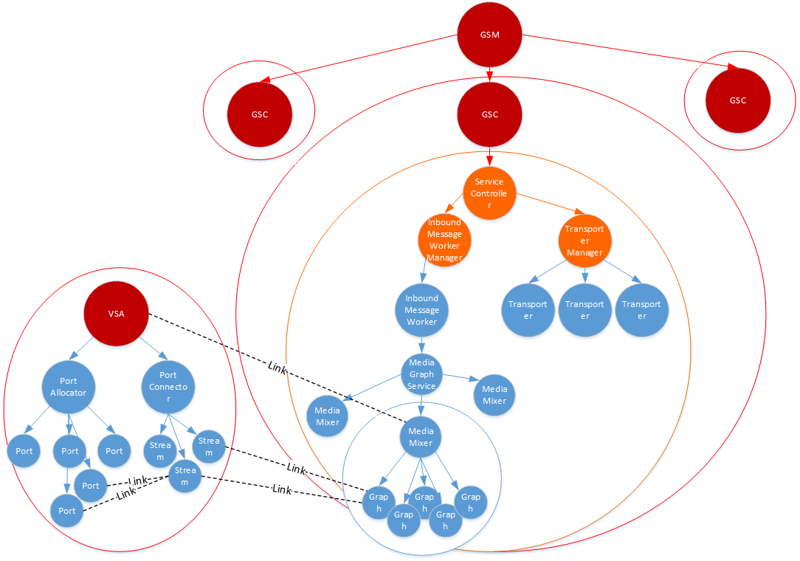
Notes:
VSA failure/anomaly detection sucks because there are no rules, no abstraction
Just fail the aggregate and the link will take care of destroying all resources on the VSA
G7 Ghost Audio (timing + state + auto restart missing)
Service should self evaluate ist load and health -> shed load, high prio work first, fresh work before stale

Slide 30
Requirements for restart-based failure handling
Tolerate crash+start of yourself (Stable Storage) and your dependencies (Timeouts etc)
Strong encapsulation - crash failures must be contained (Bulkheads, Timeouts, etc)
Resources must be automatically released and later reclaimed (Leases, OS process)

Slide 31
Isolation
Share nothing and reduce any form of coupling
Communicate only via async (immutable) messaging
Tolerate latency, silence and overload
Prevent cascading failures caused by
Blocked Threads
Slow Responses
Overload & Unbounded Queues
defend with
Timeouts
Bulkheads (Fault Containment Barrier)
Retries & Circuit Breaker & Leaky Bucket
Load sheding
Bounded Queues & Result Sets
Flow Control (Back Pressure)
Complete parameter checking (Sanity checks, Checksums, etc)
SSS_0308
The system shall be designed according to principles that minimize the impact of malfunctioning of one business domain on other business domains.
SSS_0310
The system components shall preclude the propagation of a failure to other system components.
Notes:
Other names Error Containment Barrier, Bulkheads, Quarantien
Reduce coupling in time (temporal) and space = loose coupling also during runtime = no sync call, no endless waiting
Every synchronous call implies coupling (if there is only one thread the coupling is very strong)
Share nothing (Tandem: To contain the scope of failures and of corrupted data, these multi-computer systems have no shared central components, not even main memory) Two processes operating on the same machine must be as independent as if they ran on physically separated machines.
Erroneous messages, incorrect actions, Side effects are difficult to undo
Anti pattern LifeX: One message/transaction load and modify multiple aggregates
cracks spread fast! = Detect (internal) errors quickly

Slide 32
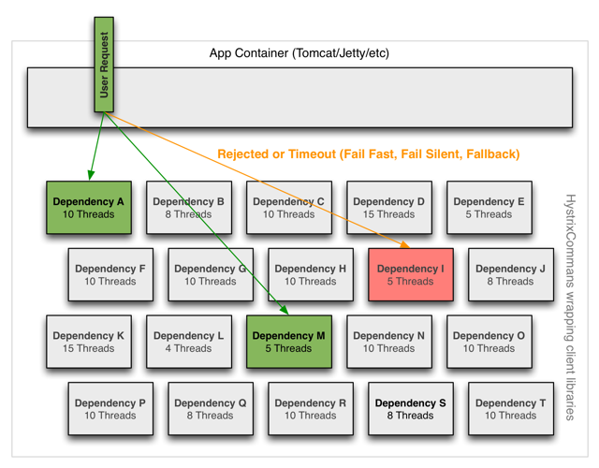
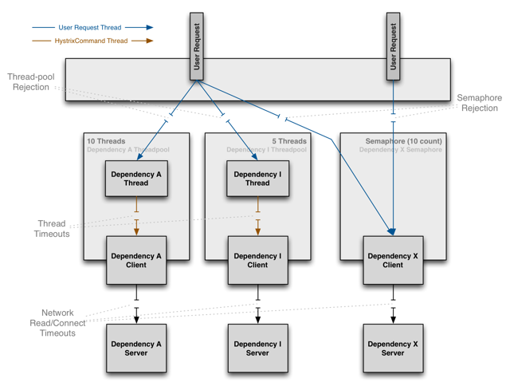

Slide 33
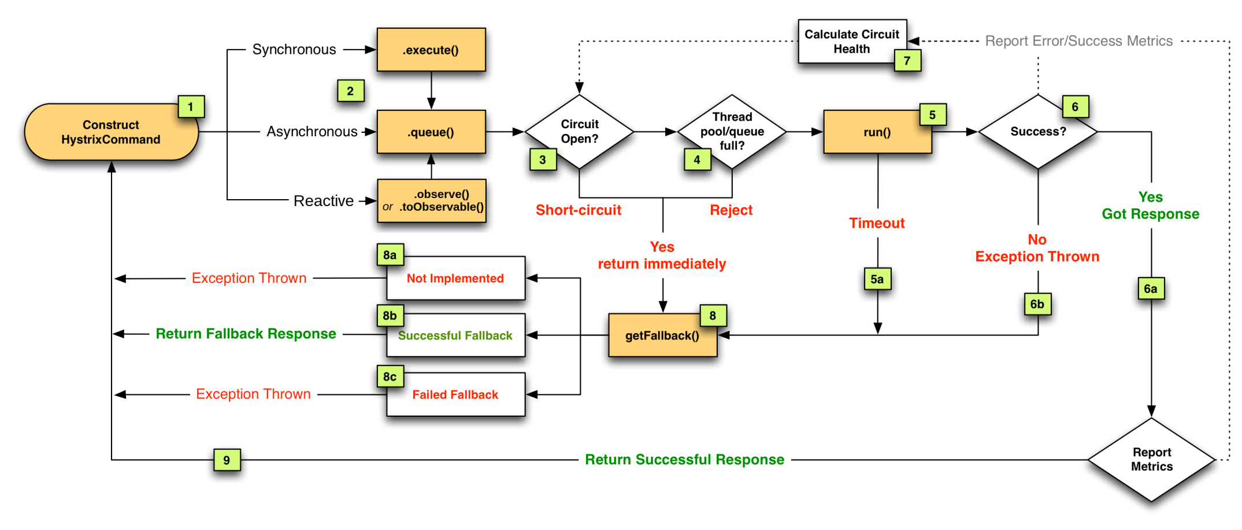
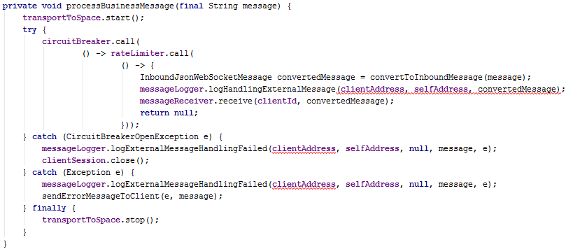
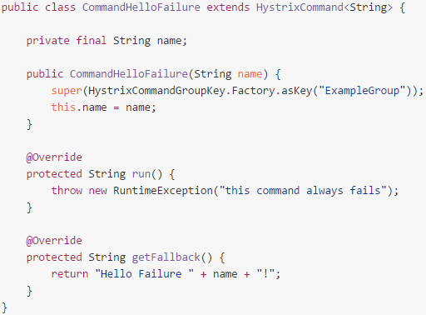

Notes:
Circuit breakers: release valve but system is dead at the time the circuit breakter kick in – bulkheads are the important thing here

Slide 34
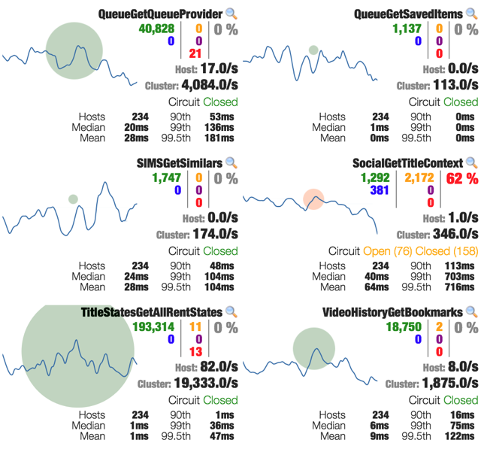
Notes:
Kibana live dashboards

Slide 35
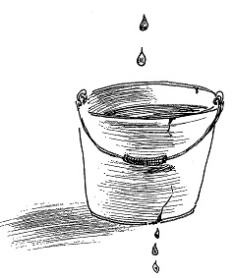
Retry on transient errors
Limit Retries! Plan for Escalation
Use Realistic Thresholds (adjust dynamic)
Think about delays
Don‘t go to fast but also not too slow (flow control again)
Randomize delays (especially for concurrent resources)
On how many lower levels are already retries present? What’s the timeout and interval on those levels?
How expensive is the retry operation? Tradeoff communication complexity vs detection/recovery time
Notes:
NServiceBus 2nd level retry
Flow/Congestion Control
http://web.archive.org/web/20090717220330/http:/blogs.msdn.com/oldnewthing/archive/2005/11/07/489807.aspx

Slide 36
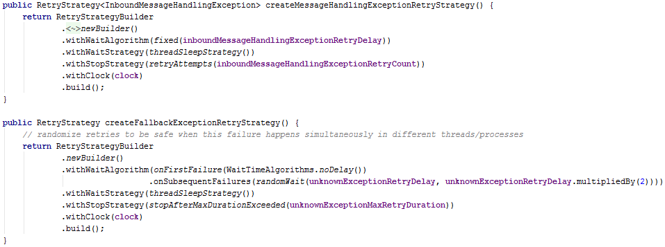
Notes:
InboundMessageWorker:
Checkpoint (Transaction), Rollback, Ride over Transients + Limit Retries, Rollforward (error free state)

Slide 37
Provide awesome support for concurrency
Use well established concurrency model
Event loop, Actors, CSP, SEDA, ..
Immutability is your friend
(Shared) Mutable state is your enemy
Look carefully for blocking calls!
Model your solution close to your problem
Be restrictive!
web workers, OTP gen_server
Get inspired
Event Loop -> Node.js, Netty, UI Frameworks
Actor Model -> Erlang
Functional -> Haskel, Clojure core async,
Async done sequential -> C# async/await
CSP -> Golang
Notes:
Example: WF Service = no framework, this means you need to look extremly carefull which calls might block, in practice ist not feasable because software evolves.
You dont know when a new version of a 3rd party lib suddenly performs a blocking DNS lookup
Blocking calls = Dont allow them by design if it‘s possible
Model = if something is concurrent in the real world, model it concurrent in your program

Slide 38


Programming techniques
Check input at untrusted „boundary“
Fail fast but don‘t clutter your code with defensive checks
Separate error handling code from „business“ code
Who should fix the problem? (you or supervisor)
Make failures explicit in your abstractions (API)
Intention revealing programming (naming + patterns again!)
Avoid „null“ – prefer types
Prefer return values over exceptions
Avoid state – go functional
https://blogs.msdn.microsoft.com/ericlippert/2008/09/10/vexing-exceptions/
Notes:
Boundary = human interface, foreign language program
Fail fast = don‘t clutter your code
Supervisor = more context
Defenive programming only necessary if you have a single thread
It reduces complexity in fault-tolerant systems by keeping the normal and error-handling code separate.
What failure behaviours are likely to be exhibited? Document them!
Defensive programming only necessary if you have a single thread

Slide 39

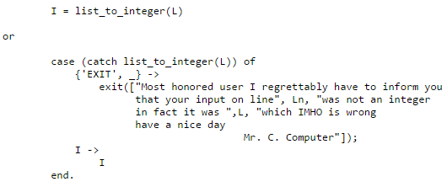


Erlangs „Let it crash“ philosophy
shorted code
2) clearer code
3) no chance of accidentally violating the spec
4) perfectly acceptable error diagnostic
Violates spec
Correct
Notes:
shorted code
2) clearer code
3) no chance of accidentally violating the spec by introducing ad hock "out of spec" code to correct the error
4) perfectly acceptable error diagnostic

Slide 40
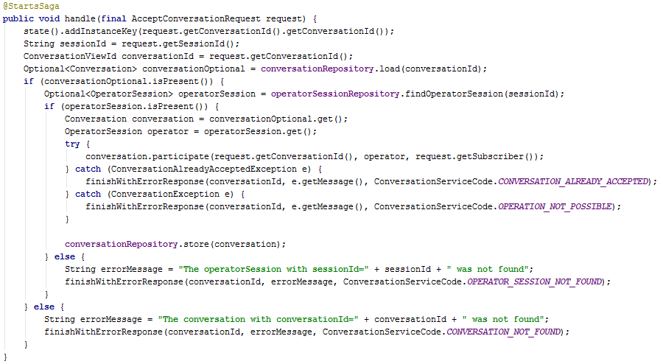
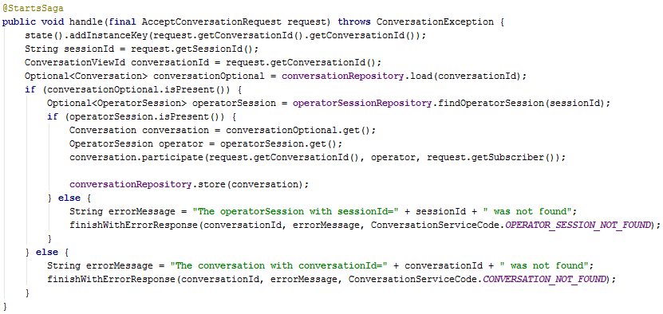
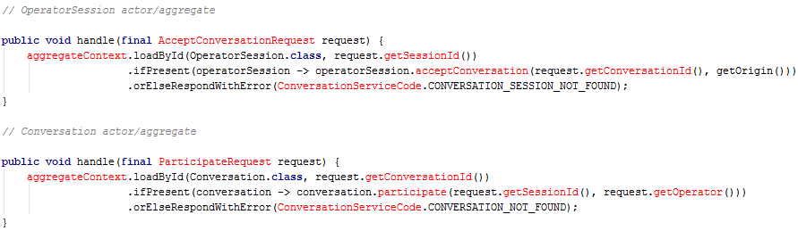


Operator

Slide 41
Overload Mitigation
Prevent chain reactions!
Fresh work before stale (Dashboard@G7)
Shed load (at system boundary if possible)
Slow down
Degrading service
Priority messagse first
Handle only high prio messages (discard low prio messages)
Unbounded queues are bad! – mkay
Flow Control – do you want me to rebuild TCP?
Backpressure
More threads, processes, machines -> more problems
Notes:
what if you can‘t keep up
VSA logging crash / G7 dashboard / op monitoring service / Intergraph Integration
https://youtu.be/6VBn9V3S2aQ?t=2864
Be aware of internal congestion issues (resource saturation, queuing effects)

Slide 42
Testing
Everything that is not tested, is a rumour
Fault insertion testing
try to f*ck up the system
Continuous regression tests
Property based testing
don‘t forget to test your backups and redundant components
// add random loss
$ iptables -A INPUT -m statistic --mode random --probability 0.1 -j DROP $ iptables -A OUTPUT -m statistic --mode random --probability 0.1 -j DROP
// limit bandwitdh, add delay and loss
$ tc qdisc add dev eth0 root netem delay 250ms loss 10% rate 1mbps
 | Example-based | Property-based
White-box | Traditional unit tests | Generative Tests
Black-box | Integration tests | Simulation Testing
https://github.com/SecurityInnovation/Holodeck
https://github.com/aphyr/jepsen
Notes:
Program testing can be used to show the presence of bugs, but never to show their absence
Inject errors into code + OS, delays, re-order messages, drop messages, low disk space, kill services, .. try to f*ck up the system
Jespsen, Holodeck, iptables, etc
WeatherFaxService Beispiel: Heartbeat escalate, Retries, Service kill -> Fazit you need to test failure scenarios -> afterwards heavy fault injection testing

Slide 43




Slide 44


Monitoring and Post analysis
Real-time
Dashboards (Kibana)
Alerting
Persistent historical data
Store everything (if feasible)
Logs
Zabbix, Veeam ONE, Kibana
Message Logging (Replay)
Provide an Admin Interface
Dumps
App Error Log should contain: context, message, error description, potential reason and fix
Stack traces are brilliant
Establish Correlation between Metrics
Notes:
Beispiel: Moderne autos, diagnostik mittels maintance interface
Self-diagnosing, Forecasting and Anomaly detection
OS process create core dump on crash
JVM create heap dump on OutOfMemError
Erlang process dumps generated when actor dies

Slide 45
References
Robert S. Hanmer: Patterns for Fault Tolerant Systems
Michael T. Nygard: Release It
Jim Gray: Why Do Computers Stop and What Can Be Done About It?
Joe Armstrong: Making reliable distributed systems in the presence of software errors
Hamilton - On Designing and Deploying Internet-Scale Services
Candea and Fox: Crash-Only Software
Candea Armando : Recursive Restartability: Turning the Reboot Sledgehammer into a Scalpel
Reactive Design Patterns EAP
Cristian: Understanding Fault Tolerant Distributed Systems
Gray, Horst, Barlett - Fault Tolerance in Tandem Computer Systems
BFT, Chou: Beyond Fault Tolerance, Chou
Schneider: Byzantine Generals in Action" Implementing Fail-Stop Processors
Somani & Vaidya: Understanding Fault Tolerance and Reliability
A survey of software fault tolerance techniques
Recovery Oriented Computing (ROC): Motivation, Definition, Techniques, and Case Studies
Overcoming Byzantine Failures Using Checkpointing
Byzantine Fault Tolerance, from Theory to Reality
Out of the Tarpit
Dijkstra: Notes on Structured Programming
Lyu: Handbook of Software Reliability Engineering

Slide 46
Videos
https://www.youtube.com/watch?v=dKWNZnuZhd0
https://www.youtube.com/watch?v=NjPVJ7ZKLnY
https://www.youtube.com/watch?v=T9MPDmw6MNI
https://www.youtube.com/watch?v=YaUPdgtUYko
https://www.youtube.com/watch?v=c8F_TGv1yME
Testing Distributed Systems w/ Deterministic Simulation https://www.youtube.com/watch?v=4fFDFbi3toc
https://www.youtube.com/watch?v=ohvPnJYUW1E
https://www.youtube.com/watch?v=9R710ry-Cbo
https://www.youtube.com/watch?v=4dfk3ucthN8
https://www.youtube.com/watch?v=gJRj3vJL4wE
https://www.youtube.com/watch?v=ZGIAypUUwoQ

