Slide 1
Internship Progress Report
Date: 2022/02/09
Kevin.Liu

Slide 2
Goal
Deploy the O-RAN components (E Release - Dec,2021)
Focus on key components , such as “SMO”, ”Non-RT RIC” and “Near-RT RIC” and relevant interfaces.
Survey the methods/papers about mitigating the flooding attack utilizing NFV.
Info.
My repository: https://github.com/leozzmc/Paths_To_Deploy_O-RAN
Note: https://hackmd.io/@Kevinneck/S1jOeL1J9

Slide 3
Weekly Progress
Mon. | Tue. | Wed. | Thur. | Fri.
1/17 | 1/18 | 1/19 | 1/20 | 1/21
Near-RT RIC Deployment (E-Release)
1/24 | 1/25 | 1/26 | 1/27 | 1/28
SMO + Non-RT RIC Deployment (E-Release)
2/7 | 2/8 | 2/9 | 2/10 | 2/11
O1 Interface Testing + Solution Survey |  |  | Meeting

Slide 4

Environment
VMware ESXi-6.7.0
VMs:
SMO:
CPU: 4 cores
Memory: 32GB
Storage: 160GB
OS: Ubuntu 18.04 LTS
Near-RT RIC:
CPU: 4 cores
Memory: 16GB
Storage: 160GB
OS: Ubuntu 18.04 LTS

Slide 5
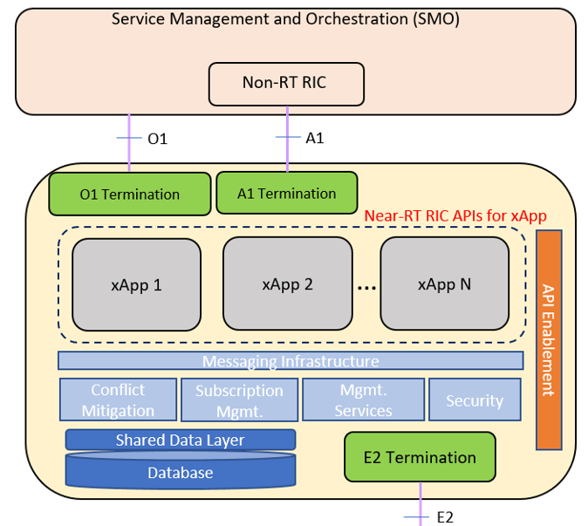
Near-RT RIC Deployment
Kubernetes Node Setup
Near-RT RIC Installation
“HelloWorld” xApp onboarding
⚠ NOTICE: the deployment of xApp is not already implemented in E release

Slide 6
SMO Deployment
Kubernetes Node Setup
ONAP installation
Non-RT RIC Deployment
Build
Run

Slide 7
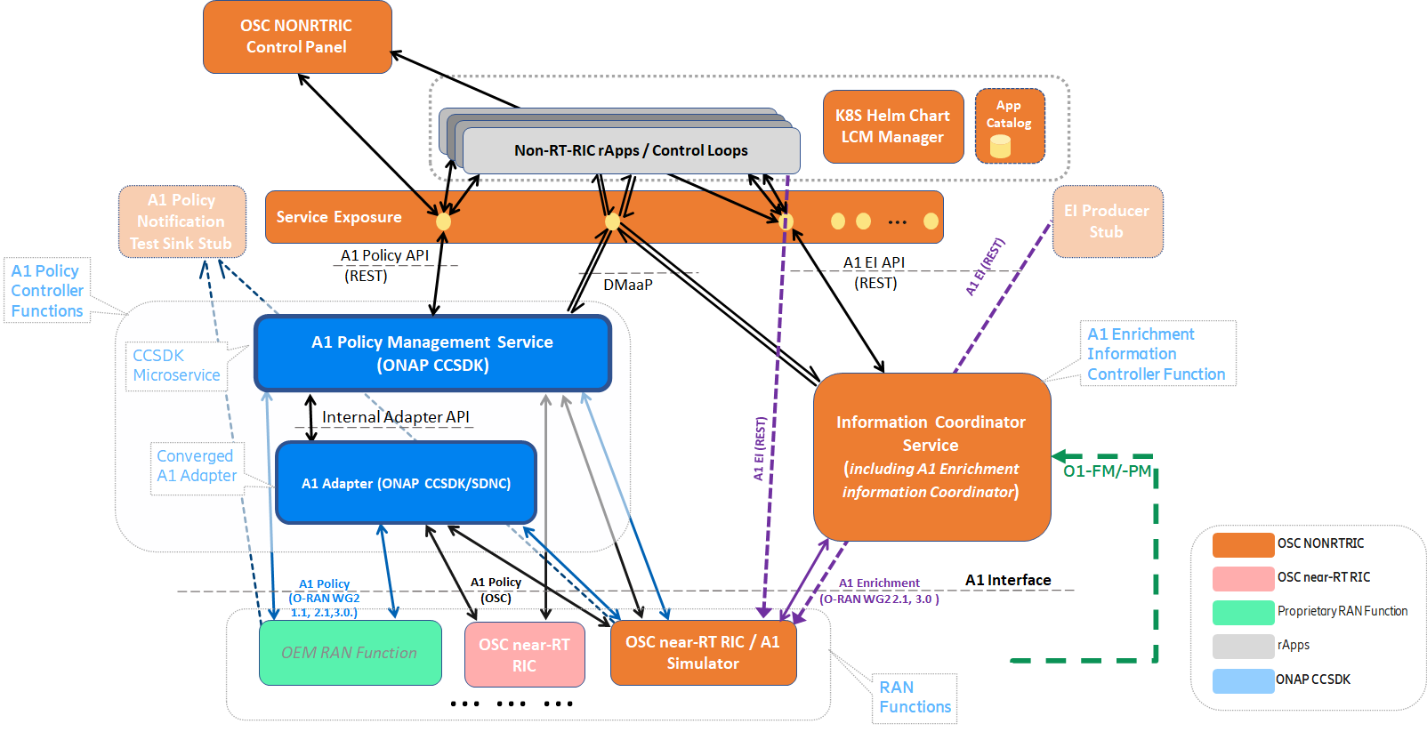
Non-RT RIC
https://wiki.o-ran-sc.org/display/RICNR/Release+E
Notes:
Non-RT RIC

Slide 8
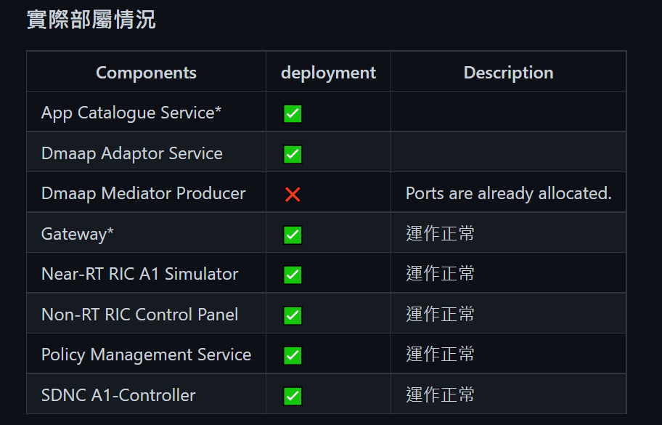
Non-RT RIC Deployment

Slide 9
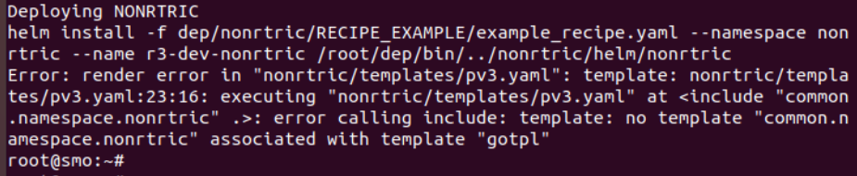
Non-RT RIC – Build and Run from K8S
Lack of “common.namespace.nonrtric ” helm template
Build + Run via Docker

Slide 10
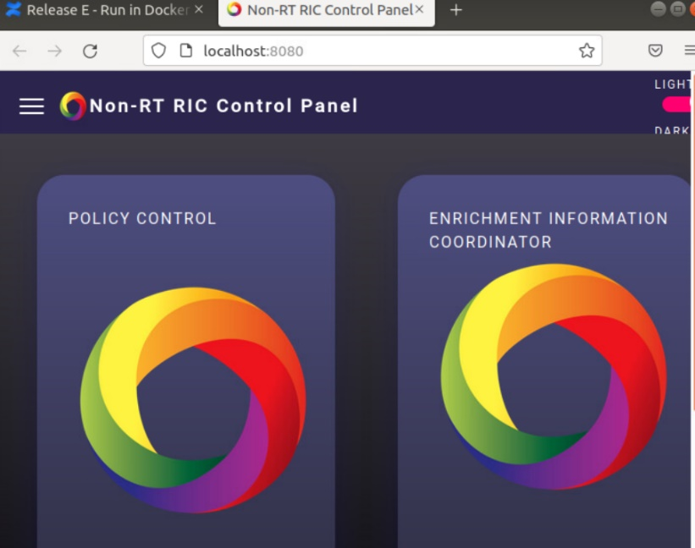
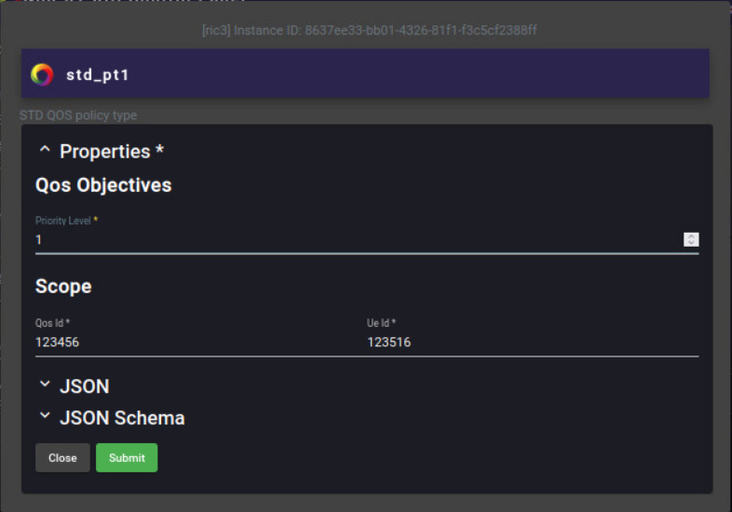
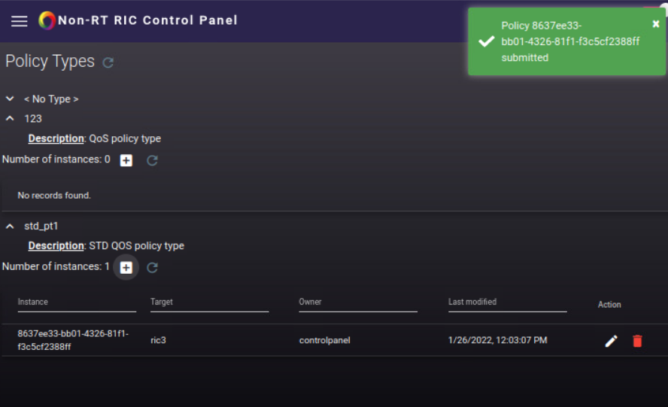
Non-RT RIC Control Panel
1. Access the policy control panel
2.Create Policy
3.Setting Properties
4. Successfully create the policy for A1-SIM

Slide 11
Non-RT RIC – manually build via Docker
Prerequire:
docker
docker-compose
Java 11
Maven 3.6
golang(v1.13.8)(v.1.17)
In the process of building the Dmaap Module:There were some errors caused by the golang version.
You will need to change the “GOROOT” environment variables if you encounter the version error to another go version
Notes:
Maven: 自動化建構工具，支援.jar的編譯、dependency、測試以及打包

Slide 12
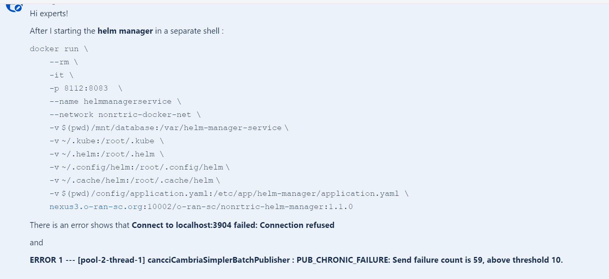
Helm Manager Issues – My Question

Slide 13
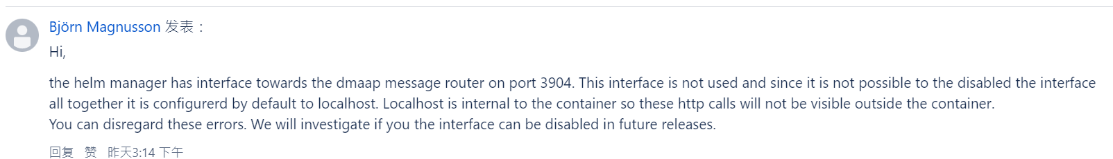
Helm Manager Issues - Response
The interface (helm manager ↔ dmaap message router) is not used
And It is not possible to disable the interface all together it is configured by default to localhost
The O-RAN Alliance will investigate if these interfaces can be disabled in future release.

Slide 14
Policy Delivery
Non-RT RIC
Gateway
A1 Policy
Management
Service
A1
Adapter
A1
Simulator
Control Panel
Near-RT
RIC

Slide 15
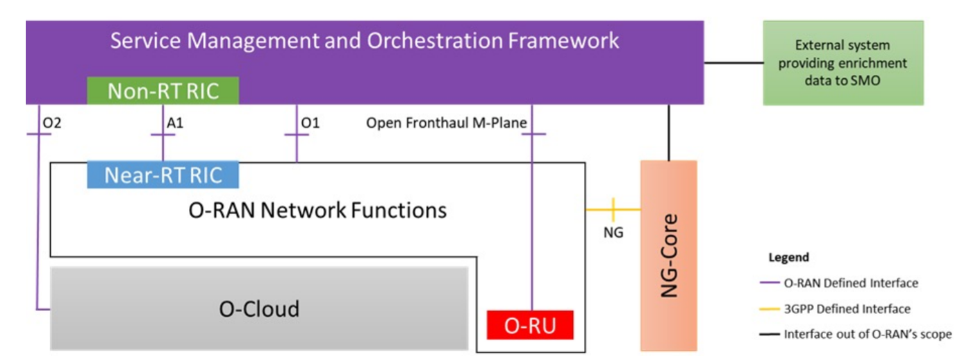
O1 Interface
2 Containers: SDNR and SDNR_DB
They are act as a NETCONF client to the O-RAN Elements
(O-RU,O-DU,O-CU and Near-RT RIC)
They(SDNR, SDNR_DB) Both have GUI and RESTCONF supporting

Slide 16
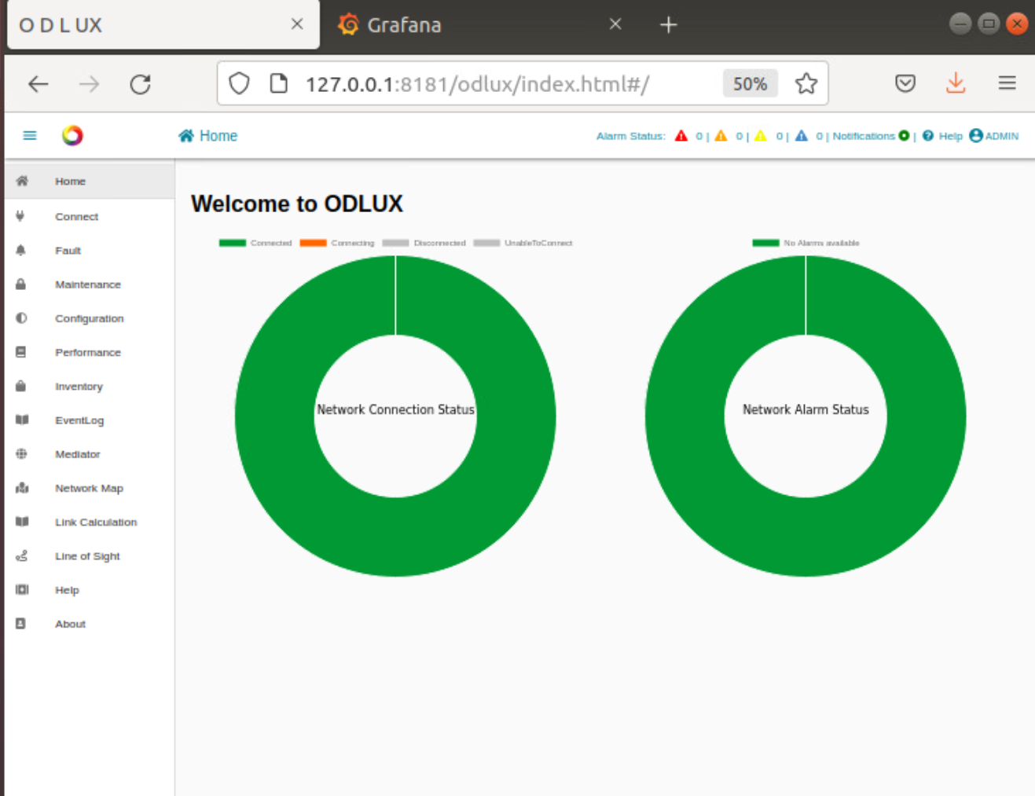
Access the panel - ODLUX
http://localhost:8181/odlux/index.html

Slide 17
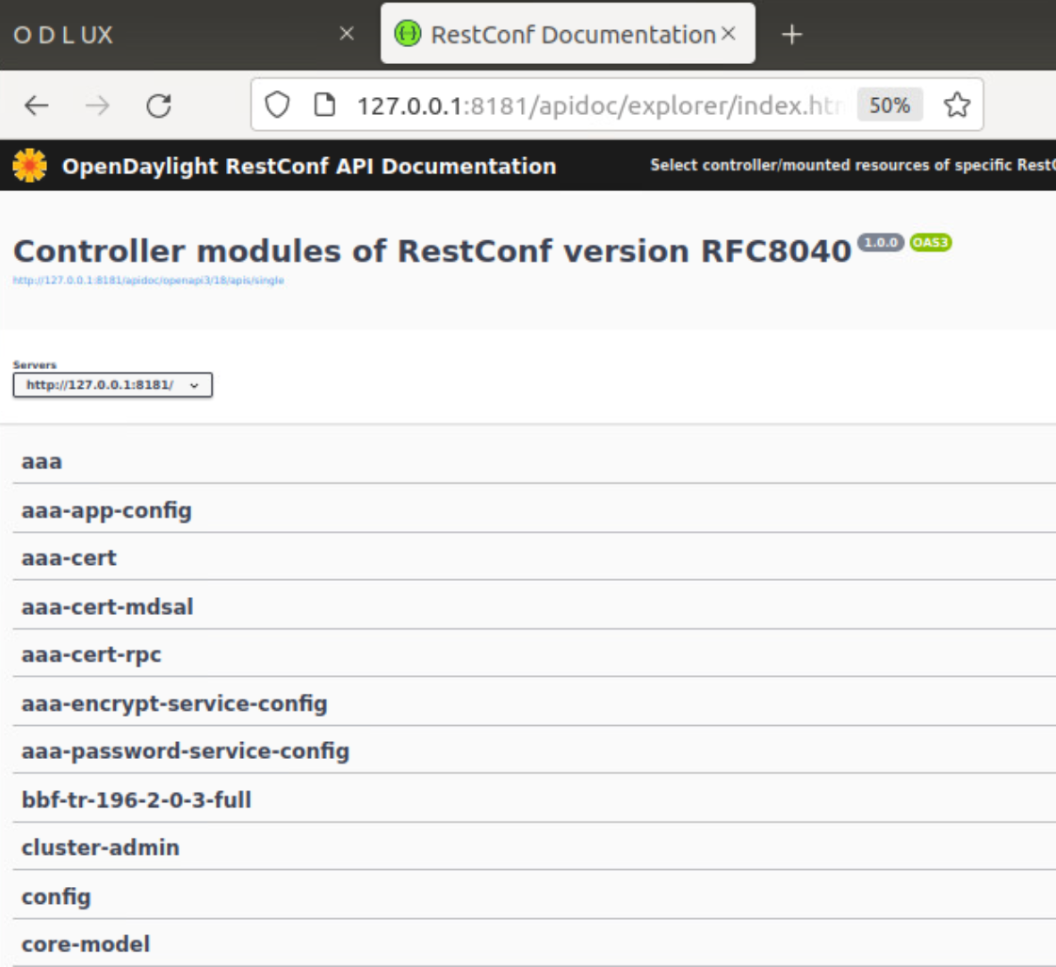
RESTCONF API Doc
http://127.0.0.1:8181/apidoc/explorer/index.html
Notes:
他跟NETCONF的差別應該是
將NETCONF封裝成HTTP Request，然後可以透過http api api的方式
來去對設備做一般的CRUD

Slide 18
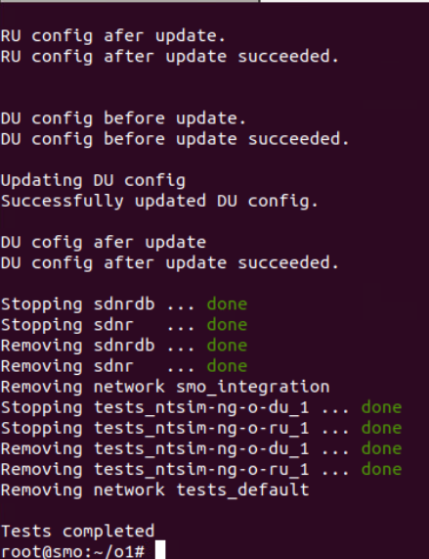
Running Test Cases
Automated test-suite
Steps:
Bring up simulators (RU & DU)
Bring up SDNR
Add Simulator to SDNR
Checks connectivity status by fetching the capabilities
Updates DU and RU config and prints the output

Slide 19
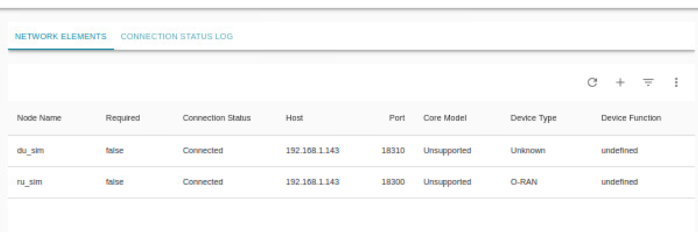
Running Test Cases – SDNR GUI(ODLUX)
The RU,DU Simulator will be add to SDNR through the REST API
You can also add simulator on the panel, or do it manually.
curl -u admin:Kp8bJ4SXszM0WXlhak3eHlcse2gAw84vaoGGmJvUy2U -X POST "http://<HOST_IP>:8181/rests/operations/netconf-node-topology:create-device" \
-H "accept: */*" -H "Content-Type: application/json" \
-d '{"input":{"pass-through":{},"login-password":{"username":"netconf","password":"netconf!"},"host":"'"$HOST_IP"'","port":"18310","node-id":"du_sim"}}')

Slide 20
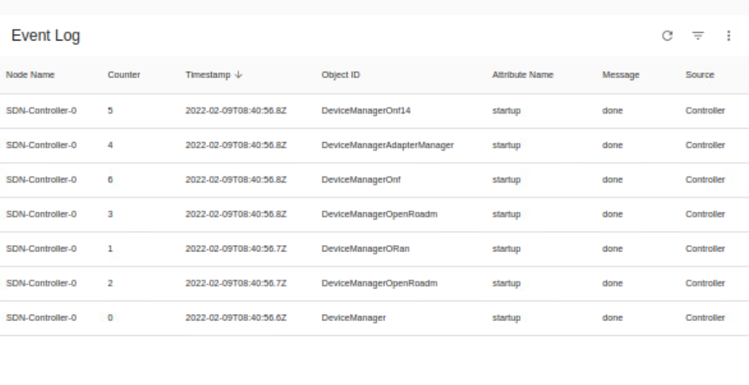
Event Logs

