Slide 1


Slide 2


Slide 3


Slide 4
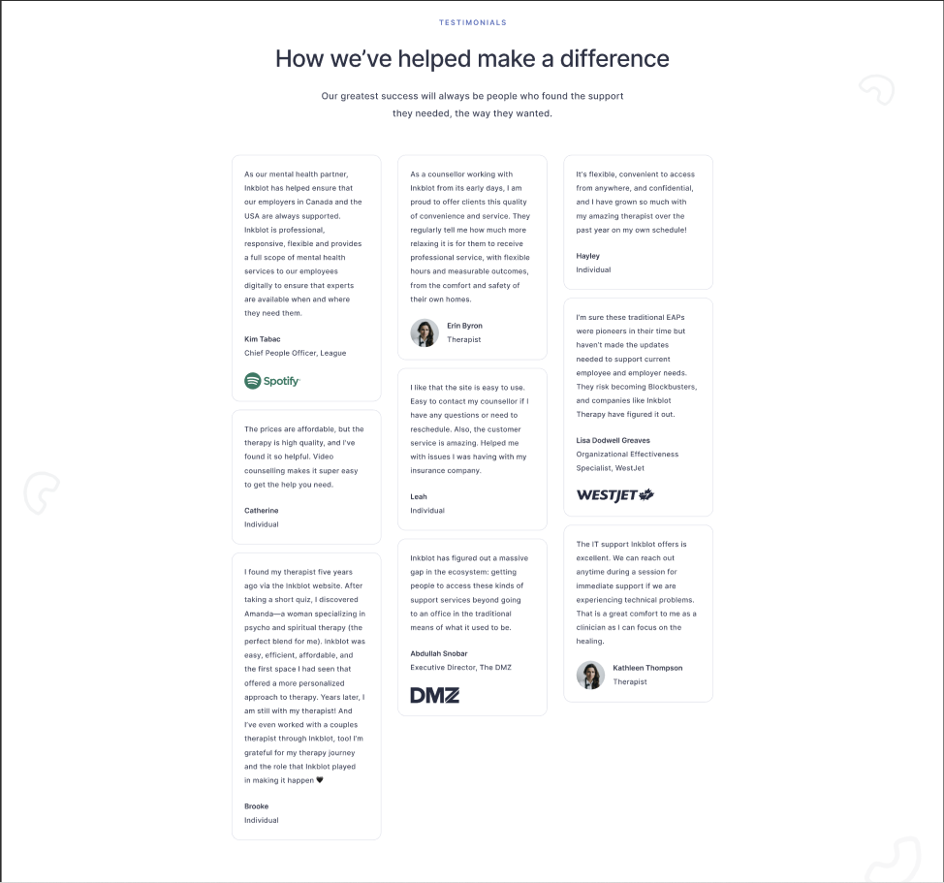

Slide 5
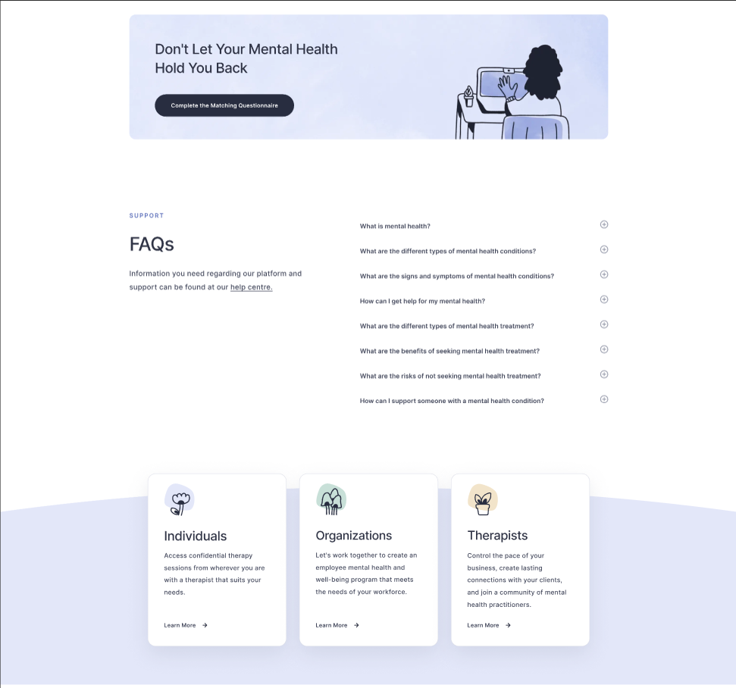

Slide 6


Slide 7





Community
Development
System, Inc.
C D S
COMMUNITY DEVELOPMENT SYSTEM
Community
Development System

