Slide 1
Global Life Expectancy 2000-2020 WHO
By Paul-Moritz Jost for Ironhack Berlin

Slide 2
Goal: Predict Life Expectancy and its Politico-Economic Antecedents

Slide 3
Global Life Expectancy 2000-2020 WHO
Introduction to Dataset
Exploratory Data Analysis
Target Variable Regression
Power Law Distribution
Prediction by Classifcation
Practical recommendations

Slide 4
1.) Introduction to Dataset
193 Countries
20 Years
Life Expectancy
Disease
Population Size
Economic (In-)Equality
Schooling

Slide 5
2.) Exploratory Data Analysis
22 features
2 categorical features, 20 numerical
2938 entries
NaN’s max 22.19% (population)
No duplicates

Slide 6
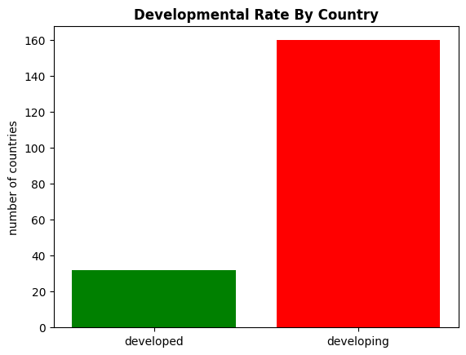
2.) Exploratory Data Analysis

Slide 7
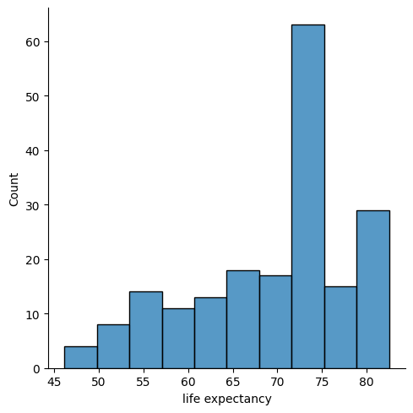
2.) Exploratory Data Analysis

Slide 8
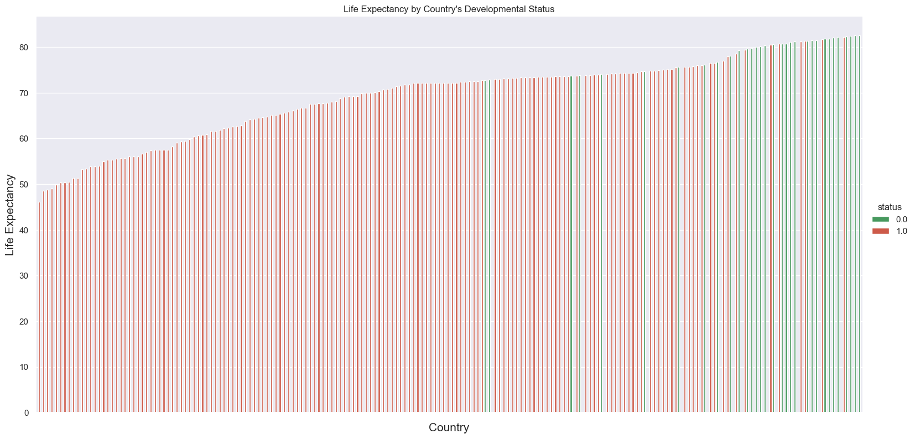
2.) Exploratory Data Analysis

Slide 9
3.) Target Variable Regression
Linear Regression
KNN
Decision Tree
Random Forest

Slide 10
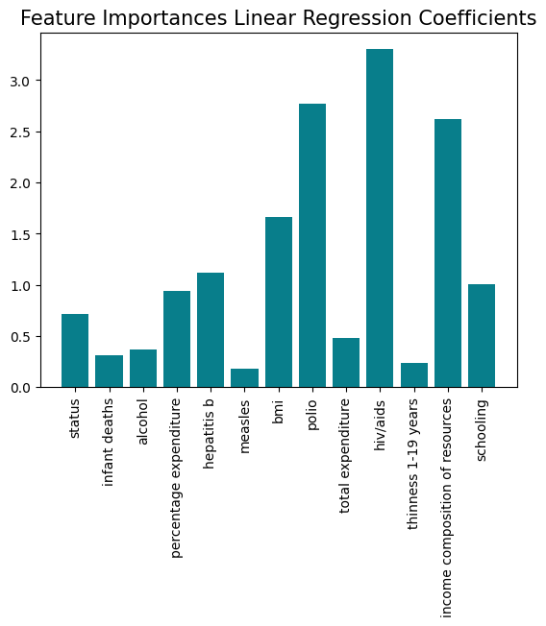
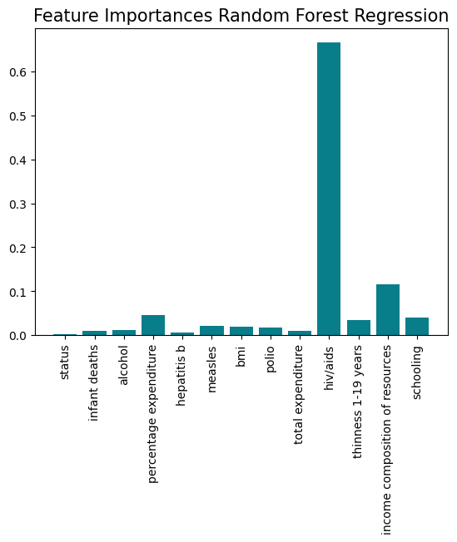
3.) Target Variable Regression

Slide 11
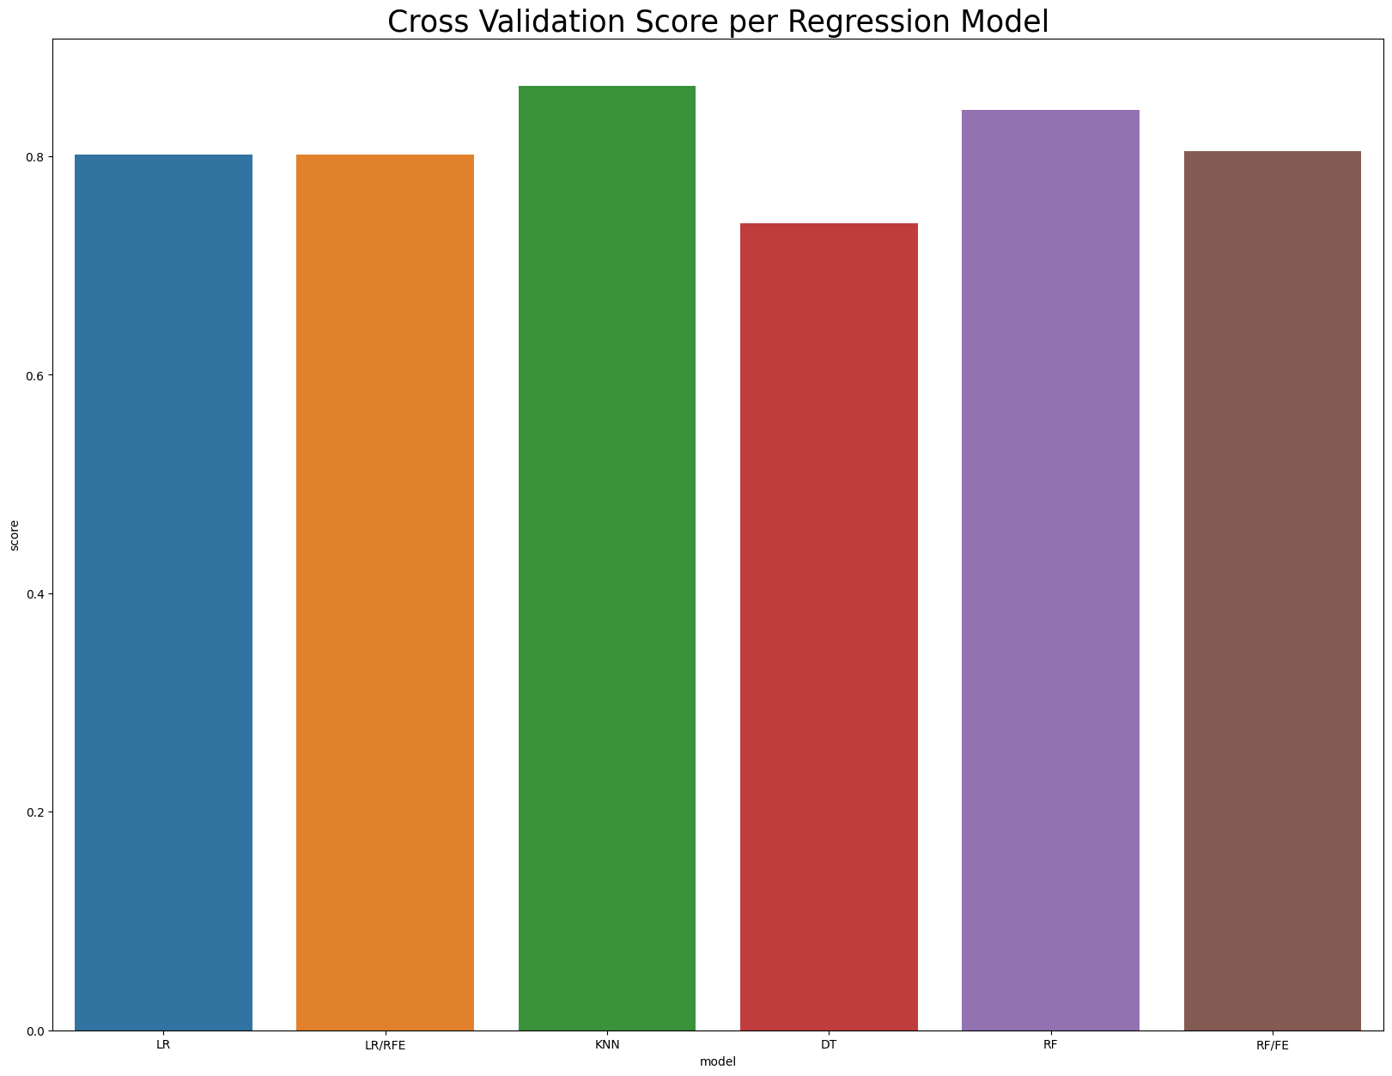
3.) Target Variable Regression

Slide 12
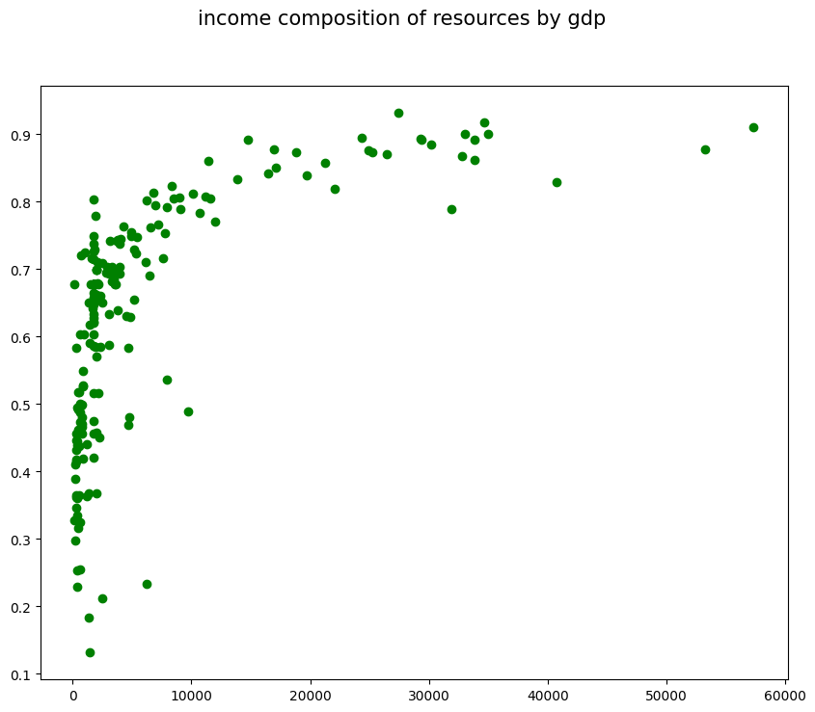
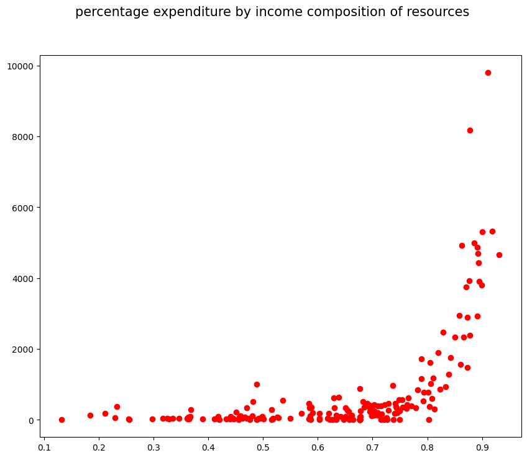
4.) Power Law Distributions

Slide 13
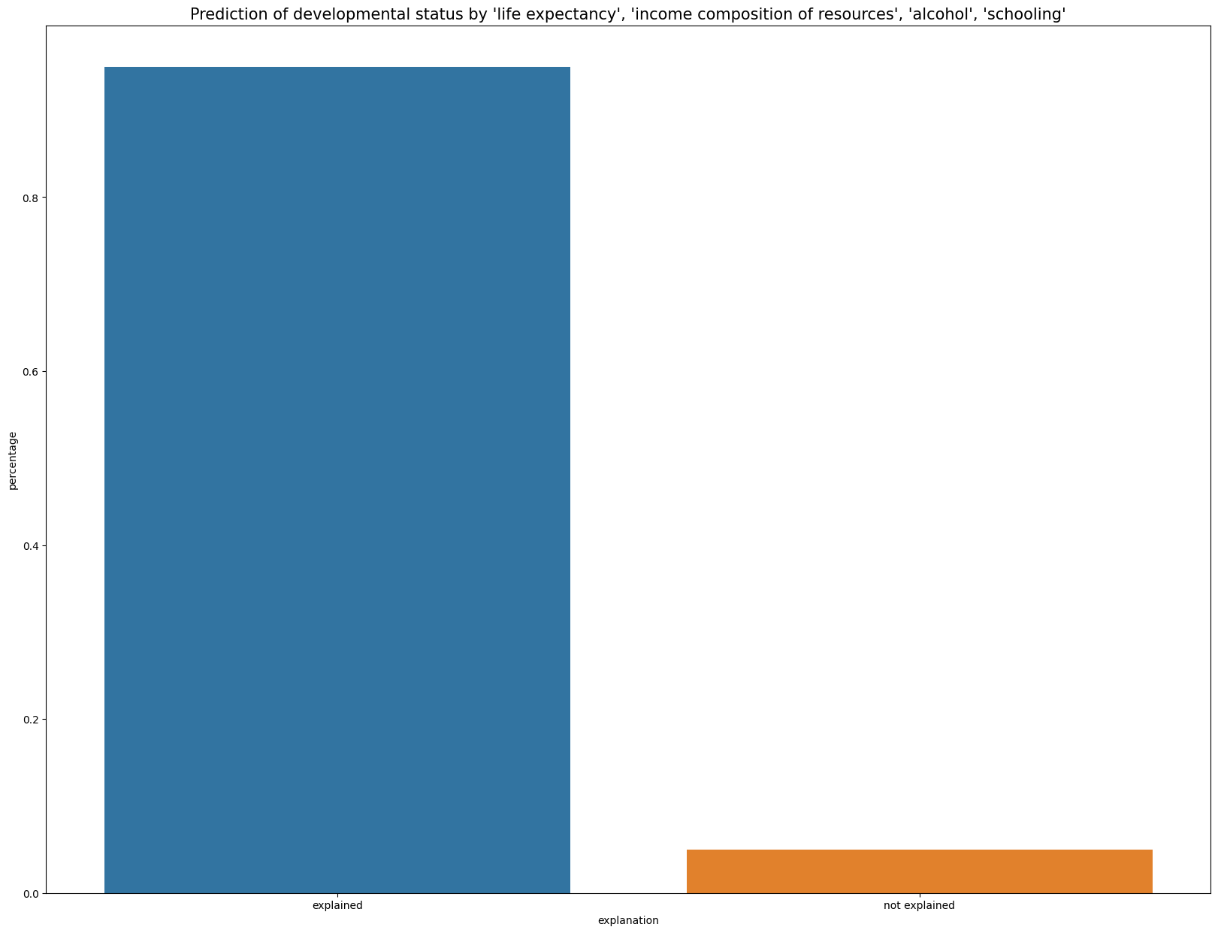
5.) Prediction by Classifcation

Slide 14
6.) Practical Recommendations
Gathering data that’s less skewed towards developing countries
Explore reasons for high life expectancy in certain developing countries
Compare algorithmic architecture of ML models to politico-economic goals
Relate data of life expectancy to data of wealth distribution within countries
Gather an exponential regressor compatible with scikit-learn

Slide 15
Thank you for listening!

