Slide 1
Plankton Classification
Jeremiah Cloud
Vanessa Lepe
Faraz Niyaghi
Katy Williams

Slide 2
Questions of Interest
How can we edit the images to make up for the different aspect ratios, orientation, and excess empty space (-1 values in the matrices)?
What features can we come up with in addition to features calculated by MATLAB’s bagoffeatures function?
Using Random Forest, what model has the best predictive performance for the test set?

Slide 3
bagOfFeatures
Creates a “vocabulary” of SURF features
Extracts SURF features
Constructs visual vocabulary by reducing number of features using k-means clustering

Slide 4
Using MATLAB
We removed all excess rows and columns of empty white space in both the training data and the test data
Split the training set into a sub-training set and validation set
Used bagOfFeatures function to get the same 500 features for the sub-training, validation, and test set
Manually calculated the mean proportion of white space per image and the length to width ratio of each image
Converted the matrix of features to .csv for R implementation

Slide 5
Using R
Used Random Forest with 15 features at each node to sequentially test the number of trees up to 1000 and then each sub interval until achieving an optimal number of trees (68 in our case)
Determined the important features from the Random Forest results for which included both of the features we manually created as two of the top features
Fit the test data using the results from the training data
Extracted the prediction matrix and scaled the probabilities to avoid having log(0) when uploading to Kaggle

Slide 6

Sample of edited image

Slide 7
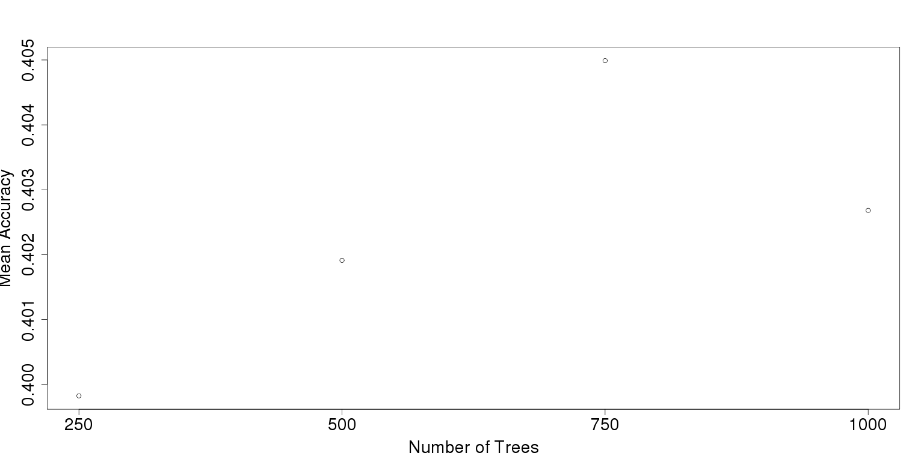
Mean Accuracy of N Random Forest Trees

Slide 8
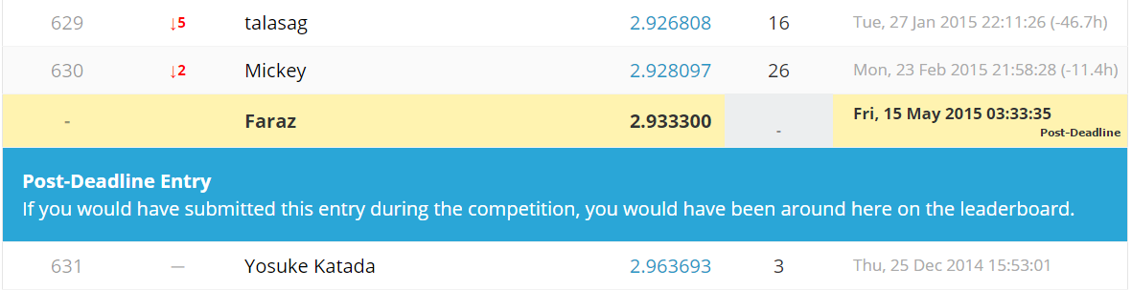
Results

Slide 9
Complications
Scaling Images
Lack of image processing functions in R
Computationally expensive

Slide 10
Future Work
Implement a technique that find features for scaled images
Compare other classification methods to Random Forest
Use Snow and/or Rpython to break up the computations in order to train with a larger number of variables per node.

