Slide 1
Heath Insurance Coverage Prediction based on the 2013 US Census Data
Presented by:
LE PHAM TUYEN (2014311082)
김진석 (2015310245)
정철진 (2015310254)

Slide 2
Outline
Review
Logistics Regression Model
Examine some prediction models
Large scale the model using Spark Apache

Slide 3


Review: objective
Find models which can predict the healthcare coverage based on US Census Data 2013.

Slide 4
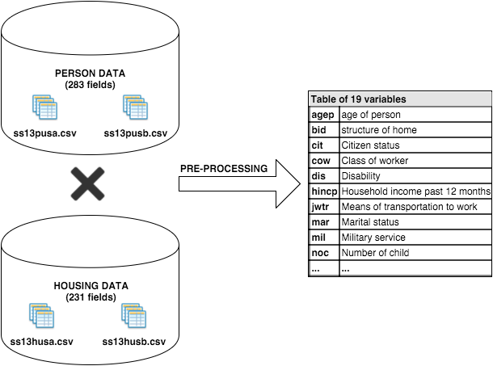
Review: Pre-processing

Slide 5
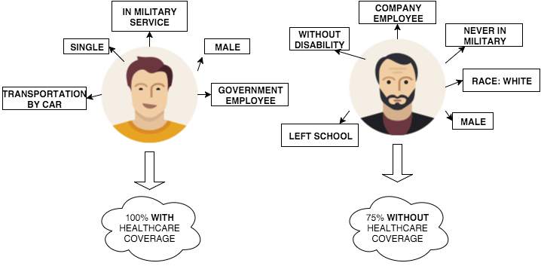
Review: Association Rules

Slide 6
Split data
Partition Data into training(75%) and testing(25%) data sets
library(caret)
intrain = createDataPartition(y = dataset_logistics$HICOV, p = 0.75, list = F)
training = dataset_logistics[intrain, ]
testing = dataset_logistics[-intrain, ]

Slide 7
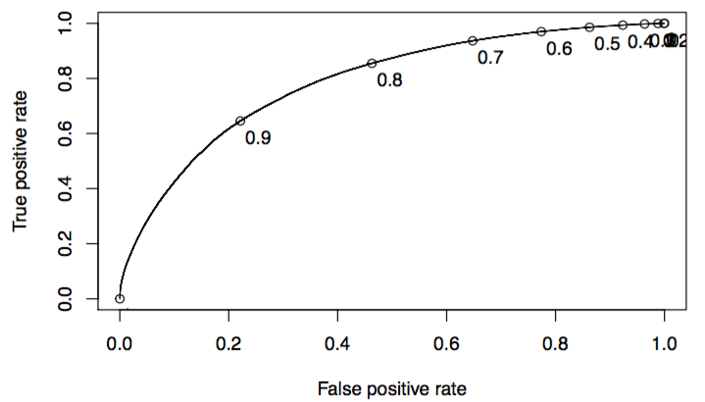
Logistics Regression Model
Using glm() for analyzing logistics regression
fit = glm(HICOV ~ ., data = training, family = "binomial")
Predicted
Observed |  | Without Coverage | Coverage
 | Without Coverage | 13737 | 9719
 | Coverage | 86120 | 673622
AUC = 0.7877123
Accuracy = 0.8776312
At cutoff = 0.5

Slide 8
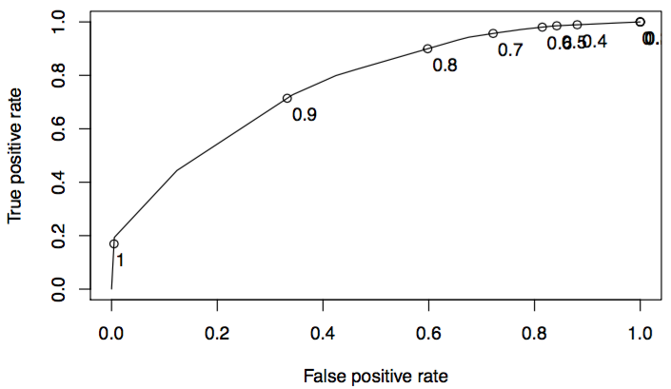
Decision Tree Model
Using rpart for decision tree model
fit = rpart(HICOV ~ ., method="class", data=training, cp=0.002)
Predicted
Observed |  | Without Coverage | Coverage
 | Without Coverage | 16444 | 10358
 | Coverage | 83413 | 672983
AUC = 0.7656657
Acuracy = 0.8802717
At cutoff = 0.5

Slide 9
Naïve Bayesian Model
Using naiveBayes for Naïve Bayesian model
model <- naiveBayes(HICOV ~ .,data=training)
Predicted
Observed |  | Without Coverage | Coverage
 | Without Coverage | 36463 | 64110
 | Coverage | 63394 | 619231
Acuracy = 0.8372008

Slide 10
Comparison
 | Logistics Regression | Decision Tree | Naïve Bayesian
AUC value | 0.7877123 | 0.7656657 | NA
Accuracy | 0.8776312 | 0.8802717 | 0.8372008
Training time | 544.505 | 559.964 | 10.082
Predicting time | 3.556 | 2.266 | 413.569

Slide 11
Large scale analytics Limitation of Hadoop Map-Reduce
HDFS read
HDFS write
HDFS read
HDFS write
Input
iter. 1
iter. 2
. . .
Map
Reduce
Input
Map
Output
Map
Reduce
Slow due to replication, serialization, and disk IO
Inefficient for:
Iterative algorithms (Machine Learning, Graphs & Network Analysis)
Interactive Data Mining (R, Excel, Adhoc Reporting, Searching)
Notes:
- One of the reason why Map Reduced is criticized is – Restricted programming framework
- MapReduce tasks must be written as acyclic dataflow programs
- Stateless mapper followed by a stateless reducer, that are executed by a batch job scheduler
- Repeated querying of datasets become difficult
- thus hard to write iterative algorithms
- After each iteration of Map-Reduce, data has to be persisted on disc for next iteration to proceed with processing.

Slide 12





Large scale analytics Spark Apache
A big data analytics cluster-computing framework written in Scala.
Open Sourced originally developed in AMPLab at UC Berkley.
Provides In-Memory analytics which is faster than Hadoop/Hive (upto 100x).
Designed for running Iterative algorithms & Interactive analytics
Highly compatible with Hadoop’s Storage APIs.
Can run on your existing Hadoop Cluster Setup.
Developers can write driver programs using multiple programming languages.
…

Slide 13



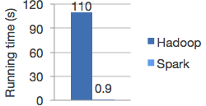
Large scale analytics Comparison
HDFS read
HDFS write
HDFS read
HDFS write
iter. 1
iter. 2
. . .
Input
HDFS read
iter. 1
iter. 2
. . .
Input
Not tied to 2 stage Map Reduce paradigm
Extract a working set
Cache it
Query it repeatedly
Logistic regression in Hadoop and Spark

Slide 14
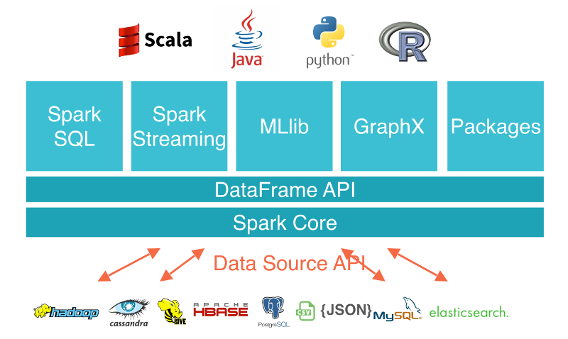
Large scale analytics Spark Architecture

Slide 15




Large scale analytics Spark Programing Model
Spark Driver (Local Machine)
Cluster Manager (Spark Master)
Spark Worker
Cache
Spark Worker
Cache
Spark Worker
Cache
....
Datanode
Datanode
....
Datanode
Block
Block
Block
HDFS

Slide 16


Healthcare Coverage Analytics using Spark R
Driver Program
library(SparkR)
sparkContext <- sparkR.init(master='spark://jupiter.kyunghee.ac.kr:7077’
sqlContext <- sparkRSQL.init(sparkContext )
Cluster Manager
(Master Node)
SparkContext
Worker Node
Worker Node
Executer
Cache
Executer
Writes
Cache
Task
Task
Task
Task
Datanode
…
Datanode
User (Developer)
HDFS
Notes:
SparkContext:
represents the connection to a Spark cluster
provides the entry point for interacting with Spark.
we can interact our jobs.
Driver program : The process runniwith Spark and distribute ng the main() function of the application and creating the SparkContext
Cluster manager : An external service for acquiring resources on the cluster (e.g. standalone manager, Mesos, YARN)
Worker node : Any node that can run application code in the cluster
Executor : A process launched for an application on a worker node, that runs tasks and keeps data in memory or disk storage across them. Each application has its own executors.
Task : A unit of work that will be sent to one executor
Job : A parallel computation consisting of multiple tasks that gets spawned in response to a Spark action (e.g. save, collect); you'll see this term used in the driver's logs.
Stage : Each job gets divided into smaller sets of tasks called stages that depend on each other (similar to the map and reduce stages in MapReduce); you'll see this term used in the driver's logs.

Slide 17


Experiences
Driver + Master Node
8 GB Memory
CPU dual core
OSX
Spark 1.5.2
R Studio
Driver Program
library(SparkR)
sparkContext <- sparkR.init(master='spark://jupiter.kyunghee.ac.kr:7077’
sqlContext <- sparkRSQL.init(sparkContext )
Cluster Manager
(Master Node)
SparkContext
4 Worker Nodes
Each node:
13GB memory
2 vCPUs
OS: Ubuntu 15.10
Spark Apache 1.5.2
OpenJDK 8
Worker Node
Worker Node
Executer
Cache
Executer
Writes
Cache
Task
Task
Task
Task
Datanode
…
Datanode
User (Developer)
HDFS
Notes:
SparkContext:
represents the connection to a Spark cluster
provides the entry point for interacting with Spark.
we can interact our jobs.
Driver program : The process runniwith Spark and distribute ng the main() function of the application and creating the SparkContext
Cluster manager : An external service for acquiring resources on the cluster (e.g. standalone manager, Mesos, YARN)
Worker node : Any node that can run application code in the cluster
Executor : A process launched for an application on a worker node, that runs tasks and keeps data in memory or disk storage across them. Each application has its own executors.
Task : A unit of work that will be sent to one executor
Job : A parallel computation consisting of multiple tasks that gets spawned in response to a Spark action (e.g. save, collect); you'll see this term used in the driver's logs.
Stage : Each job gets divided into smaller sets of tasks called stages that depend on each other (similar to the map and reduce stages in MapReduce); you'll see this term used in the driver's logs.

Slide 18
Spark R Programming
Step 1: From master node, Start Spark Master Node
./spark/sbin/start-master.sh
Step 2: From worker node, start the Spark Worker Node
./spark/sbin/start-slave.sh spark://jupiter.kyunghee.ac.kr:7077 -m 13G
Step 3: From Rstudio on Driver Node, initialize Spark Context
# set directory of spark
Sys.setenv(SPARK_HOME='/Users/tuyen/spark-1.5.2')
.libPaths(c(file.path(Sys.getenv('SPARK_HOME'), 'R’,'lib'), .libPaths()))
# call SparkR library
library(SparkR)
# Initialize Spark Context
sc <- sparkR.init(master='spark://jupiter.kyunghee.ac.kr:7077’)
sqlContext <- sparkRSQL.init(sc)

Slide 19
Spark R Programming
Read US census data 2013
ss13husa <- read.df(sqlContext,
file.path('/data/ss13husa.csv'),
header='true',
source = "com.databricks.spark.csv",
inferSchema='true')
Merge Housing Data and Person Data
dataset <- merge(population,housing,by="SERIALNO")
Logistics Regression
model <- glm(HICOV ~ ., data = training, family = "binomial")

Slide 20
Experiment: comparison

Slide 21
Conclusion
Advantages of Spark R
Faster processing than Map-Reduce
The system is scalable easily
Disadvantages of Spark R
Current version (1.5.2) not support Machine Learning well.
Only Logistics Regression (glm() function)
Consume a lot of memory. (Sometimes out of memory problem)

