Slide 1
IBM Internet of Things: Turn your mobile device into a sensor
Member 1: Le Pham Tuyen (2014311082)
Member 2: Nguyen Thi My Kieu (2014311076)

Slide 2
Outline
Motivation
MQTT Protocol
Health Monitoring Application
Demo

Slide 3
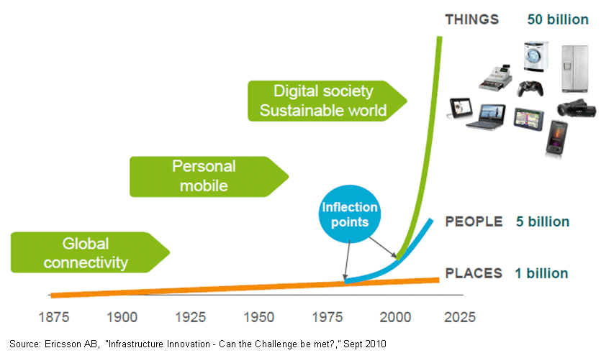
The Internet is (in) everything
Vehicles
Smart TV
Smartphones
Smart Home
Oven
Pen
…
Notes:
Then computing devices became so small, cheap and reliable that they could be installed almost anywhere - and the Internet of Things was born.

Slide 4







Everything is connected
Open the garage
Scenario 1:
SOS
Dispatch to accident location
Scenario 2:
Package has arrived
Package has arrived
Scenario 3:
Scenario ...

Slide 5


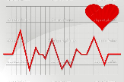

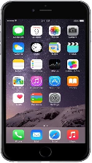


Scenarios in health monitoring (1)
Heartbeat monitoring
Send Recommendation
Send heartbeat rate
Receive heartbeat rate
Receive Recommendation

Slide 6

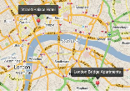
Scenarios in health monitoring (2)
Location monitoring
Send
GPS Coordinates
Receive
GPS Coordinates

Slide 7

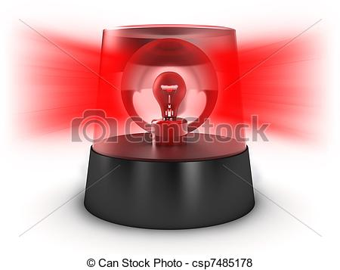
Scenarios in health monitoring (3)
Emergency call
Send
emergency call
Receive emergency call

Slide 8
IoT scenarios bring new challenges
SOS
SOS
Sending data one-to-many
Listening for events whenever they happen (real-time)
Minimizing sending packets of data.
Reliably pushing data over unreliable networks
Save power consumption
SOS
MQTT protocol

Slide 9

MQTT Protocol
Stands for Message Queue Telemetry Transport.
A machine-to-machine (M2M)/"Internet of Things" connectivity protocol.
Designed as an extremely lightweight publish/subscribe messaging transport.
Invented by Dr Andy Stanford-Clark of IBM®, and Arlen Nipper of Arcom (now Eurotech), in 1999
Facebook Messenger

Slide 10
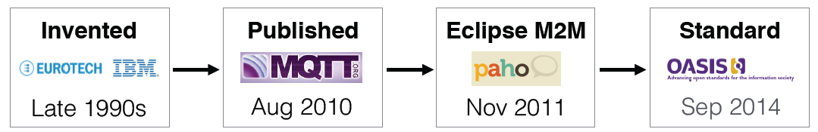
It's open
The MQTT protocol specification is available from MQTT.org.
Currently, MQTT v3.1.1 now an OASIS Standard.

Slide 11
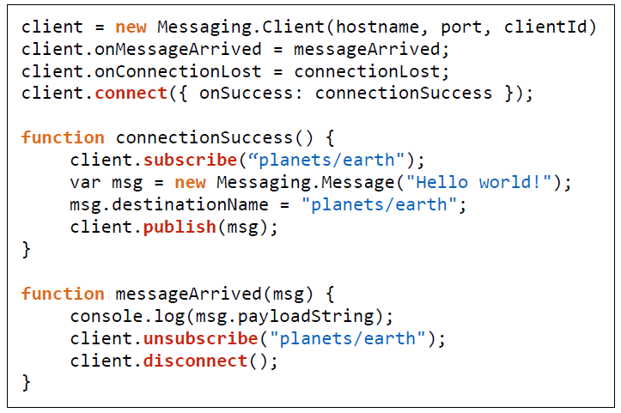
It's simple to implement
Connect
Publish
Subscribe
Unsubscribe
Disconnect

Slide 12
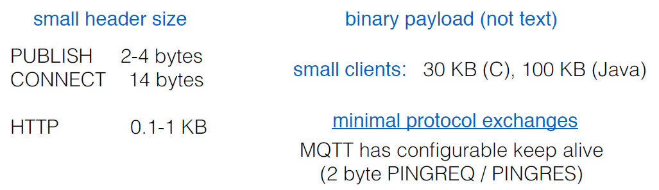
Designed for minimal network traffic and constrained devices

Slide 13
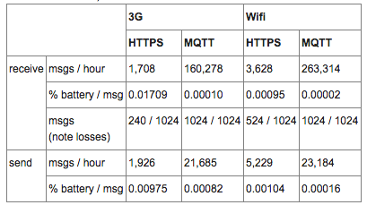
Efficient for battery life
http://stephendnicholas.com/archives/1217

Slide 14
Quality of Service for reliable messaging
It has three qualities of service for message delivery:
0: At most once
Never connection loss
Never duplicated
Message might loss
1: At least once
Assured delivery at least once per message.
Connection loss
Can be duplicated
2: Exactly once
Assured delivery once and only once per message.
Connection loss.
Never duplicated.

Slide 15
iPhone Application: Health monitoring
Flow
1. CONNECT
1. CONNECT
2. SUBSCRIBE
khu/heartbeat
khu/location
khu/emergency
2. SUBSCRIBE
khu/recommend
3. PUBLISH
khu/heartbeat
khu/location
khu/emergency
iot.eclipse.org
Patient App
Doctor App
3. PUBLISH
khu/recommend
MQTT Server

Slide 16
DEMO APPLICATION

Slide 17
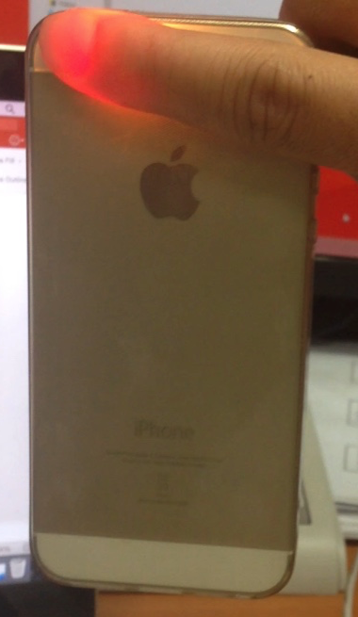
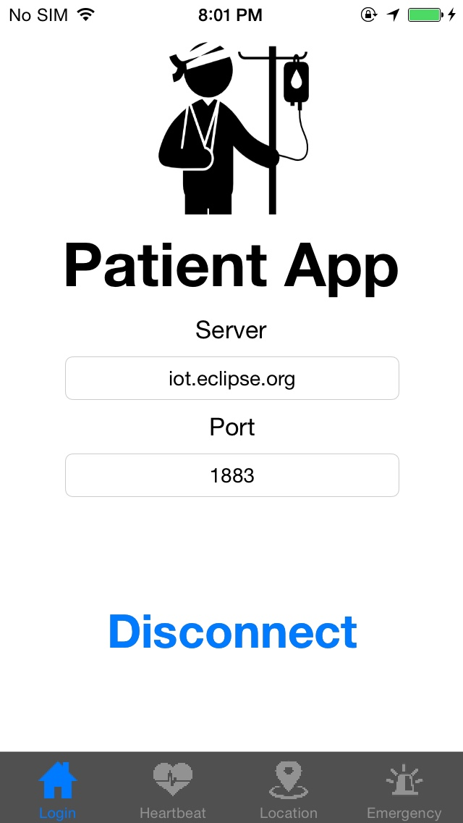
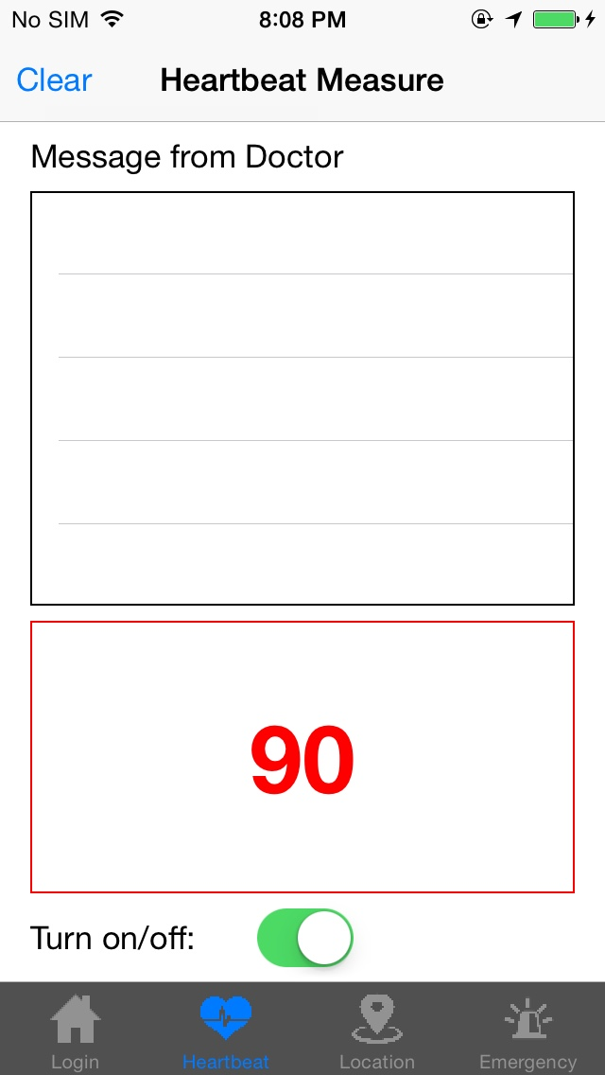
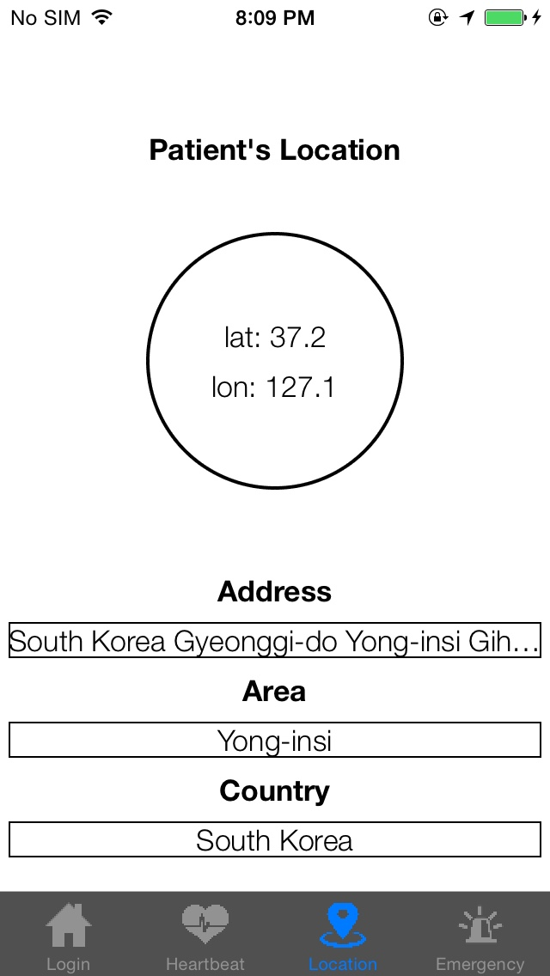
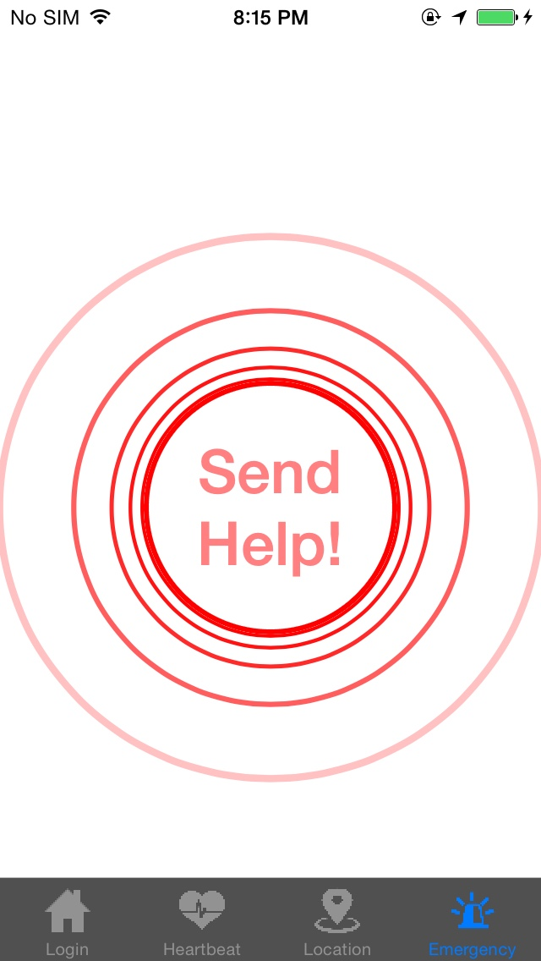
Patient Application
Connect
Measure heartbeat [1]
Publish heatbeat
Publish location
Send emergency call
[1] Poh, Ming-Zher, Daniel J. McDuff, and Rosalind W. Picard. "Non-contact, automated cardiac pulse measurements using video imaging and blind source separation." Optics express 18.10 (2010): 10762-10774.

Slide 18
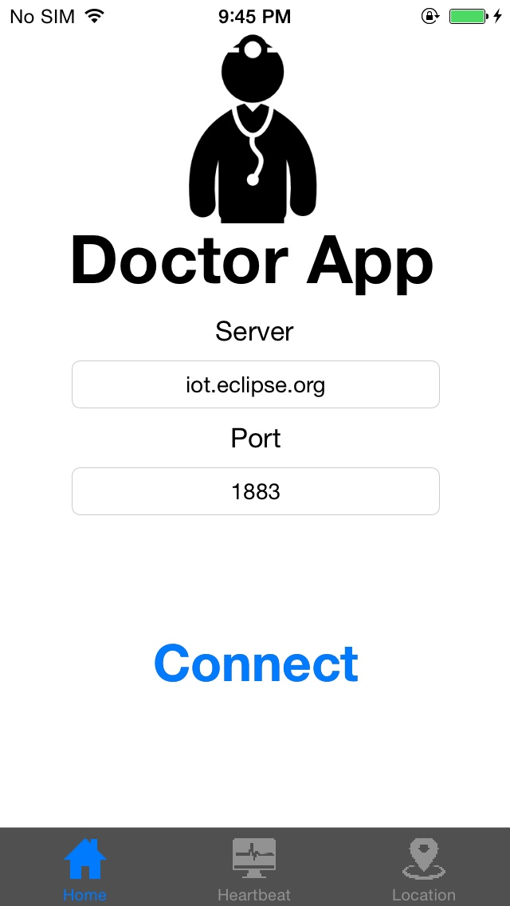
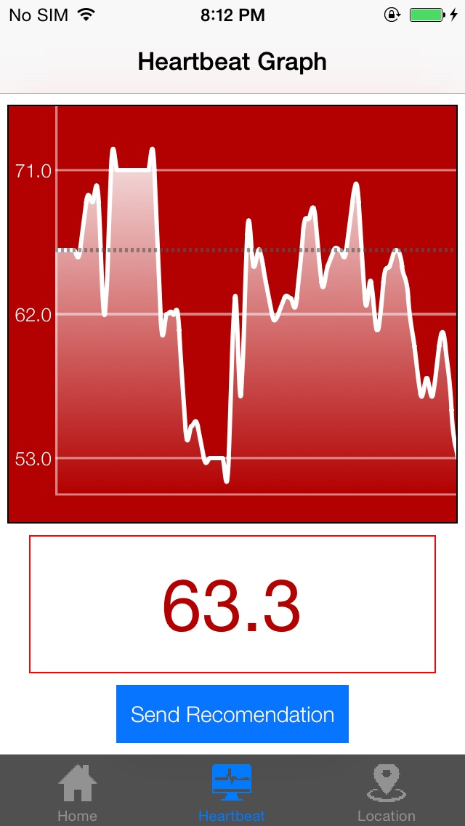
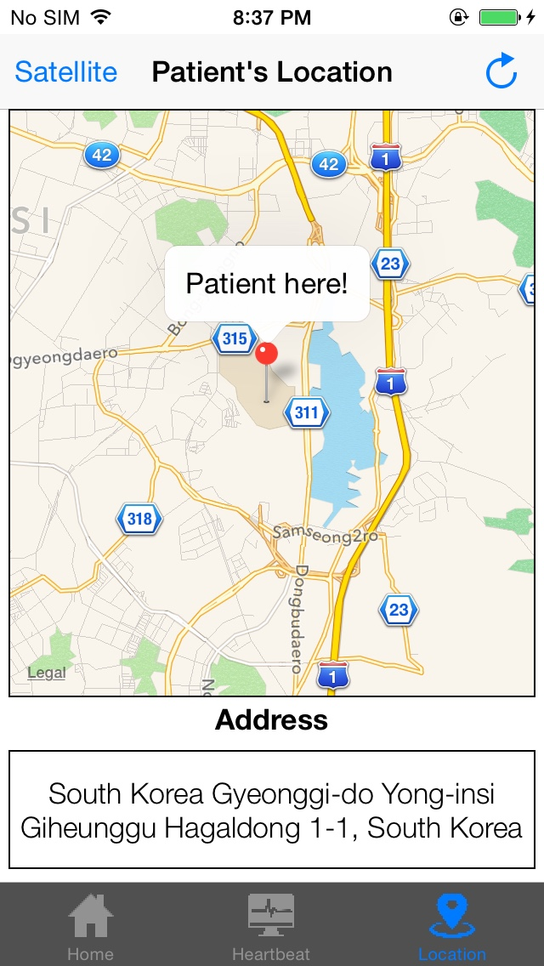
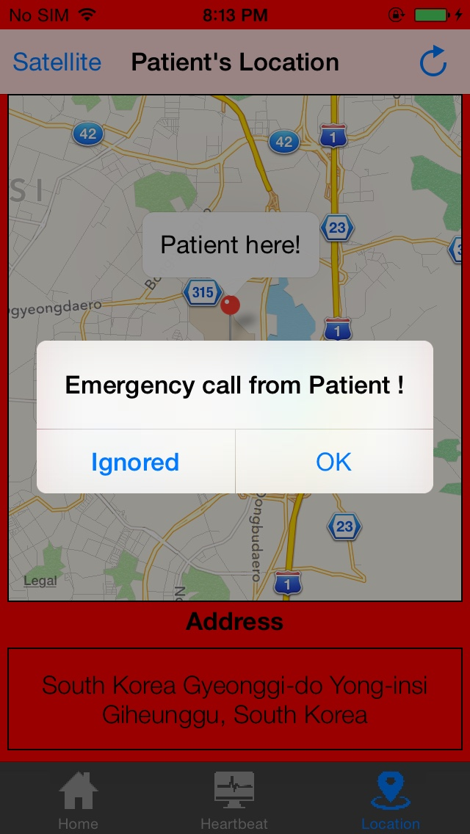
Doctor Application
Connect
Heartbeat graph
Tracking location
Turn on alarm sound
Show alert message
Change color

Slide 19
References
MQTT
http://mqtt.org/
http://m2m.demos.ibm.com/iotstarter.html
Measure heartbeat using iPhone
Poh, Ming-Zher, Daniel J. McDuff, and Rosalind W. Picard. "Non-contact, automated cardiac pulse measurements using video imaging and blind source separation." Optics express 18.10 (2010): 10762-10774.
Source code
Update later

