Slide 1
IBM Internet of Things: Turn your mobile device into a sensor
Health Monitoring Application
KHU, Future Internet Class
2014311082 - Le Pham Tuyen
2014311076 - Nguyen Thi My Kieu

Slide 2


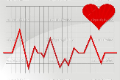

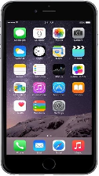


Scenarios in health monitoring (1)
Heartbeat monitoring
Send Recommendation
Send heartbeat rate
Receive heartbeat rate
Receive Recommendation

Slide 3
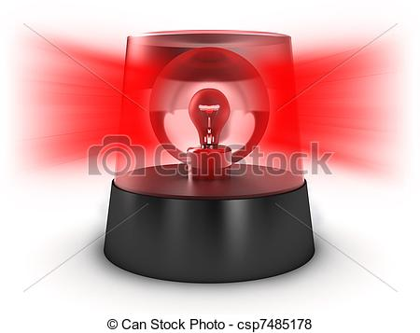

Scenarios in health monitoring (2)
Emergency call
Send
emergency call
Receive emergency call

Slide 4

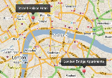
Scenarios in health monitoring (3)
Location monitoring
Send
GPS Coordinates
Receive
GPS Coordinates

Slide 5
IoT scenarios bring new challenges
SOS
SOS
Publishing information one-to-many
Listening for events whenever they happen (real-time)
Minimizing sending packets of data.
Reliably pushing data over an unreliable networks
Save power consumption
SOS
MQTT protocol
Notes:
Stands for Message Queue Telemetry Transport.
A machine-to-machine (M2M)/"Internet of Things" connectivity protocol.
Designed as an extremely lightweight publish/subscribe messaging transport.
Invented by Dr Andy Stanford-Clark of IBM®, and Arlen Nipper of Arcom (now Eurotech), in 1999
Open
The MQTT protocol specification is available from MQTT.org, published in Aug 2010
Currently, MQTT v3.1.1 now an OASIS Standard, Sep 2014

Slide 6
MQTT Protocol
It’s open (MQTT.org)
It's simple to implement (Connect, Publish, Subscribe, Unsubscribe, Disconnect)
Designed for minimizing sending packets.
Quality of Service for reliable messaging.
Support all platforms (Android, iOS, Web-based)
…

Slide 7
iPhone Application: Health monitoring
Flow:
1. CONNECT
1. CONNECT
2. SUBSCRIBE
khu/heartbeat
khu/location
khu/emergency
2. SUBSCRIBE
khu/recommend
3. PUBLISH
khu/heartbeat
khu/location
khu/emergency
iot.eclipse.org
Patient App
Doctor App
3. PUBLISH
khu/recommend
MQTT Server
Notes:
Implementation
- Connect
- Publish
- Subscribe
- Unsubscribe
Disconnect
Quality of Service for reliable messaging: three qualities of service for message delivery
0: At most once
Never connection loss
Never duplicated
Message might loss
1: At least once
Assured delivery at least once per message.
Connection loss
Can be duplicated
2: Exactly once
Assured delivery once and only once per message.
Connection loss.
Never duplicated.

Slide 8
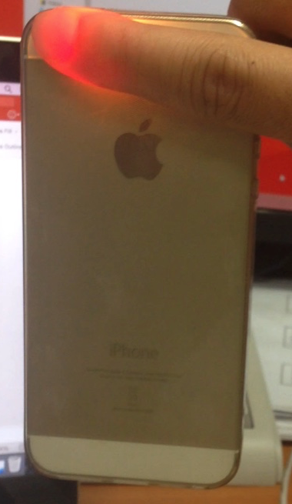
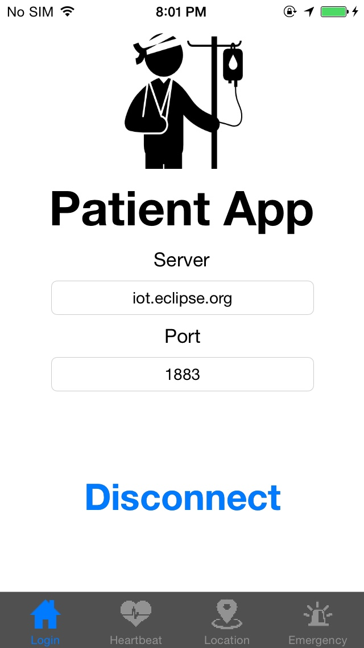
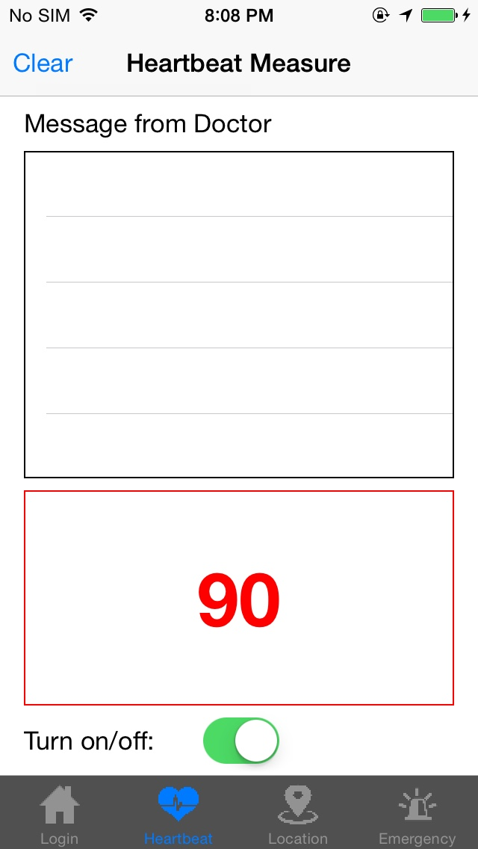
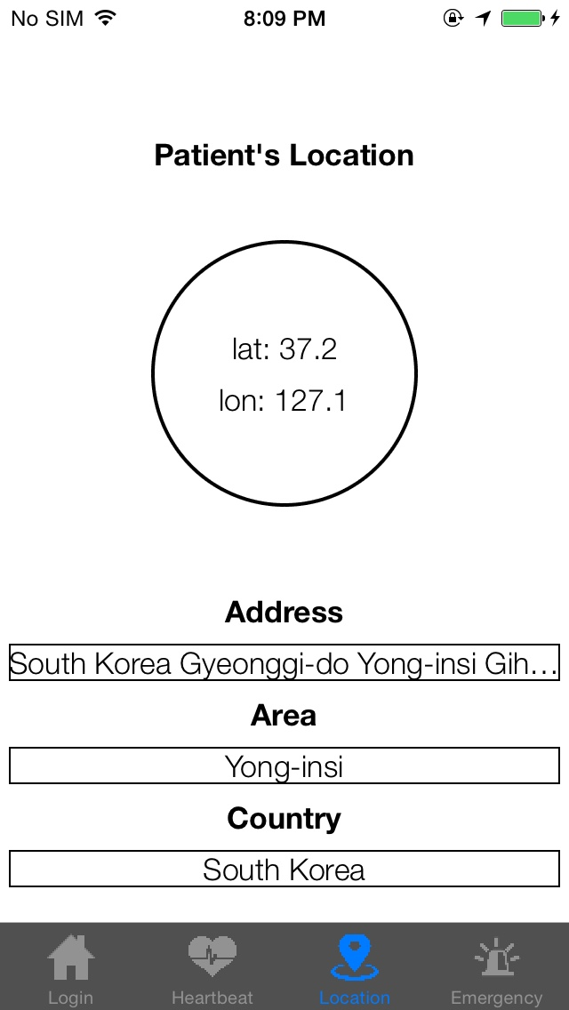
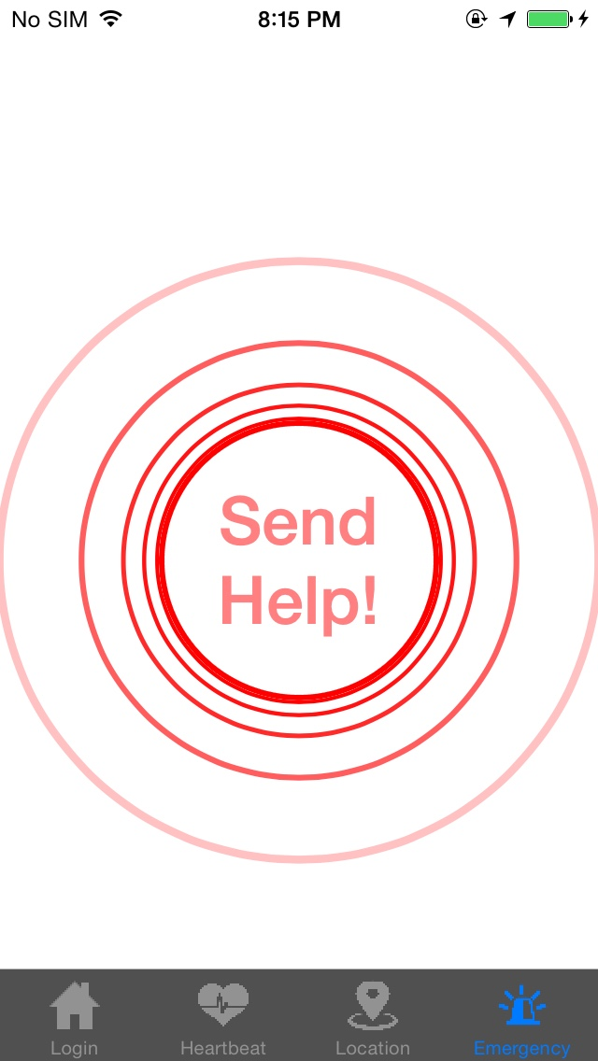
DEMO - Patient Application
Connect
Measure heartbeat
Publish heartbeat
Publish location
Send emergency call
Poh, Ming-Zher, Daniel J. McDuff, and Rosalind W. Picard. "Non-contact, automated cardiac pulse measurements using video imaging and blind source separation." Optics express 18.10 (2010): 10762-10774.

Slide 9
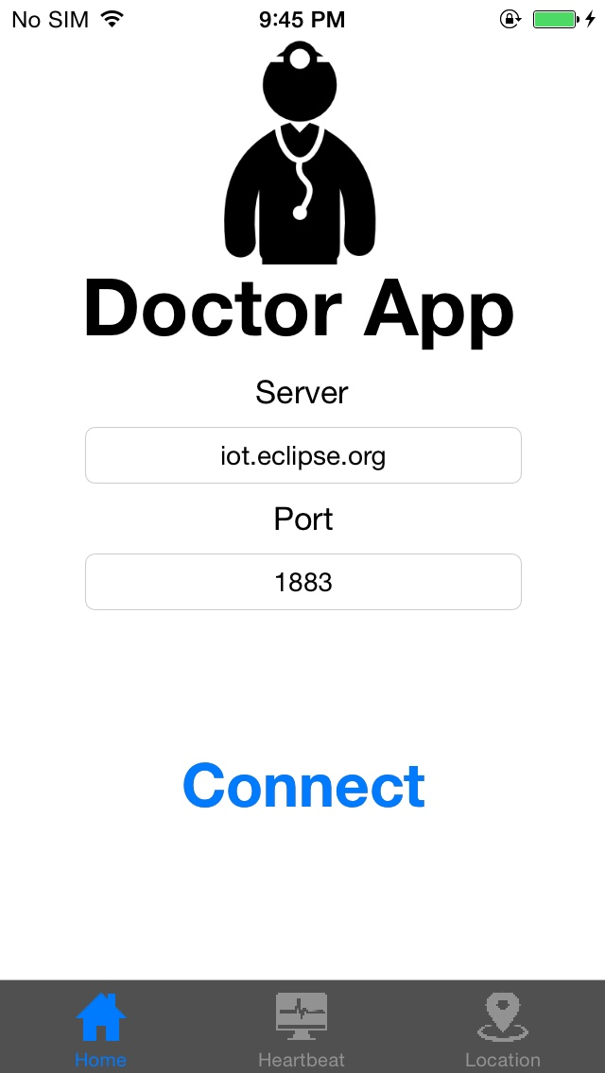
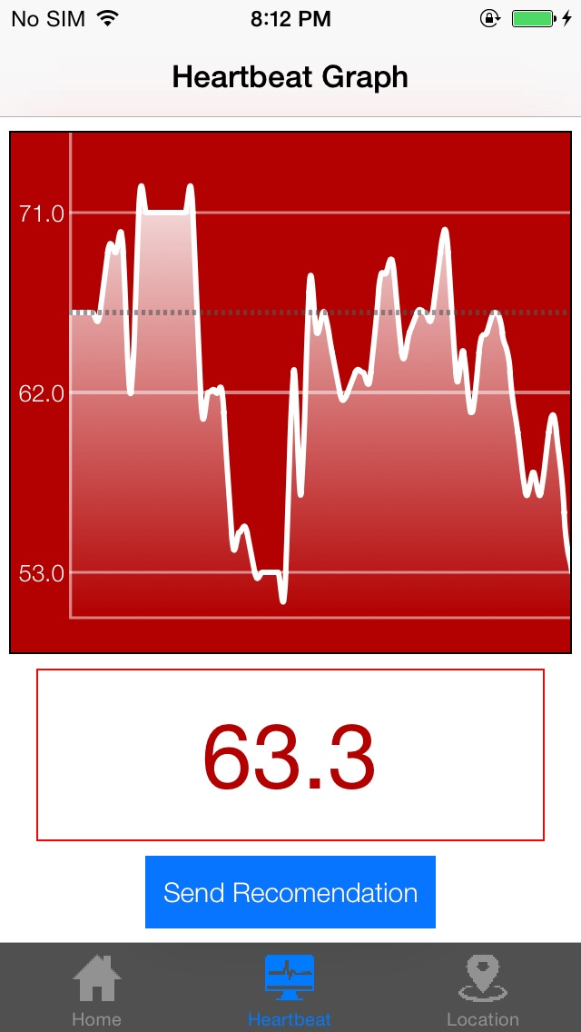
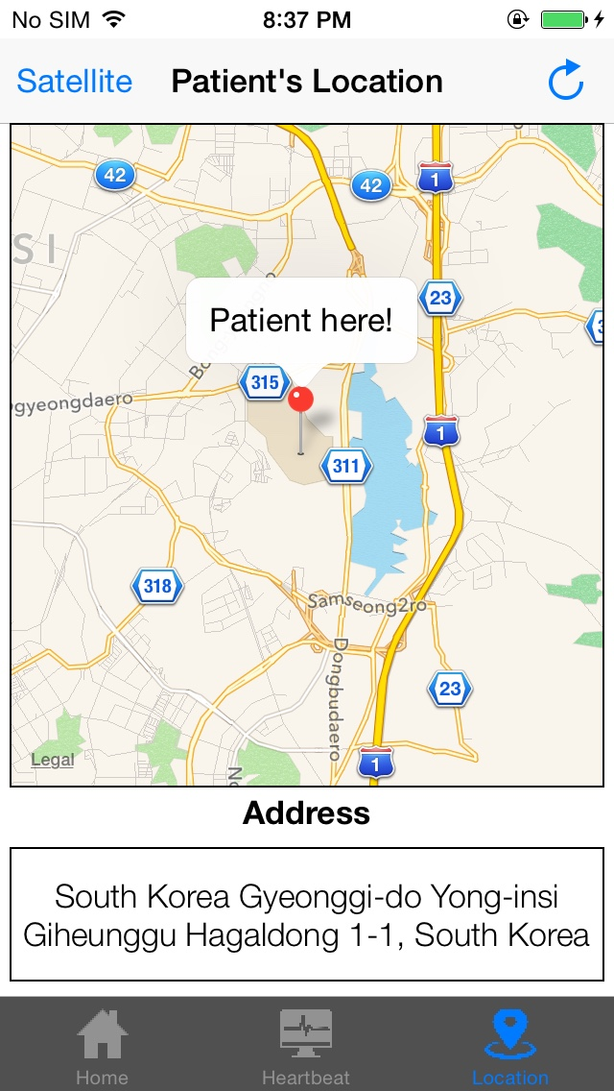
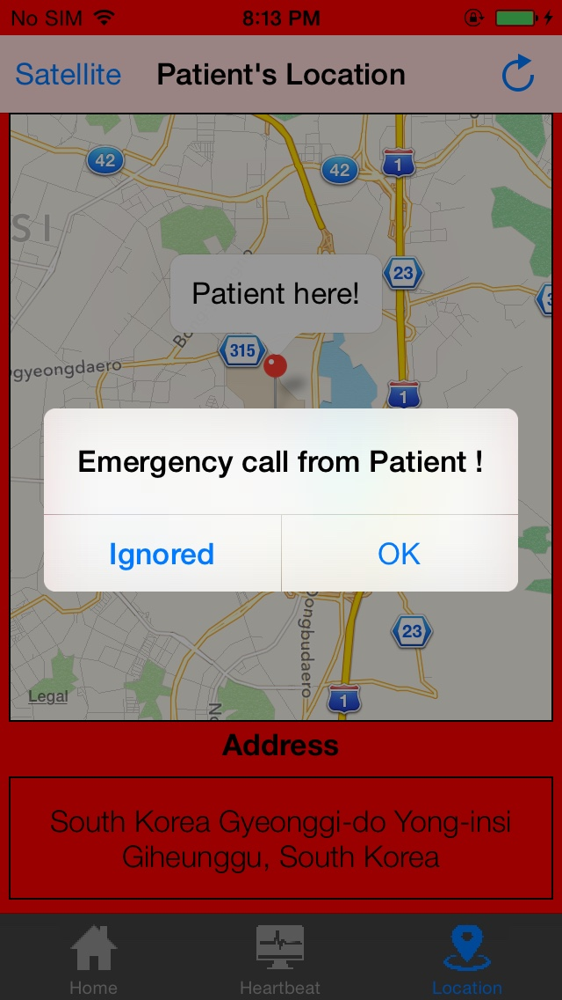
DEMO - Doctor Application
Connect
Heartbeat graph
Tracking location
Turn on alarm sound
Show alert message
Change color

Slide 10
References
MQTT
http://mqtt.org/
http://m2m.demos.ibm.com/iotstarter.html
Measure heartbeat using iPhone
Poh, Ming-Zher, Daniel J. McDuff, and Rosalind W. Picard. "Non-contact, automated cardiac pulse measurements using video imaging and blind source separation." Optics express 18.10 (2010): 10762-10774.
Source code
https://github.com/lephamtuyen/healthmonitoring

