Slide 1
IBM Internet of Things: Turn your mobile device into a sensor
Presenter: Le Pham Tuyen

Slide 2
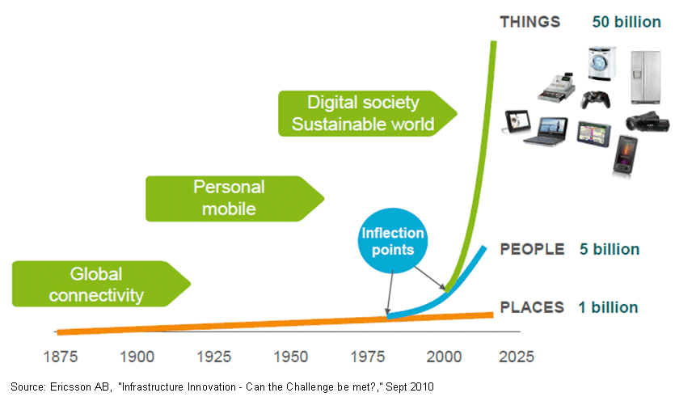
The Internet is (in) everything
Vehicles
Smart TV
Smartphones
Smart Home
Oven
Pen
…
Notes:
Then computing devices became so small, cheap and reliable that they could be installed almost anywhere - and the Internet of Things was born.

Slide 3




The world is getting smarter
Smarter Vehicles
realtime telemetry
predictive maintenance
look-ahead alerting
pay-as-you-drive
Smarter Logistics
end-to-end tracking
theft prevention
real-time updates
fleet monitoring
Smarter Homes
energy tracking
Automation
remote monitoring
smart appliances
Smarter Healthcare
smart scales
in-home monitoring
assisted living
physician messaging

Slide 4





Everything is connected
Open the garage
Scenario 1:
SOS
Dispatch to accident location
Scenario 2:
Package has arrived
Package has arrived
Scenario 3:
Scenario ...

Slide 5
IoT scenarios bring new challenges
Requires a real-time, event-driven model
Publishing information one-to-many
Listening for events as they happen
Sending small packets of data from small devices
Reliably pushing data over unreliable networks
MQTT

Slide 6
Scenarios in health monitoring
Heartbeat monitoring

Slide 7
Scenarios in health monitoring
Location monitoring

Slide 8
Scenarios in health monitoring
Emergency Call

Slide 9
The Internet of Things has fundamentally different challenges:HTTP remains ideal for requesting data from a known source
We also need an event-oriented paradigm:
Emitting information one to many
Listening for events whenever they happen
Distributing minimal packets of data in huge volumes
Pushing information over unreliable networks
And there are extra comms challenges for Mobile & M2M apps:Volume (cost) of data being transmitted (especially in M2M with limited data plans)
Power® consumption (battery powered devices)
Responsiveness (near-real time delivery of information)
Reliable delivery over fragile connections
Security and privacy
Scalability

Slide 10
The MQ Telemetry Transport (MQTT) protocol is designed to meet these challenges. MQTT was invented by Dr Andy Stanford-Clark of IBM®, and Arlen Nipper of Arcom (now Eurotech), in 1999. The protocol is openly published with a royalty-free license, and has been widely implemented across a variety of industries
MQTT is a machine-to-machine (M2M)/"Internet of Things" connectivity protocol. It was designed as an extremely lightweight publish/subscribe messaging transport. It is useful for connections with remote locations where a small code footprint is required and/or network bandwidth is at a premium. For example, it has been used in sensors communicating to a broker via satellite link, over occasional dial-up connections with healthcare providers, and in a range of home automation and small device scenarios. It is also ideal for mobile applications because of its small size, low power usage, minimised data packets, and efficient distribution of information to one or many receivers.

Slide 11
Key facts about MQTT:It's open
Open royalty free spec designed for the world of “devices”
Wide variety of clients and servers
Hobbyist to enterprise
Open source to commercial
It's lean
Minimized on-the-wire format
Smallest possible packet size is 2 bytes
No application message headers
Scalable
Reduced complexity/footprint
Clients: C=30Kb; Java=100Kb
It's reliable
Three qualities of service:
0 – at most once delivery
1 – assured delivery but may be duplicated
2 – once and once only delivery
In-built constructs to support loss of contact between client and server
“Last will and testament” to publish a message if the client goes offline
Stateful “roll-forward” semantics and “durable” subscriptions
It's simple
Simple / minimal pub/sub messaging semantics
Asynchronous (“push”) delivery
Simple set of verbs -- connect, publish, subscribe and disconnect

Slide 12
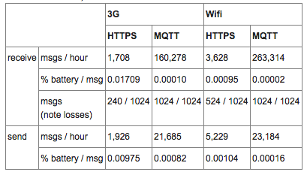

Slide 13
DEMO APPLICATION

Slide 14
END
MQTT
Measure heartbeat using iphone
Source code

