Slide 1
AI
Any technique that enables computers to mimic human behavior
ML
DL
Extract patterns from data using neural networks
Ability to learn without explicitly being programmed

Slide 2

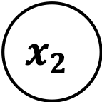

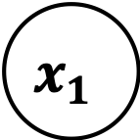



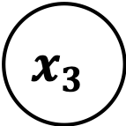

Input
Hidden
Output
$$x_{1}$$
$$w_{11}$$
$$h_{1}$$
$$w_{12}$$
$$x_{2}$$
$$⋮$$
$$h_{2}$$
$$x_{3}$$
$$w_{32}$$

