Slide 1
 | 255 | 255 |  |  |  | 255 | 255
 | 255 | 255 |  |  |  | 255 | 255
 |  |  | 255 | 255 | 255
 |  |  | 255 | 255 | 255
 |  |  | 255 | 255 | 255
 | 255 | 255 |  |  |  | 255 | 255
 | 255 | 255 |  |  |  | 255 | 255
 | 255 | 255 |  |  |  | 255 | 255
 | 255 | 255 |  |  |  | 255 | 255
 | 255 | 255 | 255 | 255 | 255
 |  |  | 255 | 255 | 255
 |  |  | 255 | 255 | 255
 | 255 | 255 |  |  |  | 255 | 255
 | 255 | 255 |  |  |  | 255 | 255

Slide 2
 | 255 | 255 |  |  |  | 255 | 255
 | 255 | 255 |  |  |  | 255 | 255
 |  |  | 255 | 255 | 255
 |  |  | 255 | 255 | 255
 |  |  | 255 | 255 | 255
 | 255 | 255 |  |  |  | 255 | 255
 | 255 | 255 |  |  |  | 255 | 255
 | 255 | 255 |  |  |  | 255 | 255
 | 255 | 255 |  |  |  | 255 | 255
 | 255 | 255 | 255 | 255 | 255
 |  |  | 255 | 255 | 255
 |  |  | 255 | 255 | 255
 | 255 | 255 |  |  |  | 255 | 255
 | 255 | 255 |  |  |  | 255 | 255

Slide 3
1 | 0 | 1
0 | 1 | 0
1 | 0 | 1
0 | 1 | 0
1 | 0 | 1
0 | 1 | 0
1 | 2 | 1
0 | 1 | 0
1 | 2 | 1
Filters
filter 1
filter 2
filter 3
1 | 0 | 3 | 5 | 4 | 8 | 7
2 | 5 | 7 | 4 | 2 | 1 | 8
5 | 1 | 1 | 8 | 4 | 2 | 0
0 | 4 | 4 | 7 | 5 | 4 | 3
1 | 2 | 1 | 8 | 4 | 7 | 2
2 | 1 | 1 | 7 | 6 | 2 | 5
3 | 1 | 7 | 0 | 7 | 1 | 0
Step 1
1x1 | 0x0 | 3x1
2x0 | 5x1 | 7x0
5x1 | 1x0 | 1x1
15
Image
Elementwise multiplication
(image value x filter value)
Feature map1

Slide 4
1 | 0 | 1
0 | 1 | 0
1 | 0 | 1
0 | 1 | 0
1 | 0 | 1
0 | 1 | 0
1 | 2 | 1
0 | 1 | 0
1 | 2 | 1
Filters
filter 1
filter 2
filter 3
Stride 2
1 | 0 | 3 | 5 | 4 | 8 | 7
2 | 5 | 7 | 4 | 2 | 1 | 8
5 | 1 | 1 | 8 | 4 | 2 | 0
0 | 4 | 4 | 7 | 5 | 4 | 3
1 | 2 | 1 | 8 | 4 | 7 | 2
2 | 1 | 1 | 7 | 6 | 2 | 5
3 | 1 | 7 | 0 | 7 | 1 | 0
Step 2
3x1 | 5x0 | 4x1
7x0 | 4x1 | 2x0
1x1 | 8x0 | 4x1
15 | 16
Image
Elementwise multiplication
(image value x filter value)
Feature map1

Slide 5
1 | 0 | 1
0 | 1 | 0
1 | 0 | 1
0 | 1 | 0
1 | 0 | 1
0 | 1 | 0
1 | 2 | 1
0 | 1 | 0
1 | 2 | 1
Filters
filter 1
filter 2
filter 3
1 | 0 | 3 | 5 | 4 | 8 | 7
2 | 5 | 7 | 4 | 2 | 1 | 8
5 | 1 | 1 | 8 | 4 | 2 | 0
0 | 4 | 4 | 7 | 5 | 4 | 3
1 | 2 | 1 | 8 | 4 | 7 | 2
2 | 1 | 1 | 7 | 6 | 2 | 5
3 | 1 | 7 | 0 | 7 | 1 | 0
Step 9
4x1 | 7x0 | 2x1
6x0 | 2x1 | 5x0
7x1 | 1x0 | 0x1
15 | 16 | 16
12 | 17 | 14
13 | 26 | 15
Image
Elementwise multiplication
(image value x filter value)
Feature map1

Slide 6
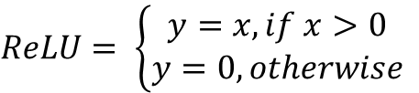
y
$$ReLU= \left\{\begin{aligned}y=x, if x>0 \\ y=0, otherwise\end{aligned}\right.$$
0
x

Slide 7
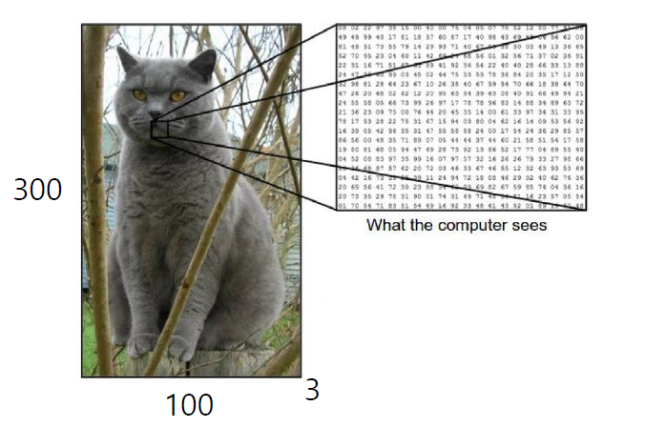

Slide 8
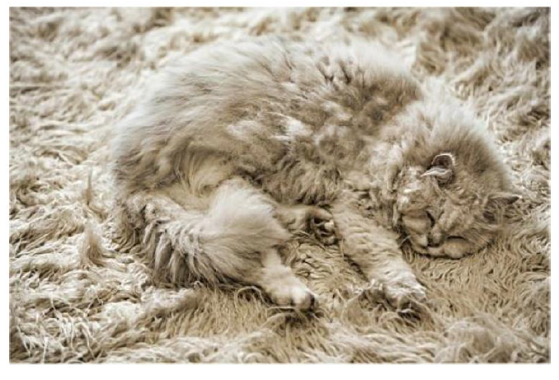

숨김(occlusion)
조명(illumination)
변형(deformation)
배경 교착(background clutter)

