Slide 1

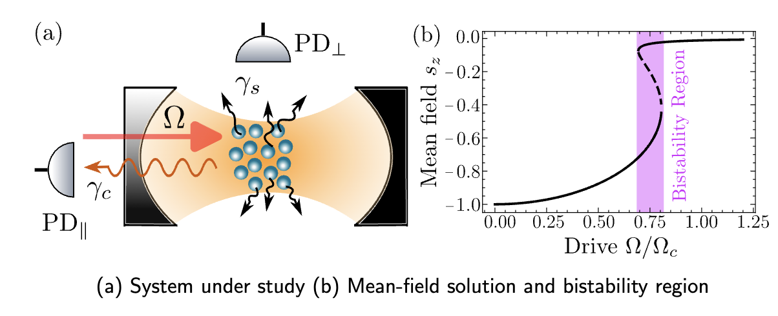
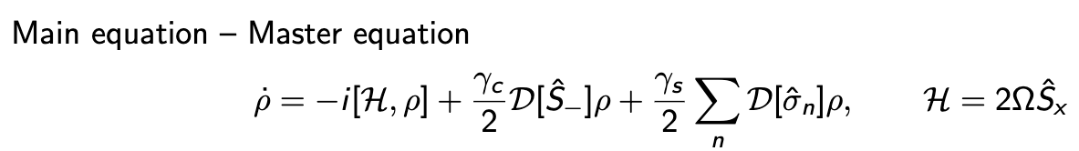
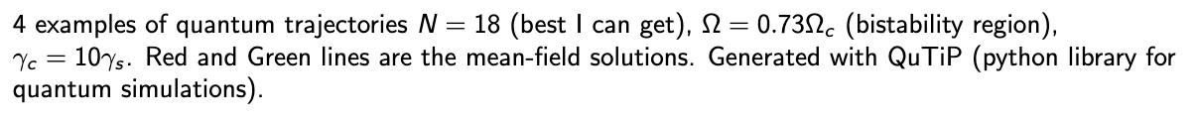
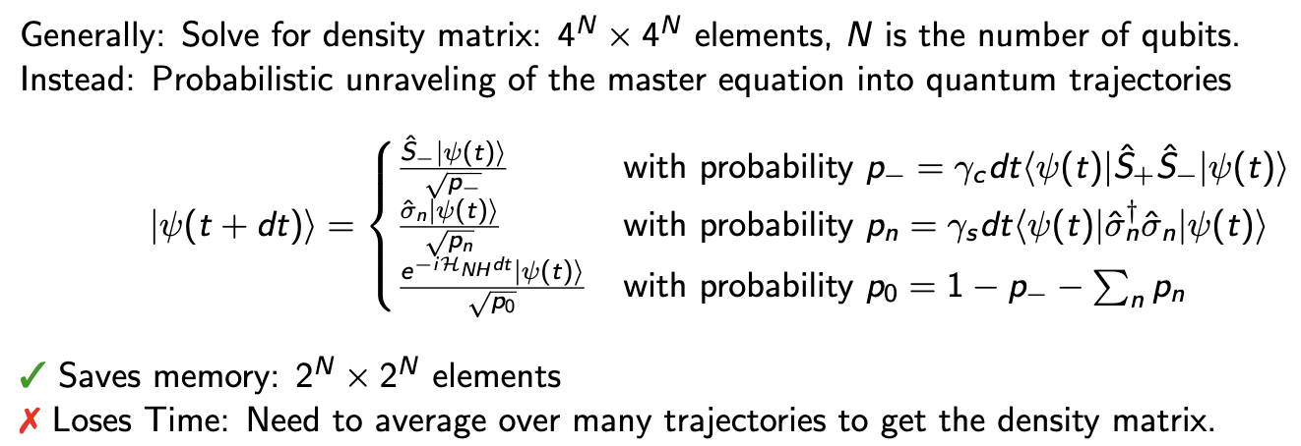
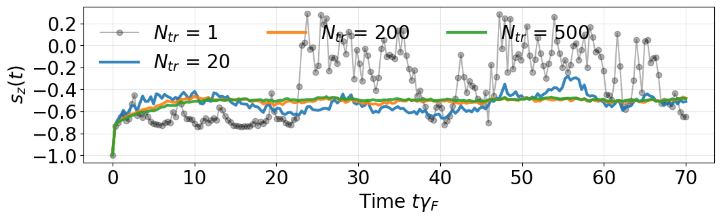
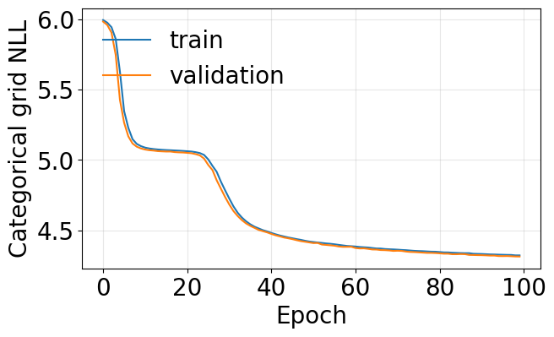
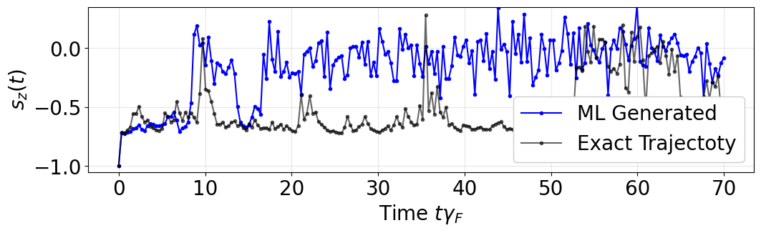
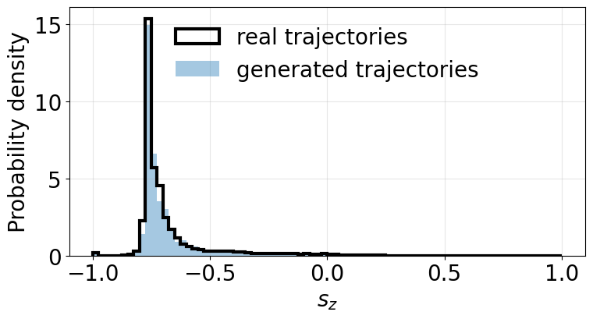
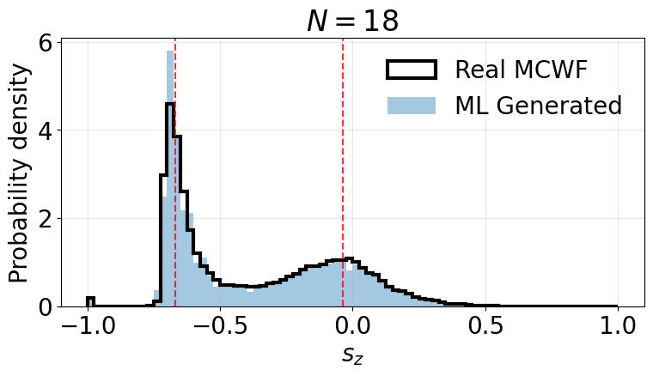
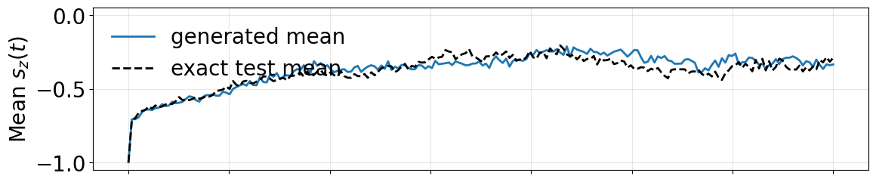
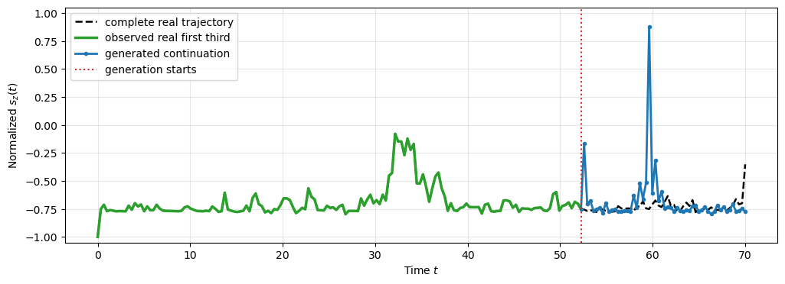
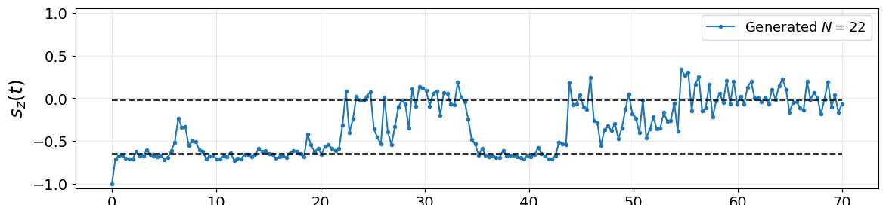
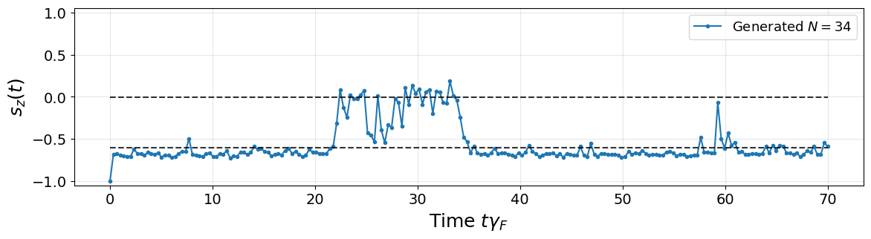
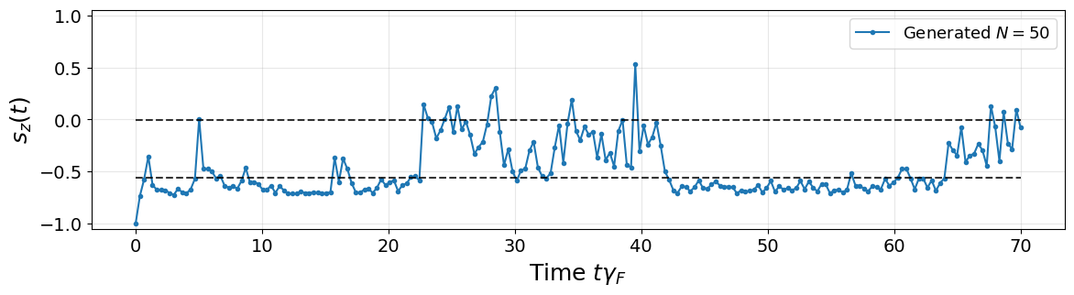
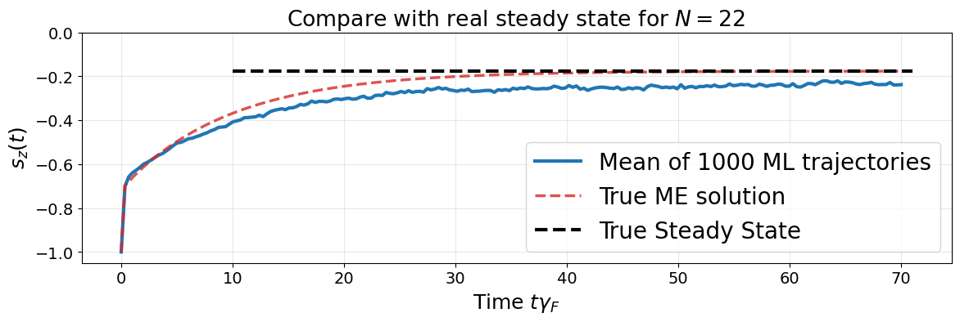


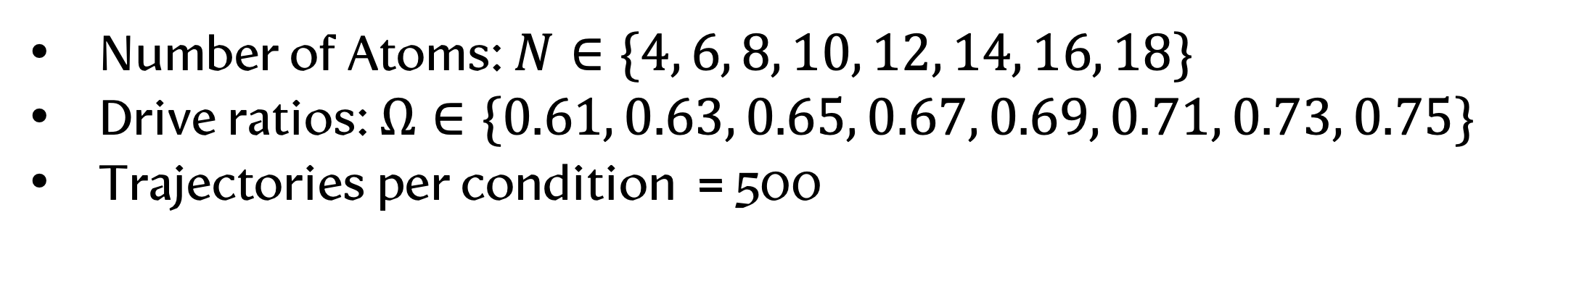



Predicting Open Quantum Systems Trajectories: TrajectoryGRUGrid
Nikita Leppenen Collective Quantum Optics Group Department of Chemical & Biological Physics
nikita.leppenen@weizmann.ac.il
Physics (short): Driven – Dissipative cavity QED
How typical trajectory looks like (in bistability region)
MC
Quantum Trajectories Approach (MCWF)
Create a model to quantum trajectories generate trajectories based on data from Monte Carlo wave-function simulations in QuTiP
Goal of the project
Fix N and $Ω$ → Generate More Trajectories Faster → Capture mean and/or bistability
Fix $Ω$ and try to extrapolate to unreachable N values
Full model with N and $Ω$
Fixed N and $Ω$ – test of the model
TrajectoryGRUGrid: Model Architecture
We use a Gate Recurrent Unit (GRU) model for predicting time series on a discrete grid
$x_{t+1}=f_{θ}\left(x_{t} | h_{t}\right);h_{t}$ - hidden state. Input: $x_{t}=[s_{t};τ_{t}]$; Output: $s_{t+1}∈[−1;1]$
N = 18, $Ω$ = 0.73. Exact vs ML Generated trajectory
N = 8
NO Bistability
N = 18
Bistability Exist
✅ Captures Bistability
✅ Captures mean
❌ Does not complete
Real trajectory
Fixed $Ω$ and try to extrapolate to larger N
Dataset: Quantum Trajectories with N and $Ω$
Learned on N up to 18 for $Ω$ = 0.73 (bistability region)
I can check larger N with (a) Mean-Field for each trajectory (b) PIQS for mean value
Number of Atoms: $N∈\{4, 6, 8, 10, 12, 14, 16, 18\}$
Drive ratios: $Ω∈\{0.61, 0.63, 0.65, 0.67, 0.69, 0.71, 0.73, 0.75\}$
Trajectories per condition = 500
✅ Works great for N = 22
🟡 Good for N = 34
❌ Wrong at N = 50
❌ Mean estimation is not precise
Full Model: Vary N and $Ω$
List
Notes:
Fixed N and $Ω$ – test of the model

