Slide 1
ContDataQC Guide Video
01 Introduction

Slide 2
ContDataQC
A package (add-in) for R (statistical programming language) that enables users to perform some quality control checks and related functions on their continuous monitoring data.
Available on GitHub (a code sharing website).
https://github.com/leppott/ContDataQC
To install within R run the code below.
library(devtools)
install_github("leppott/ContDataQC", force=TRUE, build_vignettes=TRUE)

Slide 3
Getting Help
From within R need to load the library first.
library(ContDataQC)
Help for a specific function.
Prefix the command with a question mark.
?ContDataQC
Help index for all function in the package.
help(package="ContDataQC")
Vignette, overall help file.
vignette("ContDataQC_Vignette",package="ContDataQC")

Slide 4
R
R is a statistical programming language.
A library (or package) is an add-in with customized code and functions.
ContDataQC was built as a package in R.
The package is hosted on GitHub (a code repository) to make it easier for distribution.
R’s user interface is Spartan so the use of a third-party alternative interface (e.g., Rstudio) is recommended.

Slide 5
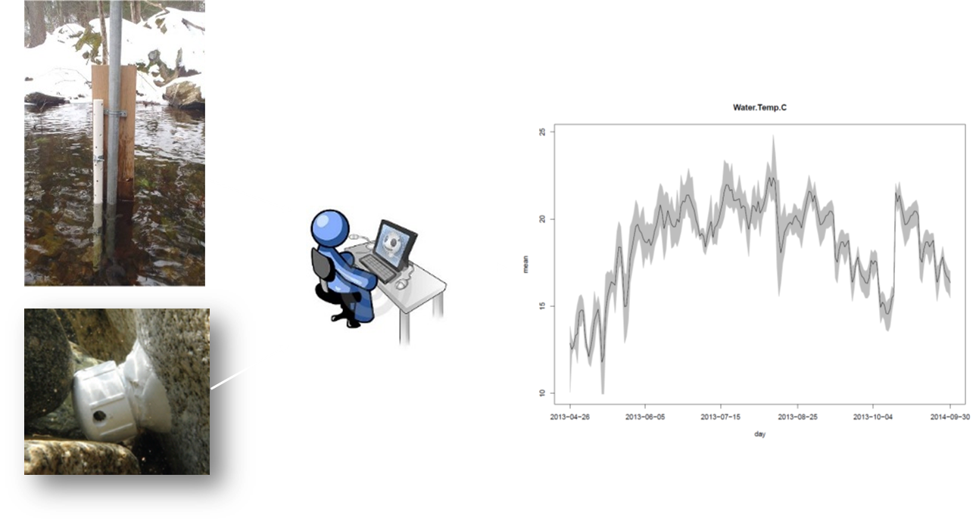
Objectives of ContDataQC
Ensure that a certain (minimum) level of QC is performed on the continuous thermal and hydrologic RMN data
Standardize, speed up and reduce missed errors in the QC process
Standardize data for further analysis
Facilitate data sharing

Slide 6
Core Functions
Focus on handling continuous data
ContDataQC
GetGageData
Acquire data from USGS gages
QCRaw
Perform QC tests on data
Aggregate
Generate a single file with a specific date range from multiple (or single) files
SummaryStats
Calculate statistics on data

Slide 7
Quality Control (QC) Tests
Unrealistic values (‘Gross range’)
Entries are flagged if values are above or below upper and lower limits
Spikes
Entries are flagged if adjacent points change by more than ‘x’ amount
Rate of change (RoC)
Entries are flagged if the RoC exceeds a given threshold (e.g., ≥ 3 st dev within 25 hrs)
Flat line
Entries are flagged if a certain # of consecutive measurements are within a certain amount of each other (e.g., >10 consecutive temperature measurements are within 0.01 degrees C of one another)

Slide 8
Flags
Flags are assigned to each data point (a single measured parameter at a unique point in time)
P = Pass,
S = Suspect,
F = Fail,
X = No Data or Not Applicable (NA).
Fail - extreme, unrealistic
Example - water temp values flagged ‘F’ if ≥ 30 or ≤ -2
Suspect - highly unlikely, but not as extreme as above
Example - water temp values flagged ‘S’ if ≥ 25 or ≤ -1

Slide 9
Additional Functions
CompSiteCDF
Generates CDF plots for comparison of sites and/or measurements for multiple time periods.
Export.IHA
Export data in a format compatible with Indicators of Hydrologic Alteration (IHA) package.
Export.StreamThermal
Export data in a format compatible with the StreamThermal package.
PeriodStats
Generates statistics based on given time frames before a specified date.
rarify
Subsamples taxonomic data to a fixed overall count.
RBIcalc
Calculates the Richards-Baker (Flashiness) Index.

Slide 10
What the package doesn’t do
Does NOT -
Automatically ‘fix’ the data.
You still have to go through the process of interpreting the QC reports and -
Checking flagged data
Doing visual checks on the time series plots
Deciding if and how to make corrections
Documenting your corrections
Catch everything.
There may be instances where the tests miss data points that should be flagged (we would love to get your feedback when this happens! we are still learning ourselves & want to keep improving the scripts).

Slide 11
Files
R is case sensitive. Be aware when naming files.
File are assumed to be of the following structure and be CSV files.
SiteID_SensorType_StartDate_EndDate

Slide 12
Installing ContDataQC
Install R
Install Rstudio recommended.
The R interface is very basic. Rstudio fixes this issue.
Install ContDataQC

Slide 13
Install R
Download
https://cran.r-project.org/bin/windows/base/
May need help from your IT department.

Slide 14
Install RStudio
Download
https://www.rstudio.com/products/rstudio/download/
May need help from your IT department

Slide 15
Install ContDataQC package
Within R
Install the “devtools” package
Load the “devtools” library
Install the “ContDataQC” package
Load the “ContDataQC” library
Open the ContDataQC Help file (optional)

Slide 16
Tips
You need to load the “ContDataQC” library each time you start a new session of R.
library(ContDataQC)
GitHub
https://github.com/leppott/ContDataQC
Follow the package on GitHub and get notified of updates.
Ability to log any issues.

Slide 17
Live Code
R Notebook
Combines text with code chunks.
Will be saved with slides and videos on GitHub
https://github.com/leppott/ContDataQC_Guide

Slide 18
Acknowledgements
Development of these instructional materials was funded by EPA ORD/NCEA (contact: Britta Bierwagen - Bierwagen.Britta@epa.gov).
Erik W. Leppo (Erik.Leppo@tetratech.com) from Tetra Tech (Tt) developed the ContDataQC R package (https://github.com/leppott/ContDataQC), with assistance from Jen Stamp (Tt) and David Gibbs (EPA ORISE fellow).

