Slide 1
ContDataQC Guide Video
03 Basic Functions

Slide 2
ContDataQC
A package (add-in) for R (statistical programming language) that enables users to perform some quality control checks and related functions on their continuous monitoring data.
Available on GitHub (a code sharing website).
https://github.com/leppott/ContDataQC
To install within R run the code below.
library(devtools)
install_github("leppott/ContDataQC", force=TRUE, build_vignettes=TRUE)

Slide 3
Getting Help
From within R need to load the library first.
library(ContDataQC)
Help for a specific function.
Prefix the command with a question mark.
?ContDataQC
Help index for all function in the package.
help(package="ContDataQC")
Vignette, overall help file.
vignette("ContDataQC_Vignette",package="ContDataQC")

Slide 4
Core Functions
Focus on handling continuous data
ContDataQC
GetGageData
Acquire data from USGS gages
QCRaw
Perform QC tests on data
Aggregate
Generate a single file with a specific date range from multiple (or single) files
SummaryStats
Calculate statistics on data

Slide 5
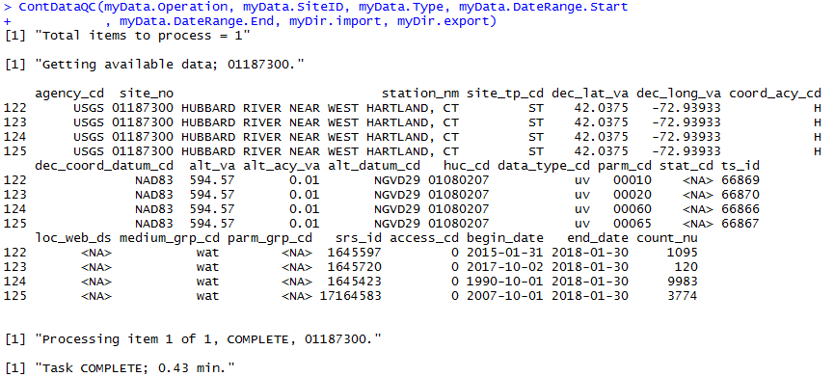
GetGageData
Download of USGS gage data.
Output is formatted for use with ContDataQC.
During the download a table of available data for the given gage is shown on screen.

Slide 6
QCRaw
Apply QC tests to data and assign flags
QC Tests
Unrealistic values (‘Gross range’)
Entries are flagged if values are above or below upper and lower limits
Spikes
Entries are flagged if adjacent points change by more than ‘x’ amount
Rate of change (RoC)
Entries are flagged if the RoC exceeds a given threshold (e.g., ≥ 3 st dev within 25 hrs)
Flat line
Entries are flagged if a certain # of consecutive measurements are within a certain amount of each other (e.g., >10 consecutive temperature measurements are within 0.01 degrees C of one another)
Flags are assigned to each data point for each test. And then to the data row based on the combination of each test.
P = Pass
S = Suspect
F = Fail
X = No Data, or Not Applicable (NA)

Slide 7
Aggregate
Combines or splits data into a single file based on user specified date range.
This process creates files for data analysis while leaving the QCed data intact.

Slide 8
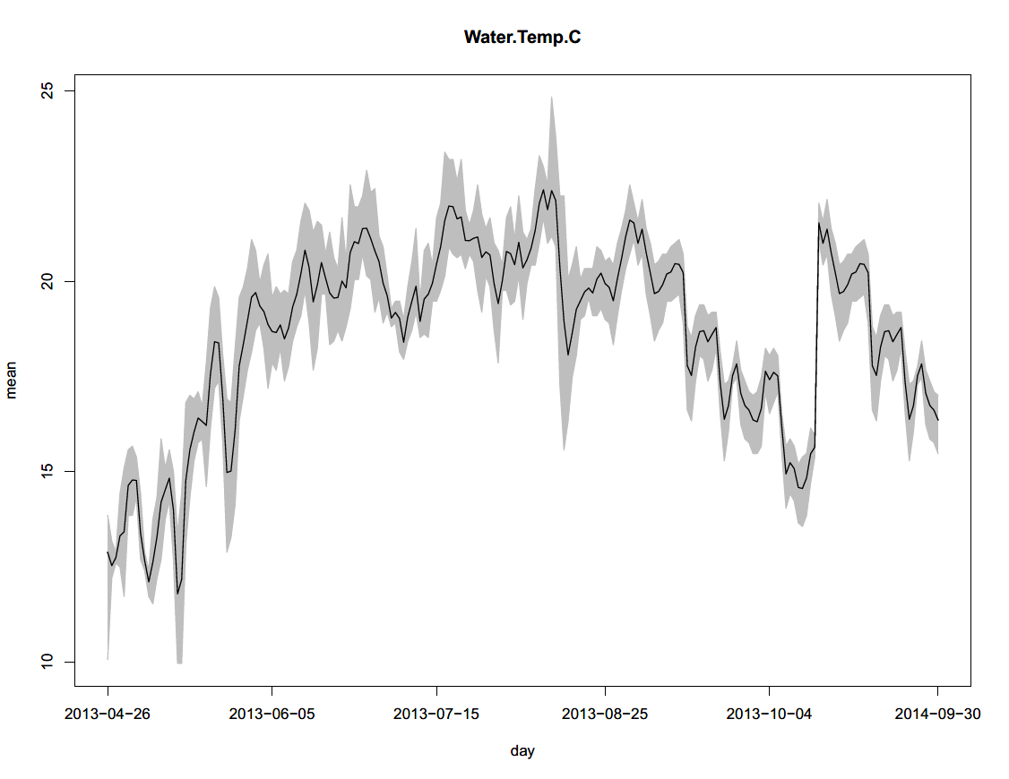
SummaryStats
Calculates summary statistics.
Two Data file (CSV)
Mean values by time period
Daily, Month, Season, Year, Year-Month, Month-Day, Julian Day, Year-Season
Statistics by time period
N, mean, median, min, max, range, standard deviation, variance, cv, and quantiles (1, 5, 10, 50, 75, 90, 95, and 99).
PDF of plots by time period
Mean and range

Slide 9
Configuration
The ContDataQC ships with a default configuration file the specifies data column names, date and time formats, QC test thresholds, and some other defaults (e.g., time zone).
The user has the ability to create their own config file for use with the functions.

Slide 10
Live Code
R Notebook
Combines text with code chunks.
Will be saved with slides and videos on GitHub
https://github.com/leppott/ContDataQC_Guide

Slide 11
Acknowledgements
Development of these instructional materials was funded by EPA ORD/NCEA (contact: Britta Bierwagen - Bierwagen.Britta@epa.gov).
Erik W. Leppo (Erik.Leppo@tetratech.com) from Tetra Tech (Tt) developed the ContDataQC R package (https://github.com/leppott/ContDataQC), with assistance from Jen Stamp (Tt) and David Gibbs (EPA ORISE fellow).

