Slide 1
ContDataQC Guide Video
04 Get Gage Data

Slide 2
ContDataQC
A package (add-in) for R (statistical programming language) that enables users to perform some quality control checks and related functions on their continuous monitoring data.
Available on GitHub (a code sharing website).
https://github.com/leppott/ContDataQC
To install within R run the code below.
library(devtools)
install_github("leppott/ContDataQC", force=TRUE, build_vignettes=TRUE)

Slide 3
Getting Help
From within R need to load the library first.
library(ContDataQC)
Help for a specific function.
Prefix the command with a question mark.
?ContDataQC
Help index for all function in the package.
help(package="ContDataQC")
Vignette, overall help file.
vignette("ContDataQC_Vignette",package="ContDataQC")

Slide 4
Get Gage Data
The ContDataQC package contains a function to download USGS gage data for use in ContDataQC.
This function is implemented with the USGS R package dataRetrieval.
Downloaded data is formatted for use with other functions in the ContDataQC package.
Example code
library(ContDataQC)
?ContDataQC
Vignette (help) file
library(ContDataQC)
vignette("ContDataQC_Vignette",package="ContDataQC")

Slide 5
Code Example, Basic
library(ContDataQC)
# Get Gage Data
myData.Operation <- "GetGageData" #Selection.Operation[1]
myData.SiteID <- "01187300" # Hubbard River near West Hartland, CT
myData.Type <- Selection.Type[4] #"Gage"
myData.DateRange.Start <- "2013-01-01"
myData.DateRange.End <- "2014-12-31"
myDir.import <- ""
myDir.export <- file.path(myDir.BASE,Selection.SUB[1])
ContDataQC(myData.Operation, myData.SiteID, myData.Type, myData.DateRange.Start
, myData.DateRange.End, myDir.import, myDir.export)

Slide 6
To include custom configuration
When run the function “ContDataQC()” there is a parameter (fun.myConfig) that allows the user to input their own configuration file.
fun.myFile=“config.tz.central.R”
“config.tz.central.R” should be in the working directory and is the name of your file.

Slide 7
Code Example, Modified Time Zone
To get gage data from a different time zone.
# Get Gage Data (central time zone)
myData.Operation <- "GetGageData" #Selection.Operation[1]
myData.SiteID <- "07032000" # Mississippi River at Memphis, TN
myData.Type <- Selection.Type[4] #"Gage"
myData.DateRange.Start <- "2013-01-01"
myData.DateRange.End <- "2014-12-31"
myDir.import <- ""
myDir.export <- file.path(myDir.BASE,Selection.SUB[1])
# include path if not in working directory
myConfig <- file.path(getwd(),Selection.SUB[1],"config.TZ.central.R")
ContDataQC(myData.Operation, myData.SiteID, myData.Type, myData.DateRange.Start
, myData.DateRange.End, myDir.import, myDir.export, myConfig)
* Creating a custom configuration is covered in a separate video.

Slide 8
USGS Parameter Codes
A summer 2017 update to the USGS dataRetrieval package removed parameter names from the summary table and only parameter codes were included.
https://nwis.waterdata.usgs.gov/usa/nwis/pmcodes
Parameter Code | Parameter Name
00060 | Discharge, cubic feet per second
00065 | Gage height, feet
00010 | Temperature, water, degrees Celsius
00020 | Temperature, air, degrees Celsius

Slide 9
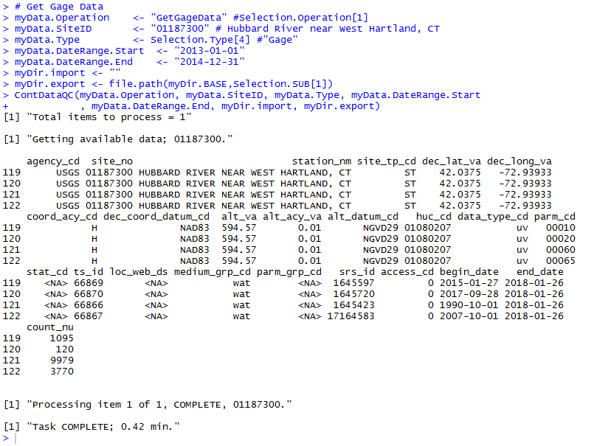
On Screen Feedback
During the download the user is presented with information on screen about the number of gages to process and the data available.
When finished the processing time is reported.

Slide 10
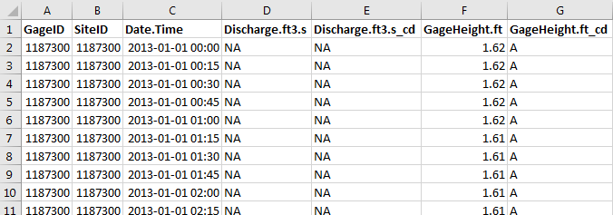
Download File Format
The downloaded file is saved to the specified directory as a CSV file and is ready for processing by other functions in the ContDataQC package.

Slide 11
Live Code
R Notebook
Combines text with code chunks.
Will be saved with slides and videos on GitHub
https://github.com/leppott/ContDataQC_Guide

Slide 12
Acknowledgements
Development of these instructional materials was funded by EPA ORD/NCEA (contact: Britta Bierwagen - Bierwagen.Britta@epa.gov).
Erik W. Leppo (Erik.Leppo@tetratech.com) from Tetra Tech (Tt) developed the ContDataQC R package (https://github.com/leppott/ContDataQC), with assistance from Jen Stamp (Tt) and David Gibbs (EPA ORISE fellow).

