Slide 1

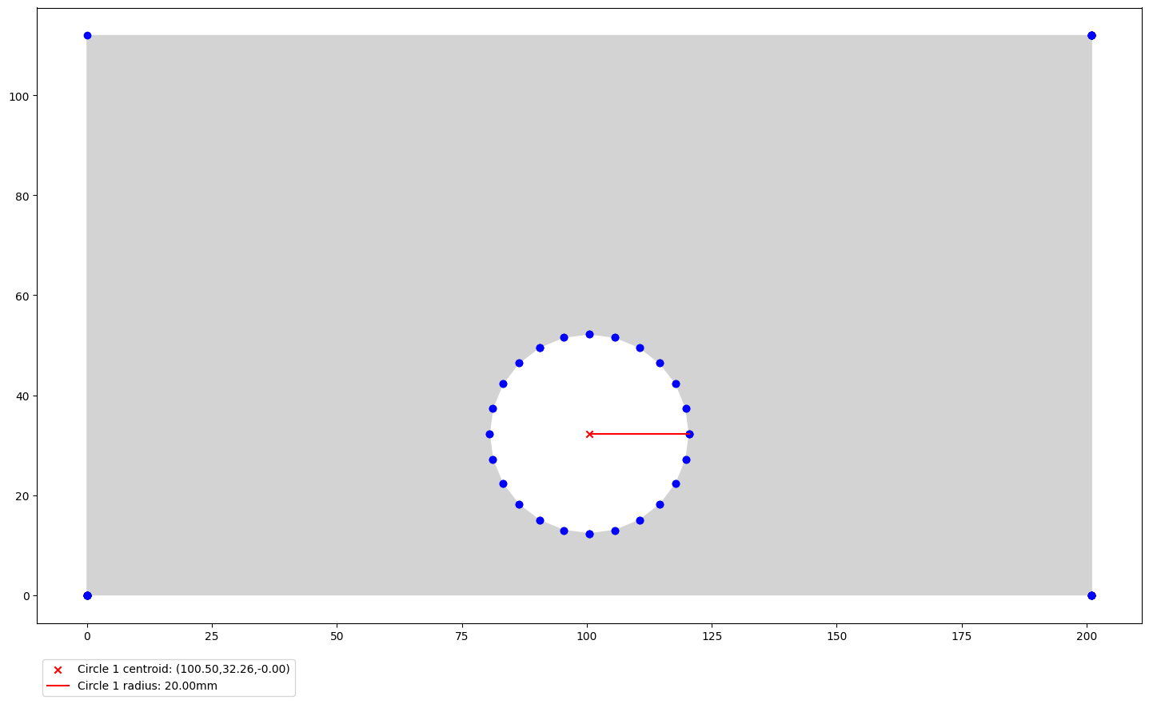
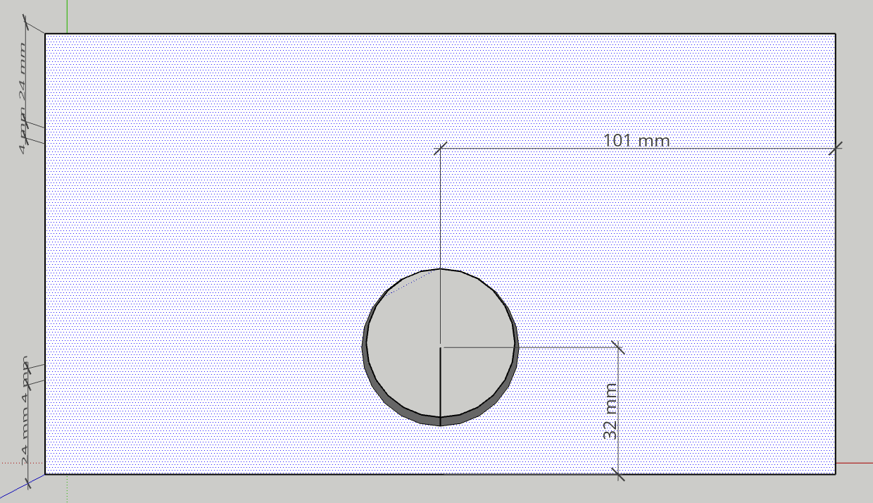
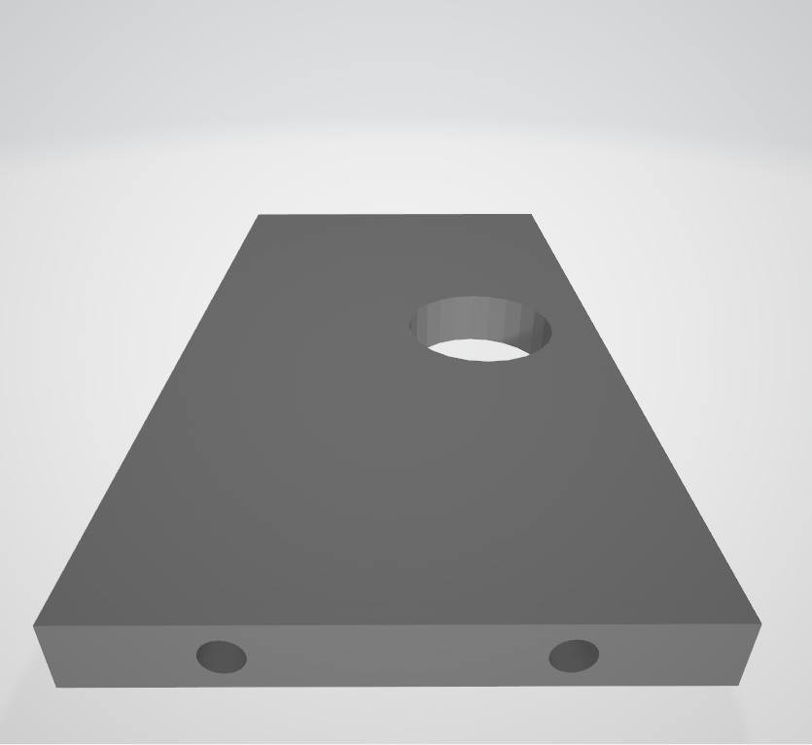
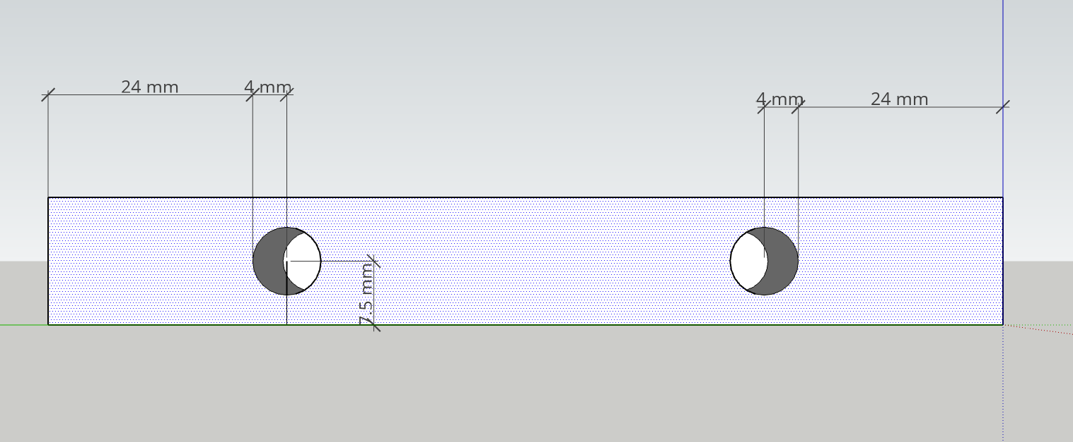
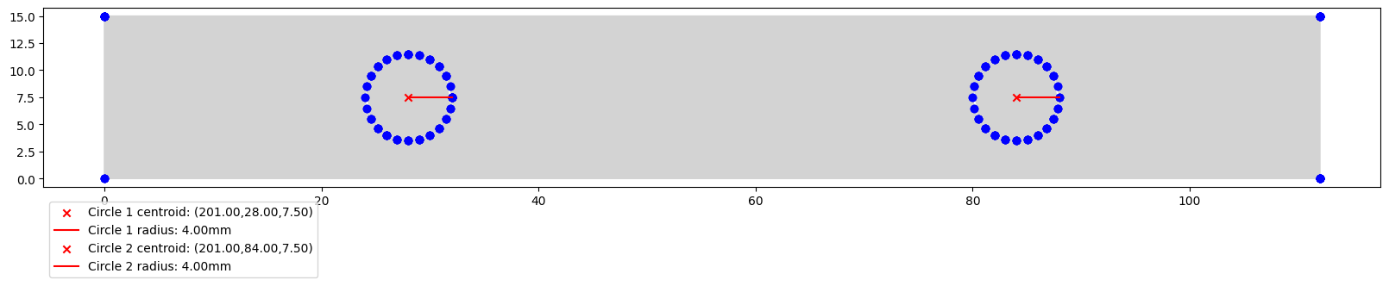
Hole extraction algorithm for 3D STL models
Jürgen Leppsalu, Kaspar Rohtmaa
University of Tartu, Institute of Computer Science, Algorithmics (MTAT.03.238)
https://github.com/leppsalujyrgen/stl_model_hole_extraction
Abstract
Picture 1 displays the narrow facet of our 3D model, featuring two holes not penetrating through the object.
Picture 2 illustrates the output of our algorithm, aligning with the measurements obtained from the CAD software.
Our focus is to accurately and reliably identify fabricated holes along with their measurements in a 3D model, aiming to streamline the quality assurance process.
Introduction
The fabrication process for various wood or metal objects always commences with a 3D model design. While quality assurance is relatively straightforward for less complex objects, the challenge intensifies when dealing with intricate designs and an increasing number of objects that must seamlessly fit together, thereby amplifying the complexity of quality control.
We are focused on 3D models presented in the STL binary file format. In this format, the entire object is defined by a mesh consisting of facet normals and, in relation to each facet, its vertices.
The facet normal acts as a perpendicular vector, providing information about the orientation of the facet within a 3D space.
The vertices of a facet normal consist of 3D coordinates employed in creating the polynomial objects essential for constructing the final model. These polynomial objects can take the form of triangles, quadrilaterals, octagons, and more. The most commonly used polynomial is the triangle due to its simplicity and efficiency in rendering the final result.
Our approach involves extracting this information from the binary file, grouping it together based on facets, and organizing it into a dictionary. This enables us to leverage graph theory to deduce the location of identified holes along with their respective coordinates and radii.
Picture 3. Visual representation of our algorithms output of the bigger all through object hole.
Implementation
The initial step, as mentioned, is to extract all the necessary data – for this we used numpy-stl library as it can directly work with binary files. We create a mesh object of the binary data enabling iteration through each facet normal. During this process, we normalized the coordinates of the facet normal and add all facet normals to the dictionary while associating them with their respective vertices.
To create our weighted graph structure, the initial step is to construct the nodes using vertex values. To do this we take our three vertices of a triangle, and we add edges between these vertices based on the coordinates and Euclidean distance of these points.
The process of isolating all the perimeters of objects in the 3D model is achieved through the convex hull method, a technique designed to identify the outermost points within a set.
Finally, we traverse the graph structure and search for cycles with consistent edge lengths. The identification of cycles with uniform edge lengths allows us to classify them as holes in the 3D model.
Upon identifying a hole, we determine the coordinates of its center point using the wedge method. This involves selecting all the coordinates on the circumference of the circle and finding a pair of points that are furthest from each other. This process yields the diameter of the circle, from which we can derive the center point coordinates.
Picture 4. Part of our 3D model with holes, facet with through object hole.
Results
Picture 5. 3D testing model for our algorithm.
In Pictures 4 and 5, we observe another favorable outcome from our algorithm, demonstrating consistency with the original 3D image in CAD software.
Picture 5 showcases the original 3D model used for testing our algorithm. It features a larger hole that traverses the object and two smaller holes on the narrow edge that do not extend through the object.
Conclusion
In summary, our objective was to develop an algorithm for identifying holes in a 3D model, aiming to streamline the quality assurance process by automatically detecting, locating the center coordinates of these holes, and providing output with both the central point coordinates and the determined hole radius.
We believe that we have made significant progress towards our goals and have obtained favorable results from our algorithm.
Additional development work could be done in betterment of our algorithm and software overall. Adding a userfriendly UI or a hold-and-drag webinterface. Furthermore, the algorithm could be improved on with different functionalities like detecting a raised part on model A and making sure it fits inside a designated hole in model B.
Picture 1. Part of our 3D model with holes, narrow facet with two not through holes.
Picture 2. Visual representation of our algorithms output on the narrow facet with two holes.

