Slide 1
NGAOUNDÉRÉ–MEIGANGA - Analysis
2025-12-04 - 2025-12-06

Slide 2
Table of Contents
03
Overview
10
Sentiment by categories
04
The most popular mentions
11
Influencers: most share of voic...
05
Mentions from top public profil...
12
Influencers: most followers
06
Mentions
13
Trending Hashtags and Links
07
Reach
14
Most active sites
08
Mentions by category
15
Current Presence Score
09
Sentiment
16
The most popular emojis ...

Slide 3
Overview
Total mentions
Total reach
Positive mentions
Negative mentions
Average Presence Score
17
460 164
0
6
1/100
+750%
+4925%
0%
+200%
0%
AVE
Social media reach
Non-Social media reach
User generated content
Social media mentions
$23 779
460 164
0
17
17
0%
+4925%
0%
+750%
+750%
Non-Social media mentions
Social media reactions (e.g. likes)
Social media comments
Social media shares
Total social media interactions
0
15 568
286
926
16 780
0%
+11020%
+3078%
0%
+11162%
% Change: Percentage compared to the previous data range

Slide 4

The most popular mentions
raphaelt565
Neutral
candyde11
Negative
tiktok.com • 71 997 followers • 2025-12-04
tiktok.com • 28 201 followers • 2025-12-05
« Blocage total sur l’axe Ngaoundéré–Meiganga. Les camionneurs exigent désorm...
cameroun infos : Tensions à Meiganga : des gendarmes démontent leur checkpoin...
raphaelt565
Neutral
enfantbenit237
Neutral
tiktok.com • 71 997 followers • 2025-12-05
tiktok.com • 134 followers • 2025-12-05
Axe Ngaoundéré–Meiganga toujours paralysé ! Les camionneurs maintiennent le b...
Axe Ngaoundéré–Meiganga : la route est fortement perturbée ce matin. Plusieur...

Slide 5

Mentions from top public profiles
raphaelt565
Neutral
EsBi_Media
Negative
tiktok.com • 71 997 followers • 2025-12-04
x.com • 1894 followers • 2025-12-06
« Blocage total sur l’axe Ngaoundéré–Meiganga. Les camionneurs exigent désorm...
🛑SOCIÉTÉ - AXE NGAOUNDÉRÉ–MEIGANGA : LA COLÈRE MONTE LES CAMIONNEURS RÉCLAME...
enfantbenit237
Neutral
candyde11
Negative
tiktok.com • 134 followers • 2025-12-05
tiktok.com • 28 201 followers • 2025-12-05
Axe Ngaoundéré–Meiganga : la route est fortement perturbée ce matin. Plusieur...
eux-mêmes Tensions à Meiganga, des camionneurs bloquent l’axe Ngaoundéré–Meig...

Slide 6
Mentions

Slide 7
Reach

Slide 8
Mentions by category

Slide 9
Sentiment

Slide 10
Sentiment by categories

Slide 11

Influencers: most share of voice
 | Profile name | Mentions | Reach | Share of Voice
 | raphaelt565 tiktok.com | 2 | 283 K | 61.465%
 | EsBi_Media x.com | 3 | 64 200 | 13.952%
 | enfantbenit237 tiktok.com | 1 | 51 364 | 11.162%
 | candyde11 tiktok.com | 1 | 39 658 | 8.618%
 | ActuMédia youtube.com | 3 | 10 972 | 2.384%

Slide 12


Influencers: most followers
 | Profile name | Mentions | Reach | Followers | Influencer Score
 | raphaelt565 tiktok.com | 2 | 283 K | 71 997 | 9
 | ActuMédia youtube.com | 3 | 10 972 | 30 200 | 8
 | candyde11 tiktok.com | 1 | 39 658 | 28 201 | 8
 | AUDIENCE youtube.com | 1 | 1142 | 26 400 | 8
 | Cameroon Concord facebook.com | 1 | 1507 | 25 128 | 8

Slide 13
Trending Hashtags and Links
Hashtag | Mentions
#ngaoundéré | 8
#meiganga | 7
#cameroun | 6
#actu237 | 5
#actualitécameroun | 5
#camionneurs | 3
#routebloquée | 3
#237 | 3
Link | Mentions
https://x.com/esbi_media/status/... | 1
https://x.com/westcameroons/stat... | 1
https://x.com/esbi_media/status/... | 1
https://x.com/esbi_media/status/... | 1
https://panoramapapers.com/camer... | 1

Slide 14



Most active sites
 | Source | Mentions
 | youtube.com | 6
 | x.com | 6
 | tiktok.com | 4
 | facebook.com | 1
 | Source | Mentions

Slide 15
Current Presence Score
1
Your Presence Score is higher than 11% of brands

Slide 16


Slide 17
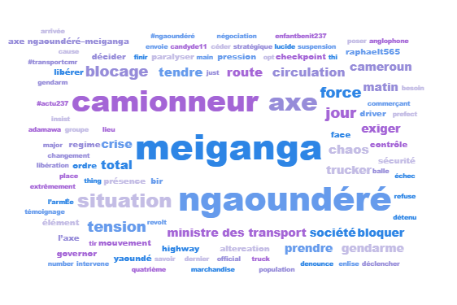
Context of a discussion

Slide 18
Thank you!

