Slide 1
FECAFOOT - Analysis
2025-01-01 - 2025-12-31

Slide 2
Table of Contents
03
Overview
10
Sentiment by categories
04
The most popular mentions
11
Influencers: most share of voic...
05
Mentions from top public profil...
12
Influencers: most followers
06
Mentions
13
Trending Hashtags and Links
07
Reach
14
Most active sites
08
Mentions by category
15
Current Presence Score
09
Sentiment
16
The most popular emojis ...

Slide 3
Overview
Total mentions
Total reach
Positive mentions
Negative mentions
Average Presence Score
728
8.4M
20
158
2/100
0%
0%
0%
0%
+100%
AVE
Social media reach
Non-Social media reach
User generated content
Social media mentions
$514K
5.2M
3.2M
283
259
0%
0%
0%
0%
0%
Non-Social media mentions
Social media reactions (e.g. likes)
Social media comments
Social media shares
Total social media interactions
469
41K
743
1 179
43K
0%
0%
0%
0%
0%
% Change: Percentage compared to the previous data range

Slide 4



The most popular mentions
christian_mdf
Neutral
Derek Katey Caesar
Neutral
tiktok.com • 144 K followers • 2025-12-10
facebook.com • 1.3 M followers • 2025-12-12
MARC BRYS DÉFINITIVEMENT RENVOYÉ ! Et surprise totale : le MINSEP soutient of...
JUST IN: Andre Onana will not feature at the ... [...] Samuel Eto’o, who rece...
Onana’s Afcon fate revealed...
Neutral
Cameroon had a chaotic AFCO...
Neutral
thesun.co.uk • 2025-12-12
nytimes.com • 2025-12-28
Onana is at the centre of an ugly tug-of-war between two leadership factions ...
[...] might, in some ways, come to symbolise the civil war that has ripped th...

Slide 5



Mentions from top public profiles
Derek Katey Caesar
Neutral
Beatrice Doudou
Positive
facebook.com • 1.3 M followers • 2025-12-12
facebook.com • 331 K followers • 2025-12-14
recently marked his fourth year as president of FECAFOOT, is locked in a bitt...
football. Le Cameroun avance. Le Cameroun inspire. : Fecafoot - Officiel #bea...
Bóng Đá
Negative
FabiolaMN
Neutral
facebook.com • 1.5 M followers • 2025-12-14
x.com • 2589 followers • 2025-12-27
‼️ BÁO ĐEN ETO O LOẠI HẬU BỐI KHỎI ĐỘI TUYỂN VÌ LO SỢ KỶ LỤC CỦA MÌNH SẼ BỊ P...
On parle du conflit fecafoot minsep Pagou dit qu’il est juste entraîneur il n...

Slide 6
Mentions

Slide 7
Reach

Slide 8
Mentions by category

Slide 9
Sentiment

Slide 10
Sentiment by categories

Slide 11


Influencers: most share of voice
 | Profile name | Mentions | Reach | Share of Voice
 | grok x.com | 4 | 579 K | 11.052%
 | Benji infos facebook.com | 6 | 523 K | 9.997%
 | Beatrice Doudou facebook.com | 2 | 429 K | 8.185%
 | Derek Katey Caesar facebook.com | 1 | 291 K | 5.56%
 | Bóng Đá facebook.com | 1 | 284 K | 5.428%

Slide 12




Influencers: most followers
 | Profile name | Mentions | Reach | Followers | Influencer Score
 | grok x.com | 4 | 579 K | 7.2 M | 10
 | RMC Sport facebook.com | 1 | 90 180 | 4.5 M | 10
 | Diario Sport facebook.com | 1 | 65 129 | 3.3 M | 10
 | Fútbol Mundial. facebook.com | 1 | 54 329 | 2.7 M | 10
 | RFI youtube.com | 1 | 2990 | 2.2 M | 10

Slide 13
Trending Hashtags and Links
Hashtag | Mentions
#fecafoot | 40
#cameroun | 37
#samueletoo | 27
#minsep | 25
#lionsindomptables | 24
#marcbrys | 15
#can2025 | 14
#footballcamerounais | 13
Link | Mentions
https://scontent-cdg4-3.xx.fbcdn... | 7
https://www.youtube.com/@repport... | 3
https://www.reddit.com/user/univ... | 2
https://www.youtube.com/channel/... | 2
https://www.kassataya.com... | 2
https://www.youtube.com/channel/... | 2
https://www.youtube.com/@infos23... | 2
https://www.afriquesports.net/... | 2

Slide 14




Most active sites
 | Source | Mentions
 | x.com | 111
 | facebook.com | 85
 | youtube.com | 54
 | actucameroun.com | 46
 | lebledparle.com | 16
 | Source | Mentions
 | camfoot.com | 13
 | africatopsuccess.com | 12
 | 237actu.com | 11
 | 237online.com | 10
 | maliactu.net | 9

Slide 15
Current Presence Score
37
Your Presence Score is higher than 66% of brands

Slide 16


Slide 17
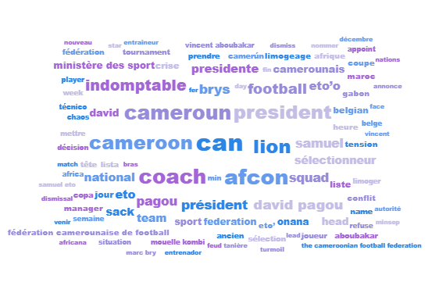
Context of a discussion

Slide 18
Thank you!

