Slide 1
Anicet Ekane - Demographics Report
2025-01-01 - 2025-12-31

Slide 2
Table of contents
03
Gender Distribution
08
Education level
04
Age Distribution
09
Income level
05
Distribution by countries
10
Interests
06
Distribution by countries - map
11
Social Media Presence
07
Occupation breakdown

Slide 3
Gender Distribution
497K
Total Reach
Female: 45.15%
Male: 54.85%

Slide 4
Age Distribution
18-24
7.5% (34 246)
9.2% (46 016)
25-34
10.6% (53 172)
11.6% (58 054)
35-44
7.5% (37 394)
8.8% (44 045)
Female
45-54
7.7% (38 535)
Male
10.3% (51 293)
55-64
6.1% (30 473)
8.4% (42 071)
65+
5.8% (28 956)
6.6% (33 066)
0
5
10
15
Percentage of Reach %

Slide 5
Distribution by countries
Country | Reach % (Value)
🇨🇲 Cameroon | 27.08% (338 K)
🇺🇸 United States | 10.55% (131 K)
🇫🇷 France | 8.62% (108 K)
🇮🇹 Italy | 7.25% (90 520)
🇨🇦 Canada | 6.21% (77 457)
🇩🇪 Germany | 5.91% (73 798)
🇹🇭 Thailand | 5.7% (71 181)
🇨🇮 Ivory Coast | 5.1% (63 685)
🇬🇧 United Kingdom | 3.95% (49 275)
🇹🇩 Chad | 3.58% (44 701)

Slide 6
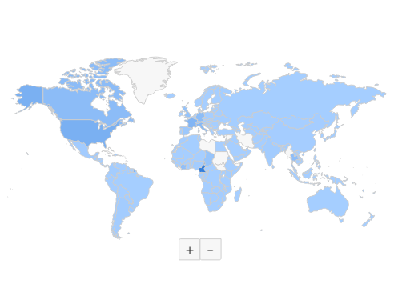
Distribution by countries - map

Slide 7
Occupation breakdown
Full-time work
57.52% (286 K)
Part-time work
15.18% (75 993)
Unemployed
12.66% (63 391)
Studies
5.64% (28 219)
Homemaker
3.05% (15 246)
Retired
2.34% (11 700)
Own business
2.18% (10 904)
Leave of absence
1.25% (6240)
Parental leave
0.18% (898)
0
10
20
30
40
50
Percentage of Reach %

Slide 8
Education level
University
54.57% (272 K)
School
29.44% (147 K)
Postgraduate
13.74% (68 797)
None completed
2.25% (11 241)
0
20
40
60
80
Percentage of Reach %

Slide 9
Income level

Slide 10
Interests
🌐 Online Services
84.09% (421 K)
📺 Mass Media
81.92% (410 K)
💻 Information Technology
65.86% (330 K)
🛒 Retail
62.58% (313 K)
📰 Newspapers
60.66% (304 K)

Slide 11
Social Media Presence

Slide 12
Thank you!

