Slide 1
Schedule Builder
By Tejas Prasad & Harprabh Sangha

Slide 2
What is Schedule Builder?
The Schedule Builder app is designed for College Students by College Students
A user will be able to enter in 1 or more classes they want to take for an upcoming semester
They can put in restrictions such as no classes on Fridays, having no class during lunch or during a specific time period on a day
The app will generate a list of all possible schedules a student can take with the classes and restrictions they inputted.

Slide 3
Why is Schedule Builder?
Right now there is no easy way at WashU to look at multiple different schedules with classes which have different sections or recitations
The only way right now to look at different schedules is for a student to make those schedules themselves which is a time consuming task

Slide 4
Schedule Builder Parts
The first part of the app will be getting a list of all courses and sections for the upcoming fall semester. This could involve scraping the WashU Course website, using an API, or hardcoding in a select number of classes
The second part would be creating a UI so user’s could input their classes and any restrictions they have such as no classes after 5PM. They can signify if a class must be in the schedule or if it’s optional
The third part is the schedule generator. This will be an algorithm which will have to take in the courses the user selected and any constraints they have and generate all possible valid schedules.
The fourth part would be allowing the user to save any schedules they want

Slide 5
Distribution of Work
Tasks | Tejas | Harprabh
App UI & Data Integration | 50% | 50%
Schedule Builder Algorithm | 100% | 0%
Scraping Course Website/Getting Course Data | 0% | 100%

Slide 6
Sprint Planning
Task | Start Week | Assignee | Estimated Time to Complete
Create App Layout in Storyboard | 7/13 | Tejas | 6 Days
Investigate acquiring Course Data | 7/13 | Harprabh | 3 Days
Acquire Course Data or Create Dummy Data | 7/13 | Harprabh | 2 Days
Create Working Schedule Input Page | 7/13 | Harprabh | 4 Days
Create Initial Schedule Algorithm to generate all schedules with no restrictions | 7/20 | Tejas | 5 Days
Schedule Algorithm generates with Optional Courses | 7/20 | Tejas | 1 Day
Display Generated Schedules | 7/20 | Harprabh | 4 Days
Schedule Algorithm generates with restrictions on Time and Days of Week | 7/27 | Tejas | 3 Days
Save favorited Schedules and export them as an image | 7/27 | Harprabh | 2 Days

Slide 7
Sprint Planning
Task | Start Week | Assignee | Estimated Time to Complete
Save and go back to last 3 searches a User did | 7/27 | Harprabh | 3 Days
Additional Feature/UI Work | 7/27 | Tejas | 3 Days
7/23 Project Update Deliverable: Working App with ability to input courses from real/dummy data and generate all schedules. These schedules can be viewed
7/30 Final Project Deliverable: Fully Working App with abilities from above and ability to input time/date restrictions. Ability to save schedules, export them, and view previous searches

Slide 8
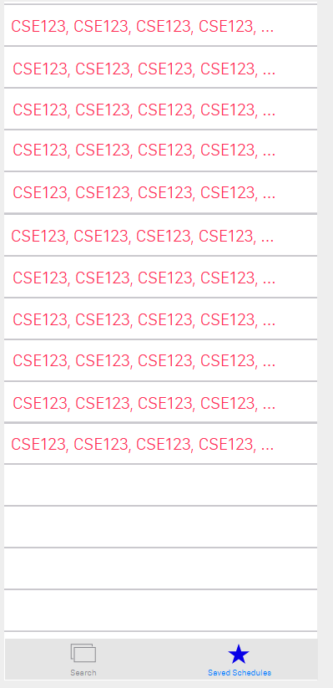
Generated Schedules Wireframe

Slide 9
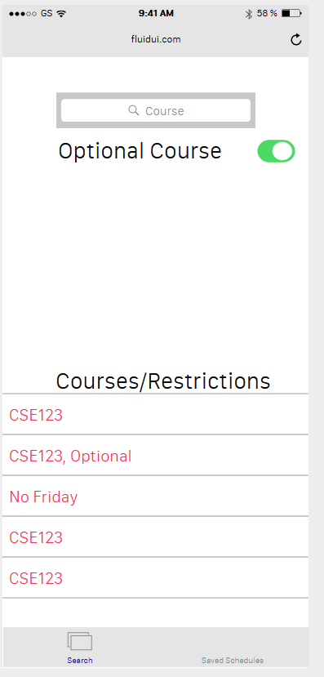
Course Input/Time Restriction Input Wireframe

Slide 10
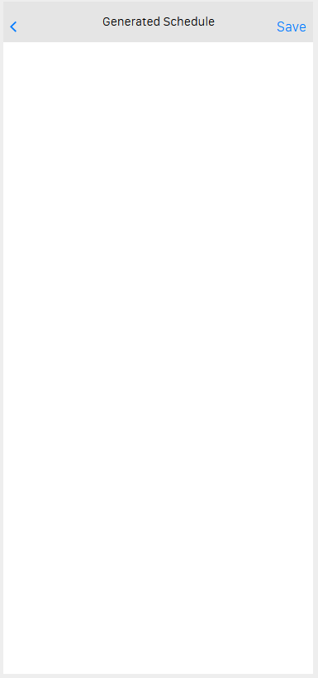
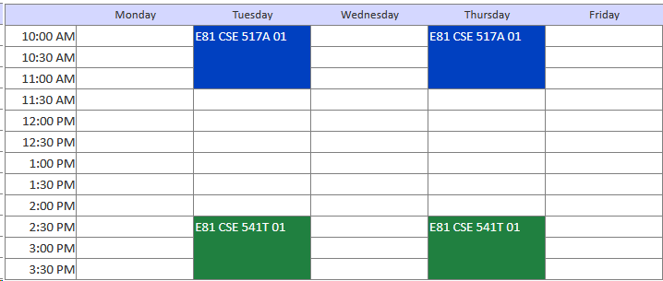
View Schedule Wireframe

Slide 11
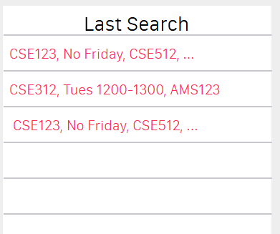
Saved Schedules Wireframe

