Slide 1
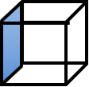
Ruler

Slide 2
Animation

Slide 3

Fix
Show Nodes

