Slide 1
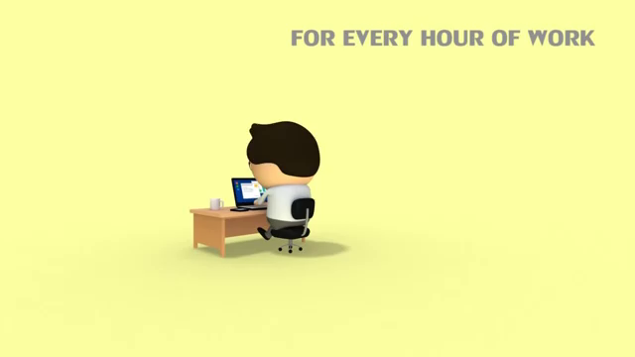

Slide 2


Slide 3


Slide 4


Slide 5


Slide 6


Slide 7


Slide 8


Slide 9

HAPPINESS AND WORK

Slide 10


Slide 11


Slide 12
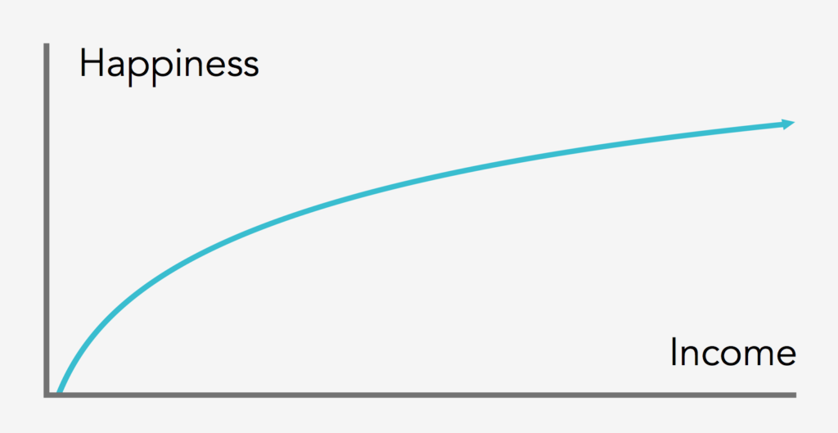

Slide 13


Slide 14


Slide 15


Slide 16
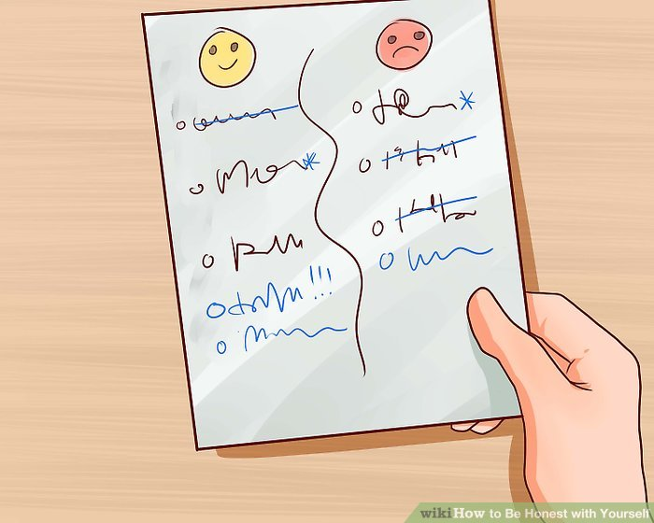

Slide 17


Slide 18


Slide 19


Slide 20
Any questions ??

Slide 21
Thank you <3

Slide 22
References:
https://www.youtube.com/watch?v=MWM-qVkBzus.
Wikipedia.

