Slide 1

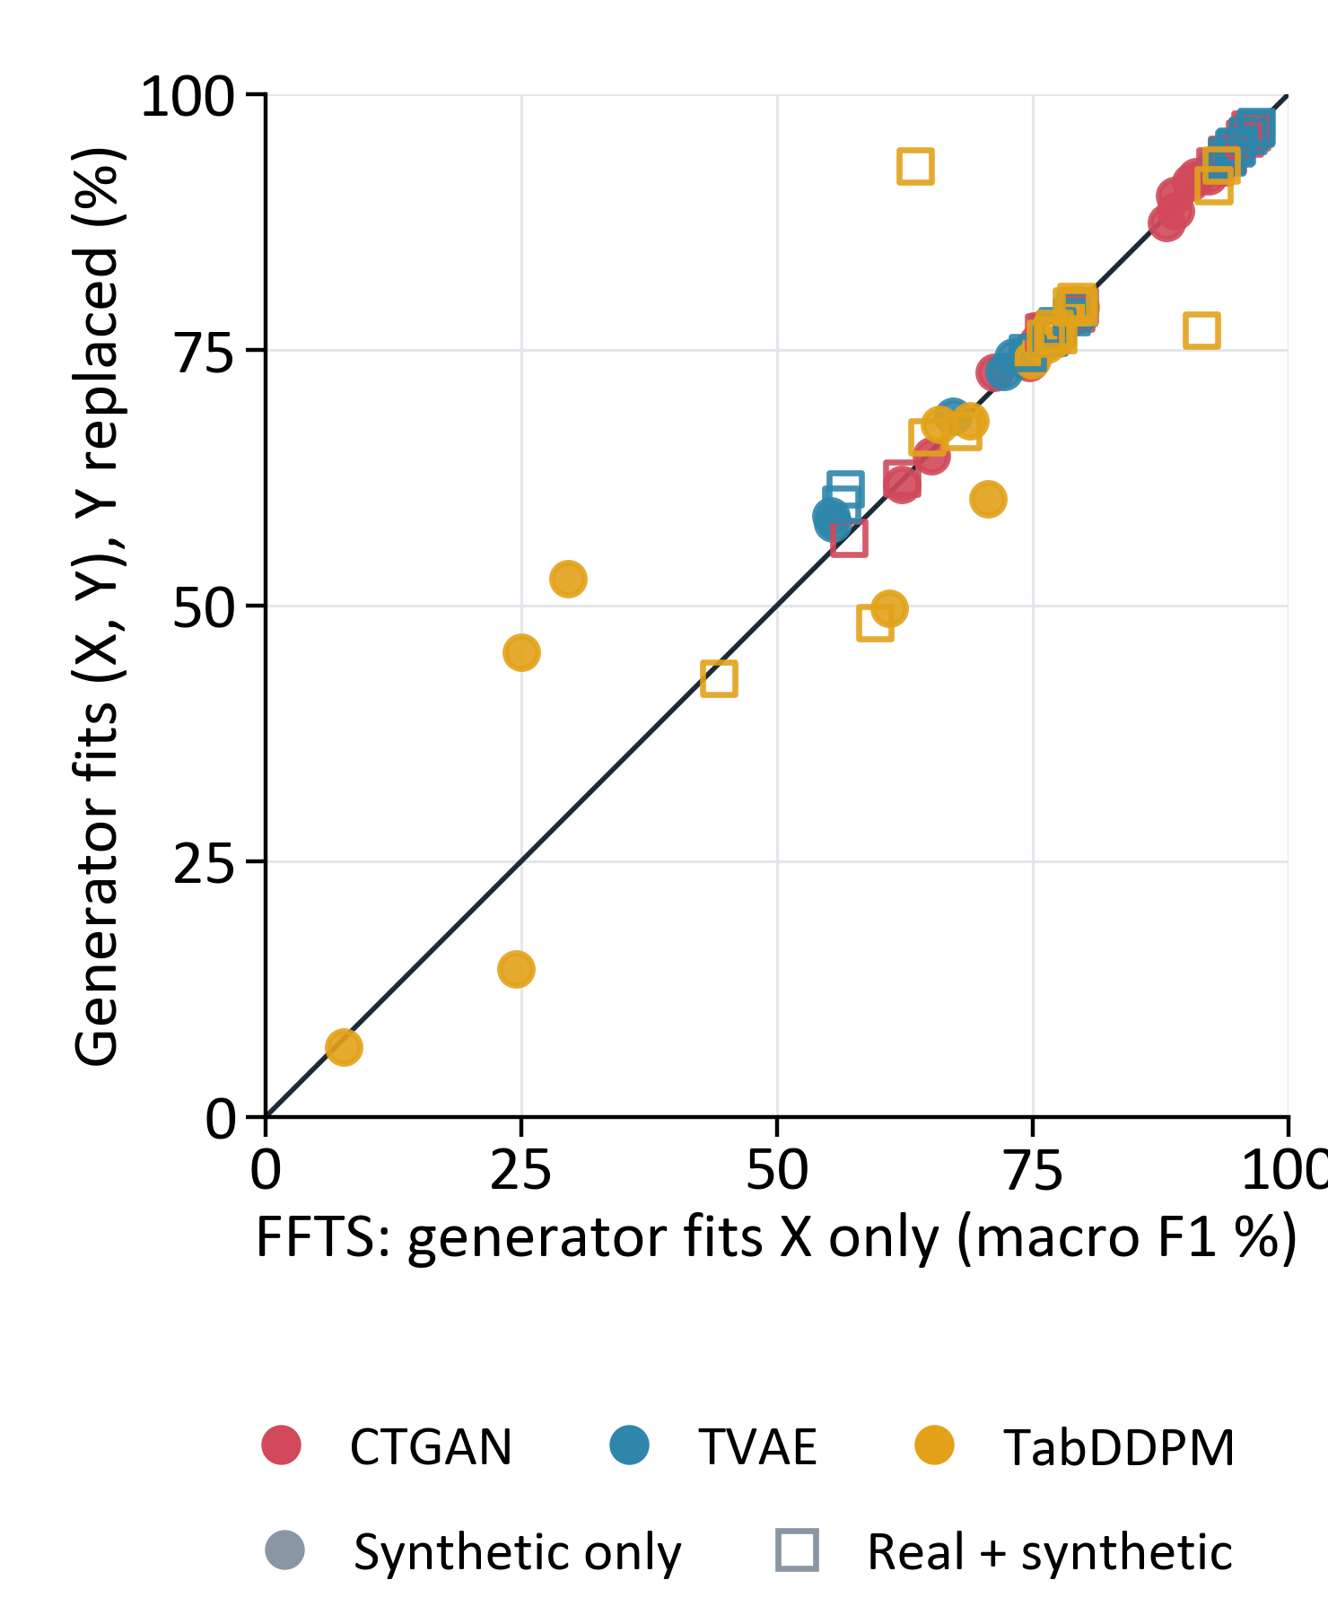
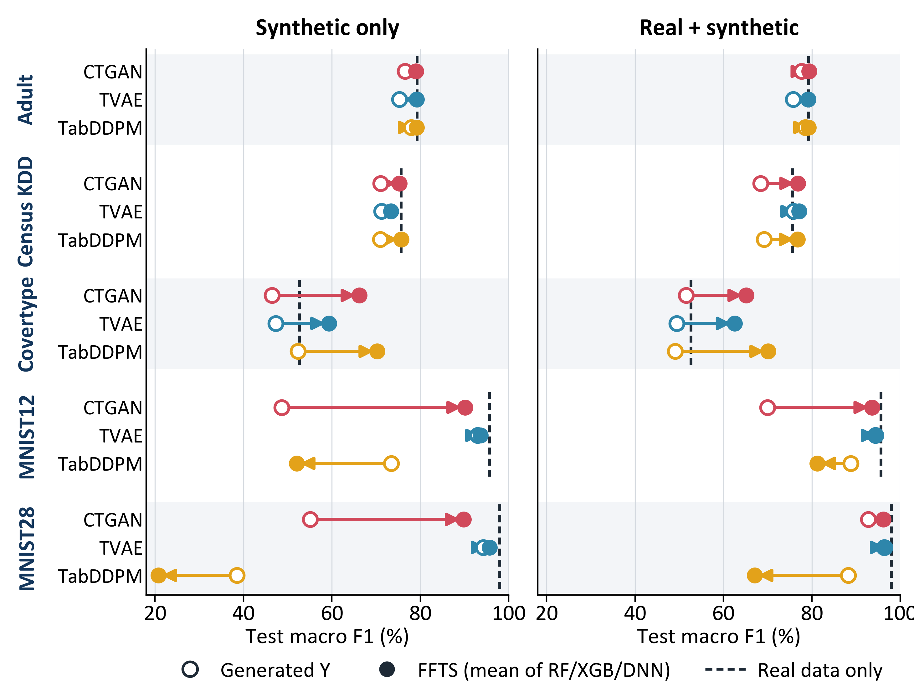



Synthetic Data Generation via Factorized Feature-Target Synthesis
Relabeling synthetic data to outperform real training data.
Minh Le, Thuy Do
Luther College
Why factorize?
Result: synthetic data that rivals real data
Does the generator need Y?
A supervised table has features X and a target Y. A model trained on synthetic data can only learn the X–Y relation that the table contains.
Generators such as CTGAN, TVAE and TabDDPM model (X, Y) jointly and treat Y as one more column. Nothing ties a generated Y to its generated X.
FFTS generates the features, then assigns every target with a model fitted to the real data.
Synthetic-only training, classification: FFTS adds +7.2 macro-F1 points over generated targets
95% CI 0.3 to 14.0; better in 13 of 15 task–generator pairs; CTGAN and TVAE: +12.3 points (18% relative).
With TVAE features, FFTS comes within 2.3 points of real-data training on every classification task, and beats it on Covertype (+6.7) and Housing (R² 0.78 vs. 0.51).
Each point is one task, generator and labeler. On the diagonal, fitting the generator to (X, Y) instead of X alone makes no difference.
Joint minus FFTS: +0.5 points (95% CI −3.0 to +3.9; Holm p = 1.00).
Fitting the generator to Y as well adds no detectable benefit.
Method
Standard: joint synthesis
Real data
(X, Y)
Generator
fits (X, Y)
Synthetic (X_{syn}, Y_{syn})
Y_{syn} is generated
FFTS: factorized feature–target synthesis
Simulated data with known truth
Real data
(X, Y)
1. Generator
fits X only
X_{syn}
Synthetic
(X_{syn}, h(X_{syn}))
any number of rows
Ring: 8 Gaussian clusters in (X₀, X₁). A binary feature S sets the slope of the Bayes boundary h*; 10% of labels are flipped. Six more datasets: Gaussian, Grid and 4 Bayesian networks.
2. Labeler h
fits Y | X
RF, XGB or DNN
h
The generator samples synthetic features X_{syn} (100,000 rows here).
The labeler h learns Y from X on the real training rows.
Ablation: keep a joint generator’s X_{syn} and replace its Y_{syn} with h(X_{syn}).
Evaluation
Classification: Adult, Census KDD, Covertype, MNIST12, MNIST28 (macro F1).
Regression: California Housing, News (R²).
A downstream neural network trains on synthetic only or real + synthetic, and is tested on held-out real rows.
Generators, labelers and preprocessing see training rows only; checkpoints are chosen on a real development split. 2 seeds; 588 downstream runs.
Regression (same layout; dashed line = real data only)
Takeaways
Labeling synthetic features with a model trained on real data is a simple add-on to any generator.
Exception: TabDDPM on MNIST. Its digits drift from real ones, so a real-data labeler mislabels them.
Caveats: the wins over real data likely distill a strong labeler into many rows, and the real-only network is weak on Housing. With 5 tasks, the primary test (+7.4 points, p = 0.047) is not significant after Holm correction (p = 0.19).
Open circle: the generator’s own targets. Filled circle: FFTS. Averaged over 2 seeds (FFTS also over 3 labelers). Generated targets fall short of real data on 5 of 5 classification tasks for every generator; News has no predictable signal for any method, including real data (|R²| ≤ 0.03).
L_{test}: fit a simple density model to the synthetic table, then average its log-density over real test rows. Higher means the synthetic table covers the real data better.
FFTS raises accuracy on all 7 datasets (+0.3 to +14.7 points, within 1.2 of real data) but lowers L_{test} on 4: hard labels erase the target’s natural randomness.

Slide 2
Synthetic Data Generation via Factorized Feature-Target Synthesis
Generate as many rows as you need, label them with a model trained on real data, and the synthetic data can stand in for the real data
Minh Le, Thuy Do
Luther College
Why factorize?
Result: synthetic data that rivals real data
Does the generator need Y?
A supervised table has features X and a target Y. A model trained on synthetic data can only learn the X–Y relation that the table contains.
Generators such as CTGAN, TVAE and TabDDPM model (X, Y) jointly and treat Y as one more column. Nothing ties a generated Y to its generated X.
FFTS generates the features, then assigns every target with a model fitted to the real data.
Synthetic-only training, classification: FFTS adds +7.2 macro-F1 points over generated targets
95% CI 0.3 to 14.0; better in 13 of 15 task–generator pairs; CTGAN and TVAE: +12.3 points (18% relative).
With TVAE features, FFTS comes within 2.3 points of real-data training on every classification task, and beats it on Covertype (+6.7) and Housing (R² 0.78 vs. 0.51).
Each point is one task, generator and labeler. On the diagonal, fitting the generator to (X, Y) instead of X alone makes no difference.
Joint minus FFTS: +0.5 points (95% CI −3.0 to +3.9; Holm p = 1.00).
Fitting the generator to Y as well adds no detectable benefit.
Method
Standard: joint synthesis
Real data
(X, Y)
Generator
fits (X, Y)
Synthetic (X_{syn}, Y_{syn})
Y_{syn} is generated
FFTS: factorized feature–target synthesis
Simulated data with known truth
Real data
(X, Y)
1. Generator
fits X only
X_{syn}
Synthetic
(X_{syn}, h(X_{syn}))
any number of rows
Ring: 8 Gaussian clusters in (X₀, X₁). A binary feature S sets the slope of the Bayes boundary h*; 10% of labels are flipped. Six more datasets: Gaussian, Grid and 4 Bayesian networks.
2. Labeler h
fits Y | X
RF, XGB or DNN
h
The generator samples synthetic features X_{syn} (100,000 rows here).
The labeler h learns Y from X on the real training rows.
Ablation: keep a joint generator’s X_{syn} and replace its Y_{syn} with h(X_{syn}).
Evaluation
Classification: Adult, Census KDD, Covertype, MNIST12, MNIST28 (macro F1).
Regression: California Housing, News (R²).
A downstream neural network trains on synthetic only or real + synthetic, and is tested on held-out real rows.
Generators, labelers and preprocessing see training rows only; checkpoints are chosen on a real development split. 2 seeds; 588 downstream runs.
Regression (same layout; dashed line = real data only)
Takeaways
Labeling synthetic features with a model trained on real data is a simple add-on to any generator.
Exception: TabDDPM on MNIST. Its digits drift from real ones, so a real-data labeler mislabels them.
Caveats: the wins over real data likely distill a strong labeler into many rows, and the real-only network is weak on Housing. With 5 tasks, the primary test (+7.4 points, p = 0.047) is not significant after Holm correction (p = 0.19).
Open circle: the generator’s own targets. Filled circle: FFTS. Averaged over 2 seeds (FFTS also over 3 labelers). Generated targets fall short of real data on 5 of 5 classification tasks for every generator; News has no predictable signal for any method, including real data (|R²| ≤ 0.03).
L_{test}: fit a simple density model to the synthetic table, then average its log-density over real test rows. Higher means the synthetic table covers the real data better.
FFTS raises accuracy on all 7 datasets (+0.3 to +14.7 points, within 1.2 of real data) but lowers L_{test} on 4: hard labels erase the target’s natural randomness.

Slide 3
Synthetic Data Generation via Factorized Feature-Target Synthesis
Relabeling synthetic data to outperform real training data.
Minh Le, Thuy Do
Luther College
Why factorize?
Result: synthetic data that rivals real data
Does the generator need Y?
A supervised table has features X and a target Y. A model trained on synthetic data can only learn the X–Y relation that the table contains.
Generators such as CTGAN, TVAE and TabDDPM model (X, Y) jointly and treat Y as one more column. Nothing ties a generated Y to its generated X.
FFTS generates the features, then assigns every target with a model fitted to the real data.
Synthetic-only training, classification: FFTS adds +7.2 macro-F1 points over generated targets
95% CI 0.3 to 14.0; better in 13 of 15 task–generator pairs; CTGAN and TVAE: +12.3 points (18% relative).
With TVAE features, FFTS comes within 2.3 points of real-data training on every classification task, and beats it on Covertype (+6.7) and Housing (R² 0.78 vs. 0.51).
Each point is one task, generator and labeler. On the diagonal, fitting the generator to (X, Y) instead of X alone makes no difference.
Joint minus FFTS: +0.5 points (95% CI −3.0 to +3.9; Holm p = 1.00).
Fitting the generator to Y as well adds no detectable benefit.
Method
Standard: joint synthesis
Real data
(X, Y)
Generator
fits (X, Y)
Synthetic (X_{syn}, Y_{syn})
Y_{syn} is generated
FFTS: factorized feature–target synthesis
Simulated data with known truth
Real data
(X, Y)
1. Generator
fits X only
X_{syn}
Synthetic
(X_{syn}, h(X_{syn}))
any number of rows
Ring: 8 Gaussian clusters in (X₀, X₁). A binary feature S sets the slope of the Bayes boundary h*; 10% of labels are flipped. Six more datasets: Gaussian, Grid and 4 Bayesian networks.
2. Labeler h
fits Y | X
RF, XGB or DNN
h
The generator samples synthetic features X_{syn} (100,000 rows here).
The labeler h learns Y from X on the real training rows.
Ablation: keep a joint generator’s X_{syn} and replace its Y_{syn} with h(X_{syn}).
Evaluation
Classification: Adult, Census KDD, Covertype, MNIST12, MNIST28 (macro F1).
Regression: California Housing, News (R²).
A downstream neural network trains on synthetic only or real + synthetic, and is tested on held-out real rows.
Generators, labelers and preprocessing see training rows only; checkpoints are chosen on a real development split. 2 seeds; 588 downstream runs.
Regression (same layout; dashed line = real data only)
Takeaways
Labeling synthetic features with a model trained on real data is a simple add-on to any generator.
Exception: TabDDPM on MNIST. Its digits drift from real ones, so a real-data labeler mislabels them.
Caveats: the wins over real data likely distill a strong labeler into many rows, and the real-only network is weak on Housing. With 5 tasks, the primary test (+7.4 points, p = 0.047) is not significant after Holm correction (p = 0.19).
Open circle: the generator’s own targets. Filled circle: FFTS. Averaged over 2 seeds (FFTS also over 3 labelers). Generated targets fall short of real data on 5 of 5 classification tasks for every generator; News has no predictable signal for any method, including real data (|R²| ≤ 0.03).
L_{test}: fit a simple density model to the synthetic table, then average its log-density over real test rows. Higher means the synthetic table covers the real data better.
FFTS raises accuracy on all 7 datasets (+0.3 to +14.7 points, within 1.2 of real data) but lowers L_{test} on 4: hard labels erase the target’s natural randomness.

