Slide 1

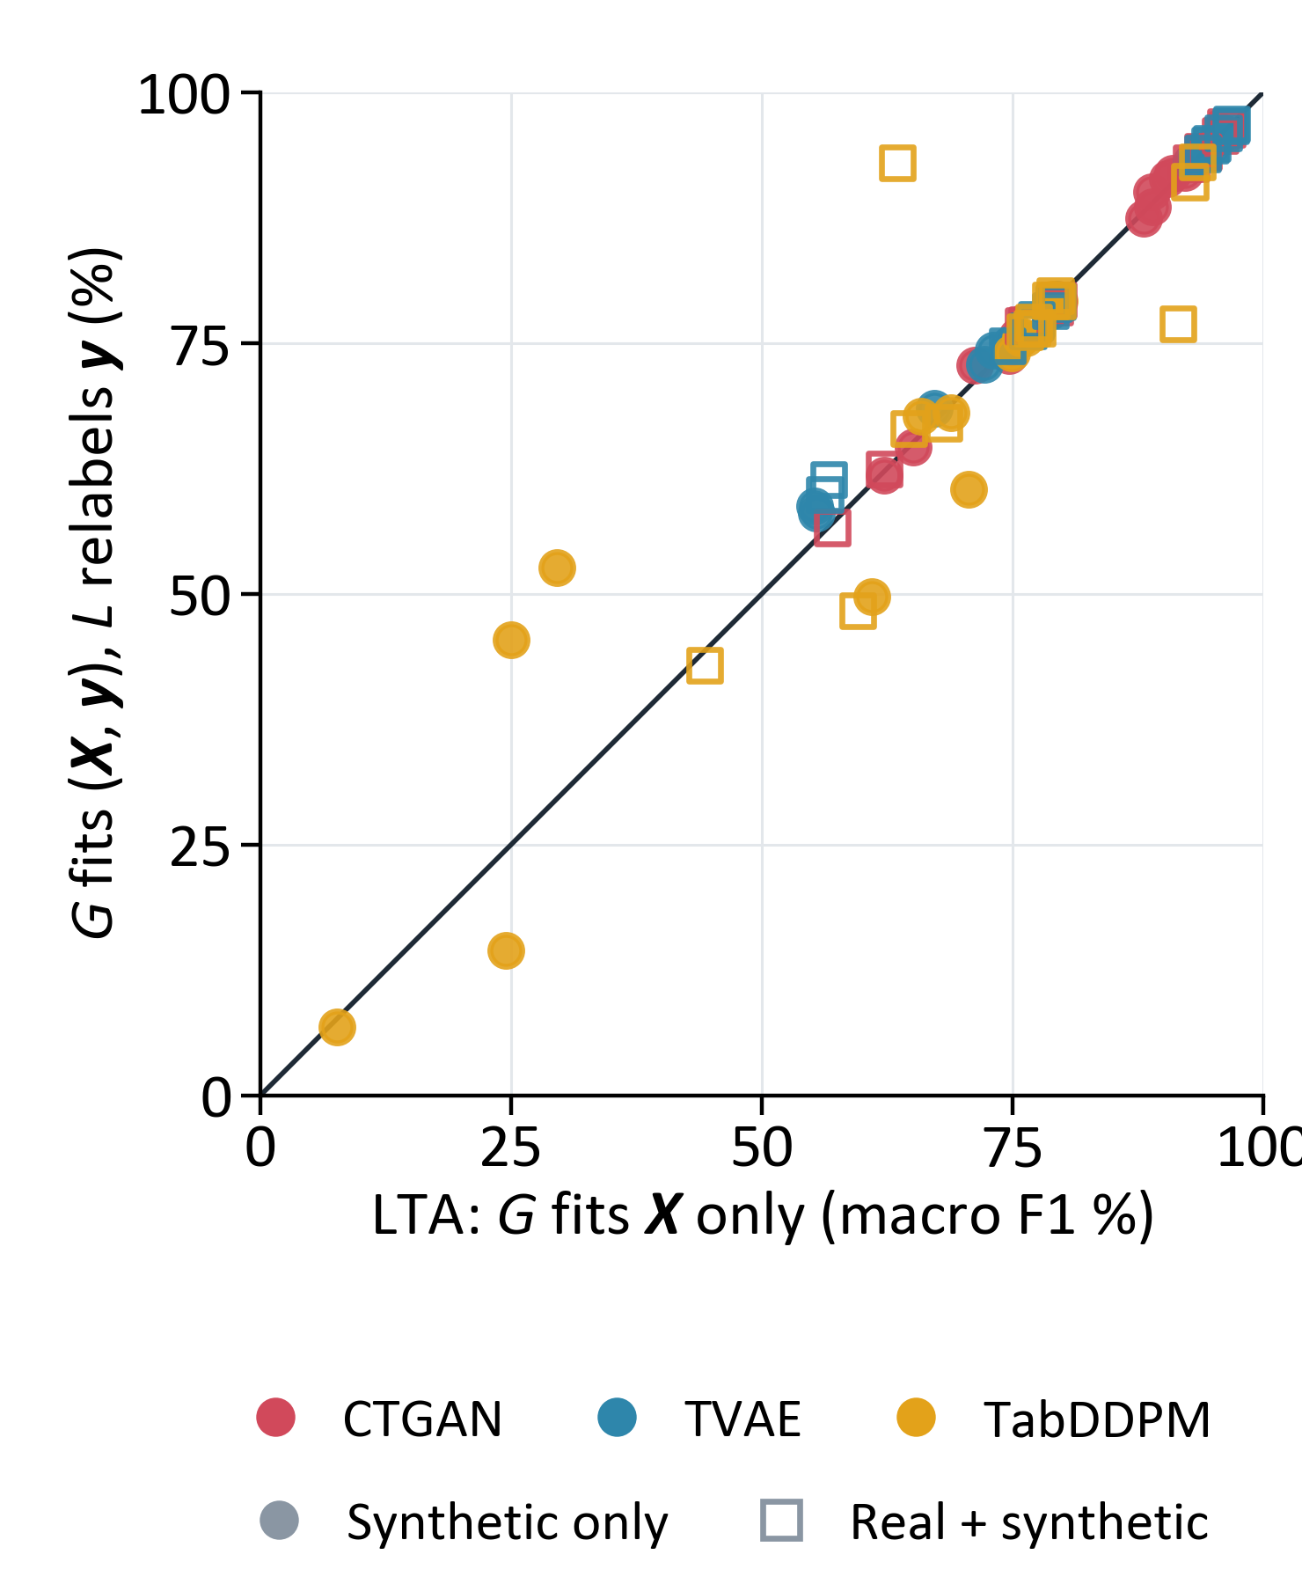
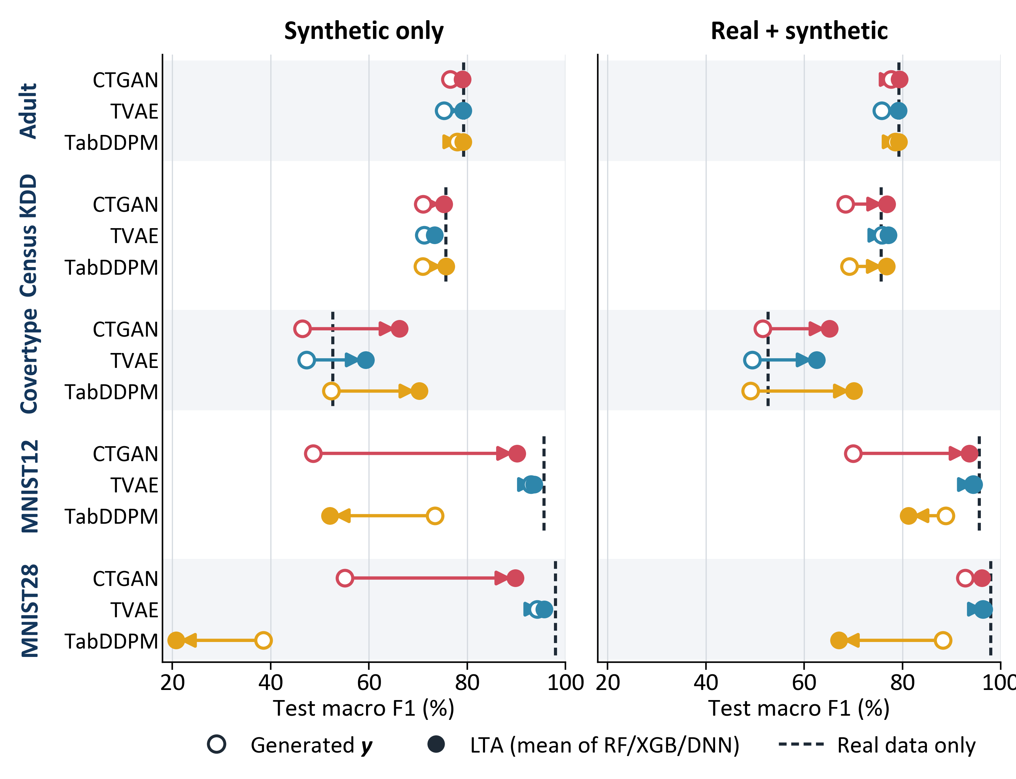



Learned Target Assignment for Synthetic Tabular Data
Relabeling synthetic data to outperform real training data.
Minh Le, Thuy Do
Luther College
Why generate X and y separately?
Result: synthetic data that rivals real data
Does the generator need y?
A supervised ML problem has input features X and a target y. Synthetic data helps a downstream model when it preserves the dependency of y on X.
CTGAN, TVAE and TabDDPM model (X, y) jointly, unaware of the target: y is one more feature column, and nothing ties a generated y to its X.
LTA models this dependency directly: a generator G samples the features, and a labeler L fitted to real (X, y) assigns their targets.
Synthetic-only training, classification: LTA adds +7.2 macro-F1 points over generated targets
95% CI 0.3 to 14.0; better in 13 of 15 task–generator pairs; CTGAN and TVAE: +12.3 points (18% relative).
With TVAE features, LTA comes within 2.3 points of real-data training on every classification task, and beats it on Covertype (+6.7) and Housing (R² 0.78 vs. 0.51).
Each point is one task, generator and labeler. On the diagonal, fitting G to (X, y) instead of X alone makes no difference.
Joint minus LTA: +0.5 points (95% CI −3.0 to +3.9; Holm p = 1.00).
Fitting G to y as well adds no detectable benefit.
Method
1. Fit to real data
2. Generate
Standard: joint synthesis
Real data
(X, y)
Generator G
learns p(X, y)
G samples (X_{syn}, y_{syn})
y_{syn} is generated
LTA: learned target assignment
Simulated data with known truth
Real data
(X, y)
Generator G
learns p(X)
G samples X_{syn}
any number of rows
Ring: 8 Gaussian clusters in (X₀, X₁). A binary feature S sets the slope of the Bayes boundary h*; 10% of labels are flipped. Six more datasets: Gaussian, Grid and 4 Bayesian networks.
Labeler L
learns y from X
y_{syn} = L(X_{syn})
y_{syn} is assigned
G can be any tabular generator and L any supervised model.
Both are fitted to real training rows only.
Evaluation
Data: Adult, Census KDD, Covertype, MNIST12, MNIST28 (macro F1); California Housing, News (R²).
Models: G = CTGAN, TVAE or TabDDPM (100,000 rows); L = RF, XGB or DNN.
Utility test: train a fresh neural network on each training set (synthetic only, or real + synthetic) and score it on held-out real rows.
Baselines: real data only; standard synthesis (generated y). Ablation: L relabels the X_{syn} of a joint G. 2 seeds; 588 runs.
Regression (same layout; dashed line = real data only)
Takeaways
Labeling synthetic features with a model trained on real data is a simple add-on to any generator.
Exception: TabDDPM on MNIST. Its digits drift from real ones, so a real-data labeler mislabels them.
Caveats: the wins over real data likely distill a strong labeler into many rows, and the real-only network is weak on Housing. With 5 tasks, the primary test (+7.4 points, p = 0.047) is not significant after Holm correction (p = 0.19).
Open circle: the generator’s own targets. Filled circle: LTA. Averaged over 2 seeds (LTA also over 3 labelers). Generated targets fall short of real data on 5 of 5 classification tasks for every generator; News has no predictable signal for any method, including real data (|R²| ≤ 0.03).
L_{test}: fit a simple density model to the synthetic table, then average its log-density over real test rows. Higher means the synthetic table covers the real data better.
LTA raises accuracy on all 7 datasets (+0.3 to +14.7 points, within 1.2 of real data) but lowers L_{test} on 4: hard labels erase the target’s natural randomness.

