Slide 1

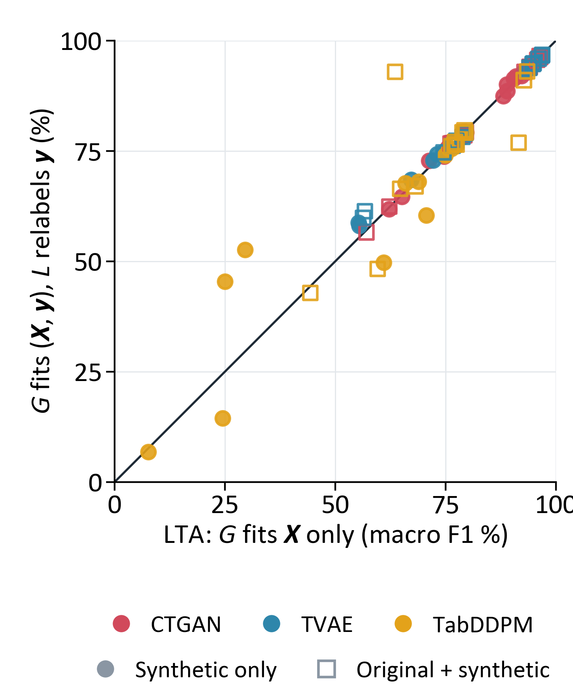
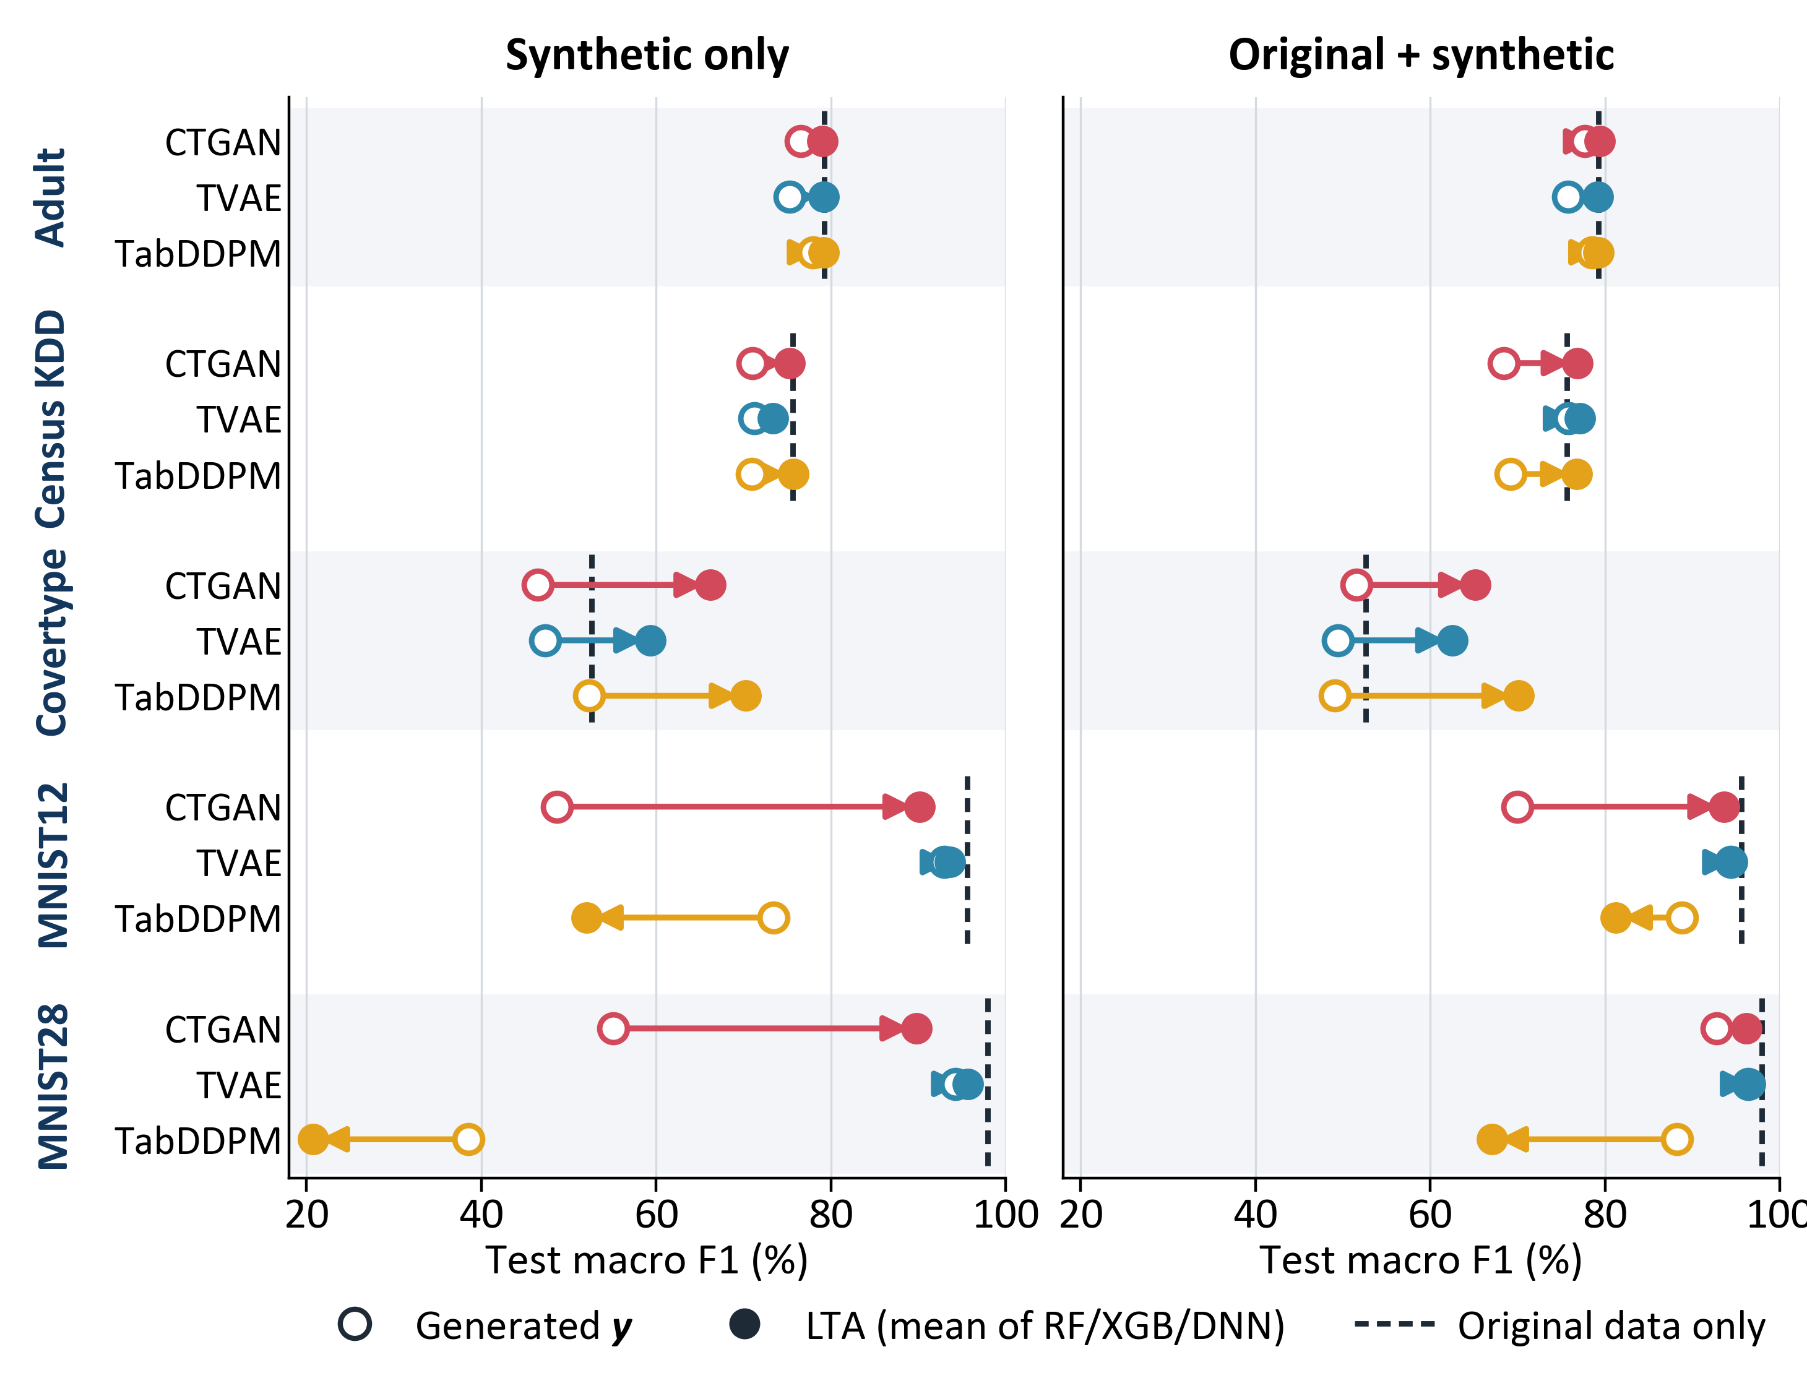



Learned Target Assignment for Synthetic Tabular Data
Relabeling synthetic data to outperform original training data.
Minh Le, Thuy Do
Luther College
Why generate X and y separately?
Result: synthetic data that rivals original data
Does the generator need y?
A supervised ML problem has input features X and a target y. Synthetic data helps a downstream model when it preserves the dependency of y on X.
CTGAN, TVAE and TabDDPM model (X, y) jointly, unaware of the target: y is one more feature column, and nothing ties a generated y to its X.
LTA models this dependency directly: a generator G samples the features, and a labeler L fitted to original (X, y) assigns their targets.
Generator | Classification: macro F1 (%) |  |  |  | Housing: R²
 | Synthetic only |  | Original + synthetic |  | Synthetic only |  | Original + synthetic
 | Generated y | LTA | Generated y | LTA | Generated y | LTA | Generated y | LTA
CTGAN | 59.5 | 80.1 | 72.1 | 82.2 | 0.63 | 0.80 | 0.64 | 0.80
TVAE | 76.2 | 80.2 | 78.4 | 82.0 | 0.71 | 0.78 | 0.70 | 0.78
TabDDPM | 62.6 | 59.6 | 74.8 | 74.9 | 0.79 | 0.80 | 0.79 | 0.80
Original data only | 80.2 |  |  |  | 0.51
Each point is one task, generator and labeler. On the diagonal, fitting G to (X, y) instead of X alone makes no difference.
Joint minus LTA: +0.5 points (95% CI −3.0 to +3.9; Holm p = 1.00).
Fitting G to y as well adds no detectable benefit.
Method
1. Fit to original data
2. Generate
Standard: joint synthesis
Original data
(X, y)
Generator G learns
the distribution of (X, y)
G samples (X_{syn}, y_{syn})
LTA: learned target assignment
Simulated data with known truth
Original data
(X, y)
Generator G learns
the distribution of X
G samples X_{syn}
Ring: 8 Gaussian clusters in (X₀, X₁). A binary feature S sets the slope of the Bayes boundary h*; 10% of labels are flipped. Six more datasets: Gaussian, Grid and 4 Bayesian networks.
Labeler L learns
y | X
y_{syn} = L(X_{syn})
G can be any tabular generator and L any supervised model.
Both are fitted to original training rows only.
Evaluation
Data: Adult, Census KDD, Covertype, MNIST12, MNIST28 (macro F1); California Housing, News (R²).
Models: G = CTGAN, TVAE or TabDDPM (100,000 rows); L = RF, XGB or DNN.
Scoring: each training set trains a fresh neural network, which is tested on held-out original rows.
Training sets: original data only, or synthetic data with generated y (standard) or y_{syn} = L(X_{syn}) (LTA), alone or added to the original data.
Ablation: L relabels the X_{syn} of a joint G (right). 2 seeds; 588 runs.
Regression (same layout; dashed line = original data only)
Takeaways
Labeling synthetic features with a model trained on original data is a simple add-on to any generator.
Exception: TabDDPM on MNIST. Its digits drift from the original ones, so a labeler trained on original data mislabels them.
References
Table and figure: averaged over 2 seeds (LTA also over RF, XGB and DNN); classification cells also average over the 5 tasks. Open circle: the generator’s own targets. Filled circle: LTA. Generated targets fall short of original data on 5 of 5 classification tasks for every generator; News has no predictable signal for any method, including original data (|R²| ≤ 0.03).
L_{test}: fit a simple density model to the synthetic table, then average its log-density over original test rows. Higher means the synthetic table covers the original data better.
LTA raises accuracy on all 7 datasets (+0.3 to +14.7 points, within 1.2 of original data) but lowers L_{test} on 4: hard labels erase the target’s natural randomness.
1. Xu, L., Skoularidou, M., Cuesta-Infante, A., and Veeramachaneni, K. Modeling tabular data using conditional GAN. NeurIPS 2019. (CTGAN, TVAE)
2. Kotelnikov, A., Baranchuk, D., Rubachev, I., and Babenko, A. TabDDPM: Modelling tabular data with diffusion models. ICML 2023.
3. Breiman, L. Random forests. Machine Learning 45, 2001.
4. Chen, T. and Guestrin, C. XGBoost: A scalable tree boosting system. KDD 2016.

