Slide 1

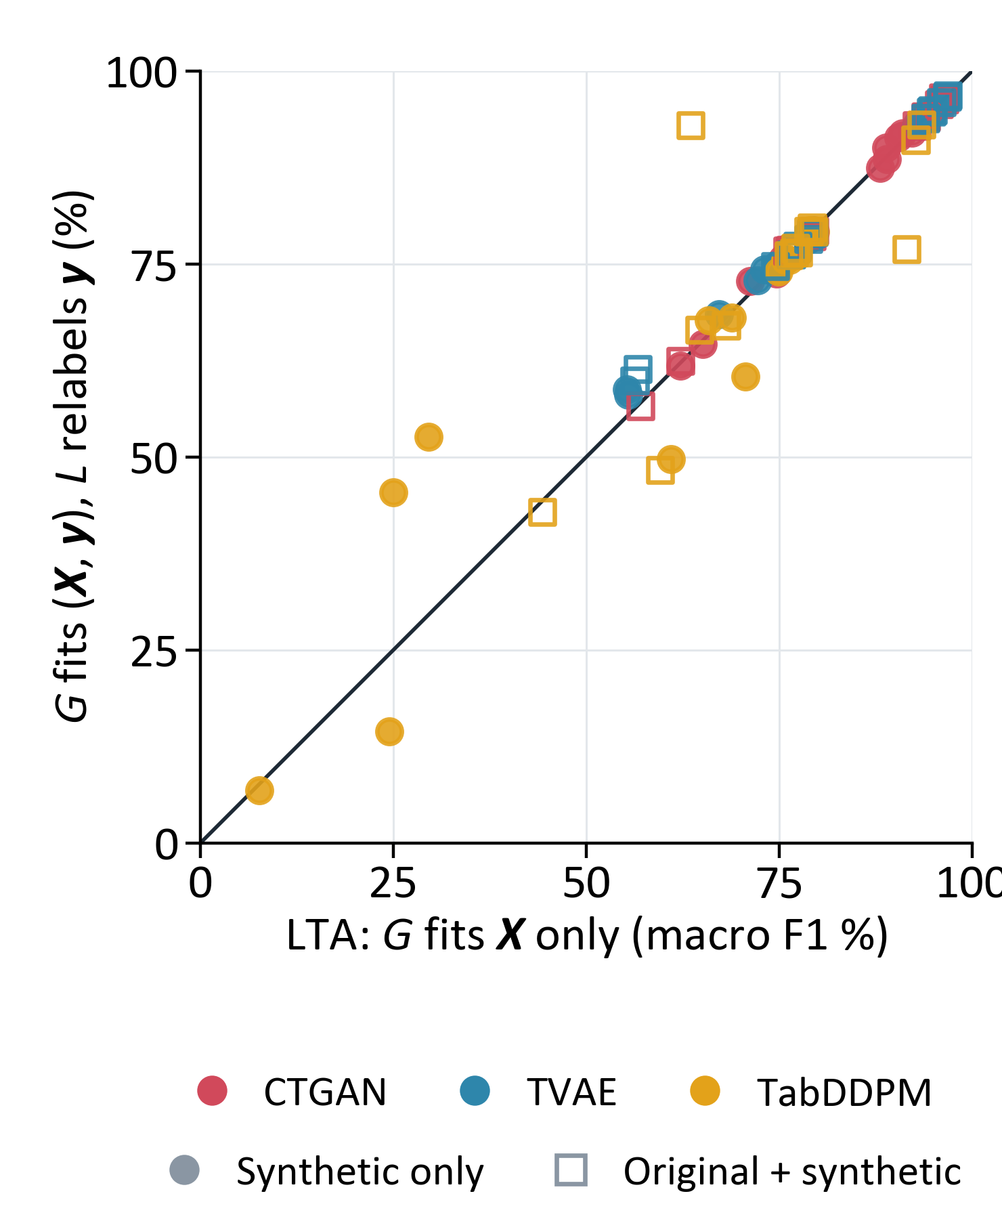
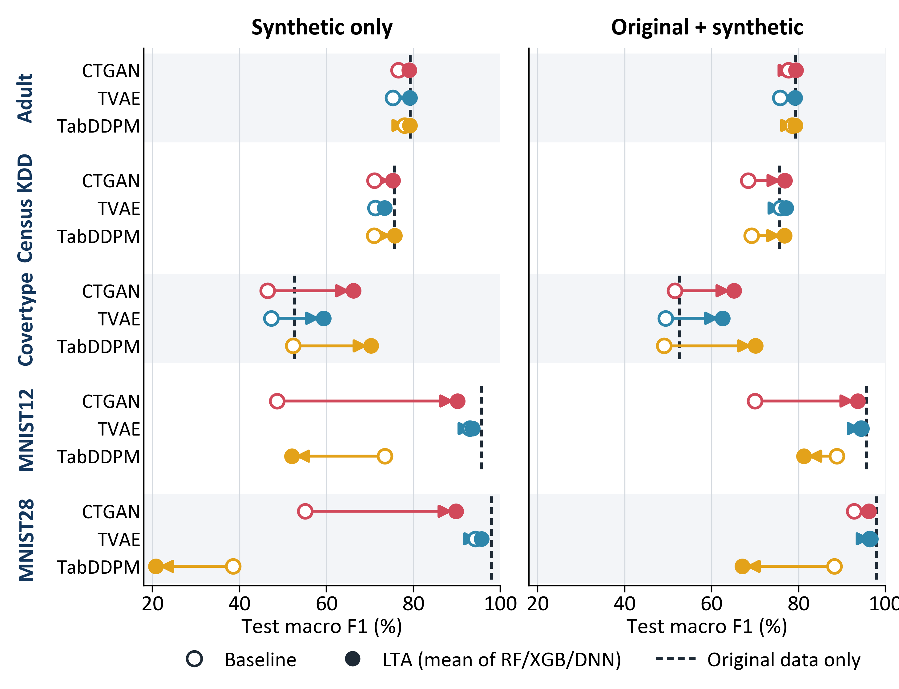



Learned Target Assignment for Synthetic Tabular Data
Relabeling synthetic data to outperform original training data.
Minh Le, Thuy Do
Luther College
Why generate X and y separately?
Result: synthetic data that rivals original data
Does the generator need y?
A supervised ML problem has input features X and a target y. Synthetic data helps a downstream model when it preserves the dependency of y on X.
CTGAN, TVAE and TabDDPM model (X, y) jointly, unaware of the target: y is one more feature column, and nothing ties a generated y to its X.
LTA models this dependency directly: a generator G samples the features, and a labeler L fitted to original (X, y) assigns their targets.
Generator | Classification: macro F1 (%) |  |  |  | Regression: R²
 | Synthetic only |  | Original + synthetic |  | Synthetic only |  | Original + synthetic
 | Baseline | LTA | Baseline | LTA | Baseline | LTA | Baseline | LTA
CTGAN | 59.5 | 80.1 | 72.1 | 82.2 | 0.31 | 0.40 | 0.31 | 0.40
TVAE | 76.2 | 80.2 | 78.4 | 82.0 | 0.34 | 0.39 | 0.34 | 0.39
TabDDPM | 62.6 | 59.6 | 74.8 | 74.9 | 0.38 | 0.40 | 0.39 | 0.40
Average | 66.1 | 73.3 | 75.1 | 79.7 | 0.34 | 0.40 | 0.35 | 0.40
Original data only | 80.2 |  |  |  | 0.24
Each point is one task, generator and labeler. On the diagonal, fitting G to (X, y) instead of X alone makes no difference.
Joint minus LTA: +0.5 points (95% CI −3.0 to +3.9; Holm p = 1.00).
Fitting G to y as well adds no detectable benefit.
Method
On average, LTA beats the baseline by +7.2 macro F1 points with synthetic data only and +4.6 with original + synthetic (regression R²: +0.06, +0.05). With CTGAN or TVAE, LTA matches original data on its own (80.1, 80.2 vs. 80.2) and beats it when added to it (82.2, 82.0). In regression, every LTA set beats original data (R² ≥ 0.39 vs. 0.24).
1. Fit to original data
2. Generate
Baseline: joint synthesis
Original data
(X, y)
Generator G learns
the distribution of (X, y)
G samples (X_{syn}, y_{syn})
LTA: learned target assignment
Simulated data with known truth
Original data
(X, y)
Generator G learns
the distribution of X
G samples X_{syn}
Ring: (X₀, X₁) from 8 Gaussian clusters on a circle, a binary feature S ∈ {−1, +1}, and
P(S = +1 | X) = σ(2X₀X₁), Bayes rule h* = 1[X₁ + (1 + 0.75S)X₀ > 0],
y = h* with 10% of labels flipped (Bayes accuracy 90%). Six more datasets: Gaussian, Grid and 4 Bayesian networks.
Labeler L learns
y | X
y_{syn} = L(X_{syn})
G can be any tabular generator and L any supervised model.
Both are fitted to original training rows only.
Evaluation
Baselines: each generator with its own generated y; original data only.
Classification: Adult, Census KDD, Covertype, MNIST12, MNIST28 (macro F1).
Regression: California Housing, News (R²).
LTA: G = each of the three generators (100,000 rows); L = RF, XGB or DNN.
Scoring: a fresh neural network per training set, tested on held-out original rows.
Training sets: synthetic only, or synthetic added to the original data.
Ablation: L relabels the X_{syn} of a joint G (right). 2 seeds; 588 runs.
Conclusion
Regression (same layout; dashed line = original data only)
LTA beats the baseline by +7.2 macro F1 points on average (+4.6 added to original data), as an add-on to any generator.
The base generator matters: with CTGAN or TVAE, LTA matches or beats original data; with TabDDPM it does not.
Fitting G to y as well does not matter (+0.5 points, 95% CI −3.0 to +3.9).
Future work: more regression tasks (News has no predictable target for any method).
References
Each bar: LTA minus baseline, averaged over CTGAN and TVAE, RF/XGB/DNN and 2 seeds. Prediction: accuracy on original test rows.
Coverage: L_{test} = (1/n) Σ_{i} log q(z_{i}), where q is a simple density fitted to the synthetic table and z₁, …, z_{n} are original test rows. Higher means the synthetic table covers the original data better.
LTA raises accuracy on all 7 datasets (+0.3 to +14.7 points, within 1.2 of original data) but lowers L_{test} on 4: hard labels erase the target’s natural randomness.
1. Xu et al. Modeling tabular data using conditional GAN. NeurIPS 2019. (CTGAN, TVAE)
2. Kotelnikov et al. TabDDPM: Modelling tabular data with diffusion models. ICML 2023.
3. Breiman. Random forests. Machine Learning, 2001.
4. Chen and Guestrin. XGBoost: A scalable tree boosting system. KDD 2016.
Table and figure: averaged over 2 seeds (LTA also over RF, XGB and DNN); table cells also average over the 5 classification or 2 regression tasks. Open circle: baseline, the generator’s own targets. Filled circle: LTA.

