Slide 1
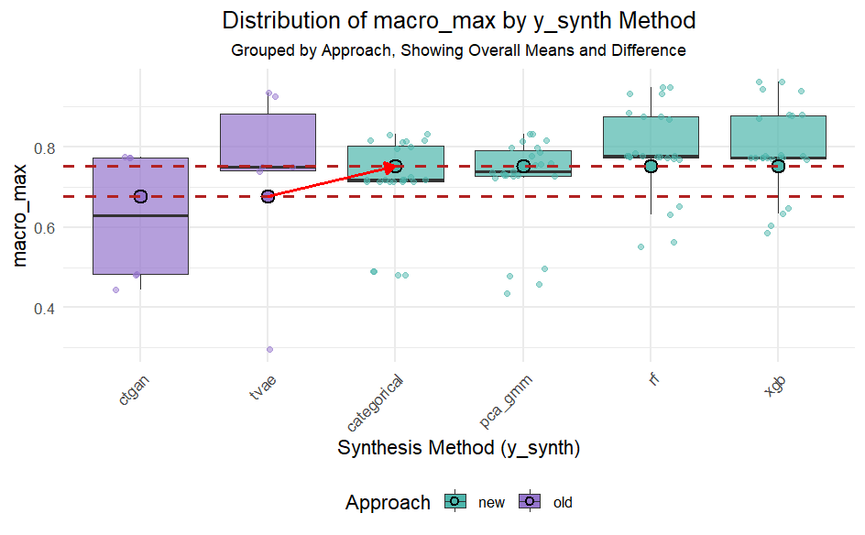
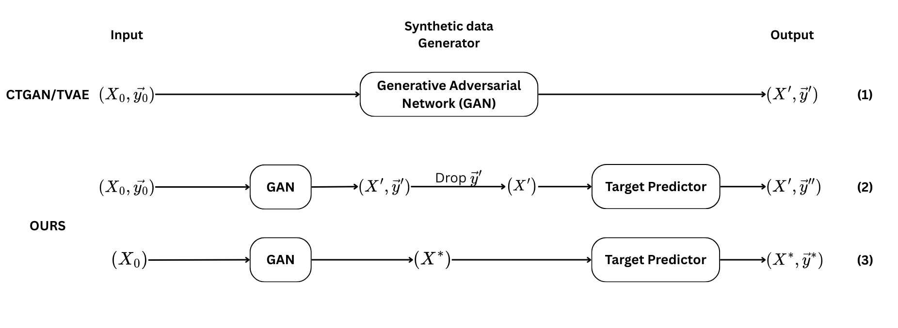
Synthesis and Augmentation for Structured data
Minh Le et al.
Advisor: Dr. Thuy Do
Department of Computer Science
Luther College
Introduction
The activity level of an animal (i.e., the distance it traveled) is a great proxy for its current health state. Sluggishness and lameness can be early indications of an illness. [1]
Despite the common use of cameras on farms and ranches, limited time and resources prevent farmers from fully leveraging their monitoring capabilities. Furthermore, the scale and variety of livestock footages make it impossible for traditional programs with pre-designed instructions to monitor sheep in real-time.
Deep learning allows us to autonomously glean insights from data that would otherwise be unutilized or need extensive human monitoring. However, there has not yet been an effective method to precisely monitor moving objects (i.e., livestock) accurately over a time period without losing track, as well as calculate the physical distance they have traveled in real time.
To address this gap, we developed an algorithm to accurately track sheep from frame to frame and compute the distance they traveled in real time, using YOLOv8 [2] as our foundational model for object detection for each individual frame.
Result
We fine-tuned an object detection model specialized in detecting sheep using YOLOv8.
Using the number of sheep in the pen as an invariant, we developed an algorithm using vector similarity search to map the sheep from one frame to the next.
We transformed 2D bounding box coordinates from detected images to 3D physical coordinates using vector decomposition and infinitesimal approximation.
Results
On average, the new approach (ours) is statistically better than the old approach by 7.36% across 6 datasets, 2 X synthesizers, regardless of whether y was included in training the X_synthesizer.
Across 6 datasets, 6 y synthesizers, regardless of X_synthesizer (ctgan or tvae), including y in the X_input increases the result only marginally (0.3%). However, this effect is not statistically significant (p_value=0.5091>0.05).
Don’t include y in X_input to save computational power and time
Generate X’ and y’ separately
Methods
We collected footage from a local Iowa farm. A random subset of frames was sampled from the video to create our dataset. Each sheep in every frame was labeled using bounding boxes. The dataset was then split into training, validation, and test sets. Each example in the training set was augmented into 7 examples by adjusting brightness, exposure, and bounding box rotation (Fig. 1). Data augmentation helped the model better distinguish between the sheep and the background, improved its adaptability under different lighting conditions, and reduced the risk of overfitting.
Conclusion and Future Work
Run more datasets
Expand for regression
improve X_synthesizer (using Fourier features)
References
Xu, Lei, et al. "Modeling tabular data using conditional gan." Advances in neural information processing systems 32 (2019).
Chen, Tianqi, and Carlos Guestrin. "Xgboost: A scalable tree boosting system." Proceedings of the 22nd acm sigkdd international conference on knowledge discovery and data mining. 2016.
Breiman, Leo. "Random forests." Machine learning 45 (2001): 5-32.
Goodfellow, Ian, et al. "Generative adversarial networks." Communications of the ACM 63.11 (2020): 139-144.

Slide 2
Synthesis and Augmentation for Structured Data
Minh Le et al.
Advisor: Dr. Thuy Do
Department of Computer Science
Luther College
Introduction
Generating high-fidelity synthetic tabular data is challenging due to mixed data types (discrete/continuous) and complex column distributions (multimodal, imbalanced). While generative models like GANs (e.g., CTGAN, TVAE) have advanced the field, a gap often remains between synthetic and real data quality. This work aims to improve the realism of generated structured data.
Results
Conclusion
Generating X_{syn} & y_{syn} separately will result in synthetic data that more closely resemble distribution and properties of the real data, demonstrated through the higher F1-macro scores
Don’t include y in X_input to save computational power and time
Data & Evaluation
We evaluate synthetic data quality using its practical utility in a ML task across 6 datasets.
A Deep Neural Network (DNN) is trained only on the generated synthetic data.
The DNN is then tested on unseen real data (the test set).
We measure this performance using the F1-macro score, where higher scores (max 1) indicate better accuracy.
Strong performance by the DNN on real data signifies that the synthetic data realistically captures the original data's patterns.
On average, the new approach (ours) is statistically better (p_value <.0001) than the old approach by 7.36% across 6 datasets, 2 X synthesizers, regardless of whether y was included in training the X_synthesizer.
Across 6 datasets, 6 y synthesizers, regardless of X_synthesizer (ctgan or tvae), including y in the X_input increases the result only marginally (0.3%). However, this effect is not statistically significant (p_value=0.5091>0.05).
Future Work
Run more datasets
Expand for regression
improve X_synthesizer (using Fourier features, etc.)
Method
We propose a decoupled/composite synthesis pipeline, separating feature (X_{syn}) and target (y_{syn}) generation, to replace the current modulus pipeline outlined in Xu et al. [4].
Additionally, we investigate the impact of excluding the target y during the training of the feature generator (X_{synthesizer}​) on downstream performance and resource usage.
Generate X_{syn}​ using a chosen generative model (e.g., CTGAN, TVAE) trained on real features X₀
Train a predictive model (e.g., XGBoost, Random Forest) on the original (X₀ , y₀) data
Use the trained predictor to generate y_{syn}​ based on X_{syn}​
References
Breiman, Leo. "Random forests." Machine learning 45 (2001): 5-32.
Chen, Tianqi, and Carlos Guestrin. "Xgboost: A scalable tree boosting system." Proceedings of the 22nd acm sigkdd international conference on knowledge discovery and data mining. 2016.
Goodfellow, Ian, et al. "Generative adversarial networks." Communications of the ACM 63.11 (2020): 139-144.
Xu, Lei, et al. "Modeling tabular data using conditional gan." Advances in neural information processing systems 32 (2019).
Data Synthesis Pipelines Flowchart

Slide 3
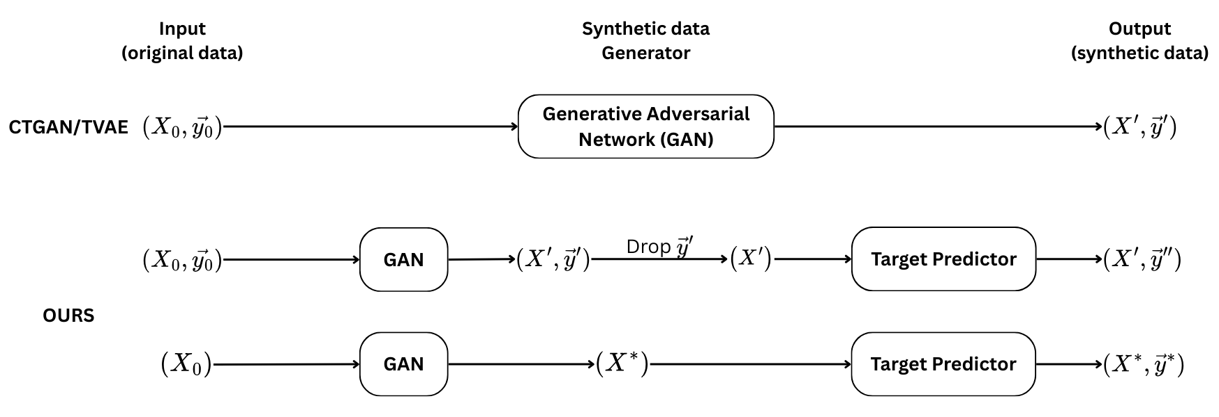
Synthesis and Augmentation for Structured Data
Minh Le et al.
Advisor: Dr. Thuy Do
Department of Computer Science
Luther College
Introduction
Generating high-fidelity synthetic tabular data is challenging due to complex data distributions (multimodal, imbalanced) and mixed data types (discrete/continuous). While generative models like CTGAN & TVAE have advanced the field, a gap remains between synthetic and real data quality. We propose a decoupled method, improving synthetic data realism by ~11% compared to SOTA models.
Results
Conclusion
Decoupled Synthesis Enhances Utility: Generating features (X_{syn}) and targets (y_{syn}) separately produces higher-quality synthetic data compared to end-to-end methods, evidenced by significantly improved downstream F1-macro scores.
Optimize Feature Generation: Excluding the target variable (y) during feature synthesis is recommended; it offers computational savings with negligible impact on final model performance.
Evaluation
We evaluate synthetic data quality using its practical utility in a ML task across 6 datasets.
A Deep Neural Network (DNN) is trained only on the generated synthetic data.
The DNN is then tested on unseen real data (the test set).
We measure this performance using the F1-macro score (ranging from 0 to 1), where higher scores indicate better accuracy.
Strong performance by the DNN on real data signifies that the synthetic data realistically captures the original data's patterns.
Future Work
More Validation: Evaluate the proposed pipeline across a more extensive and diverse range of datasets.
Task Expansion: Adapt and test the decoupled approach for regression tasks, not just classification.
X_{synthesizer} Research: Implement advanced techniques (e.g., incorporating Fourier features) to further improve the quality of the feature synthesizer.
Our decoupled synthesis approach significantly improves upon standard end-to-end generation:
Achieved an average F1-score improvement of 10.86% relative increase over baseline. This significant gain was consistent across 6 datasets and various generative models
Including target y during feature X synthesis offered negligible benefit, yielding only a marginal (+0.3% F1-macro) and statistically insignificant (p=0.5091) improvement. This indicates potential for model simplification without performance loss
Method
We propose a decoupled synthesis method, separating feature (X_{syn}) and target (y_{syn}) generation, to replace the current modulus method outlined in Xu et al. [4].
Additionally, we investigate the impact of excluding the target y during the training of the feature generator (X_{synthesizer}​) on downstream performance and resource usage.
Datasets
Generate X_{syn}​ using a chosen generative model (e.g., CTGAN, TVAE) trained on real features X₀
Train a predictive model (e.g., XGBoost, Random Forest) on the original (X₀ , y₀) data
Use the trained target predictor to generate y_{syn}​ based on X_{syn}​
References
Breiman, Leo. "Random forests." Machine learning 45 (2001): 5-32.
Chen, Tianqi, and Carlos Guestrin. "Xgboost: A scalable tree boosting system." Proceedings of the 22nd acm sigkdd international conference on knowledge discovery and data mining. 2016.
Goodfellow, Ian, et al. "Generative adversarial networks." Communications of the ACM 63.11 (2020): 139-144.
Xu, Lei, et al. "Modeling tabular data using conditional gan." Advances in neural information processing systems 32 (2019).
Data Synthesis Pipelines Flowchart

Slide 4
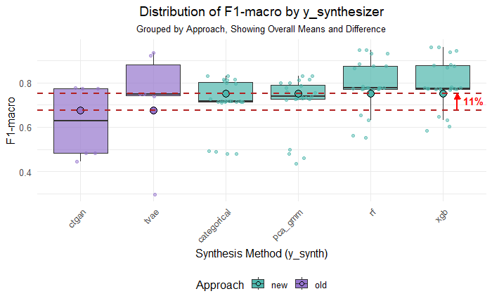
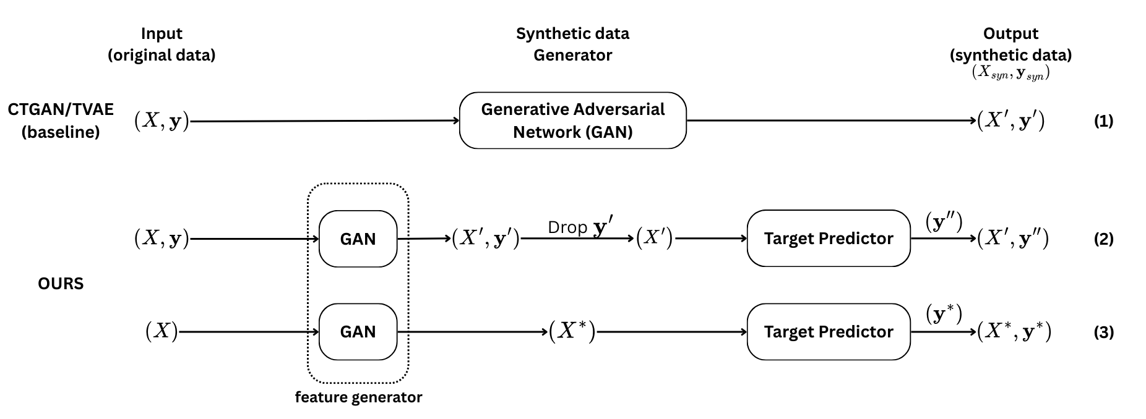
Synthesis and Augmentation for Structured Data
Minh Le et al.
Advisor: Dr. Thuy Do
Department of Computer Science
Luther College
Introduction
Generating high-fidelity synthetic tabular data is challenging due to complex data distributions (multimodal, imbalanced) and mixed data types (discrete/continuous). While generative models like CTGAN & TVAE have advanced the field, a gap remains between synthetic and real data quality. We propose a decoupled method, improving synthetic data realism by 11% compared to SOTA models.
Results
Conclusion
Decoupled Synthesis Enhances Utility: Generating features (X_{syn}) and targets (y_{syn}) separately produces higher-quality synthetic data compared to end-to-end methods, evidenced by significantly improved downstream F1-macro scores.
Optimize Feature Generation: Excluding the target variable (y) during feature synthesis is recommended; it offers computational savings with negligible impact on final model performance.
Evaluation
We evaluate synthetic data quality using its practical utility in a ML task across 6 datasets.
A Deep Neural Network (DNN) is trained only on the generated synthetic data.
The DNN is then tested on unseen real data (the test set).
We measure this performance using the F1-macro score (ranging from 0 to 1), where higher scores indicate better accuracy.
Strong performance by the DNN on real data signifies that the synthetic data realistically captures the original data's patterns.
Future Work
More Validation: Evaluate the proposed pipeline across a more extensive and diverse range of datasets.
Task Expansion: Adapt and test the decoupled approach for regression tasks, not just classification.
X_{synthesizer} Research: Implement advanced techniques (e.g., incorporating Fourier features) to further improve the quality of the feature synthesizer.
Our decoupled synthesis approach significantly improves upon standard end-to-end generation:
Achieved an average F1-score improvement of 11% relative increase over baseline. This significant gain was consistent across 6 datasets and various generative models
Including target y during feature X synthesis offered negligible benefit, yielding only a marginal (+0.3% F1-macro) and statistically insignificant (p=0.5091) improvement. This indicates potential for model simplification without performance loss
The data quality of method (2) ≈ (3) > (1). Method (3) is the best method because it uses less resource than (2).
Method
We propose a decoupled synthesis method, separating feature (X_{syn}) and target (y_{syn}) generation, to replace the current modulus method outlined in Xu et al. [4].
Additionally, we investigate the impact of excluding the target y during the training of the feature generator (X_{synthesizer}​) on downstream performance and resource usage.
Datasets
Dataset name | Adult | Census | CoverType | Census-Kdd | MNIST12 | MNIST28
# data point (rows) | 48,842 | 48,842 | 581,012 | 299,285 | 60,000 | 60,000
# features (columns) | 14 | 14 | 54 | 41 | 144 | 784
Generate X_{syn}​ using a chosen generative model (e.g., CTGAN, TVAE) trained on real features X
Train a predictive model (e.g., XGBoost, Random Forest) on the original (X, y) data
Use the trained target predictor to generate y_{syn}​ based on X_{syn}​
References
Breiman, Leo. "Random forests." Machine learning 45 (2001): 5-32.
Chen, Tianqi, and Carlos Guestrin. "Xgboost: A scalable tree boosting system." Proceedings of the 22nd acm sigkdd international conference on knowledge discovery and data mining. 2016.
Goodfellow, Ian, et al. "Generative adversarial networks." Communications of the ACM 63.11 (2020): 139-144.
Xu, Lei, et al. "Modeling tabular data using conditional gan." Advances in neural information processing systems 32 (2019).
Data Synthesis Methods Flowchart

