Slide 1
Real estate website building
Member: Lê Quang Nghĩa
Class: 21SE5

Slide 2

1 Reason forchoose the topic
- Football is the most popular sport in the world, dubbed the king sport, with 3.3-3.5 billion football fans around the world.

Slide 3

2 Technology used
- Frontend: HTML, CSS, JavaScript, Ajax…
- Backend: Php, MySQL.
- Framework: Bootstrap 4, DataTables, OwlCarousel2

Slide 4
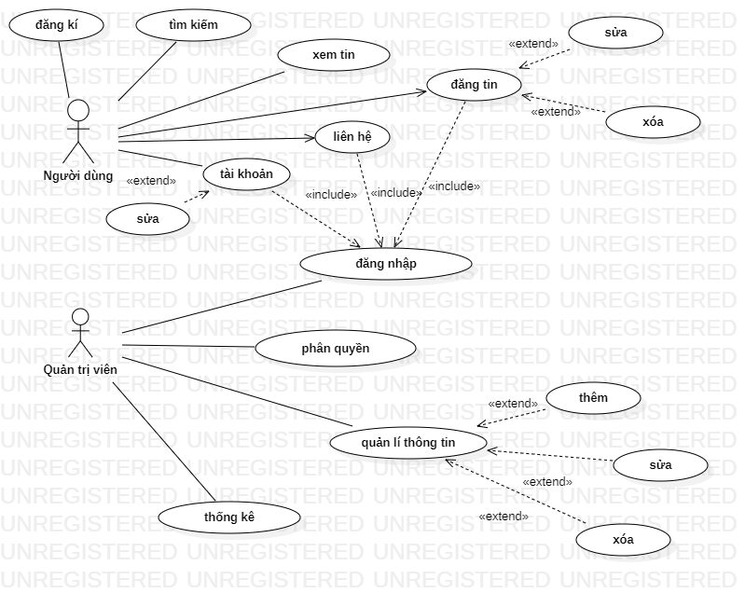
3 System analysis and design

Slide 5

4 Website introduction

Slide 6
5 Directions for development
Build more functions.
Check for missing cases.
Apply framework like Laravel.

Slide 7


