Slide 1
Note
Created by Enma

Slide 2
Reference
https://khuenguyencreator.com/lap-trinh-stm32-usb-cdc-truyen-nhan-du-lieu-qua-cong-com-ao/

Slide 3
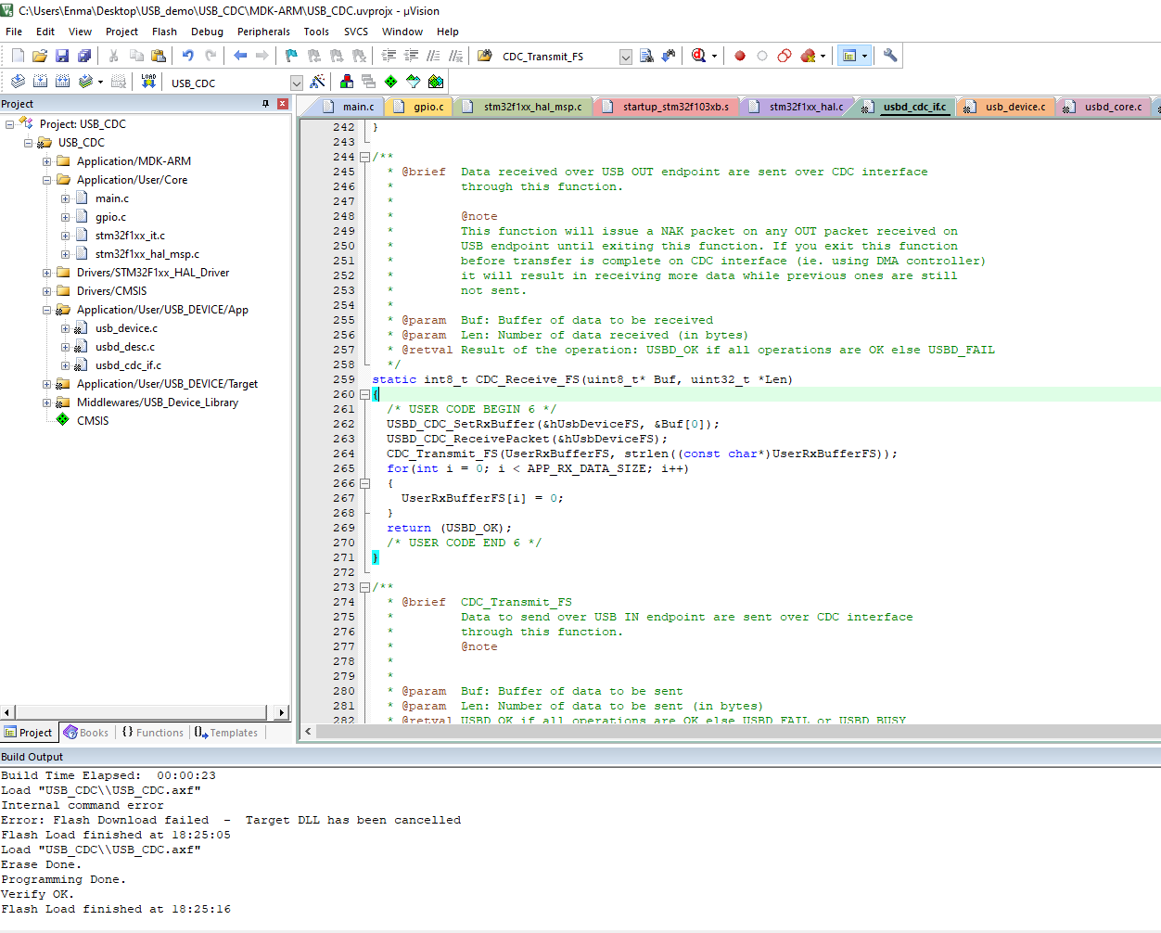
Add code to this file

Slide 4
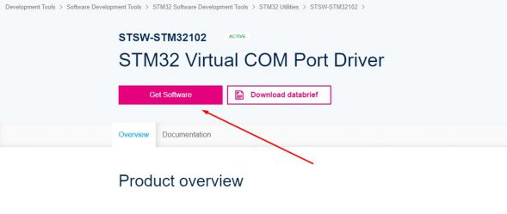
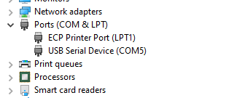
Driver - STM32 Virtual COM Port Driver
Win < 10 need to install driver
Win 10 doesn’t install driver
Result after download code
and install correct driver

Slide 5
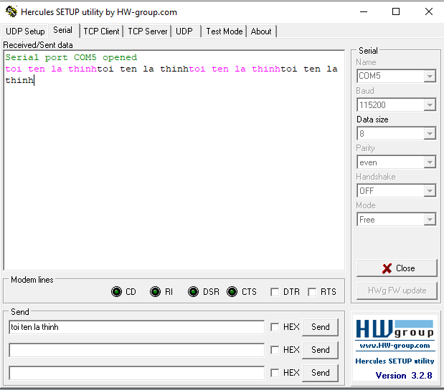
Result
Data received
Sent data to Stm32
Config like that
Note: Other baud rate still OK

Slide 6
End

