Slide 1
Note
Created by Enma

Slide 2
Reference
https://khuenguyencreator.com/lap-trinh-stm32-usb-cdc-truyen-nhan-du-lieu-qua-cong-com-ao/

Slide 3
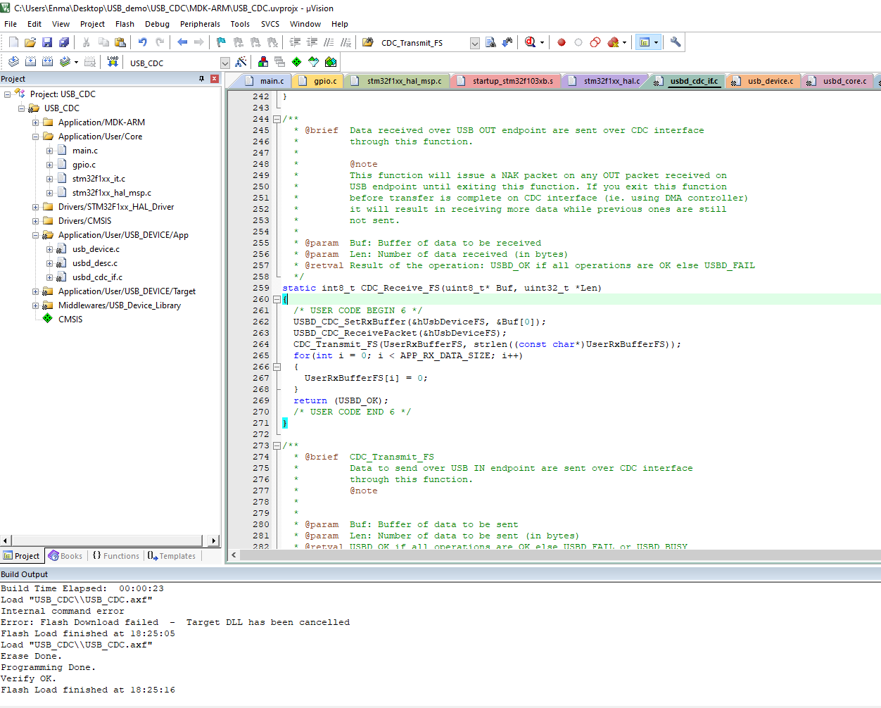
Add code to this file

Slide 4
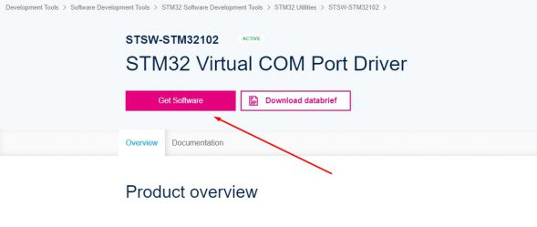
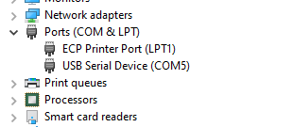
Driver - STM32 Virtual COM Port Driver
Win < 10 need to install driver
Win 10 doesn’t install driver
Result after download code
and install correct driver

Slide 5
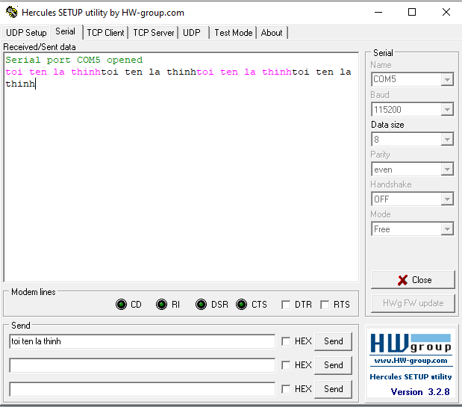
Result
Data received
Sent data to Stm32
Config like that
Note: Other baud rate still OK

Slide 6
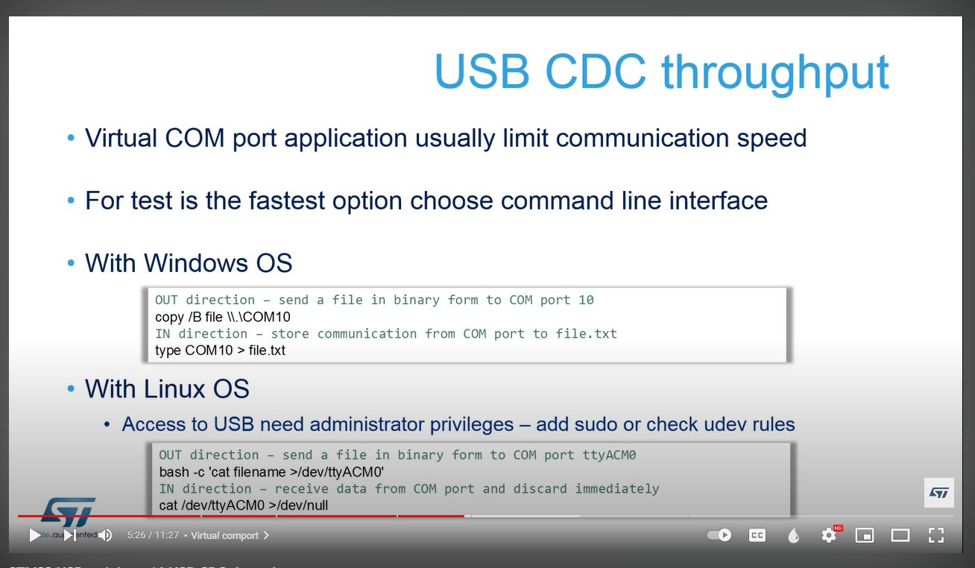
USB CDC test speed

Slide 7

USB CDC test speed
Method test
Copy “Japanese – copy.txt” file
Result
Speed result: ~ 0.7 Mbps

Slide 8
Q and A
How to extent 2 device?

Slide 9
End

