Slide 1
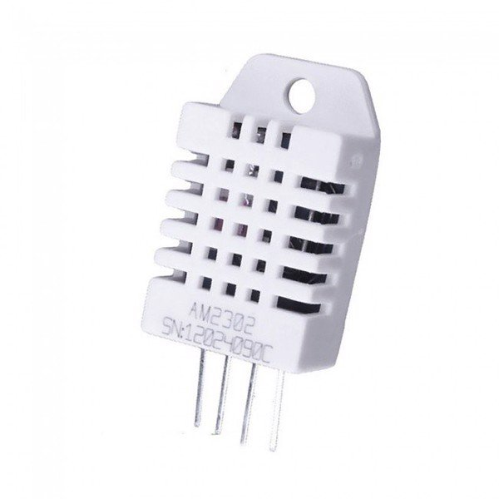
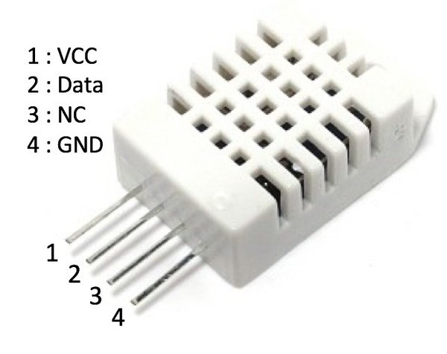

Slide 2

Blynk Server
Request
Response
Response
Request
Mạch ESP32

