Slide 1
COCO 2017
VisCaption
118 K
Training Images
Image-to-Text Generation
500
Using CLIP Vision Encoders and GPT-2 Language Decoders
Val Images Evaluated
3
IE 7615 Deep Learning for AI
Instructor: Prof. Xuemin Jin
Group 8: Quoc Hung Le, Khoa Tran, Hassan Alfaree
Fine-tuning Strategies
0.9364
Best CIDEr Score

Slide 2
Presentation Outline
01
Problem & Motivation
05
Sensitivity Analysis
Why image captioning matters
Beam width and temperature
02
Architecture
06
Key Findings
CLIP + ProjectionHead + GPT-2
What the numbers tell us
03
Fine-Tuning Strategies
07
Ethical Considerations
Frozen vs FT-4L vs LoRA
Bias, risk, and responsibility
04
Results
COCO 500-image benchmark
2

Slide 3
01 MOTIVATION
Why Image Captioning?
2.2B
10X
55.5%
visually impaired people
globally need alt-text
(WHO, 2026)
faster content indexing
with auto-generated metadata
(MomentsLab, 2026)
of web images lack
accessible descriptions
(wearetenet, 2026)
The Task
Given an arbitrary image, generate a fluent, accurate natural-language description of its content - without any human annotation at inference time.
3

Slide 4
02 ARCHITECTURE
End-to-End Pipeline
512-d
10x768
Dynamic tokens + sentences
Image
Input
CLIP
ViT-B/32
Projection
Head
GPT-2
Decoder
Caption
Output
Any resolution
Frozen encoder
512-d embedding
2-layer MLP
10 prefix tokens
117M params
Autoregressive
Natural language
description
ProjectionHead Detail
Linear
(512→3072)
GELU Activation
Dropout
(p=0.1)
Linear
(3072→7680)
LayerNorm
Reshape→
(10, 768)
Image prefix conditioning: visual context is injected as 10 learnable prefix tokens prepended to GPT-2's input.
4

Slide 5
03 FINE-TUNING
Three Training Strategies Compared
Frozen
FT-4L
LoRA r=8,a=16
62.9M params
129.9M params
63.76M params
187.4 M total
129.9 M total
63.7 M total
Only ProjectionHead is trained.
GPT-2 weights stay completely fixed.
Fastest to train, smallest memory footprint.
ProjectionHead + last 4 GPT-2
transformer blocks fine-tuned.
Highest raw capacity.
Low-rank adapters injected
into GPT-2 attention layers via PEFT.
alpha=16, scaling factor = 2.0.
Baseline
Best Accuracy
Most Efficient
5

Slide 6
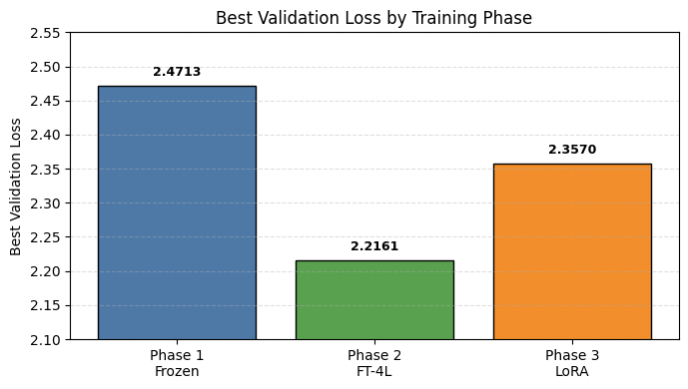
03 TRAINING
Split COCO 2017 (106K train, ~6K val, ~6K test)
Phase 1: Frozen
20 epochs
Early stopped, patience=3
Phase 2: FT-4L
15 epochs
Converges faster with LR=5e-5
Phase 3: LoRA (r=8, scale =2)
15 epochs
Should change params
6

Slide 7
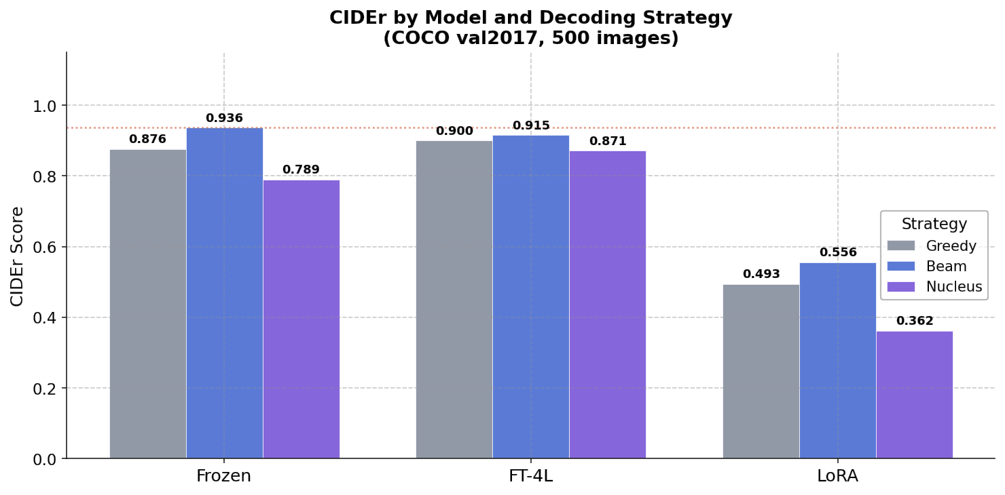
04 RESULTS
COCO val2017: 500 Images - All Configurations
Best per Model (Beam Search)
Model
CIDEr
BLEU-4
Frozen
0.9364
0.2896
FT-4L
0.9364
0.2917
LoRA
0.5556
0.1835
Key Insight
Frozen/Beam = FT-4L/Beam on CIDEr despite 67M fewer parameters
Change LoRA r=32, scale =2; Evaluate on 5000 images
7

Slide 8
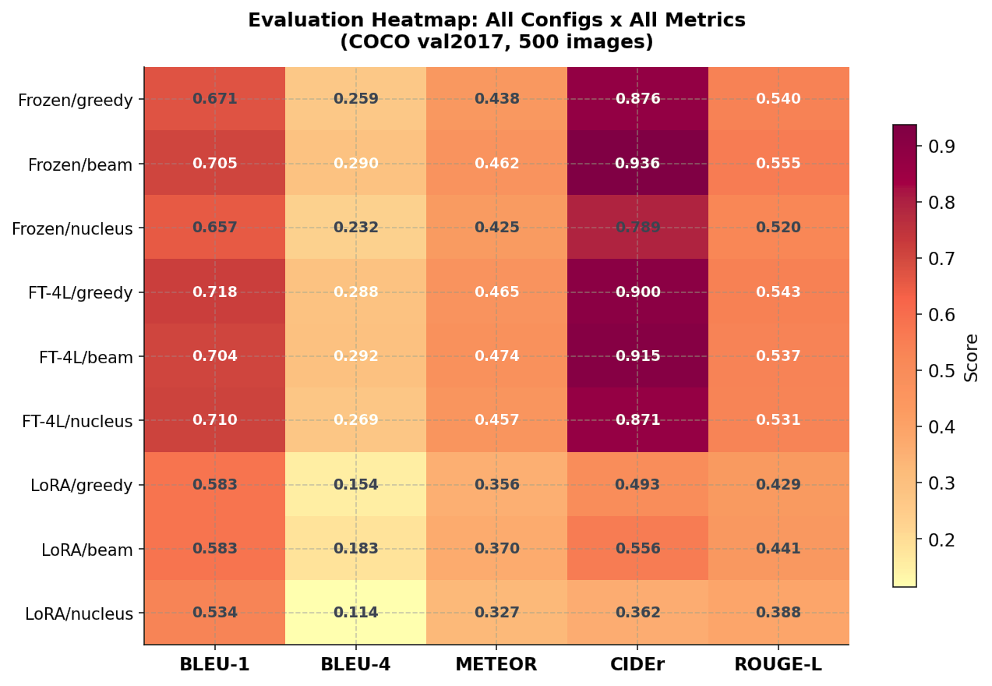
04 RESULTS
Complete Evaluation Heatmap: 9 Configurations x 5 Metrics
Warmer colors = higher score within each metric column.
Best row: FT-4L / Beam (highlighted). Evaluation on COCO val2017, 500 images.
8

Slide 9
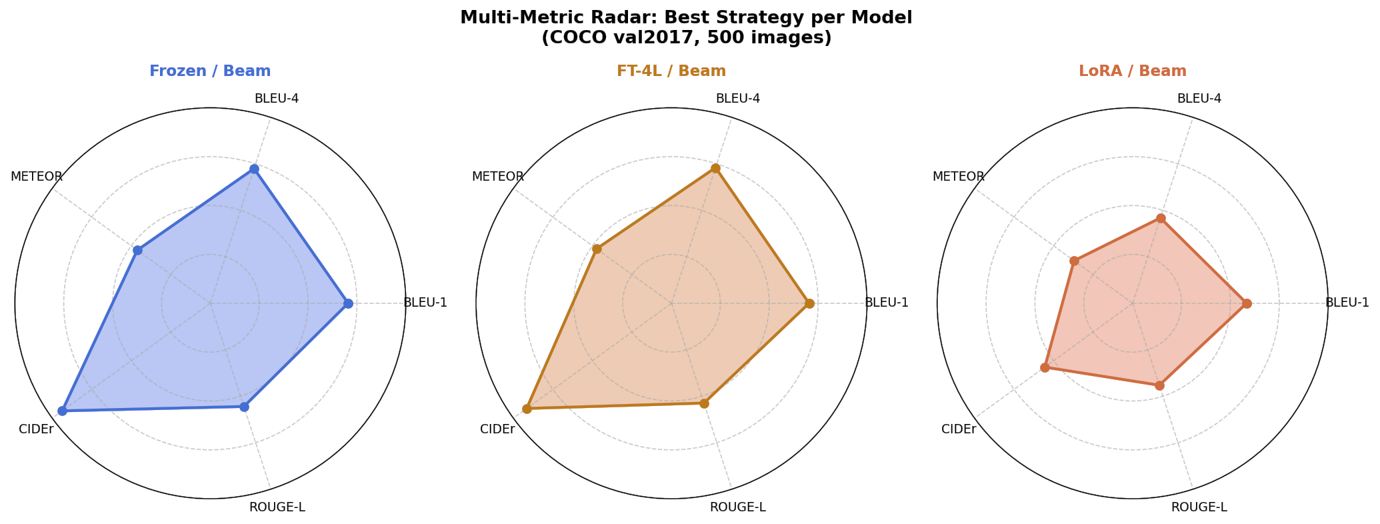
04 RESULTS
Multi-Metric Radar: Best Strategy per Model
Frozen / Beam
Competitive on all metrics
with zero LM fine-tuning
FT-4L / Beam
Best METEOR (0.474)
Marginally better than Frozen
LoRA / Beam
Lower scores on COCO scale
Parametric efficiency trade-off -> upgrade by r=32
9

Slide 10
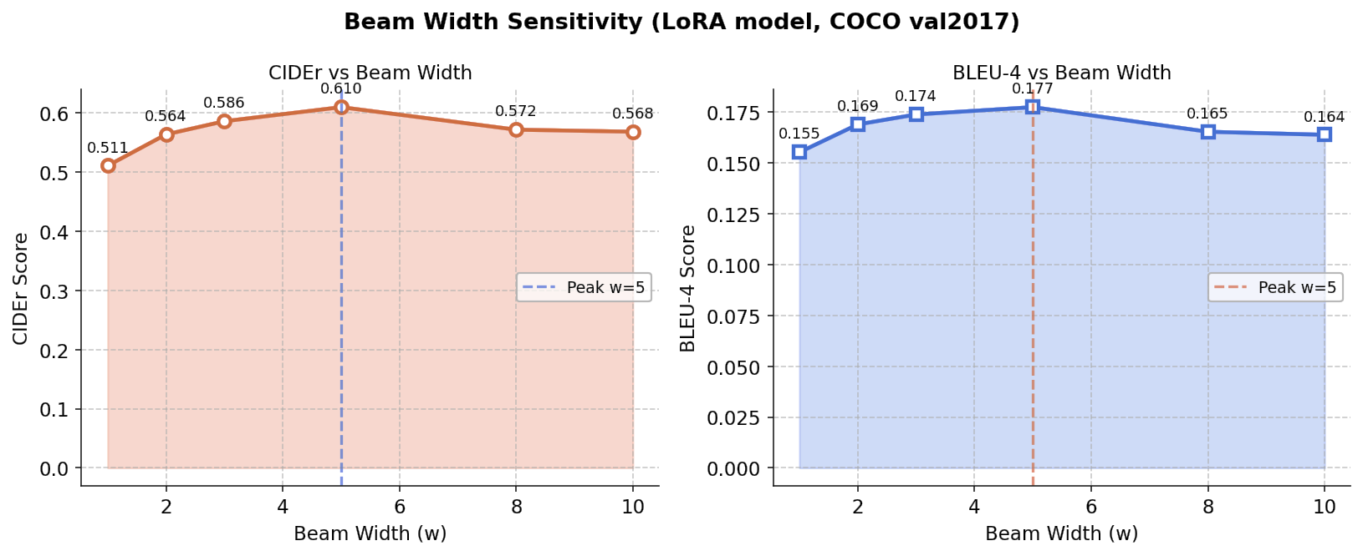
05 SENSITIVITY
Beam Width Sweep: CIDEr and BLEU-4
Beam Sweep Results
w=1
0.5109
0.1553
w=2
0.5638
0.1690
w=3
0.5861
0.1739
w=5
0.6099
0.1775
w=8
0.5718
0.1654
w=10
0.5684
0.1639
Recommended: w = 5
10

Slide 11
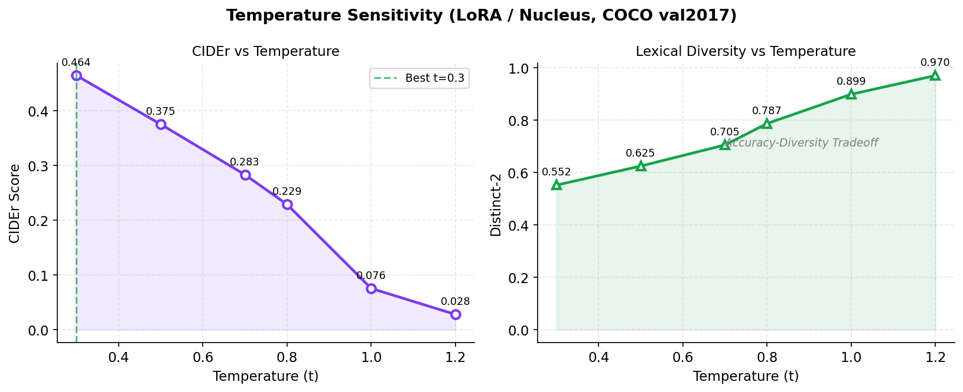
05 SENSITIVITY
Temperature Sweep: Accuracy vs. Diversity Trade-off
Accuracy - Diversity
t=0.3
0.464
0.552
t=0.5
0.375
0.625
t=0.7
0.283
0.705
t=0.8
0.229
0.787
t=1.0
0.076
0.899
t=1.2
0.028
0.970
CIDEr / Distinct-2
Use t=0.3 for accuracy, t=0.5 for diversity
11

Slide 12
06 FINDINGS
01
Prefix conditioning works
without LM fine-tuning
02
Beam search wins on all
accuracy metrics
CIDEr 0.9364
+12% vs Greedy
Frozen/Beam matches FT-4L/Beam exactly. ProjectionHead alone provides sufficient visual conditioning on 118K images.
Beam search outperforms greedy and nucleus across all 3 models. Gap is largest for LoRA (+12.4% CIDEr).
03
Optimal beam width is
dataset-dependent
04
Temperature degrades
accuracy monotonically
w=5 on COCO
CIDEr: 0.46→0.03
w=5 peaks on COCO vs. w=8 on Flickr30k. Tune on a held-out validation set, not fixed heuristics.
CIDEr drops from 0.46 at t=0.3 to 0.03 at t=1.2. Diversity rises proportionally. Use t=0.3 for factual captioning.
12

Slide 13
07 ETHICS
Ethical Considerations
Dataset Bias
Misrepresentation Risk
COCO was annotated by workers with Western, English-speaking demographics: - Cultural bias
- Linguistic bias
→ Train on diverse multilingual datasets; evaluate across demographics
Models generate confident captions even for out-of-distribution images. In accessibility tools (screen reader alt-text), incorrect captions actively mislead visually impaired users → Deploy with human-in-loop for high-impact accessibility applications
Accessibility Value
Privacy & Surveillance
CIDEr 0.93 on common COCO scenes approaches usable quality for assistive technology. 2.2B visually impaired people could benefit from automatic alt-text generation when deployed responsibly → Human review pipeline; confidence thresholds; grounding supervision
Automatic scene description at scale could enable mass surveillance by generating textual logs from camera feeds → Consent frameworks; on-device processing; data minimization
13

Slide 14
8. DEMO
VisCaption: Interactive Web Dashboard
Live Inference (Both CLI and Web)
LAUNCH DEMO
Upload any image, select model and strategy, generate captions in real time with preprocessing pipeline visualization.
1. Web app:
bash run.sh
2. CLI
demo.ipynb
Dynamic Metrics
No Ground-Truth panel: CLIPScore, Perplexity, Grammar Score computed instantly. GT References panel: BLEU/METEOR/CIDEr.
Sensitivity Analysis
Go ahead….
Real-time 12-inference sweep on your image. Static COCO 500 charts for beam width and temperature.
Analysis Page
Key findings and ethical considerations grounded in COCO 500 evaluation data.
14

Slide 15
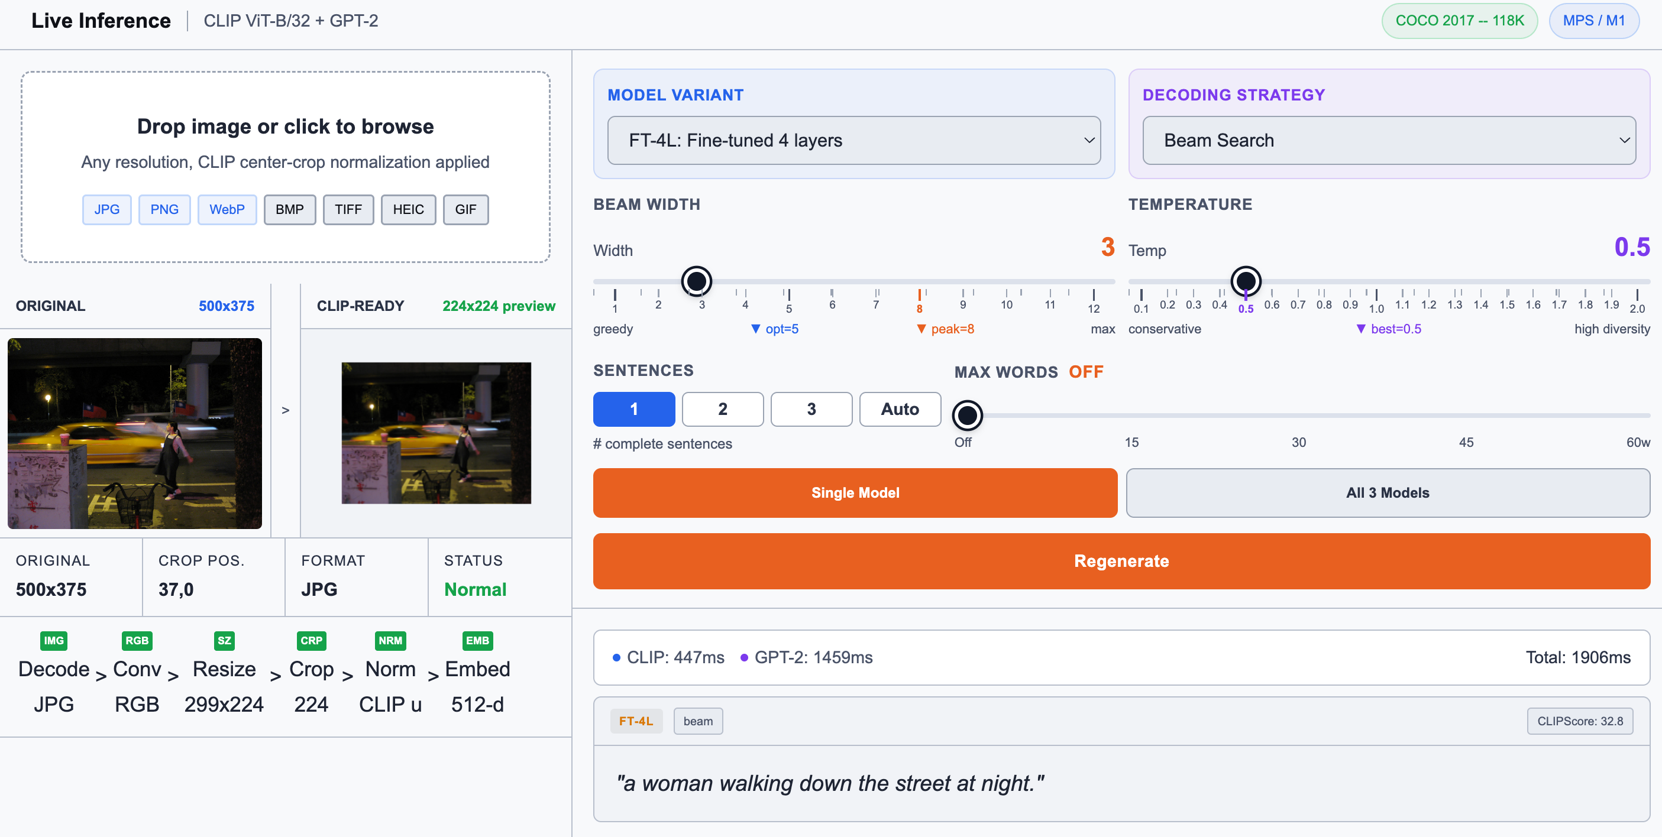
8. DEMO
Web demo

Slide 16
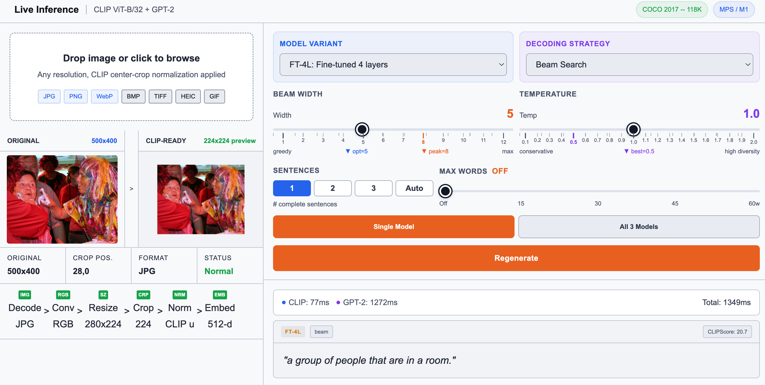
8. DEMO
Web demo

Slide 17
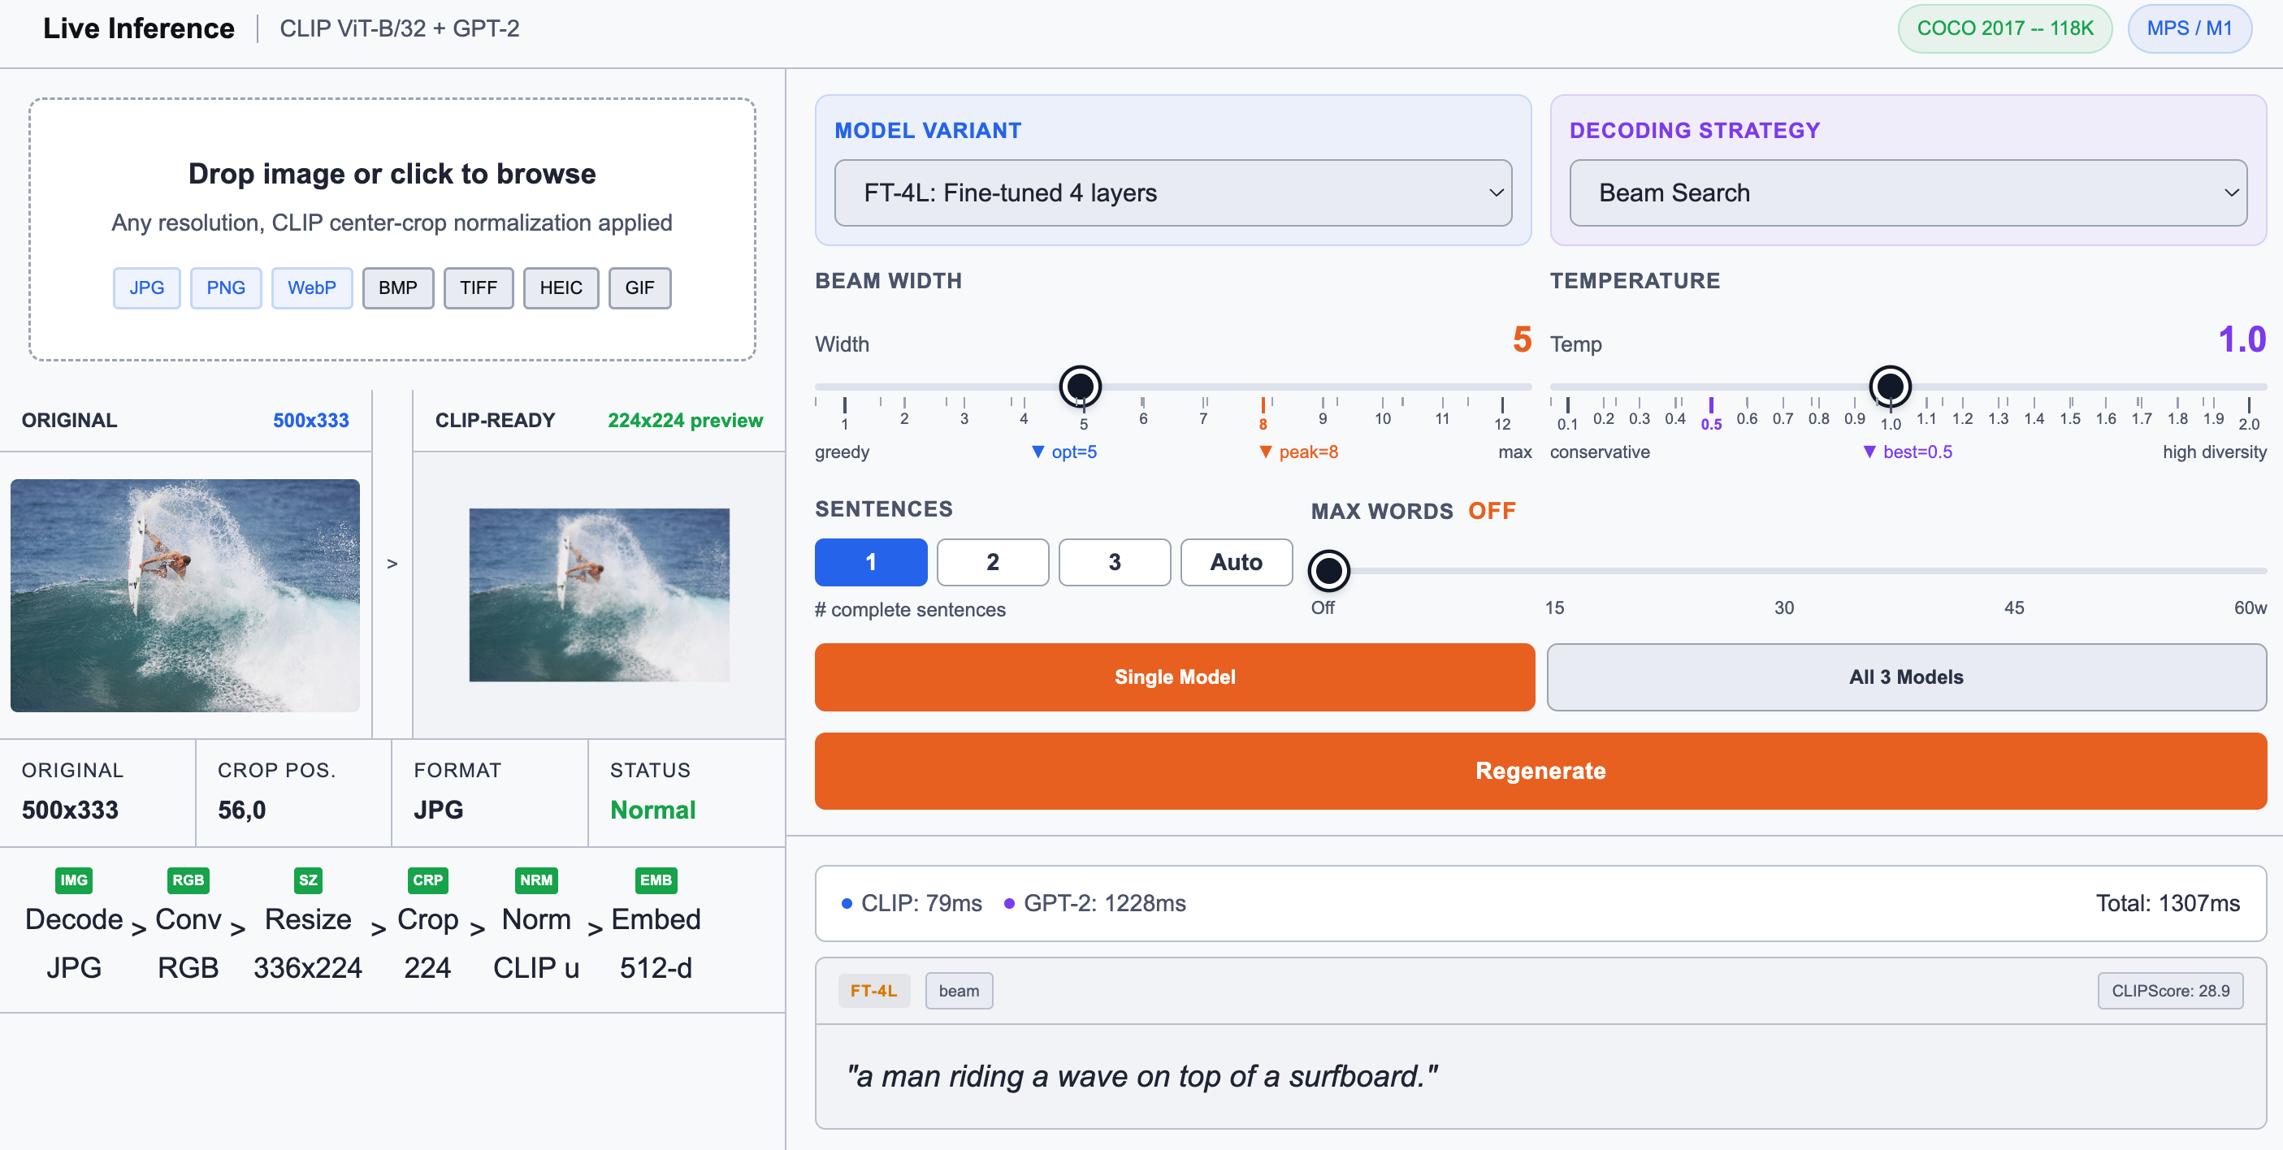
8. DEMO
Web demo

Slide 18
8. DEMO
Web demo

Slide 19
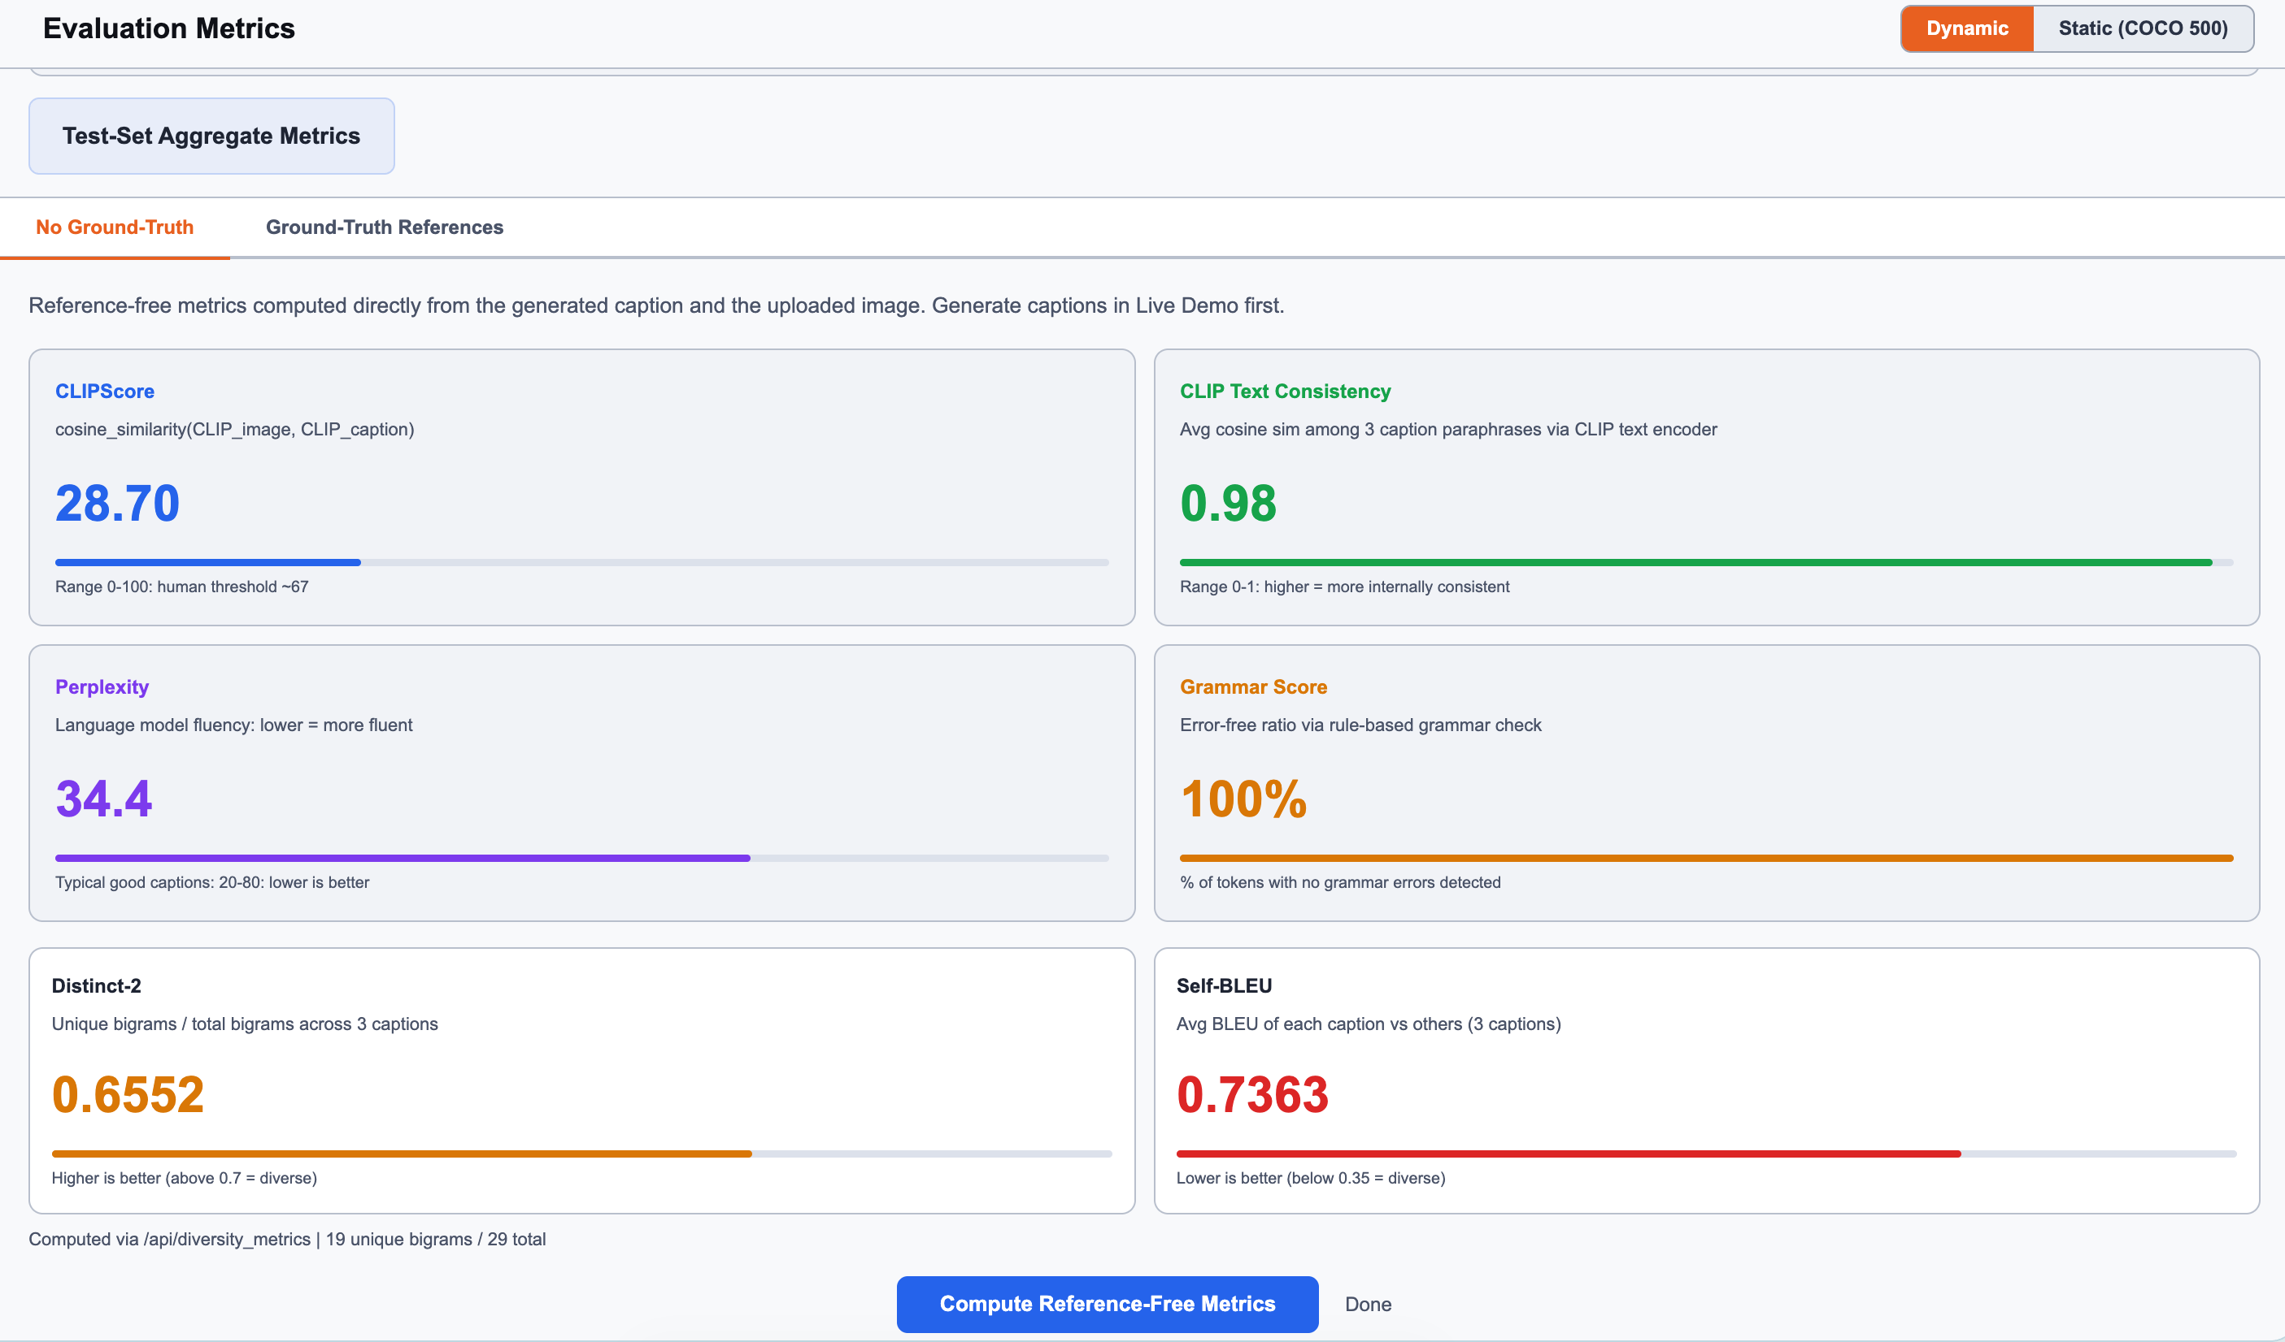
8. DEMO
Web demo

Slide 20
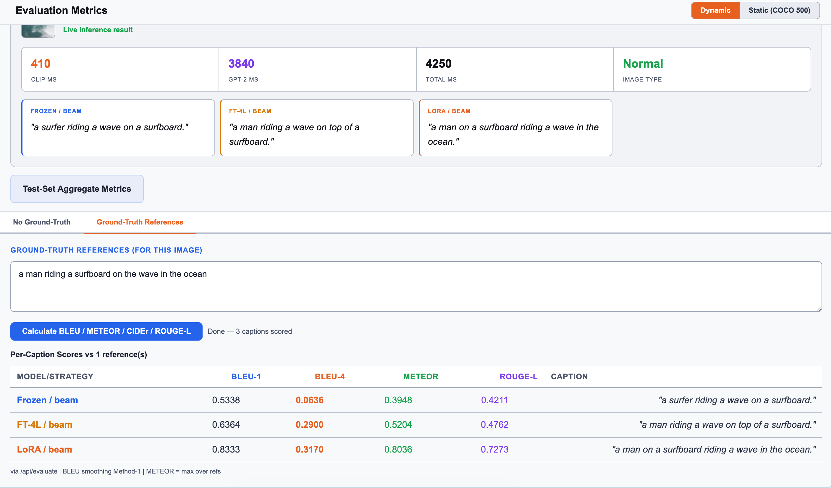
8. DEMO
Web demo

Slide 21
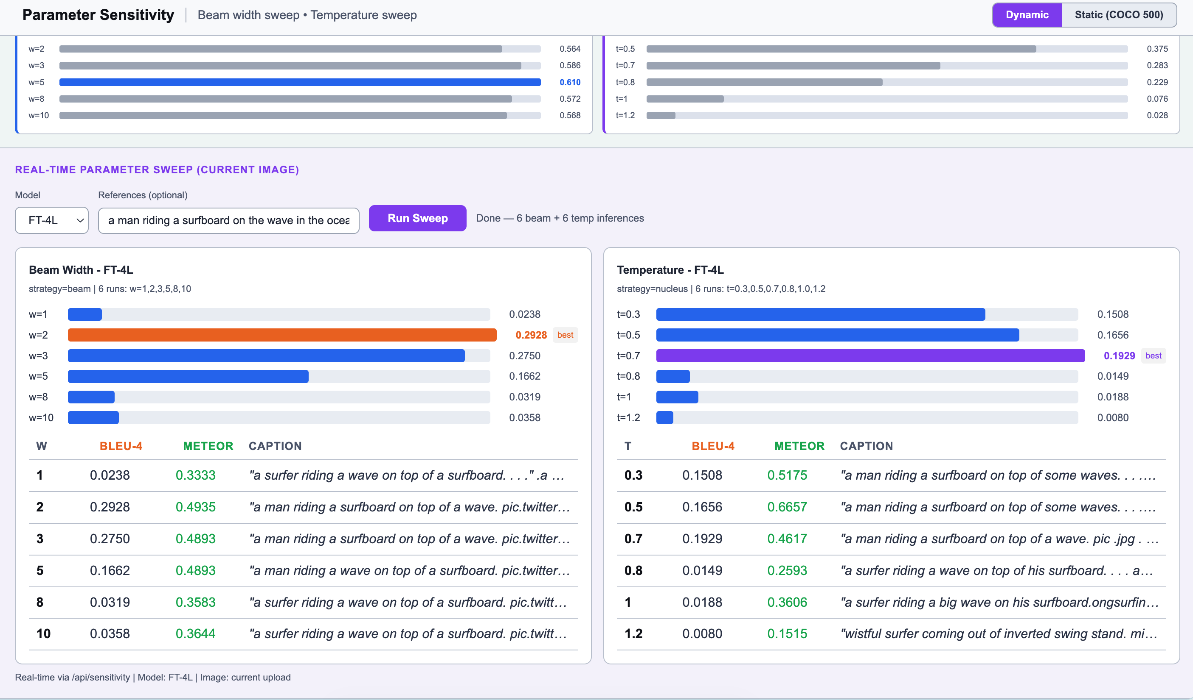
8. DEMO
Web demo

Slide 22
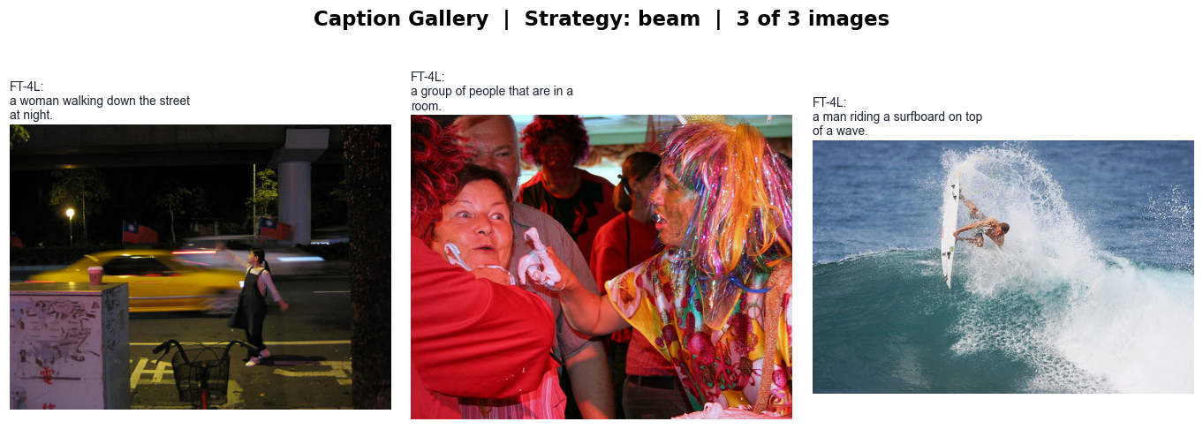
8. DEMO
CLI

Slide 23
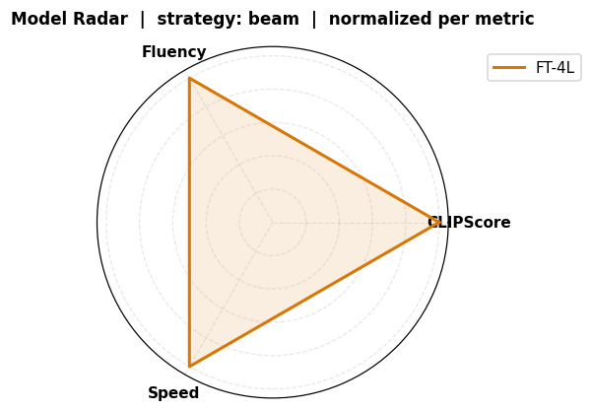
8. DEMO
CLI

Slide 24
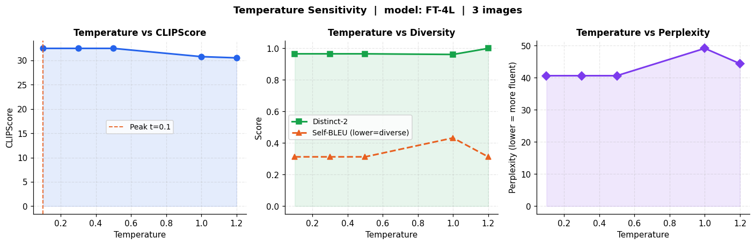
8. DEMO
CLI

Slide 25
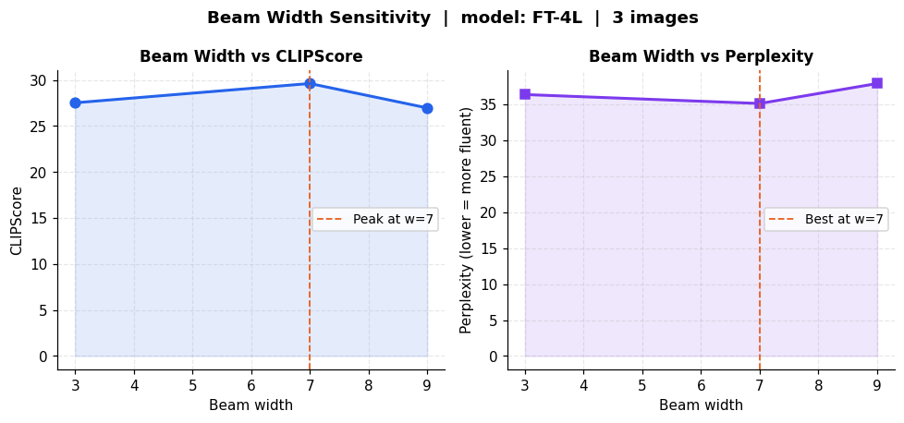
8. DEMO
CLI

Slide 26
Conclusion
Best result: FT-4L / Beam achieves CIDEr 0.9364 on COCO val2017 (500 images). Frozen / Beam ties exactly with 67M fewer parameters, validating prefix conditioning as an effective approach.
Future Directions
Cross-attention conditioning to overcome the 10-token prefix bottleneck -> map GPT-2, like BLIP-2
Larger CLIP encoder (ViT-L/14, 768-d) for richer visual representation
BLIP-2 (3.1B, Q-Former) / GIT (680M, Unified Transformer) comparison
15

